Slide 1
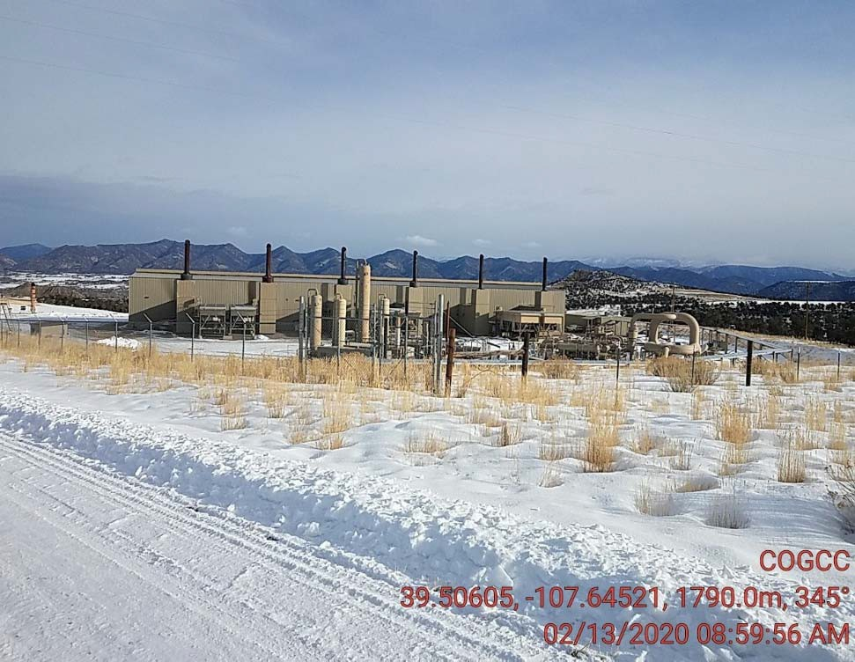
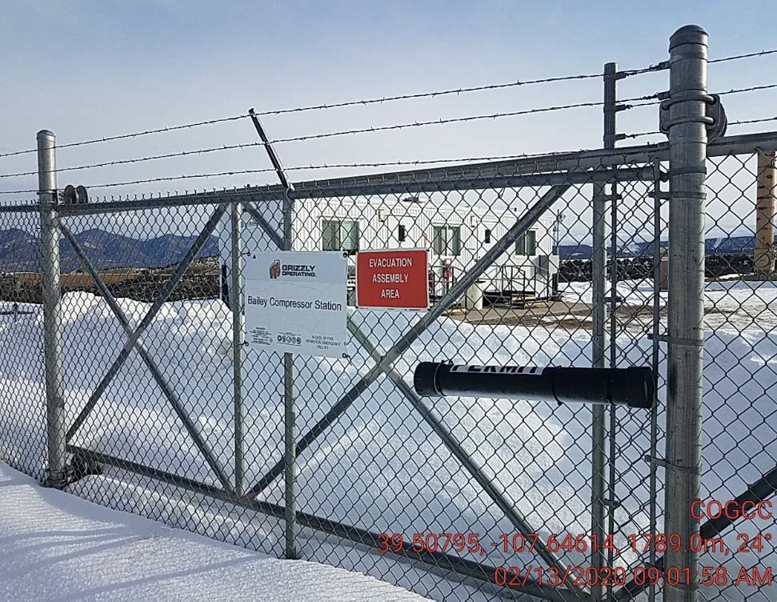
Grizzly Operating
Location #
location
location

Slide 2
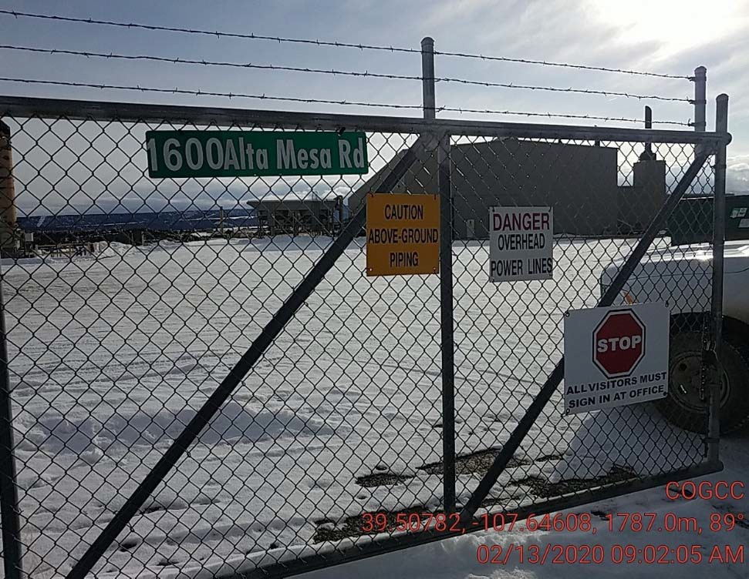
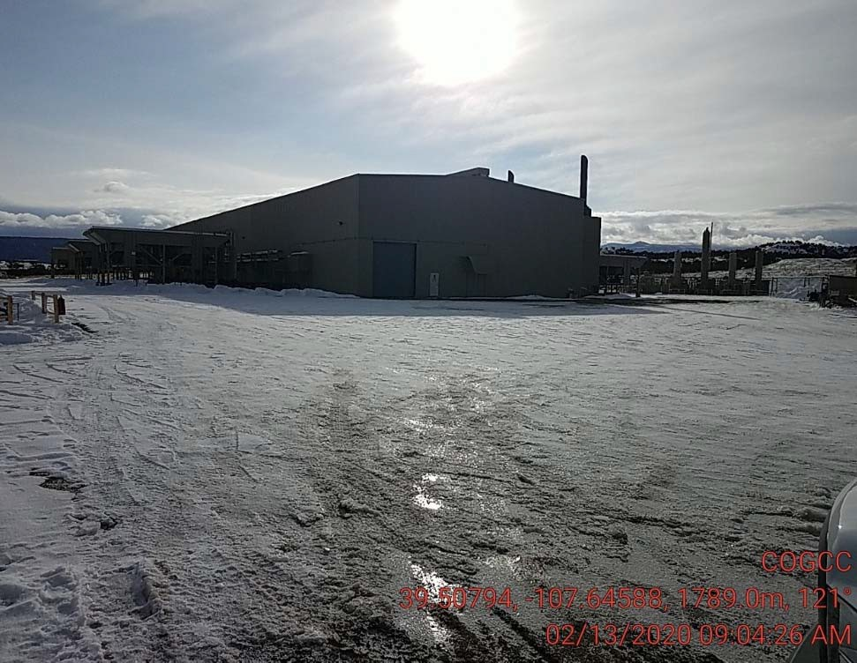
Grizzly Operating
Location #
location
location

Slide 3
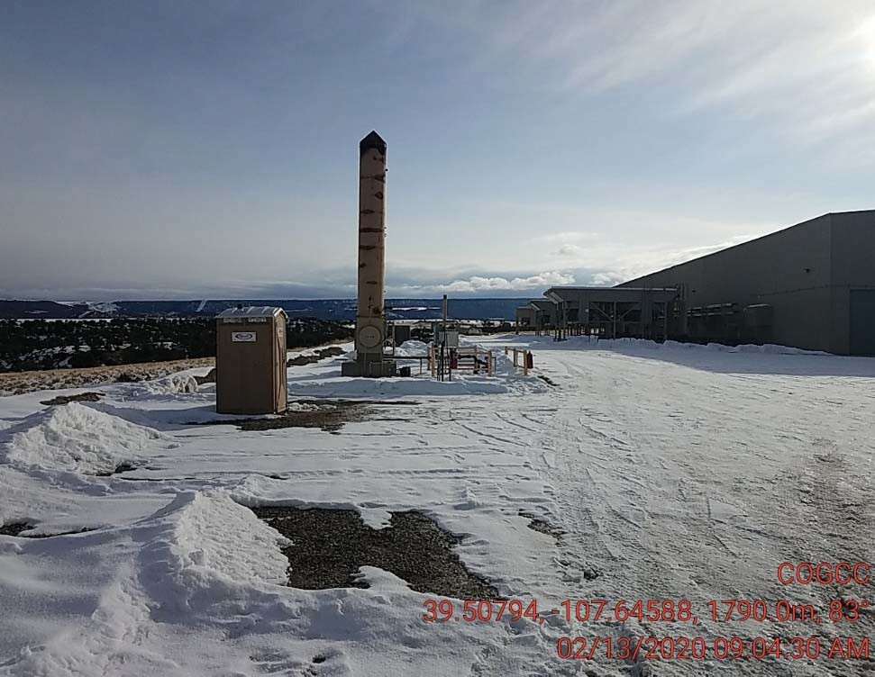
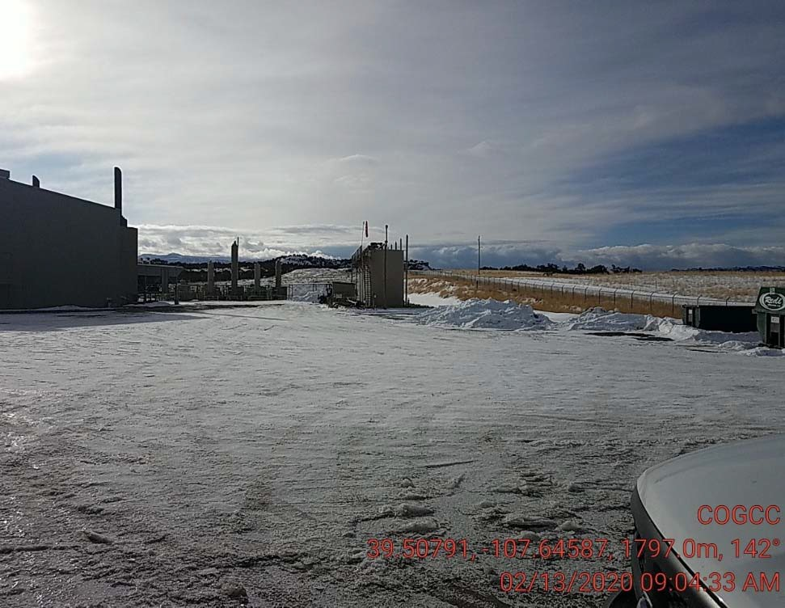
Grizzly Operating
Location #
location
location

Slide 4
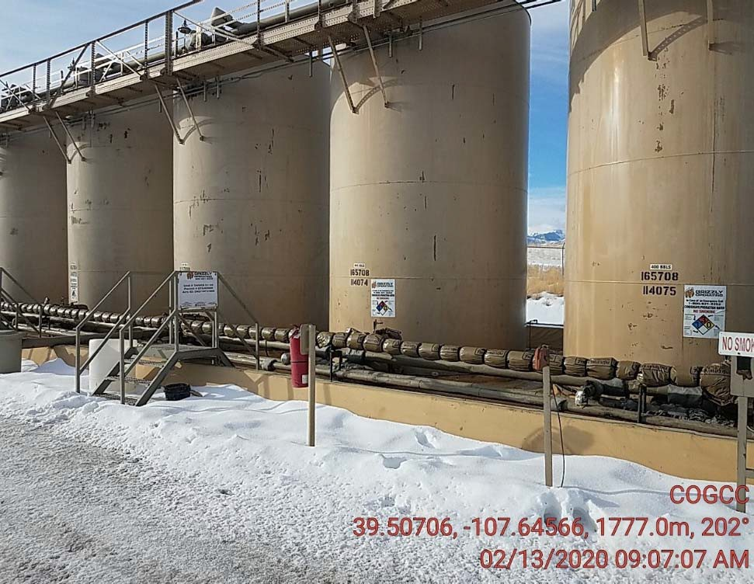
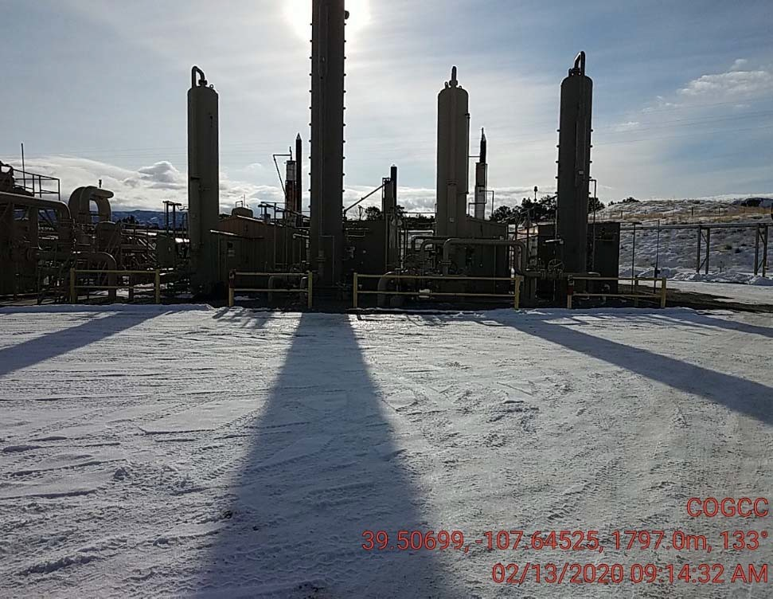
Grizzly Operating
Location #
location
location

Slide 5
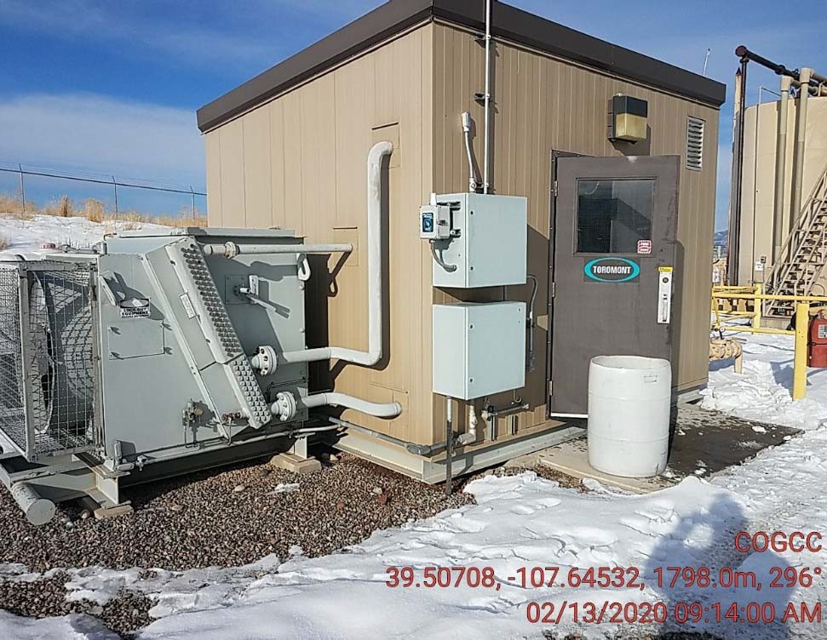
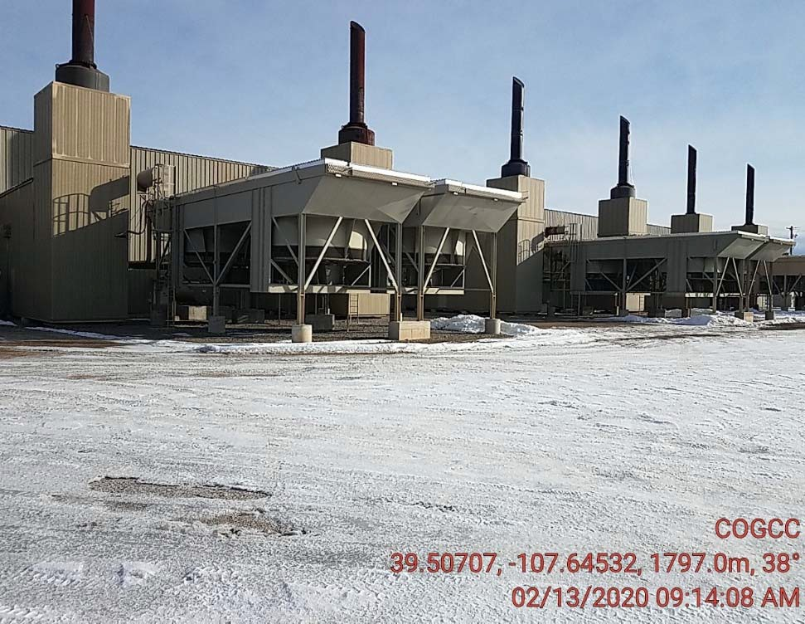
Grizzly Operating
Location #
location
location

Slide 6
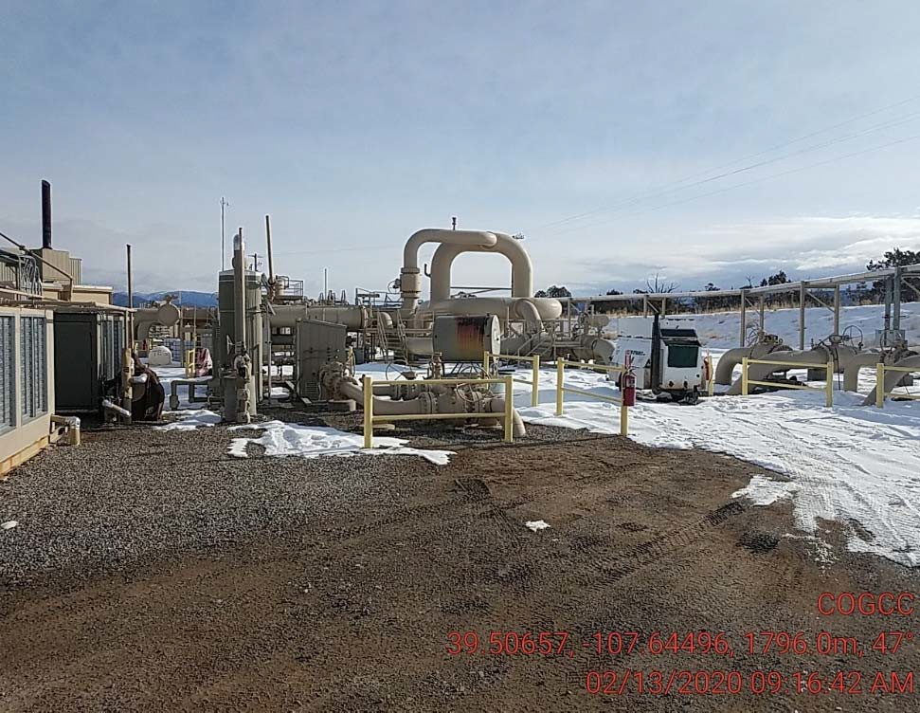
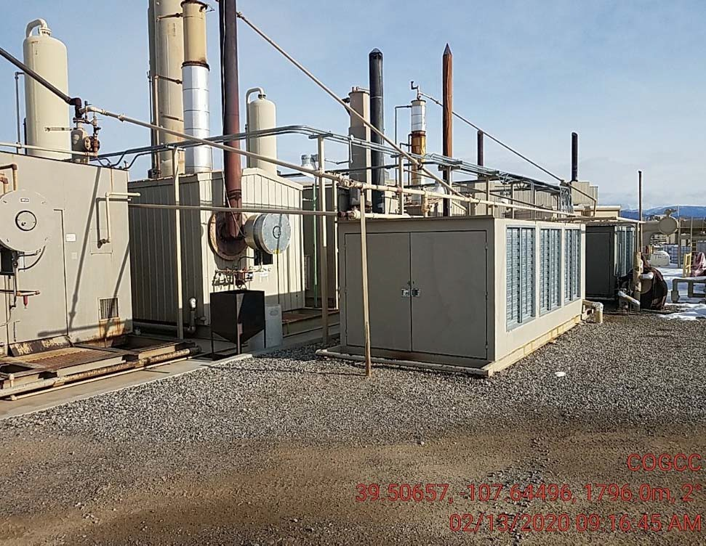
Grizzly Operating
Location #
location
location

Slide 7
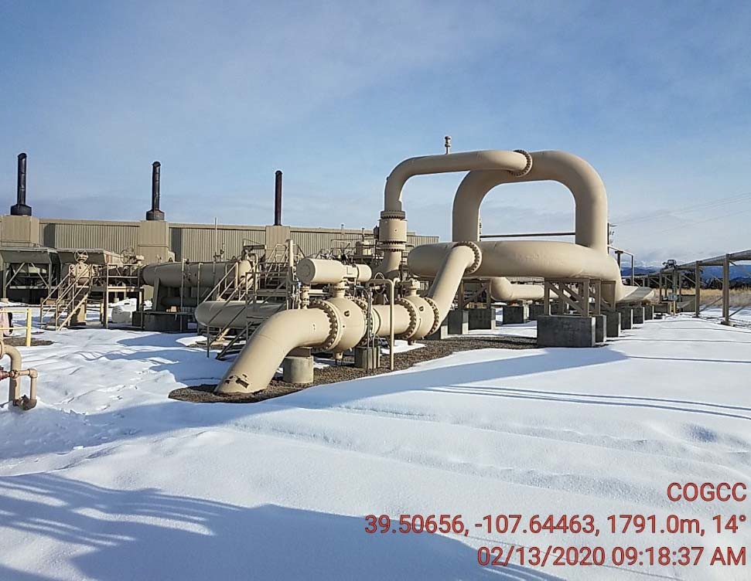
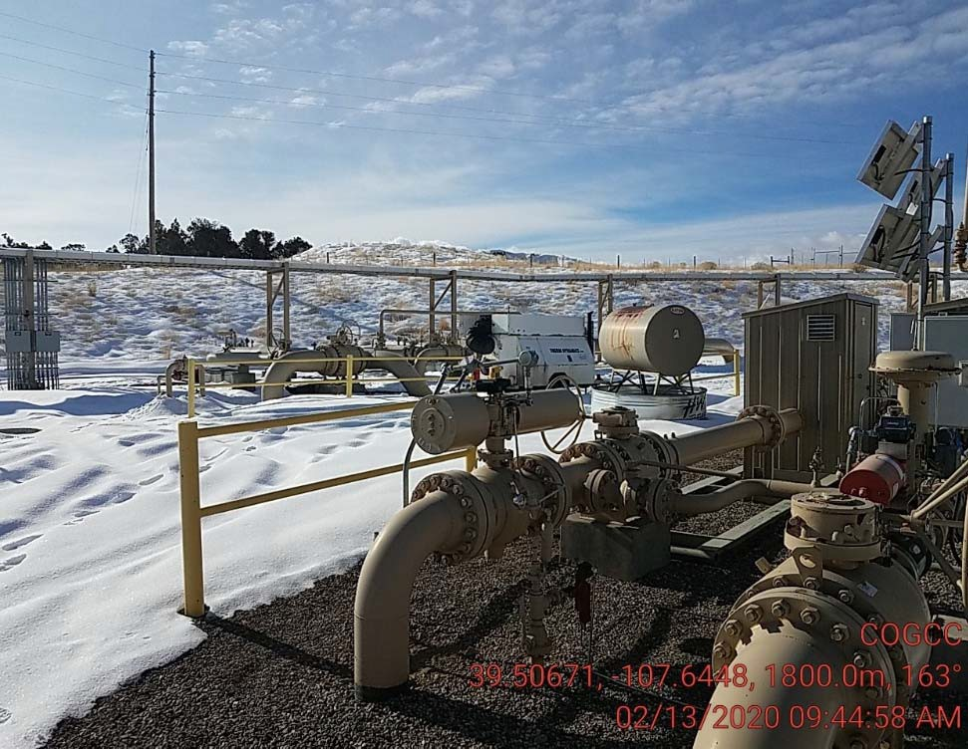
Grizzly Operating
Location #
location
location

Slide 8
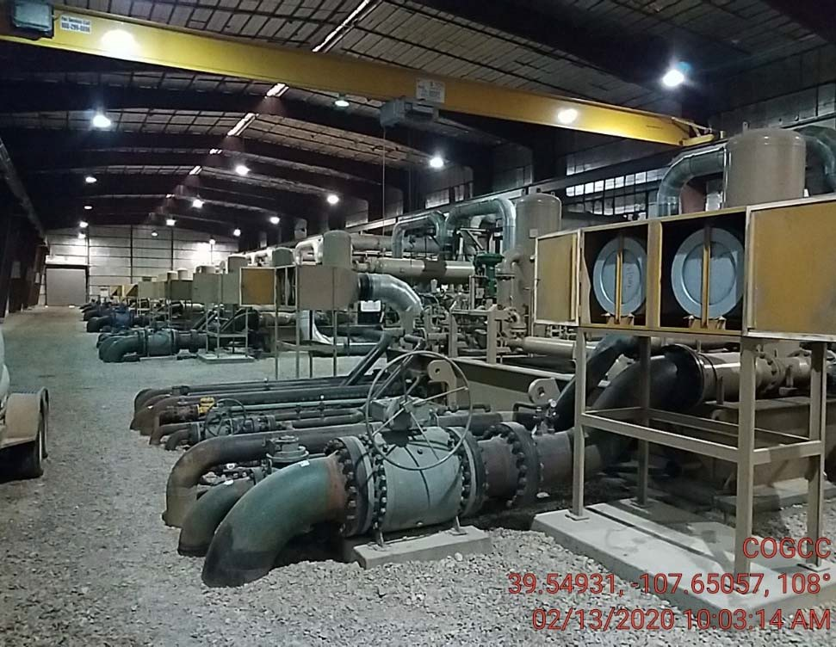
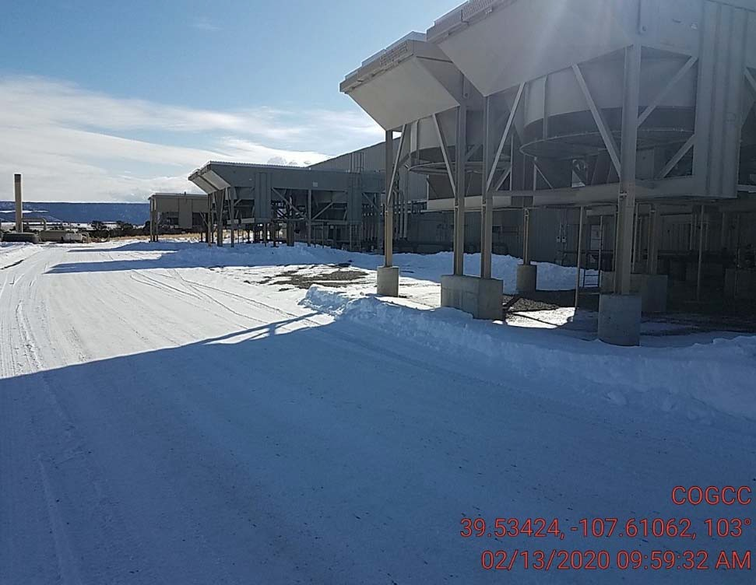
Grizzly Operating
Location #
location
location

Slide 9
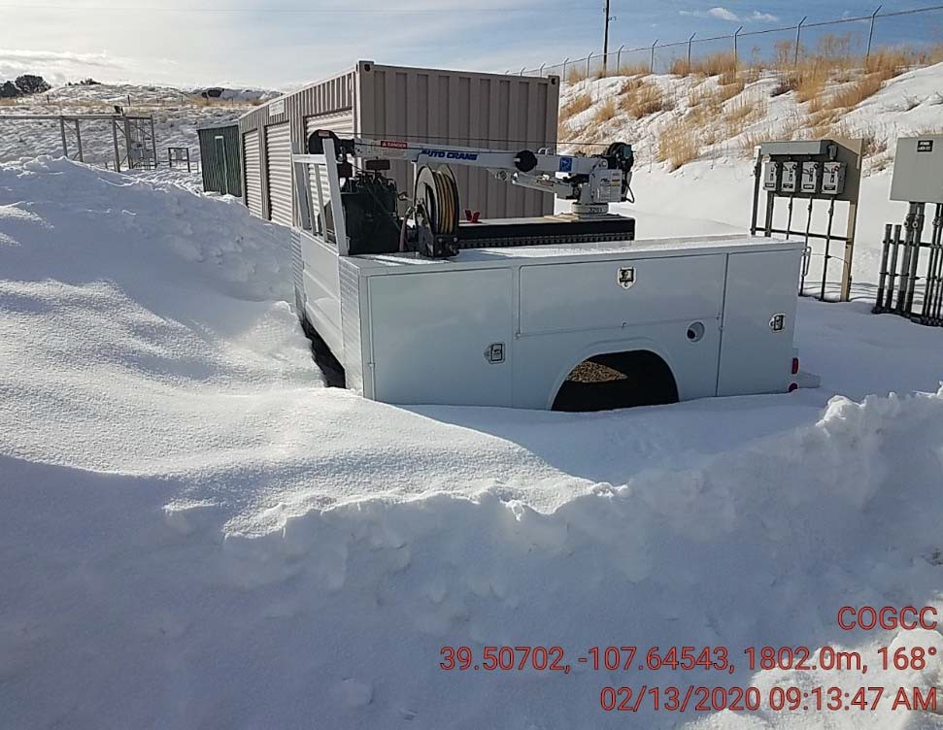
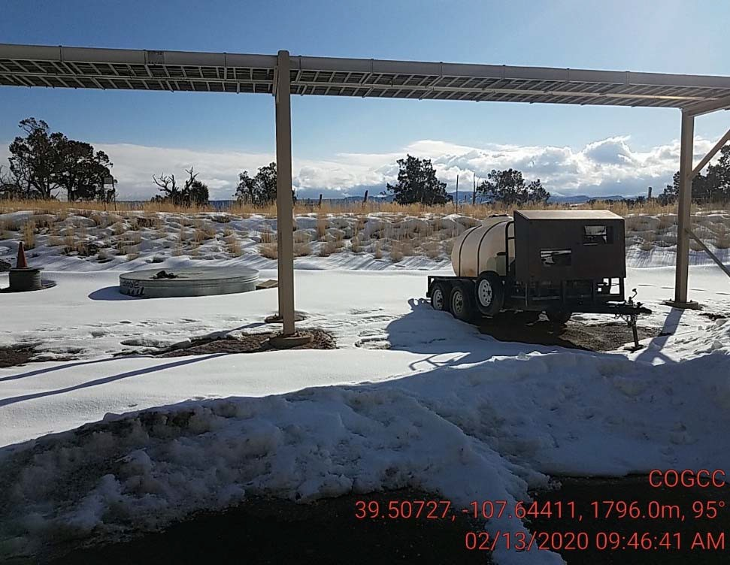
Grizzly Operating
Location #
Storage of supply/unused equipment
Storage of supply/unused equipment

Slide 10
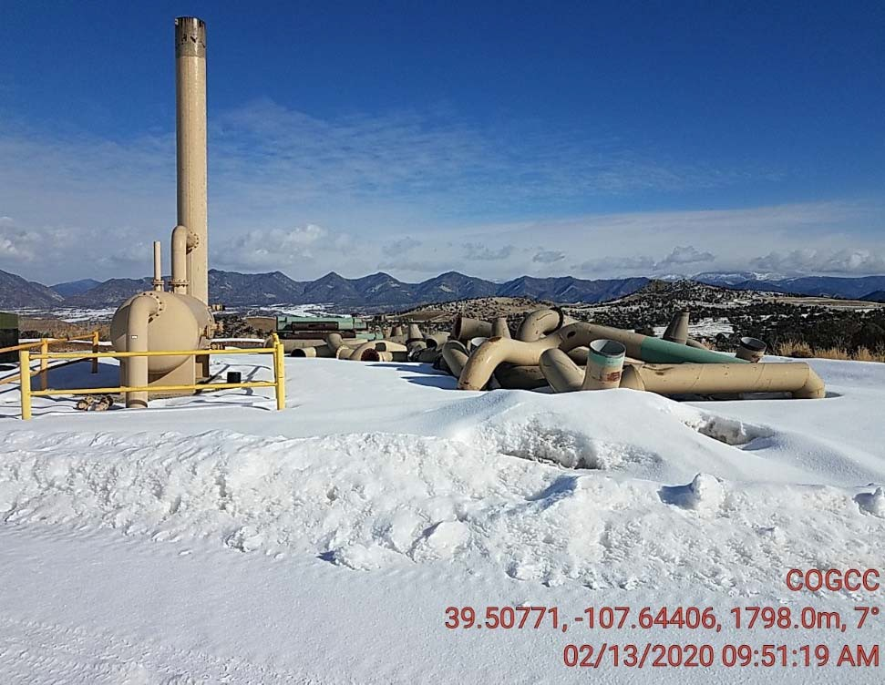
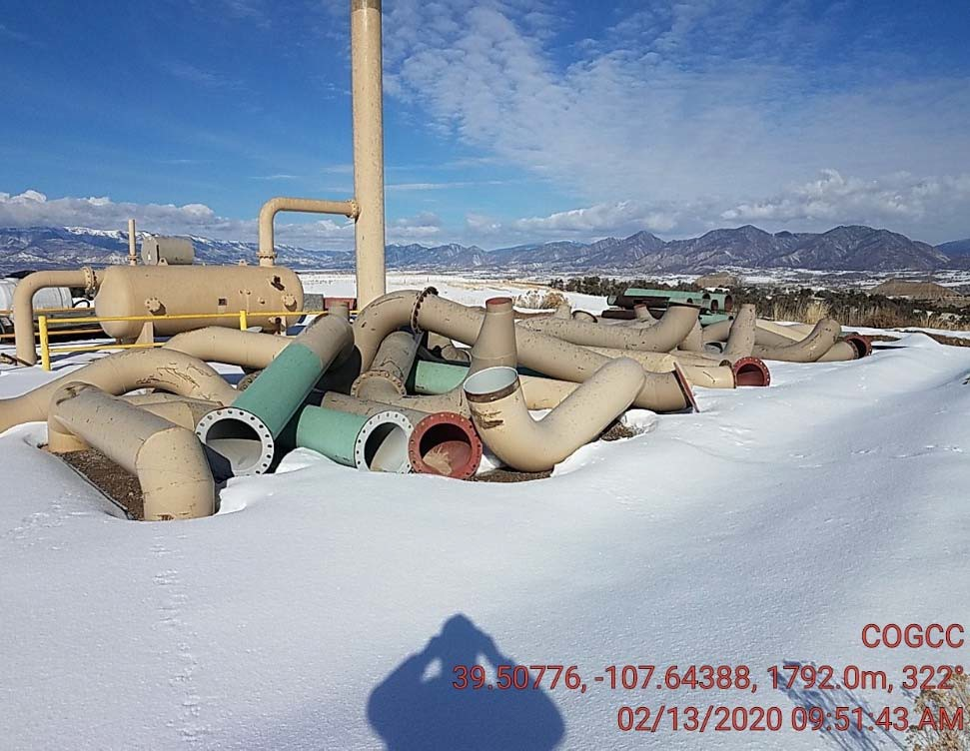
Grizzly Operating
Location #
Storage of supply/unused equipment
Storage of supply/unused equipment

Slide 11
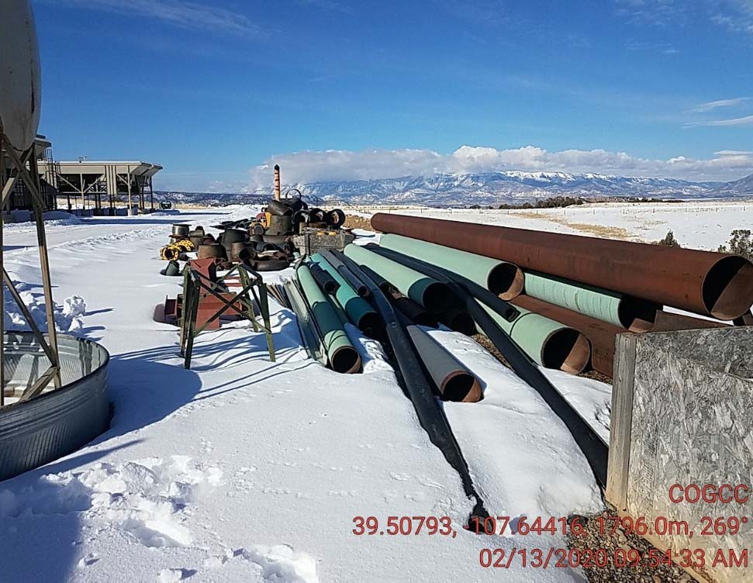
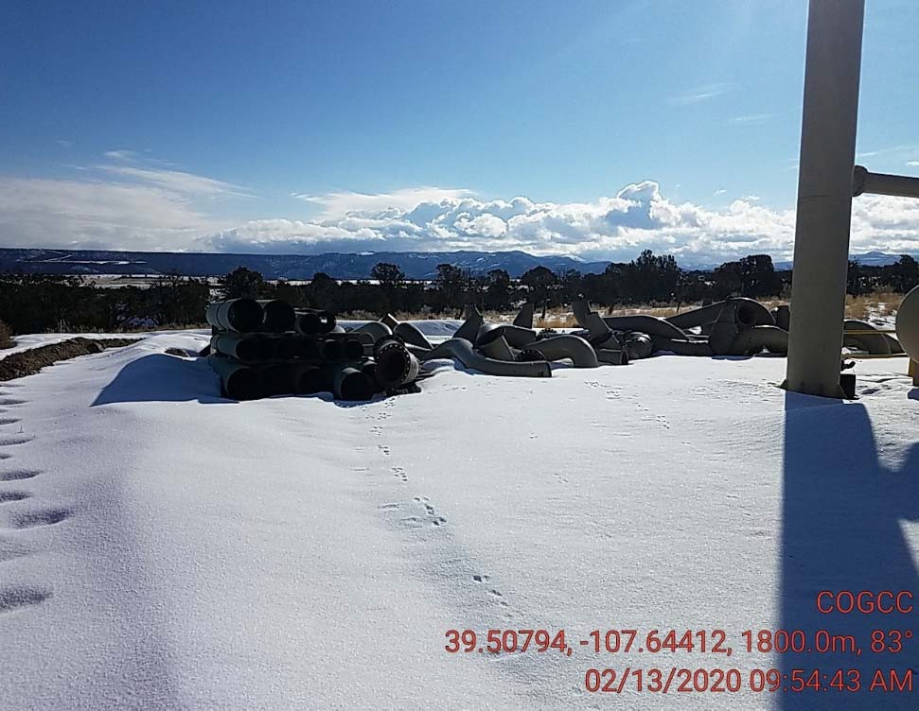
Grizzly Operating
Location #
Storage of supply/unused equipment
Storage of supply/unused equipment

Slide 12
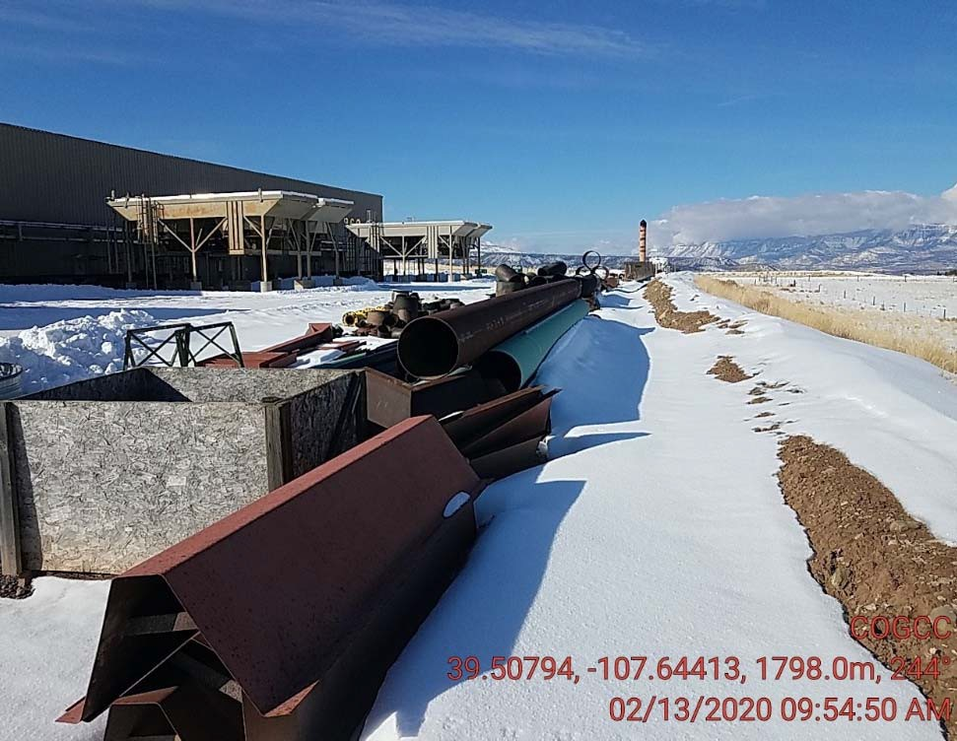
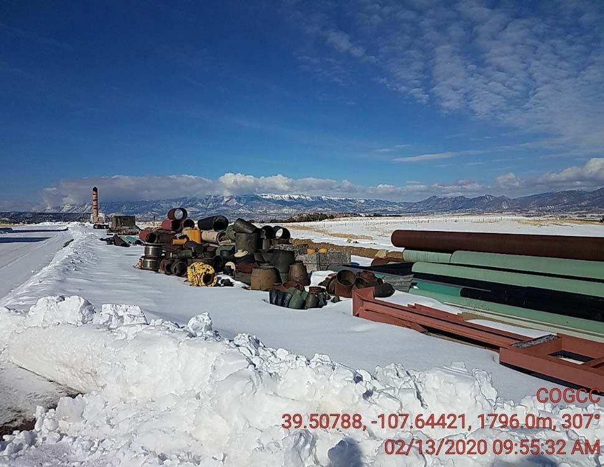
Grizzly Operating
Location #
Storage of supply/unused equipment
Storage of supply/unused equipment

Slide 13
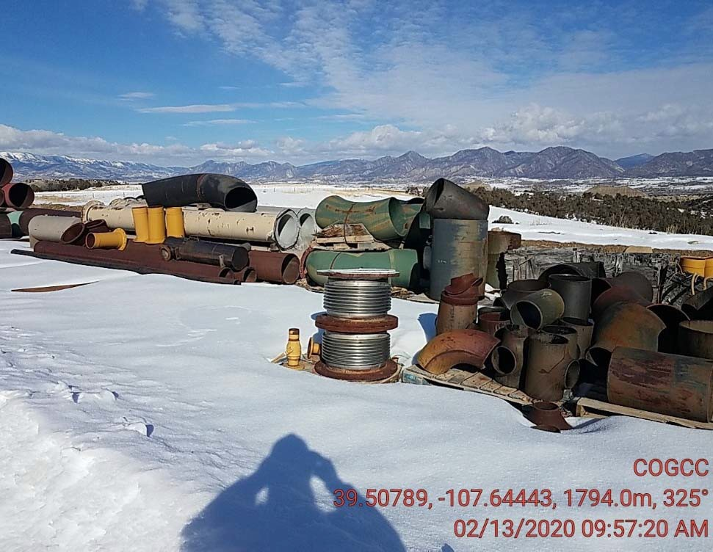
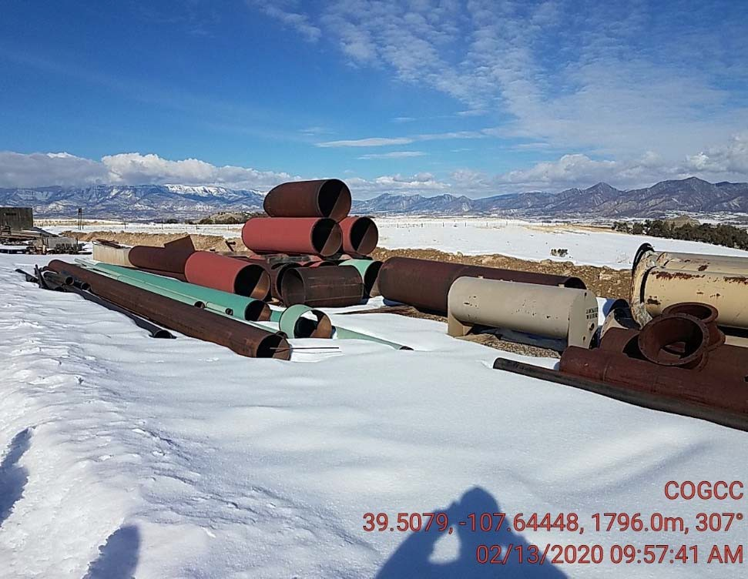
Grizzly Operating
Location #
Storage of supply/unused equipment
Storage of supply/unused equipment

Slide 14
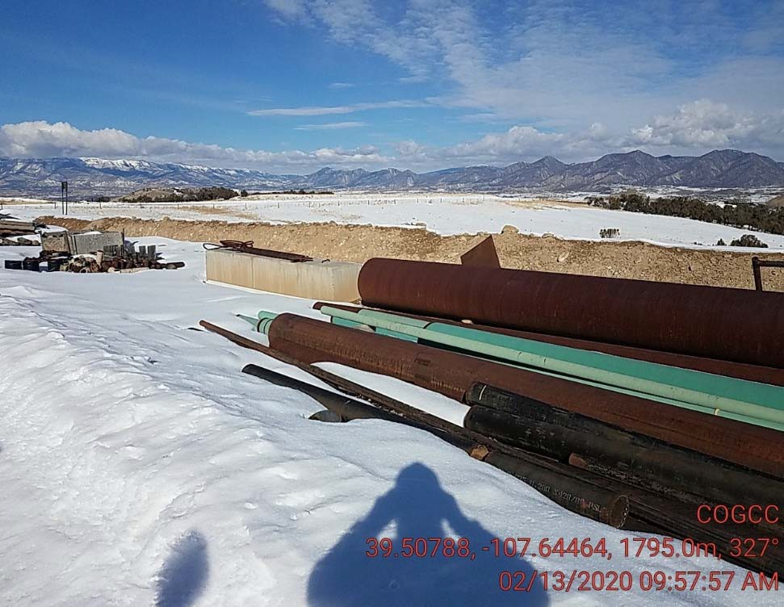
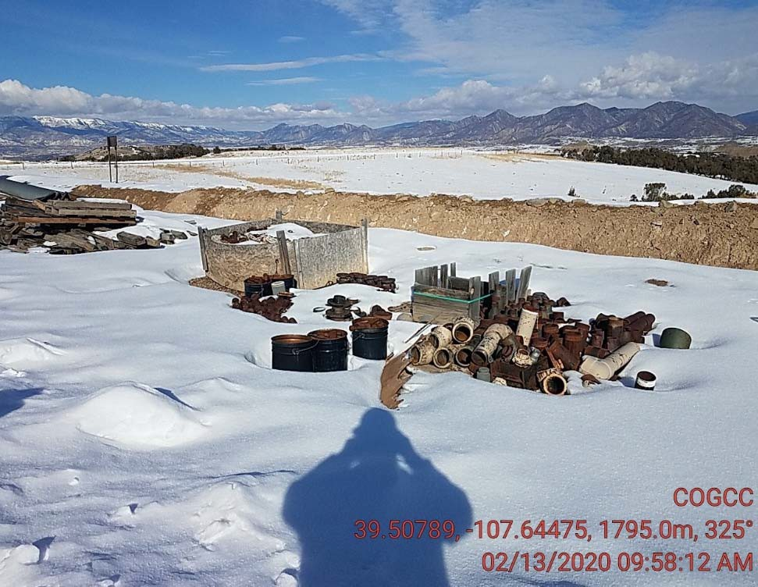
Grizzly Operating
Location #
Storage of supply/unused equipment
Storage of supply/unused equipment

Slide 15
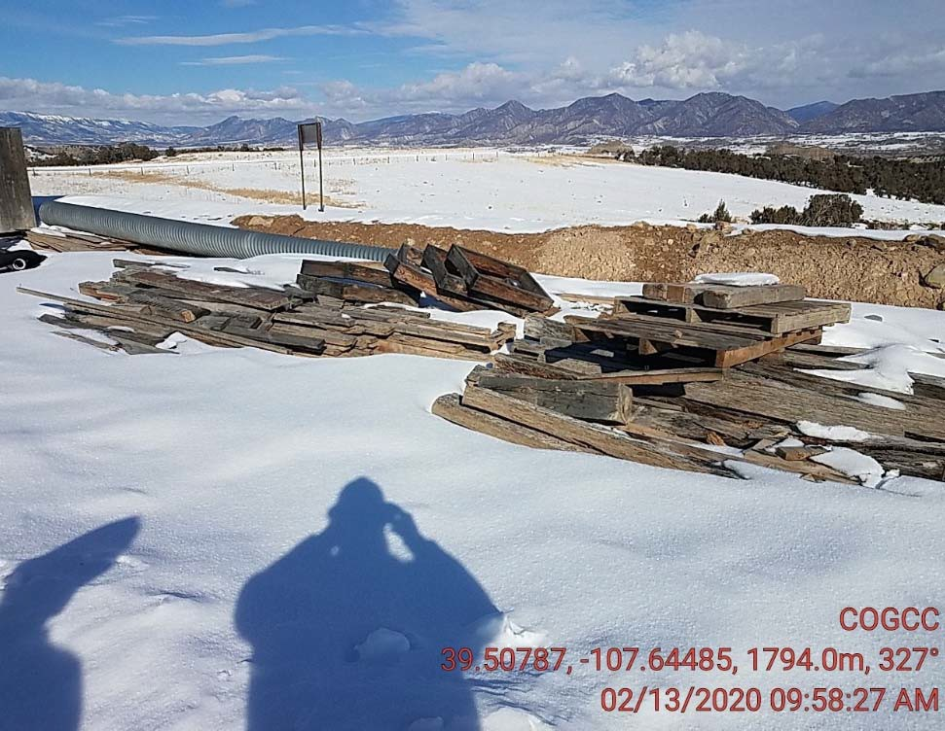
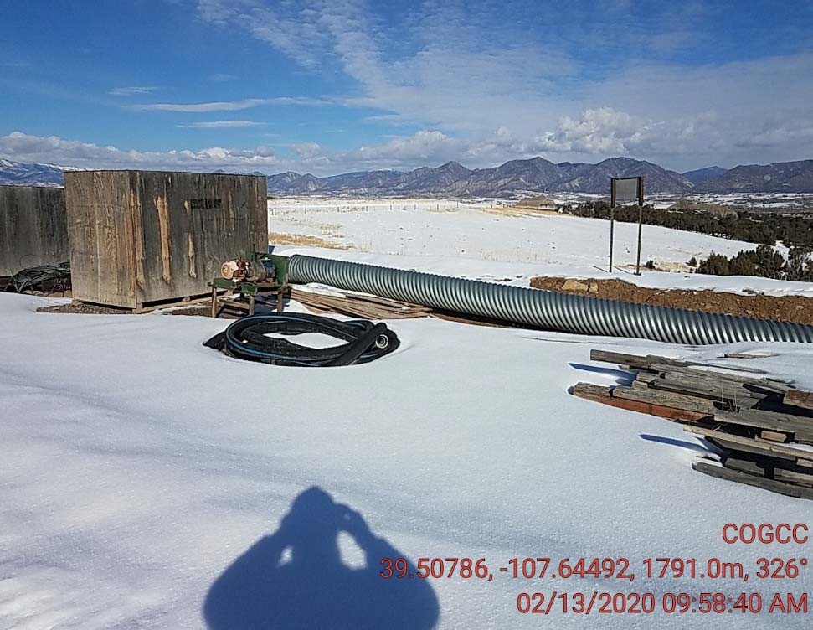
Grizzly Operating
Location #
Storage of supply/unused equipment
Storage of supply/unused equipment

Slide 16
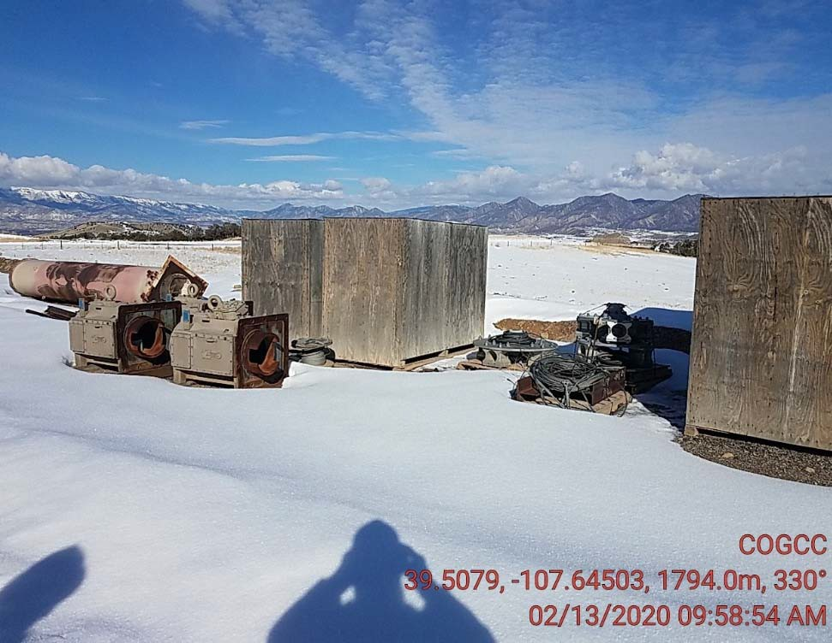
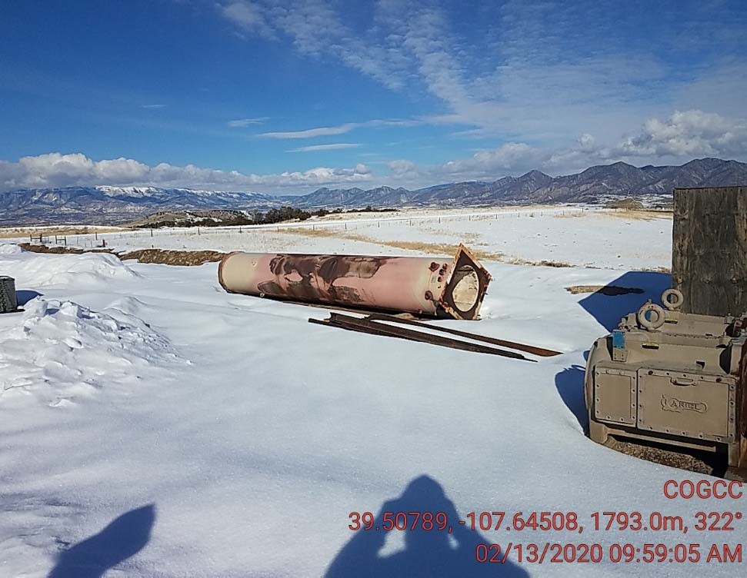
Grizzly Operating
Location #
Storage of supply/unused equipment
Storage of supply/unused equipment

Slide 17
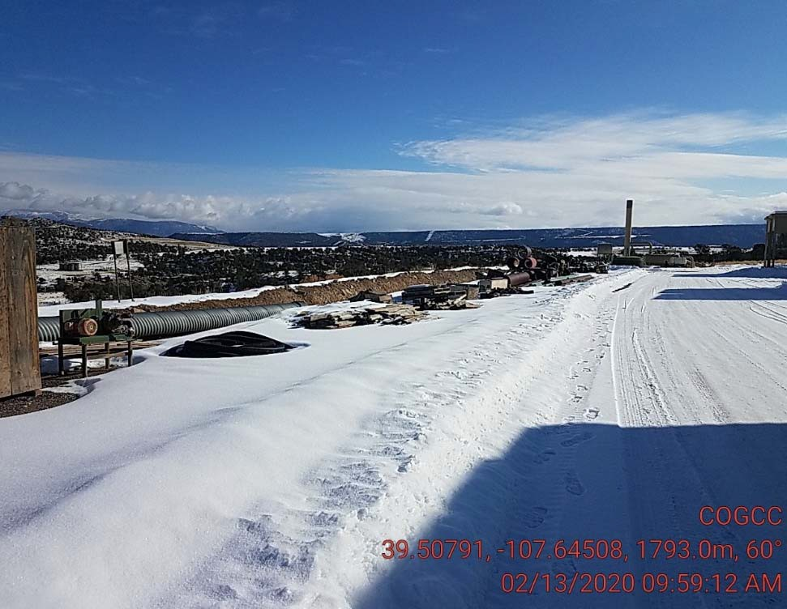
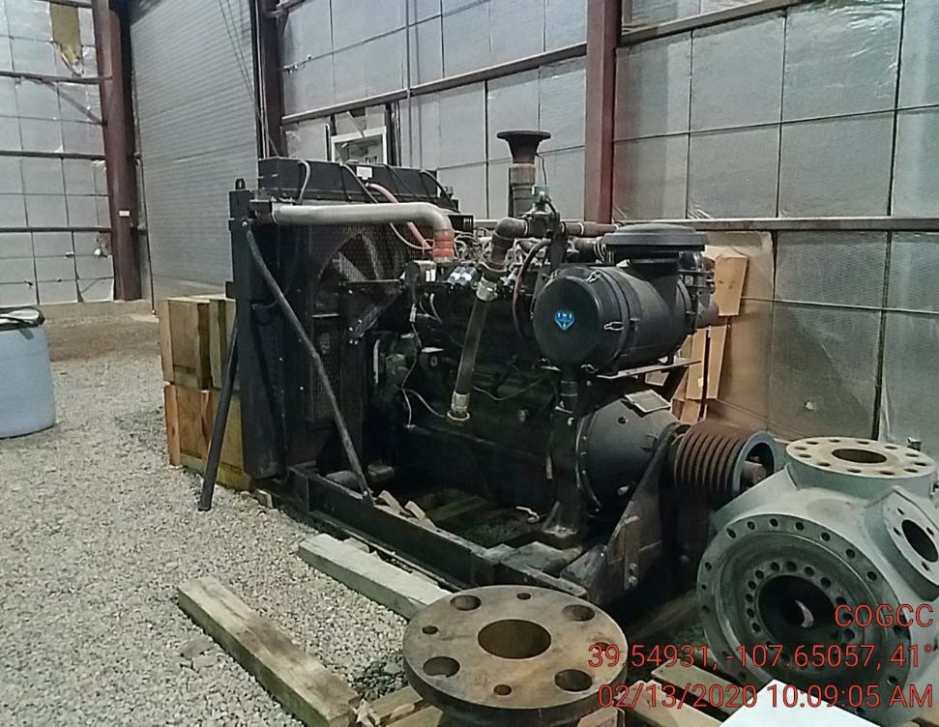
Grizzly Operating
Location #
Storage of supply/unused equipment
Storage of supply/unused equipment

Slide 18
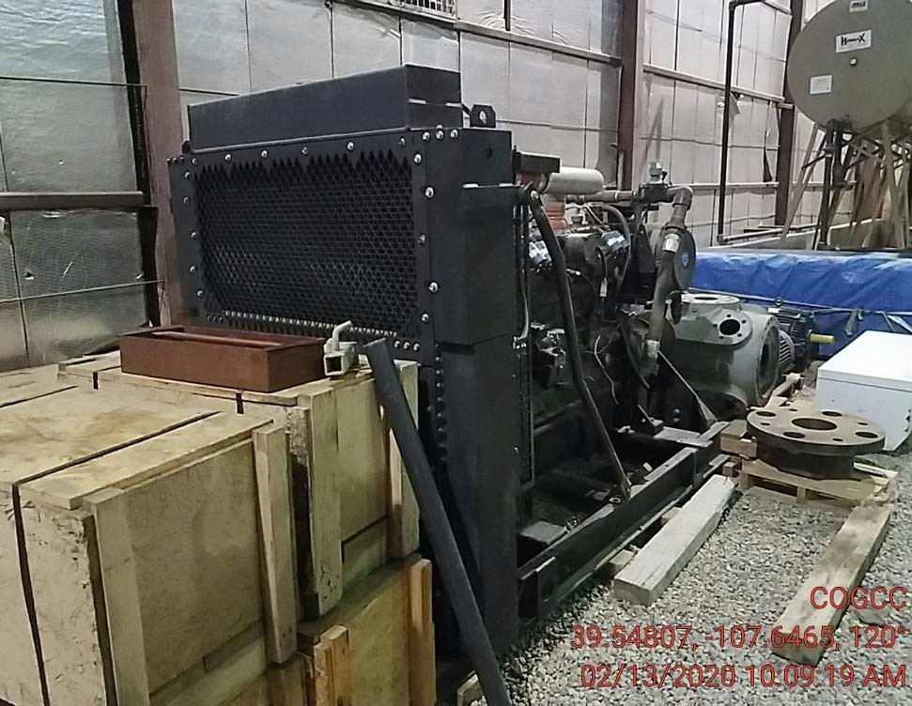
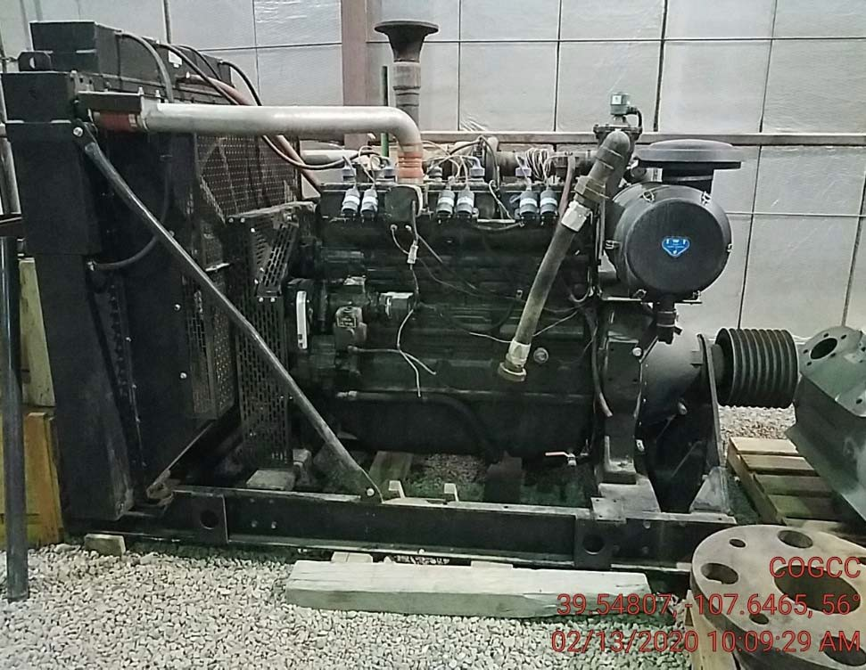
Grizzly Operating
Location #
Storage of supply/unused equipment
Storage of supply/unused equipment

