Slide 1
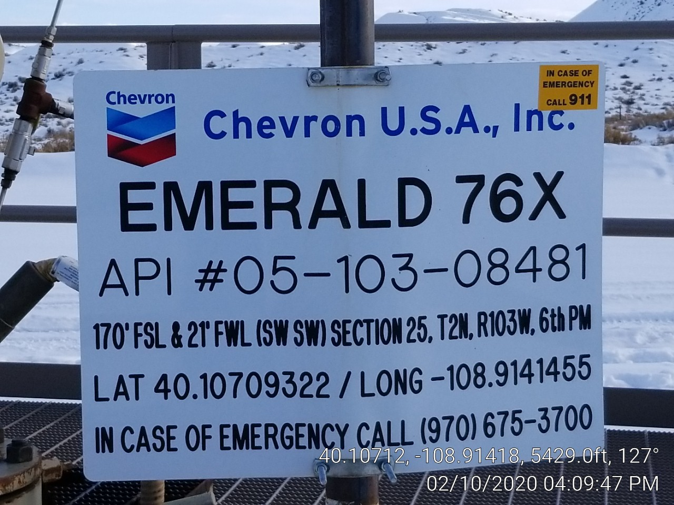
Emerald 76X
API: 05-103-08481
Inspection: 679707289
Photo 1. Well head sign.

