Slide 1
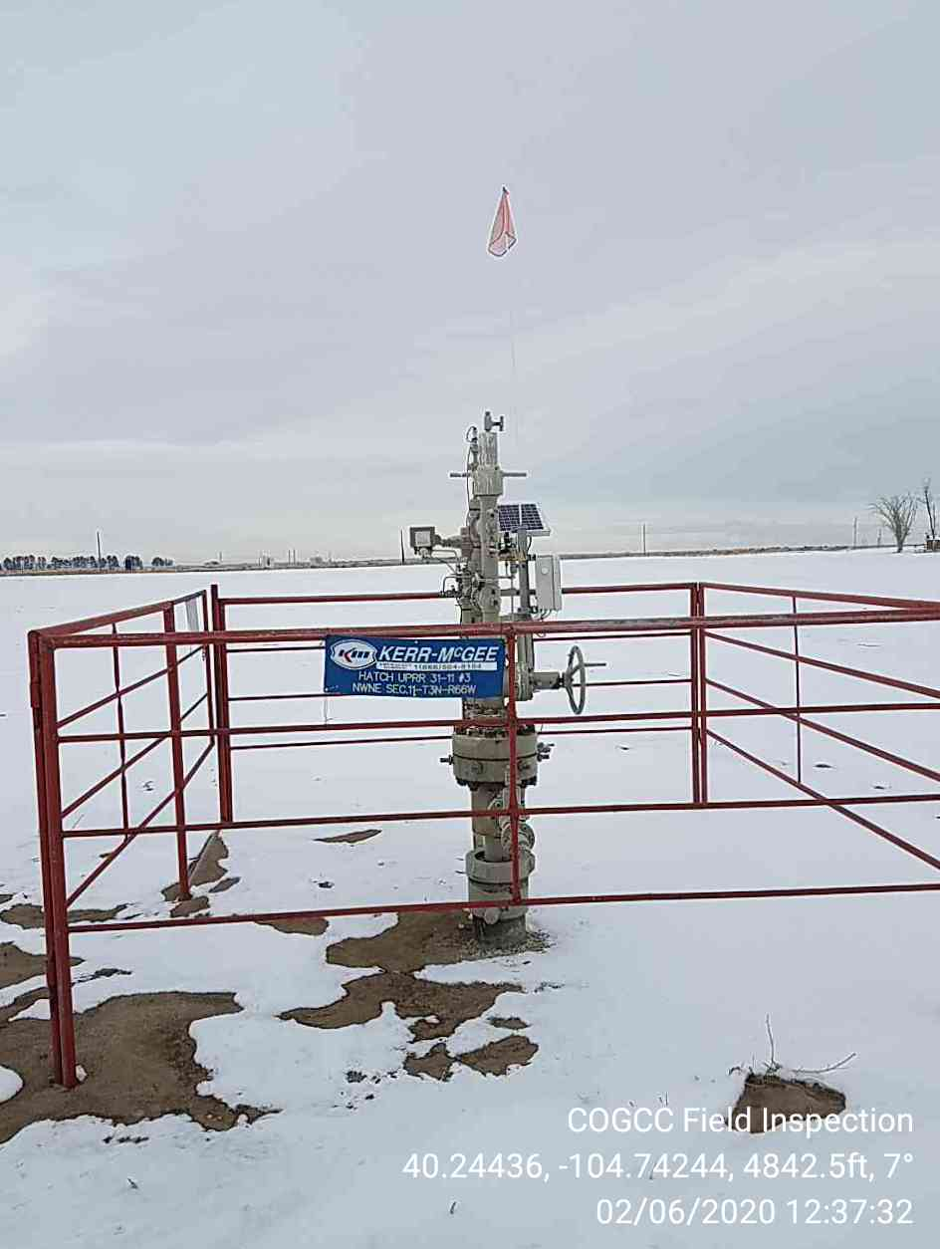
Inspection Photo
Location ID, Name: 323480
HATCH UPRR-63N66W 11NWNE
Photo 1 05-123-13096
HATCH UPRR
31-11#3

