Slide 1
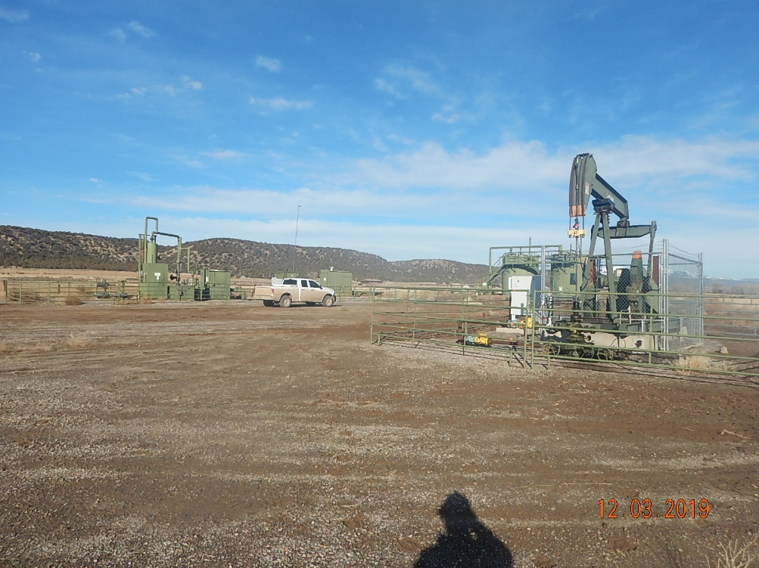
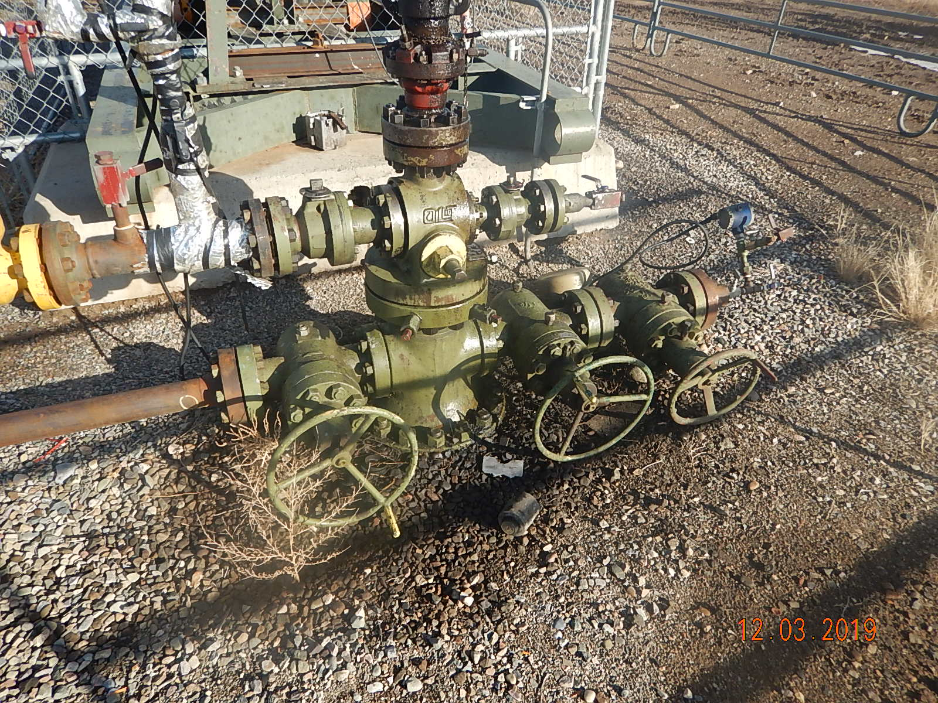
Inspection Photos
BP
Location Name: MF Sharp A1
Location ID: 05-067-07266
Photo #1 Overview photo looking Northwest.
Photo #2 Stained soil/gravel approx. 5’ diameter around wellhead, trash and unserviceable equipment circled.

Slide 2
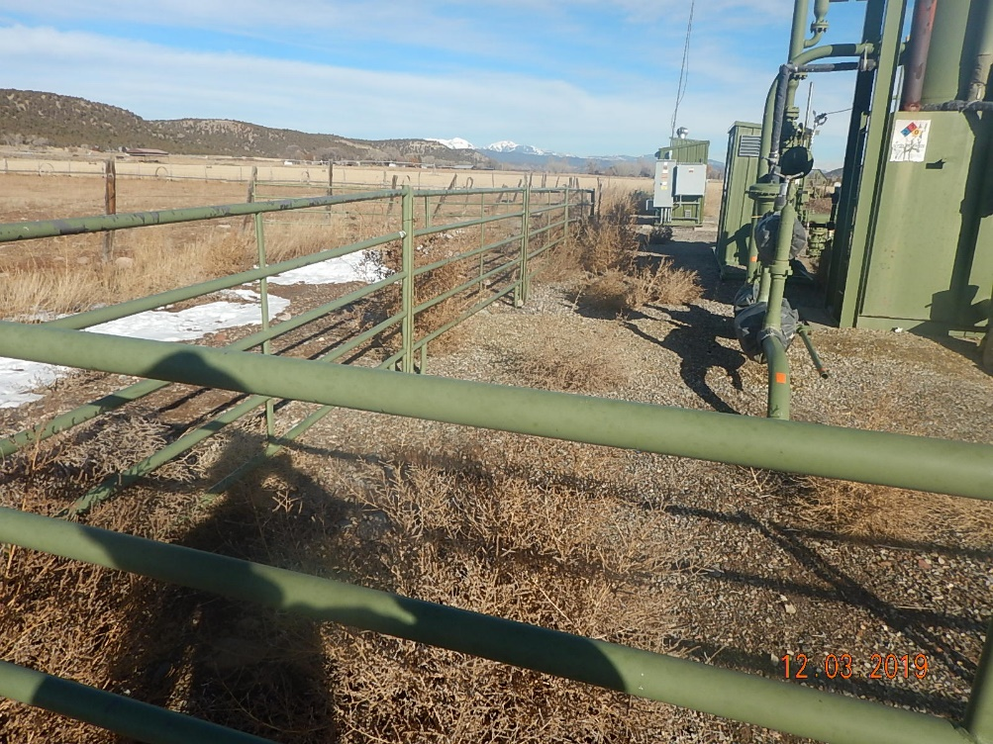
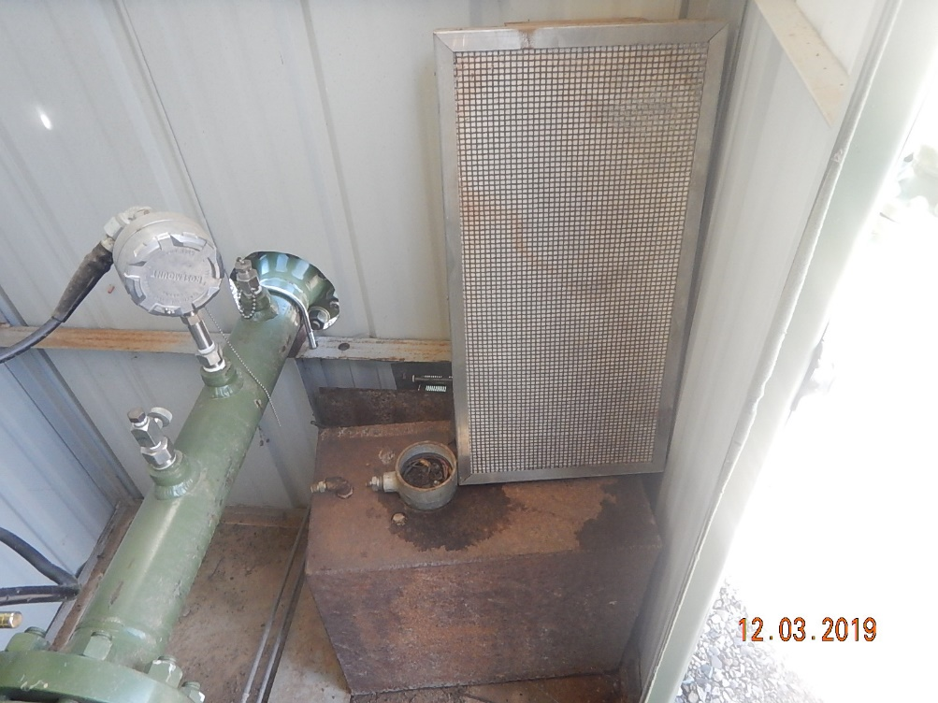
Inspection Photos
BP
Location Name: MF Sharp A1
Location ID: 05-067-07266
Photo #3 Weeds along western/southern fence panels around separator.
Photo #4 Unused equipment in meter shed.

Slide 3
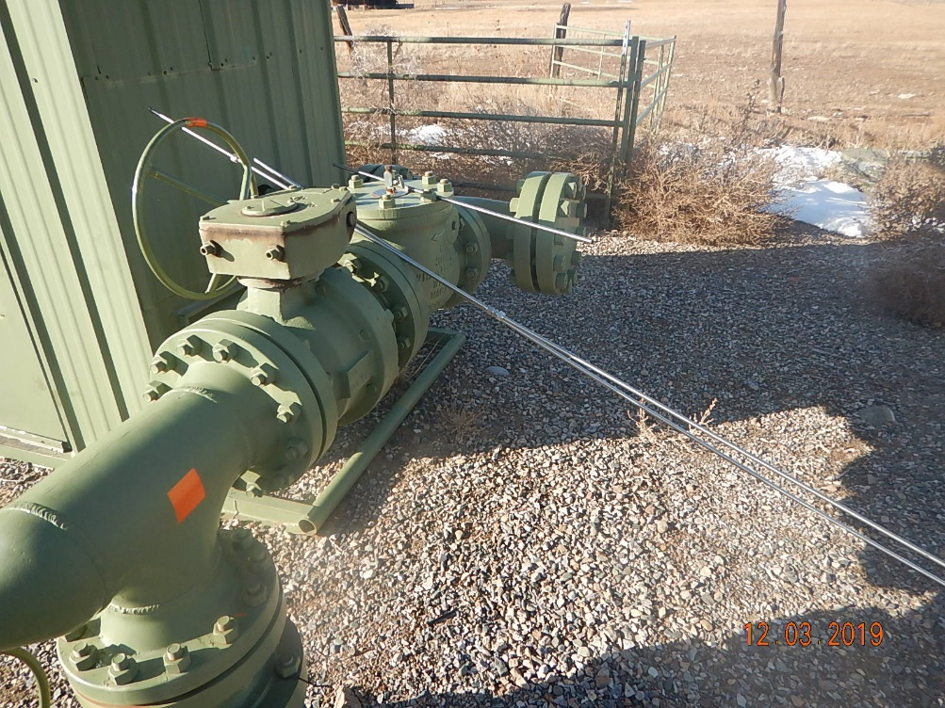
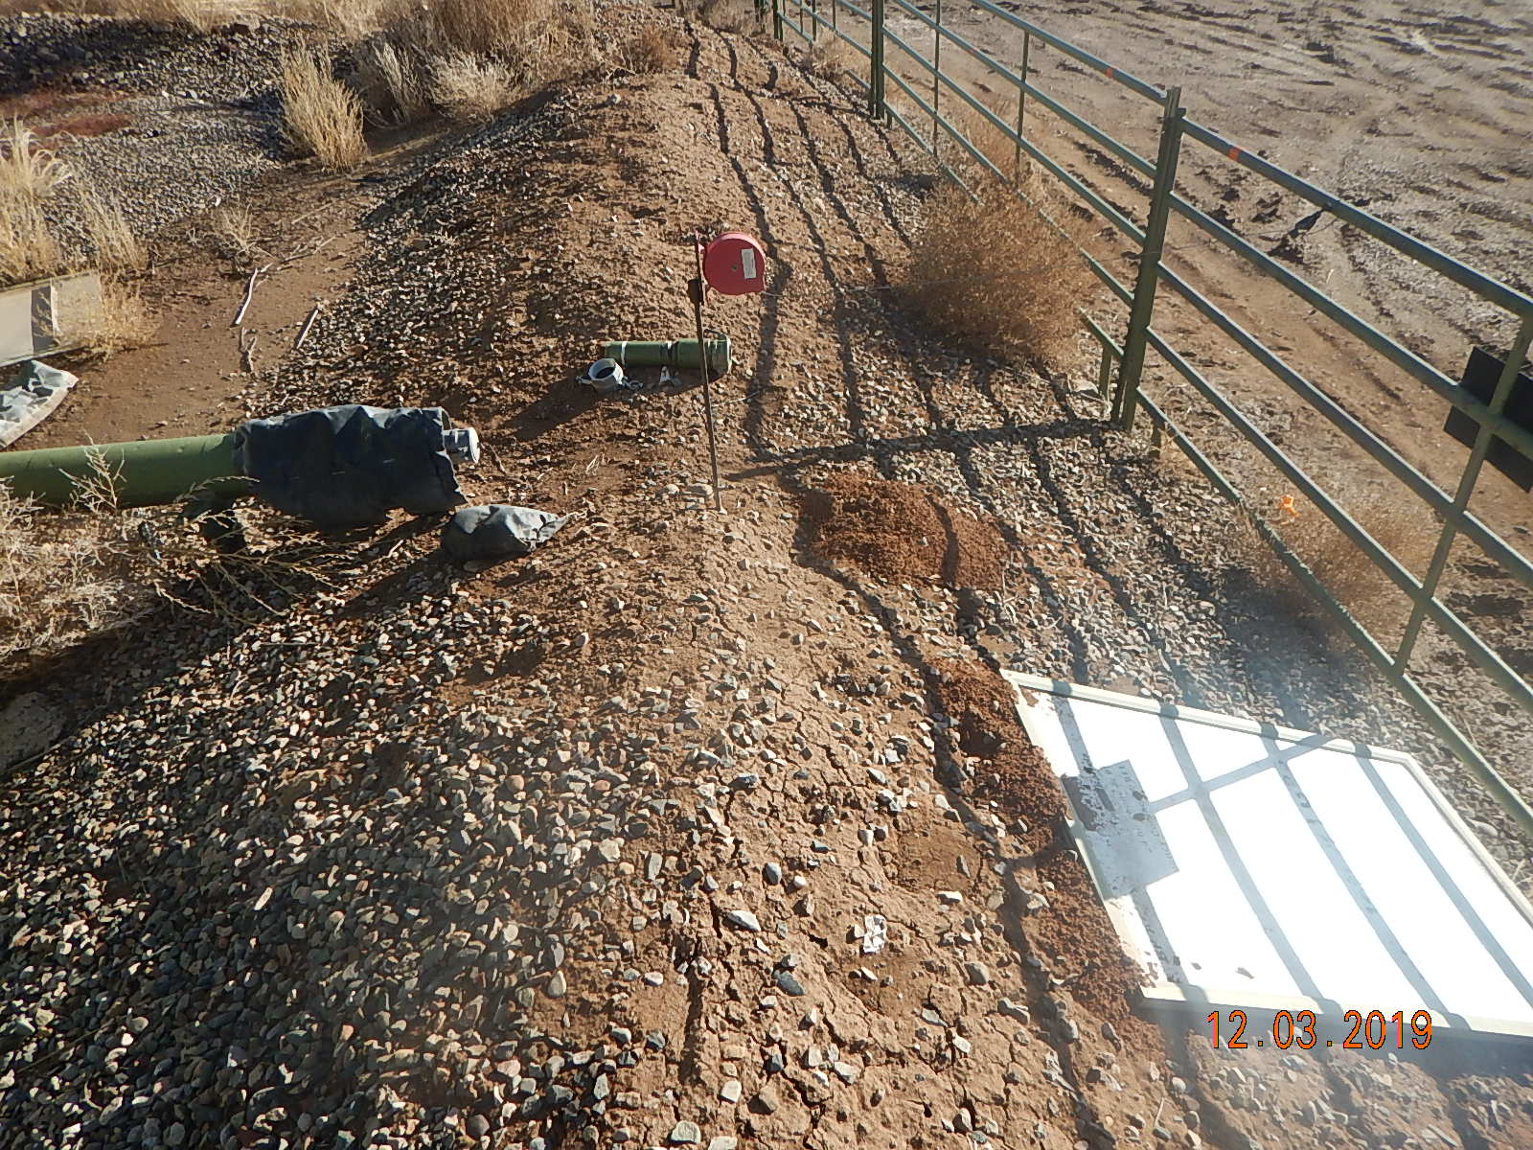
Inspection Photos
BP
Location Name: MF Sharp A1
Location ID: 05-067-07266
Photo #5 Unused SS tubing next to meter house.
Photo #6 Unused parts, piping, camlock fittings circled, illegible tank sign debris in square and arrow pointing to one of multiple wildlife burrows in secondary containment.

Slide 4
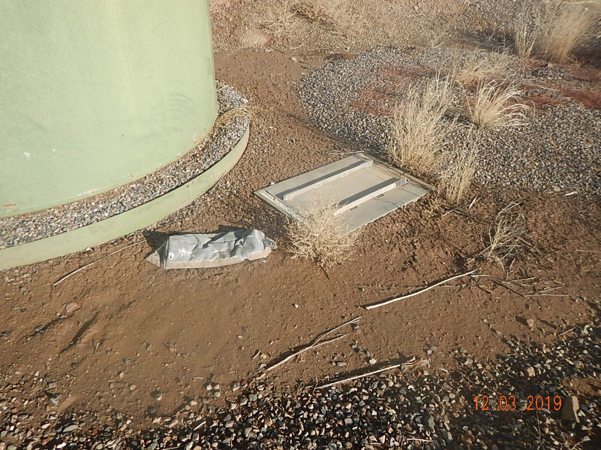
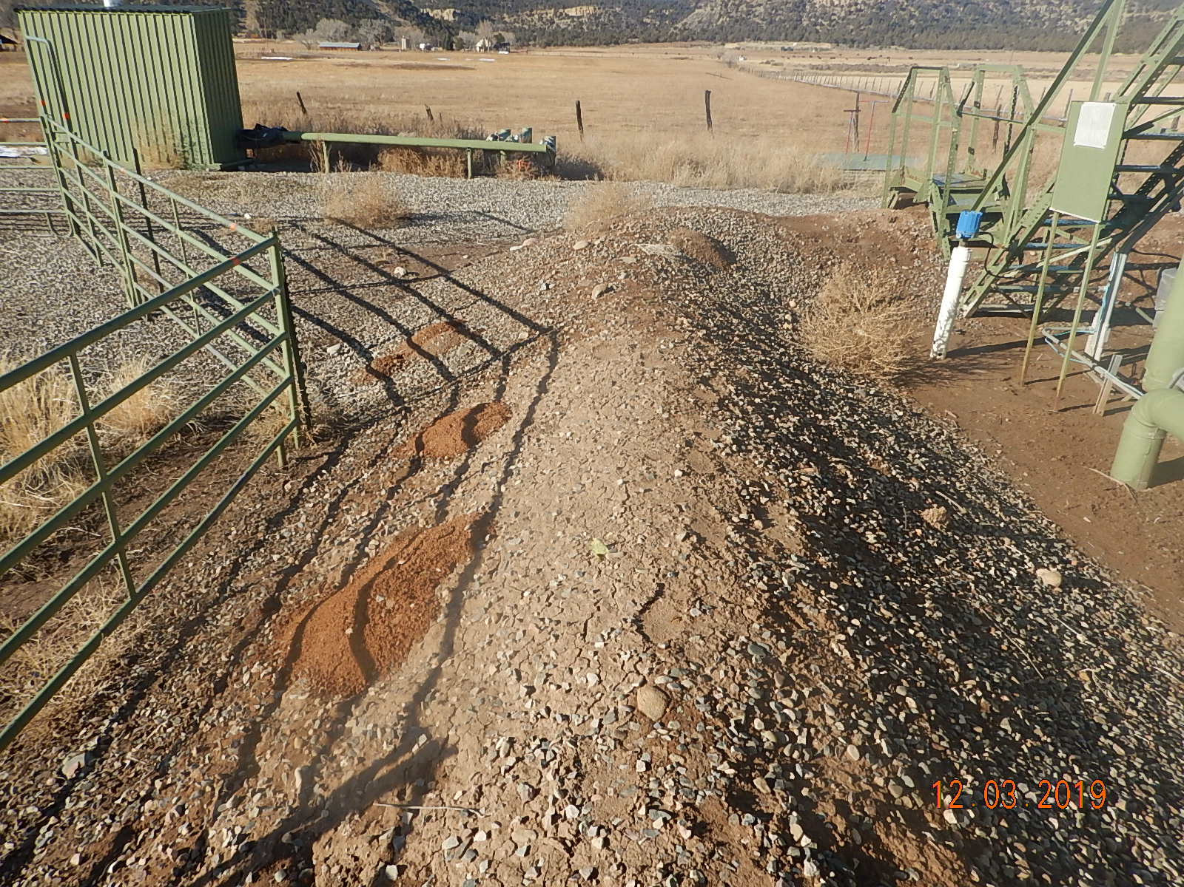
Inspection Photos
BP
Location Name: MF Sharp A1
Location ID: 05-067-07266
Photo #7 Used insulation blanket and sign pieces inside secondary containment. Weeds inside secondary containment.
Photo #8 Wildlife burrows along southern side of secondary containment.

Slide 5
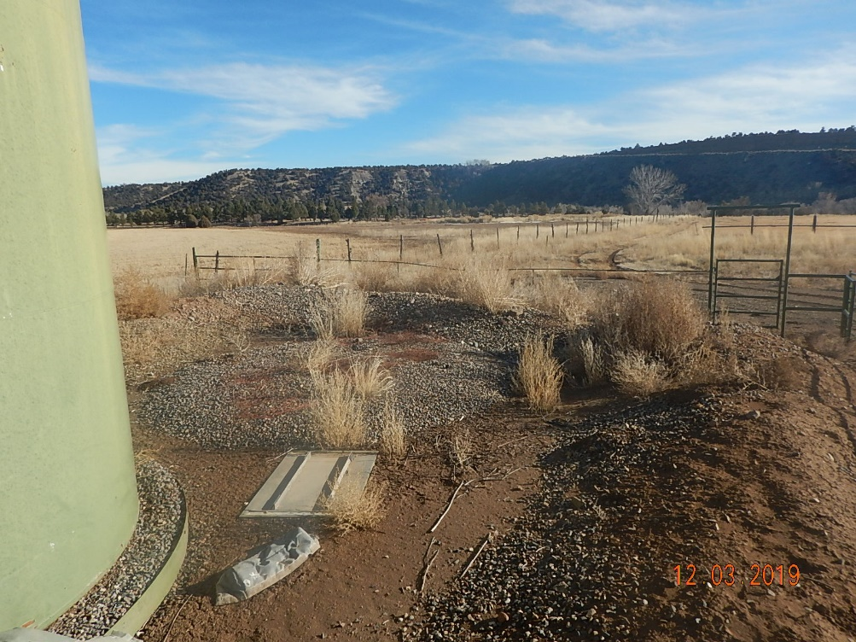
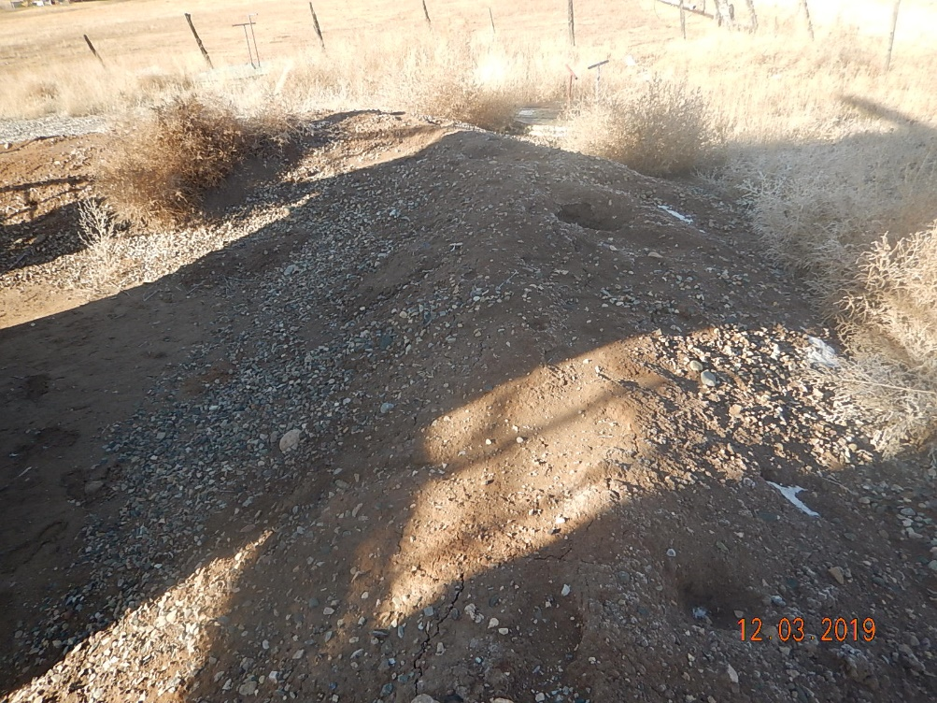
Inspection Photos
BP
Location Name: MF Sharp A1
Location ID: 05-067-07266
Photo #9 Weeds and debris in the secondary tank containment along eastern side..
Photo #10 Wildlife burrows in secondary containment along north side.

Slide 6
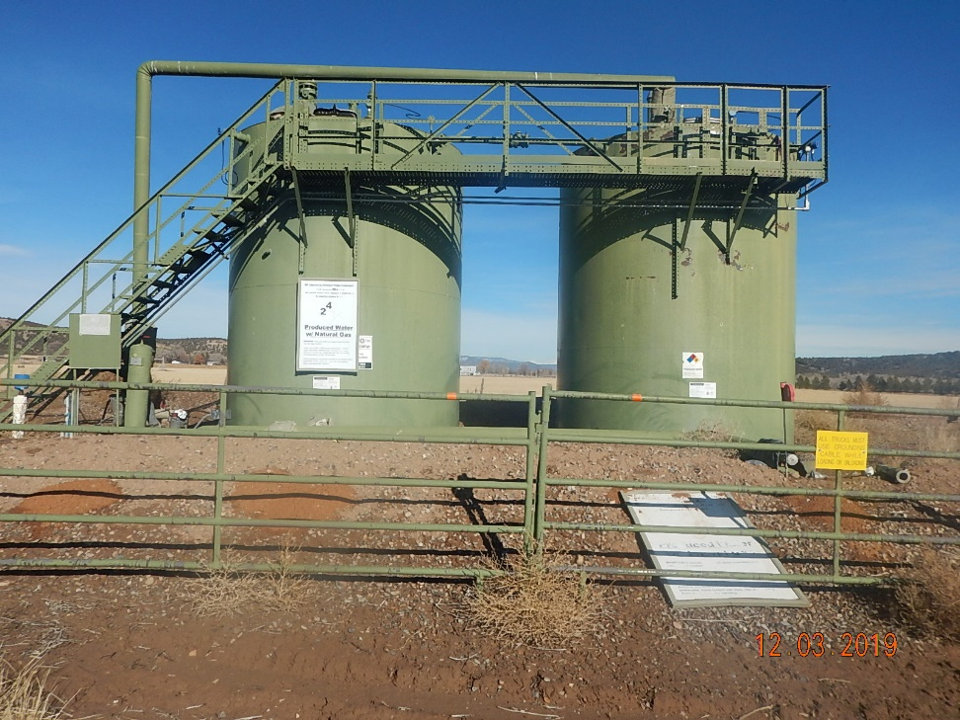
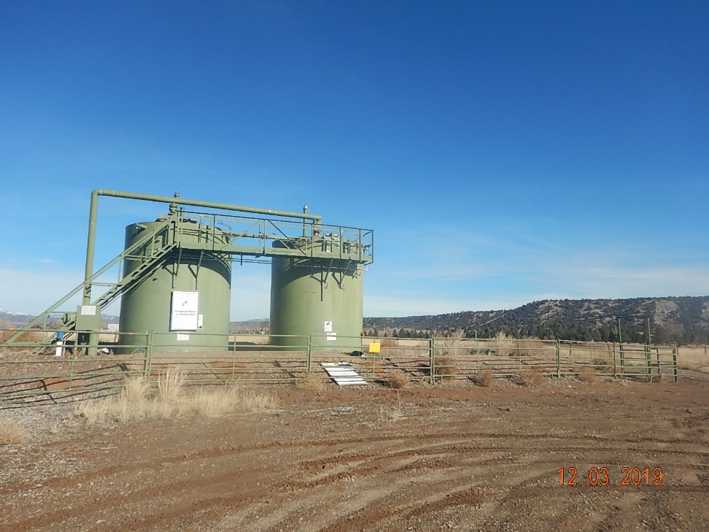
Inspection Photos
BP
Location Name: MF Sharp A1
Location ID: 05-067-07266
Photo #11 Tank battery signs to be updated to be legible. Wildlife burrows along fence panels.
Photo #12 Overview photo of tank battery looking north.

