Slide 1

Inspection Photos
Operator: BP America
Location/API #: 067-06662
Date: 11-12-2019

Slide 2
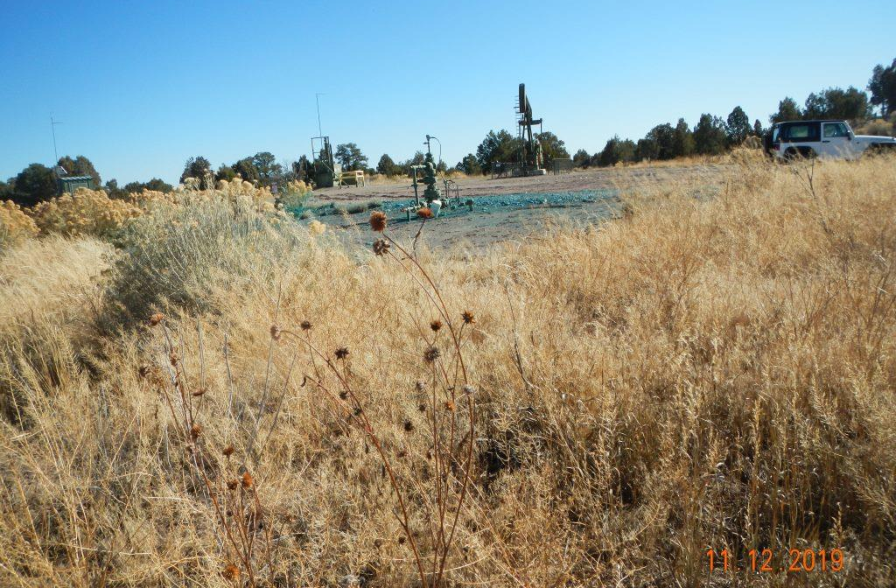
Photo 1. View of the project area from the northwestern corner facing center.
Reference area
Inspection Photos | 05-067-06662

Slide 3
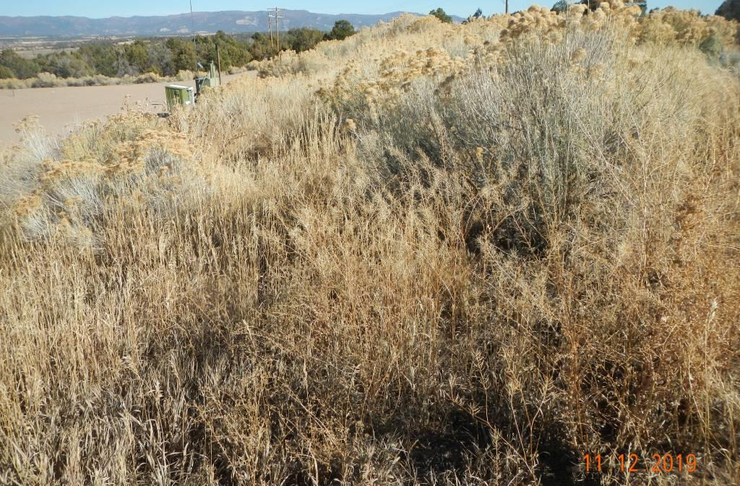
Photo 2. View of the northern fill slope from the northwestern corner facing eastward. Revegetation is progressing, largely with grasses such as smooth brome and shrubs such as rubber rabbitbrush.
Reference area
Inspection Photos | 05-067-06662

Slide 4
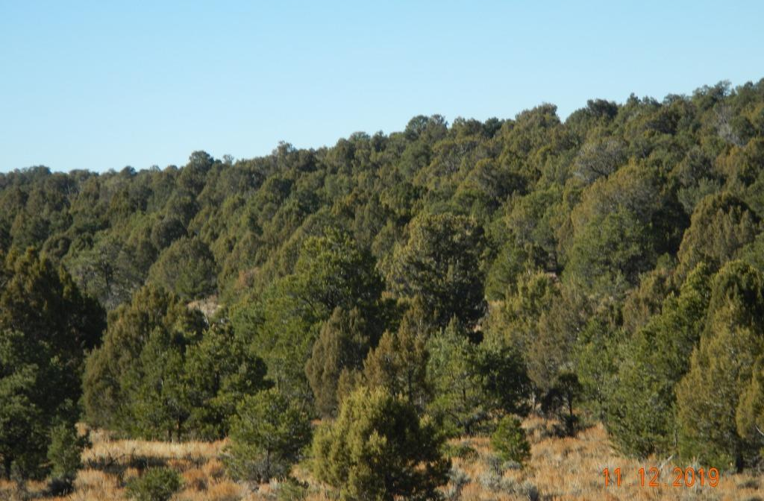
Photo 3. View of reference area, comprised of sagebrush and pinyon juniper woodland.
Reference area
Inspection Photos | 05-067-06662

