Slide 1
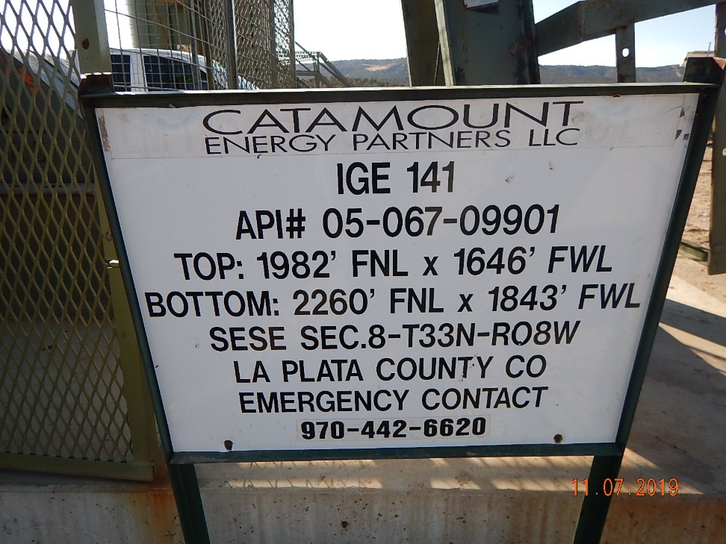
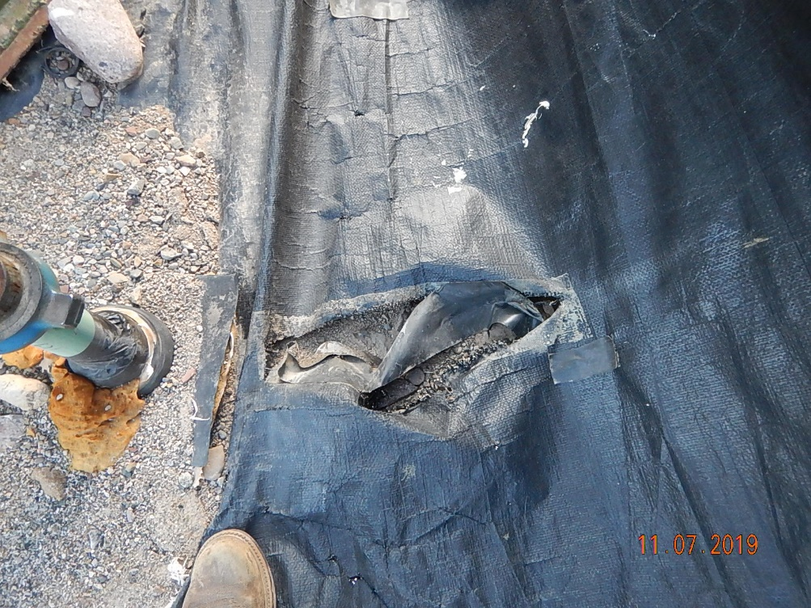
Inspection Photos
Catamount
Location Name: IGE 141
Location ID: 05-067-09901
Photo #1 Update EMS contact information on sign.
Photo #2 Rip in previously repaired liner on base of containment structure.

Slide 2
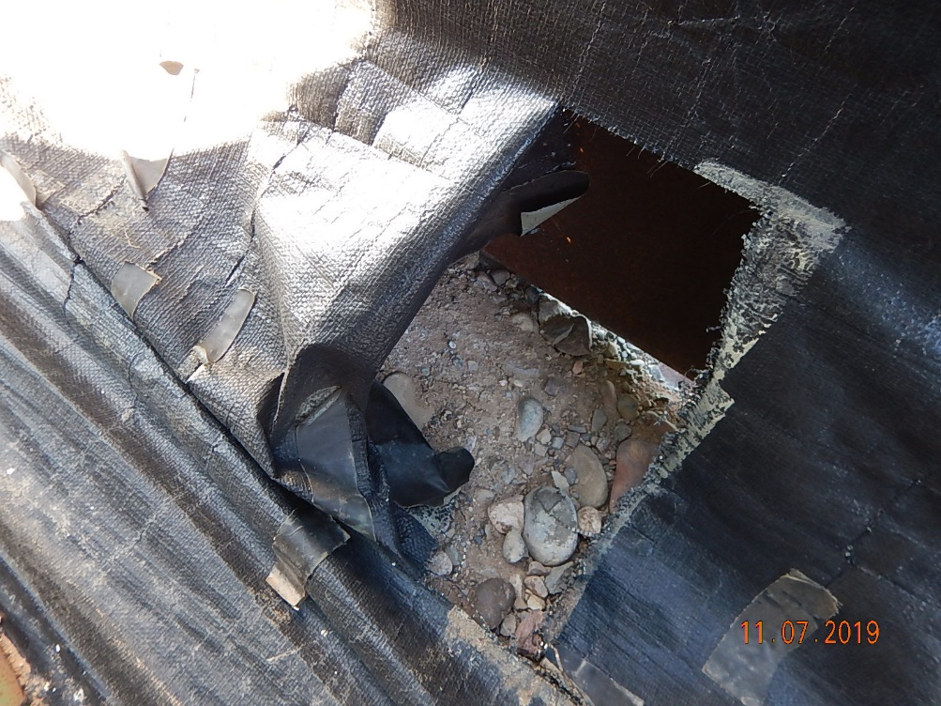
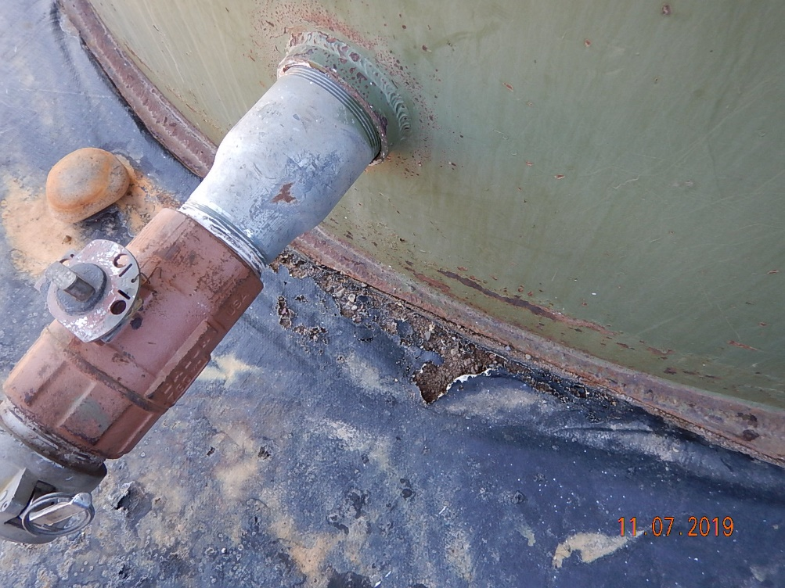
Inspection Photos
Catamount
Location Name: IGE 141
Location ID: 05-067-09901
Photo #3 Rip in liner showing daylight from under exterior metal containment structure at base.
Photo #3 liner holes around the base of produced water tank.

