Slide 1
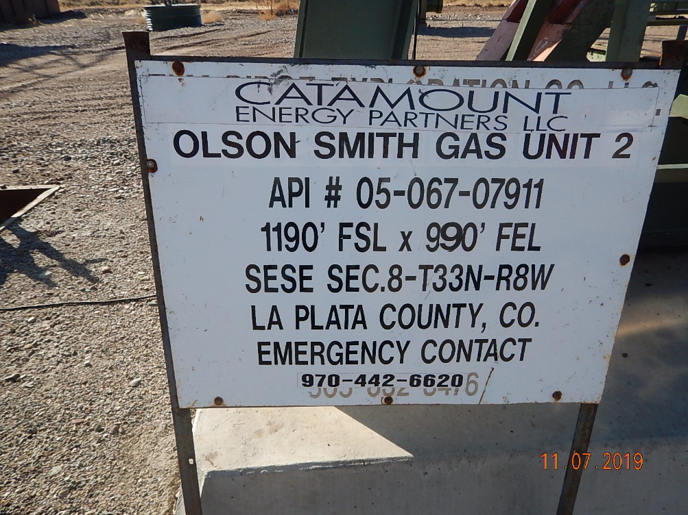
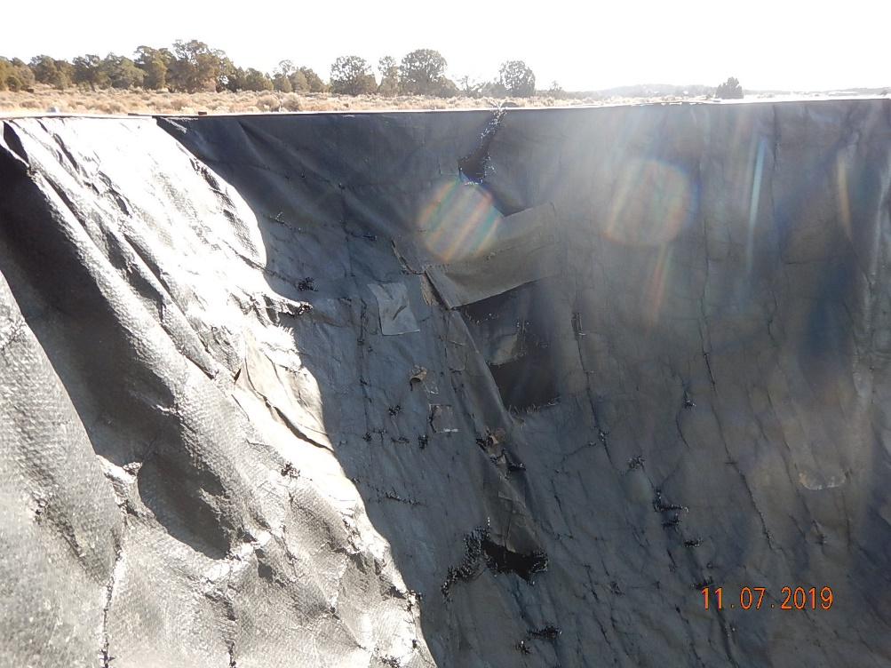
Inspection Photos
Catamount
Location Name: Olson Smith GU-2
Location ID: 05-067-07911
Photo #1 Sign missing EMS contact information.
Photo #2 Multiple holes and tears on previously repaired liner along East side of containment structure.

Slide 2
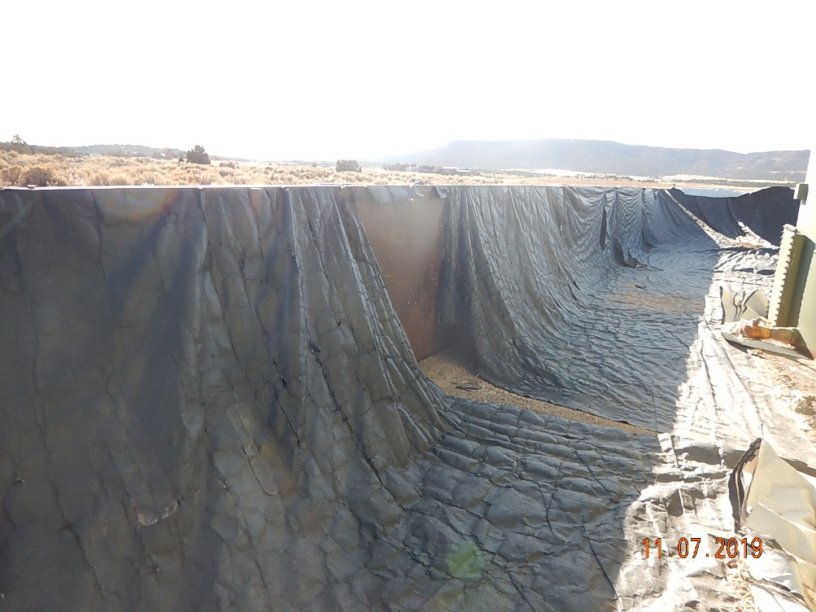
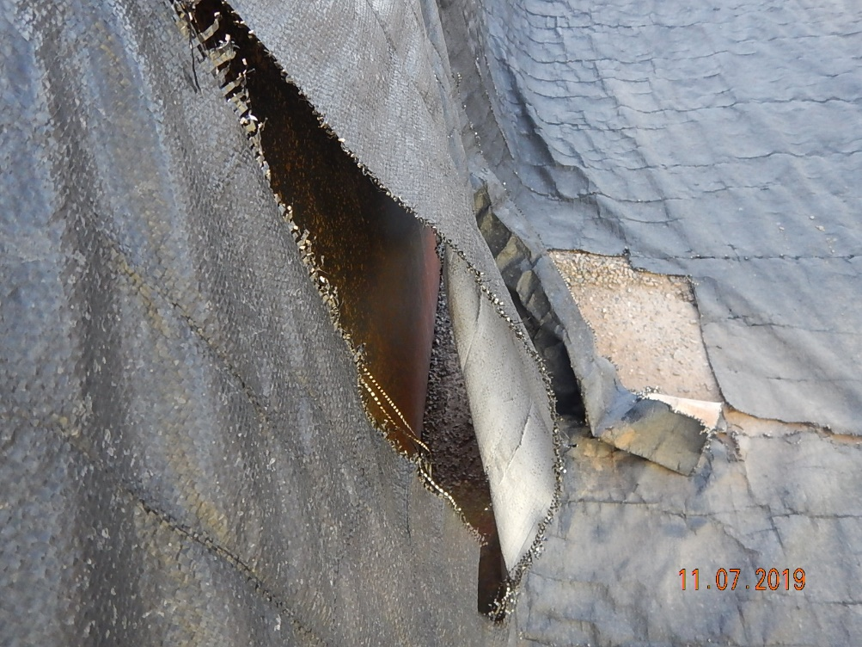
Inspection Photos
Catamount
Location Name: Olson Smith GU-2
Location ID: 05-067-07911
Photo #3 Large portions of liner ripped from walls and along base on East side of containment structure.
Photo #4 Liner tears on walls and base east side of containment structure.

Slide 3
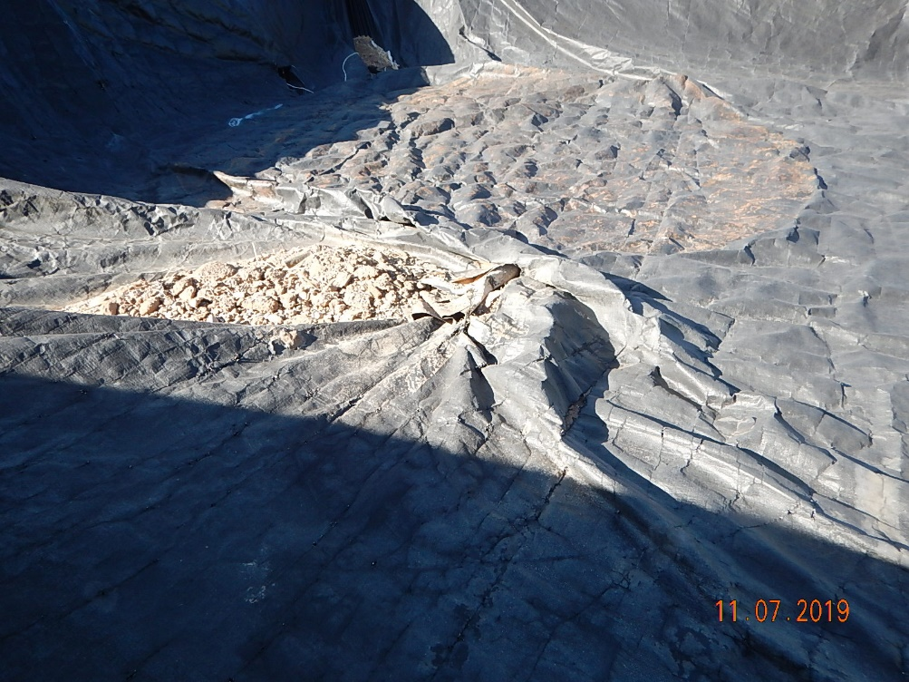
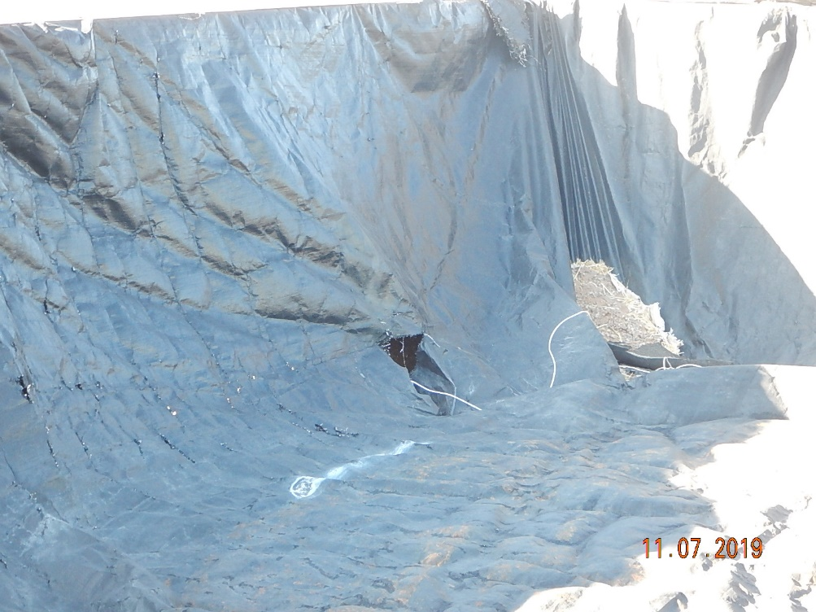
Inspection Photos
Catamount
Location Name: Olson Smith GU-2
Location ID: 05-067-07911
Photo #5 Holes in liner on southern side of containment structure.
Photo #6 Holes in liner at base of wall on southern side of containment structure.

Slide 4
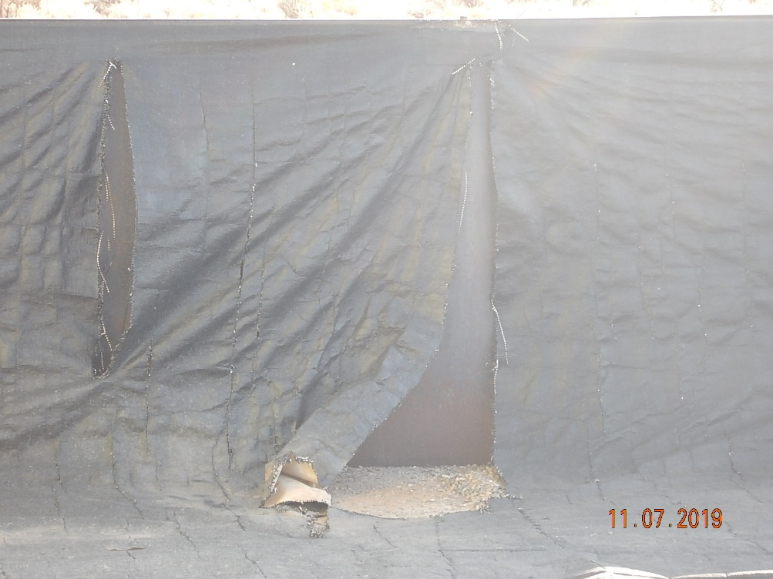
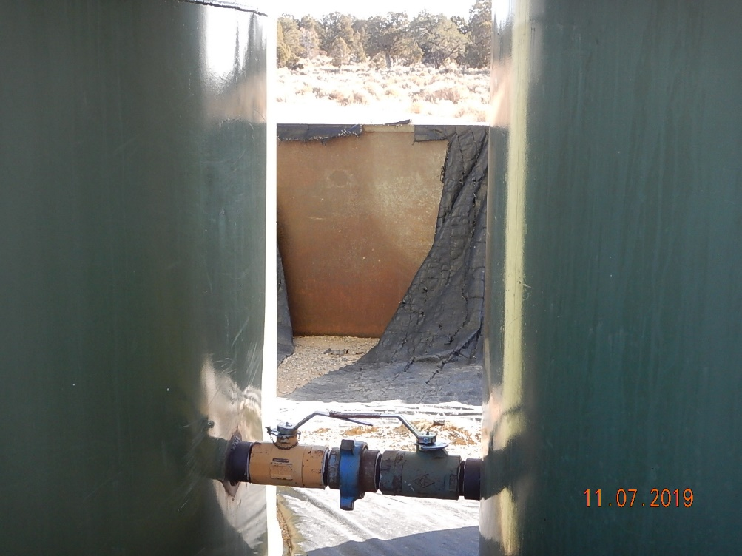
Inspection Photos
Catamount
Location Name: Olson Smith GU-2
Location ID: 05-067-07911
Photo #7 tears along wall and base on western side of containment structure.
Photo #8 tears in liner in relation to tanks along eastern wall of containment structure.

