Slide 1
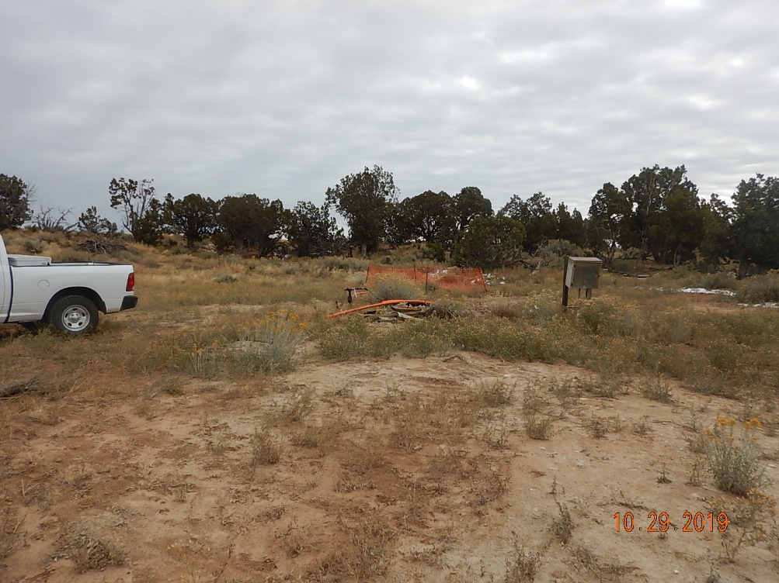
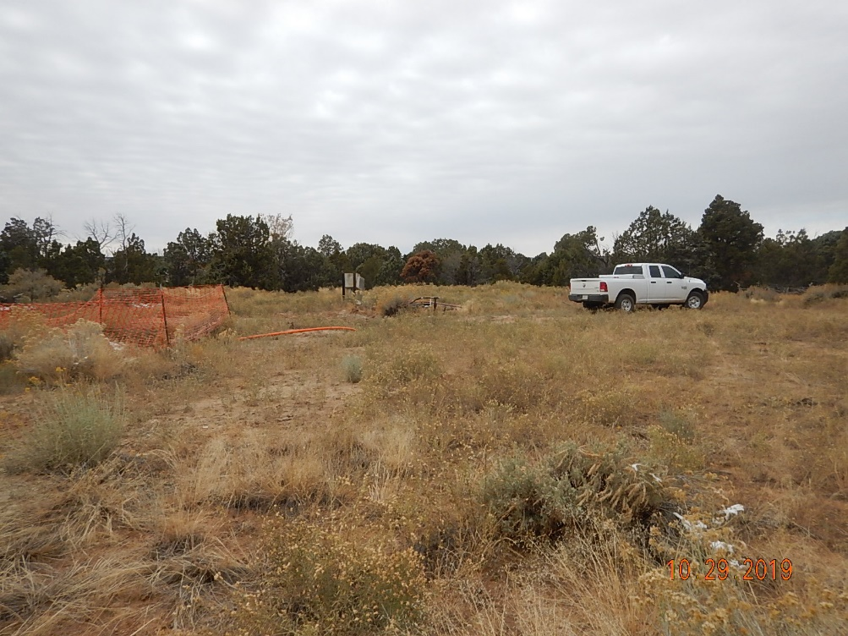
Inspection Photos
Location Name: Ester #1 (OWP)
Location ID: 05-067-06232
Location looking East.
Location looking West.

Slide 2
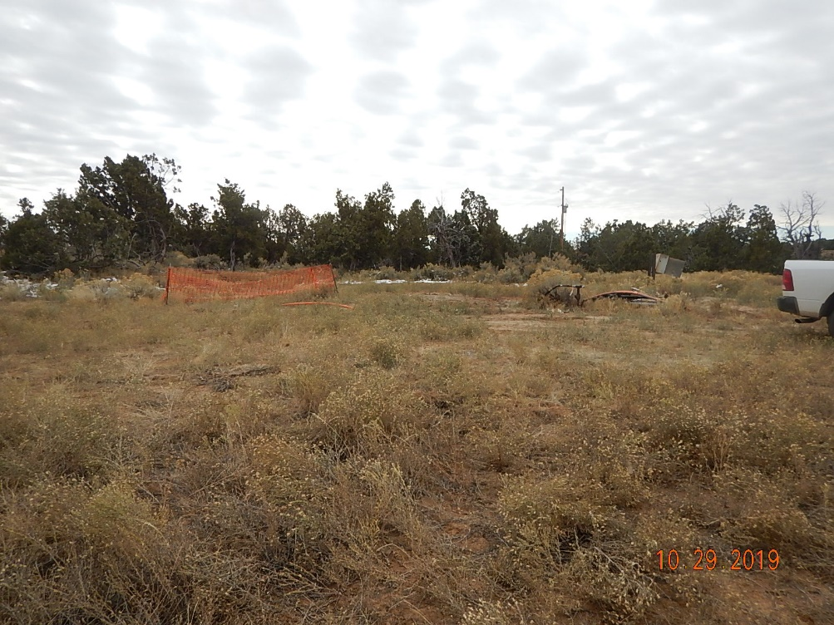
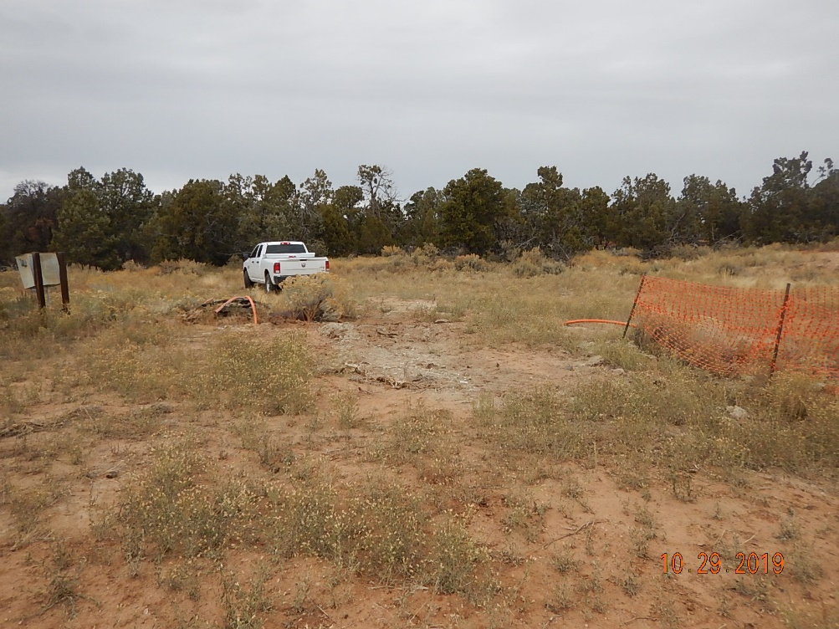
Inspection Photos
Location Name: Ester #1 (OWP)
Location ID: 05-067-06232
Location looking South.
Location looking North.

Slide 3
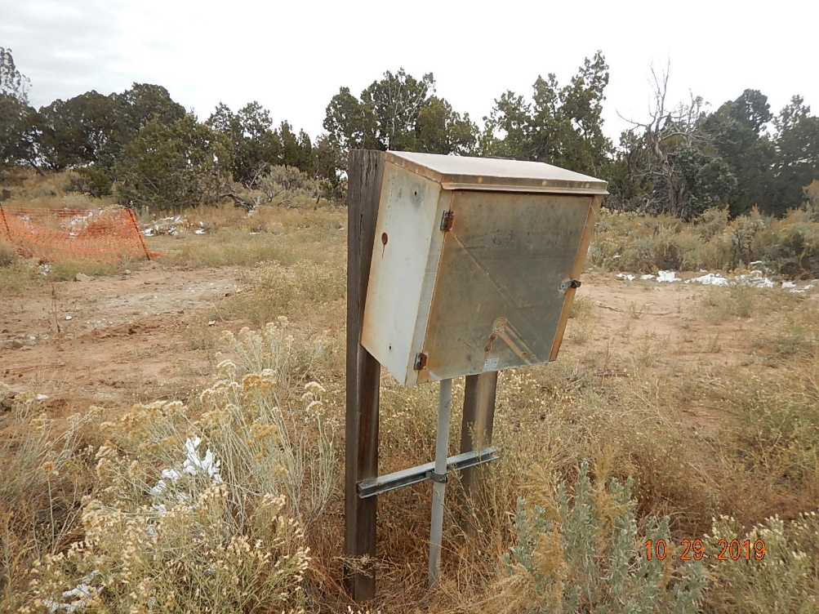
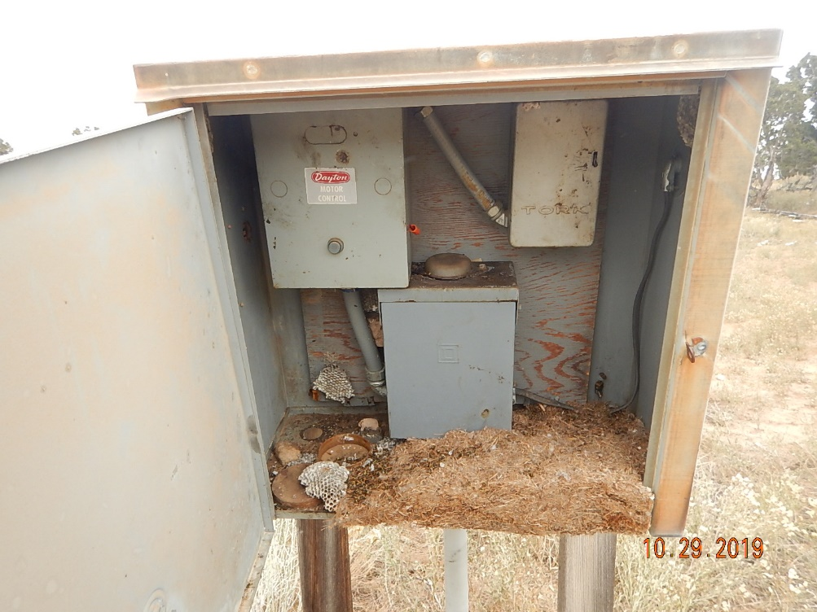
Inspection Photos
Location Name: Ester #1 (OWP)
Location ID: 05-067-06232
Disconnect panel and power line on location prior to removal.
Disconnect panel with mouse/rat nest inside. POSSIBLE HAUNTAVIRUS NOTED.

Slide 4
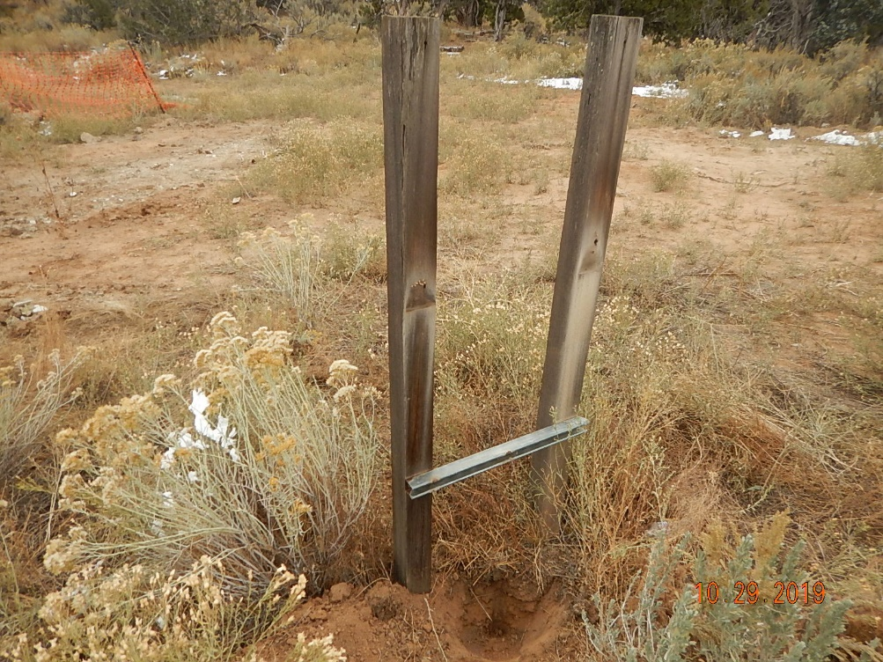
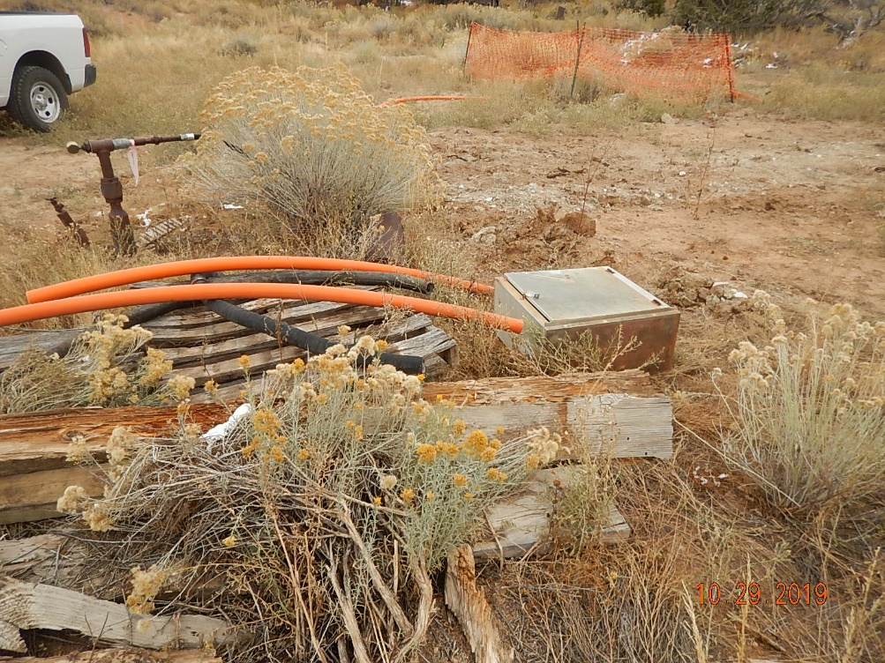
Inspection Photos
Location Name: Ester #1 (OWP)
Location ID: 05-067-06232
Disconnect panel power line and conduit removed, power cut 12” below grade.
Debris and disconnect panel next to wellhead on location.

Slide 5
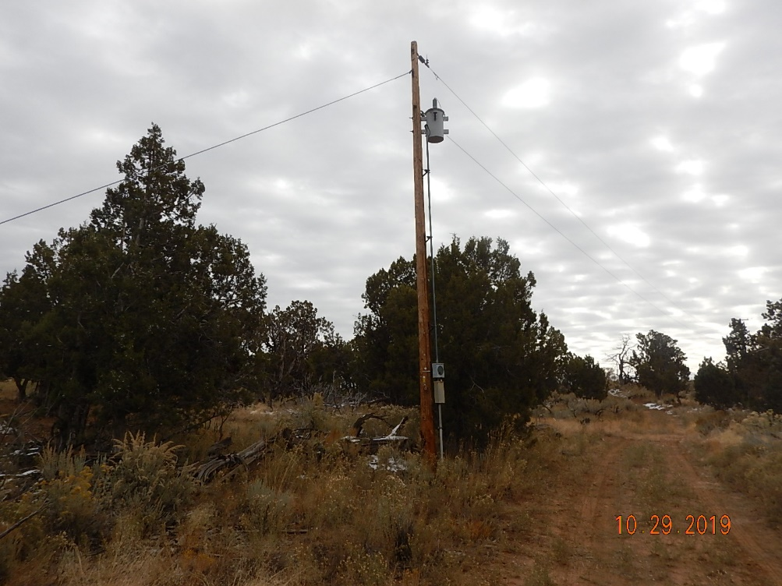
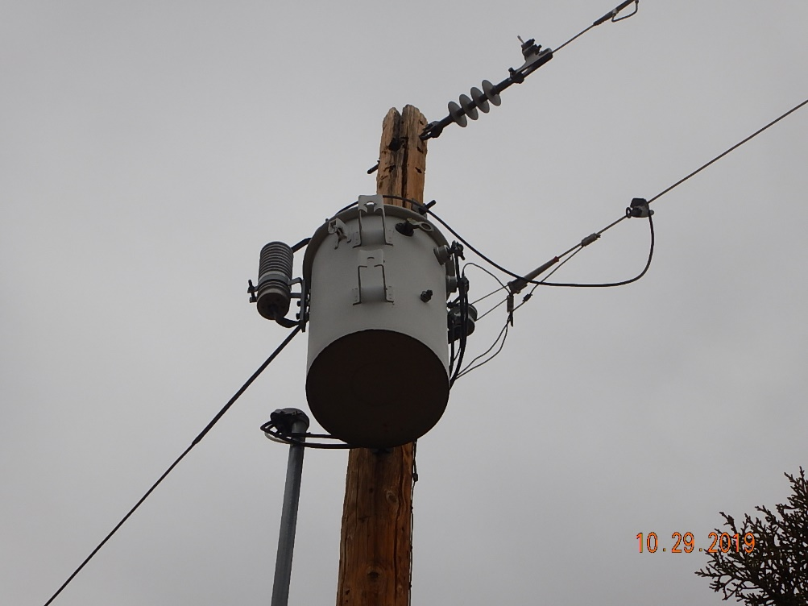
Inspection Photos
Location Name: Ester #1 (OWP)
Location ID: 05-067-06232
La Plata Electric Association power pole approx. 100’ off Southwest corner of location.
La Plata Electric Association transformer on pole appears to be terminated to the power line currently.

Slide 6
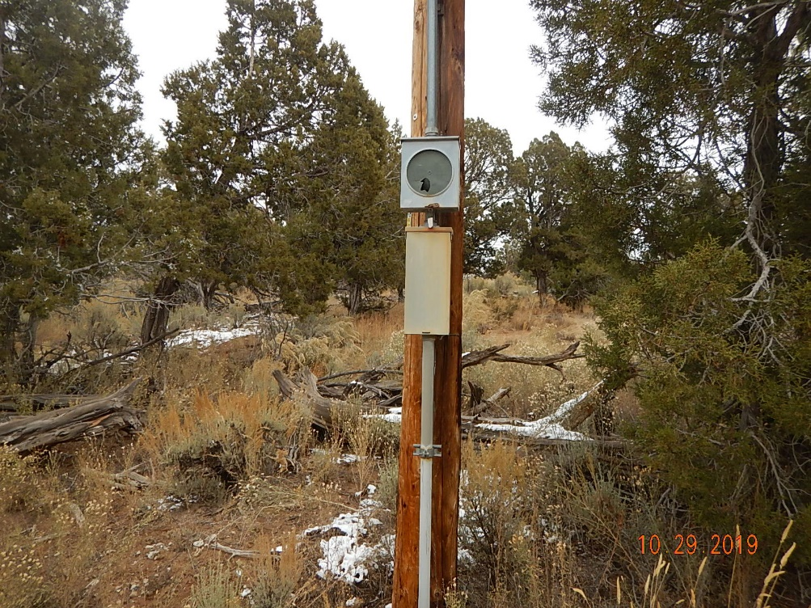
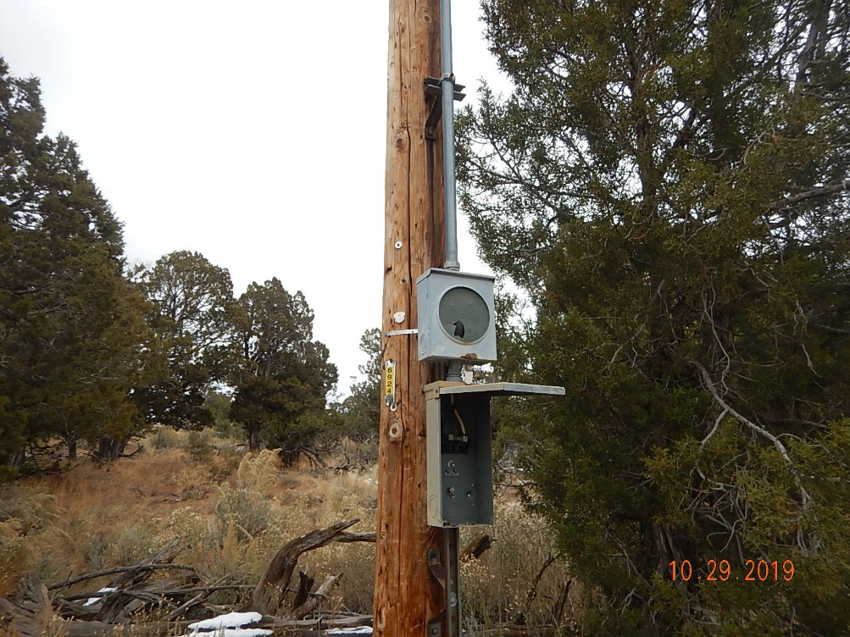
Inspection Photos
Location Name: Ester #1 (OWP)
Location ID: 05-067-06232
La Plata Electric Association power pole. Meter is pulled but live wires exist from transformer to meter ped.
La Plata Electric Association power main disconnect panel with breaker pulled and service wiring and conduit removed from pole.

Slide 7
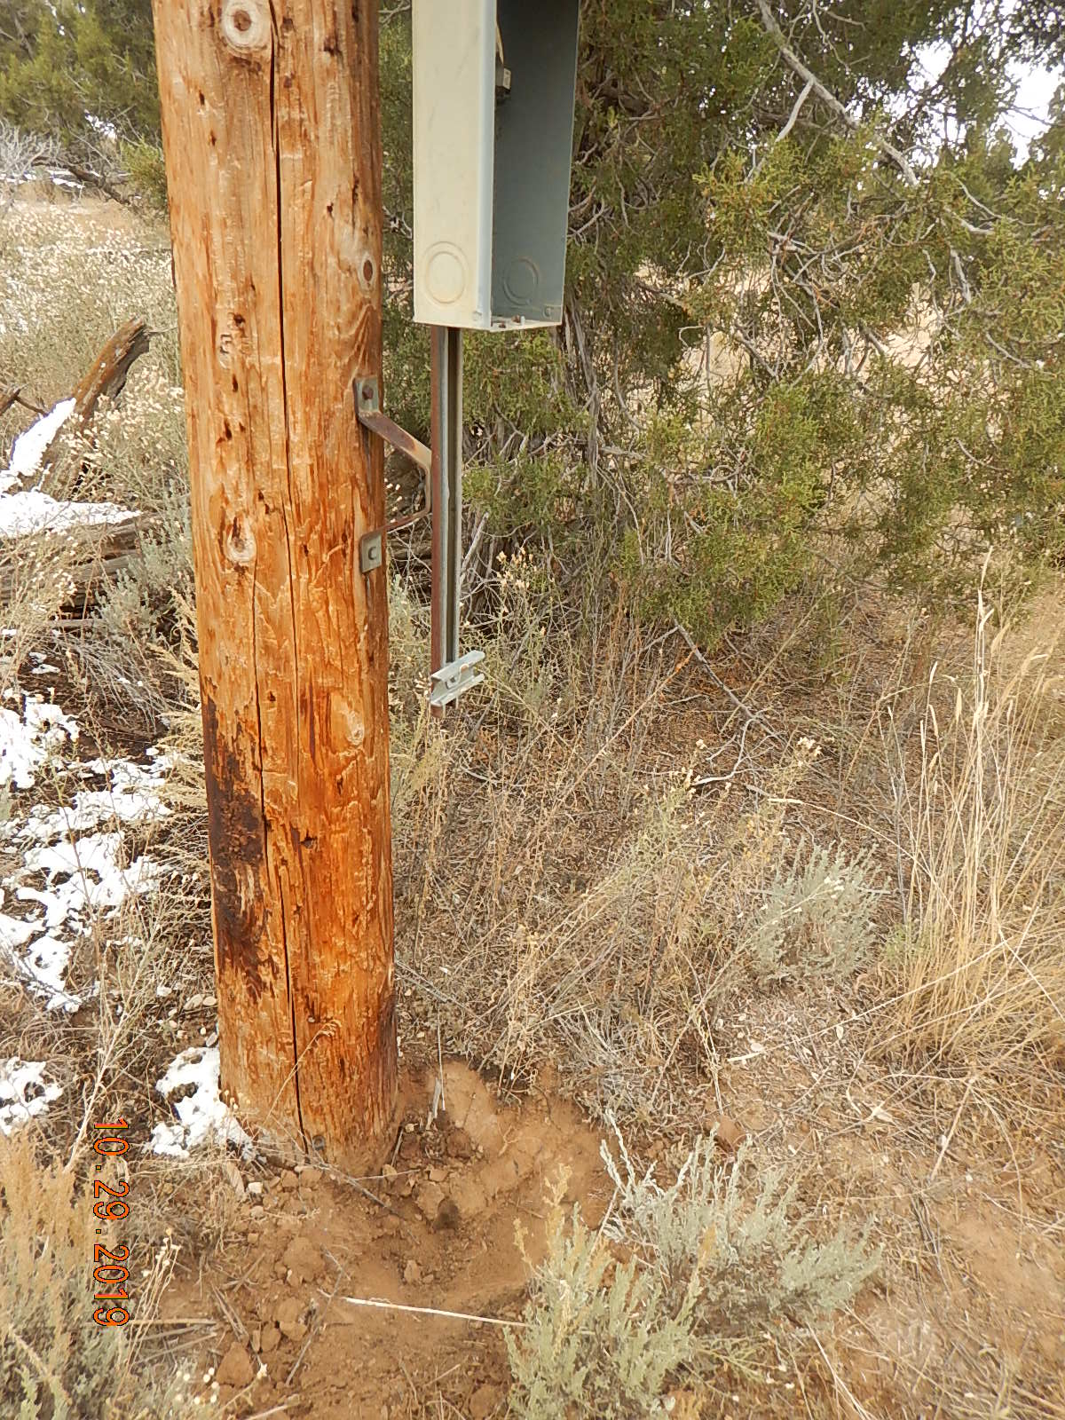
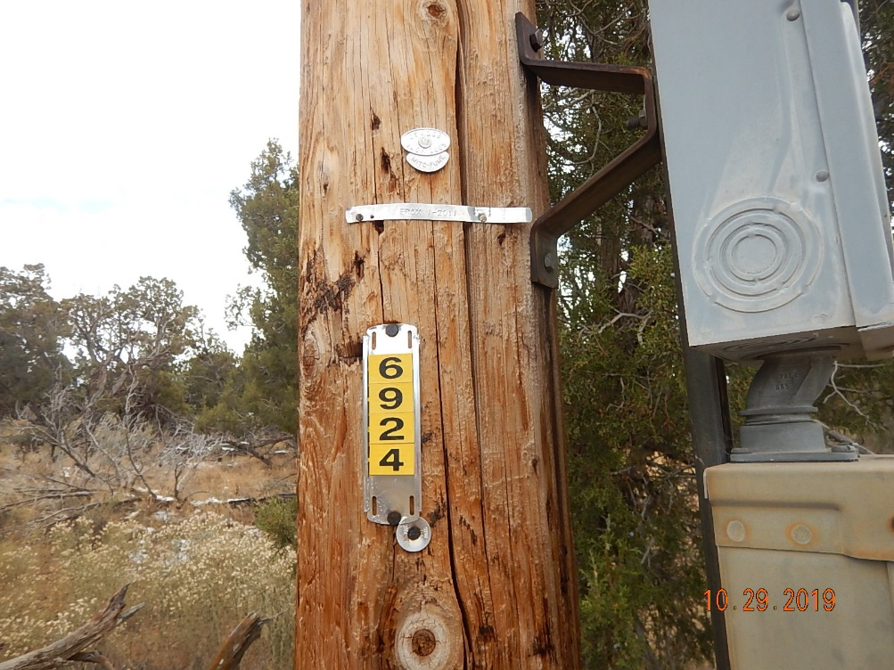
Inspection Photos
Location Name: Ester #1 (OWP)
Location ID: 05-067-06232
La Plata Electric Association power pole with conduit and wiring pulled. Wiring cut 12” below grade.
La Plata Electric Association POLE ID# 6924 that has transformer and (disconnected) location power drop attached to pole.

Slide 8
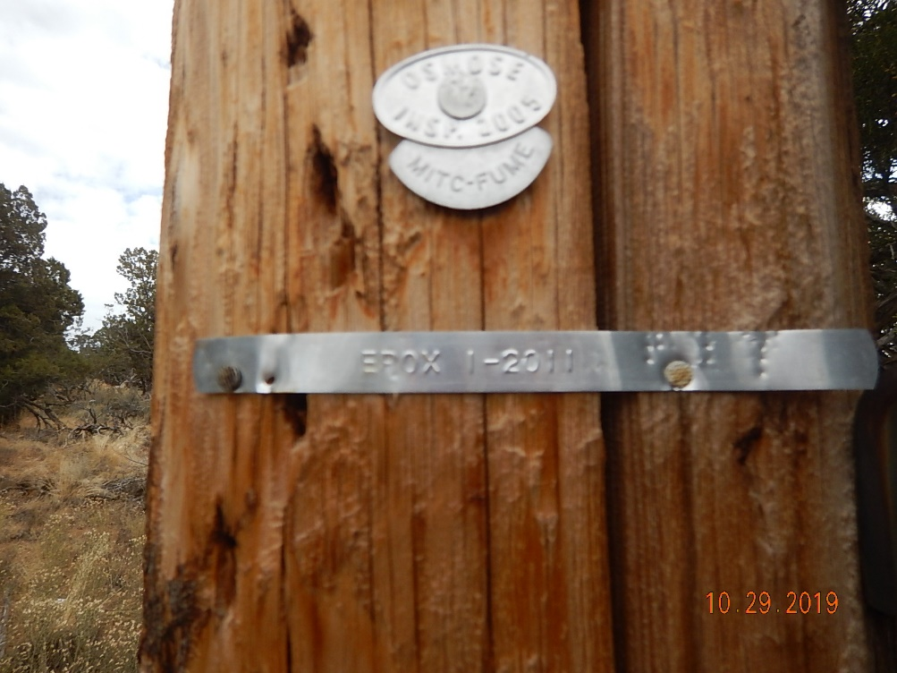
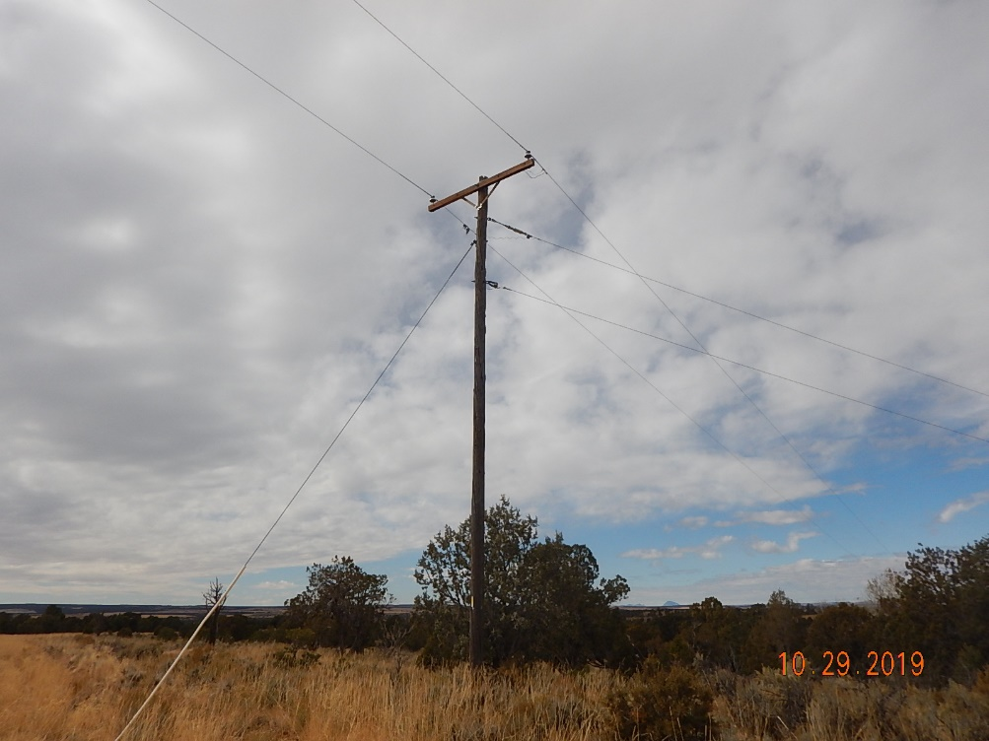
Inspection Photos
Location Name: Ester #1 (OWP)
Location ID: 05-067-06232
La Plata Electric Association (POLE #6924) other possible needed information attached to pole.
La Plata Electric Association feeder power pole (next upstream power pole) approx. 500’ South of location.

Slide 9
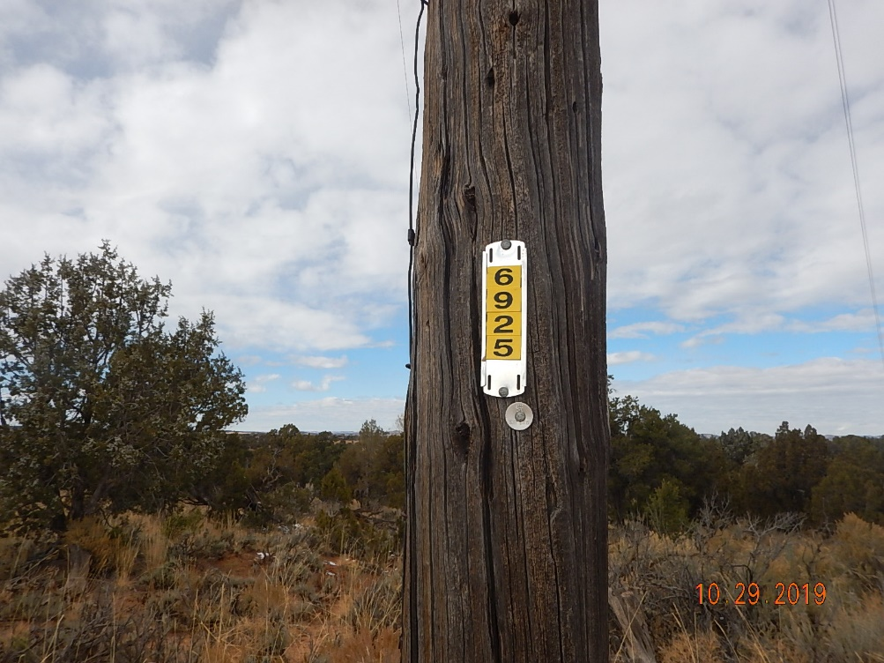
Inspection Photos
Location Name: Ester #1 (OWP)
Location ID: 05-067-06232
La Plata Electric Association feeder power pole (next upstream power pole) approx. 500’ South of location. POLE ID# 6925

