Slide 1
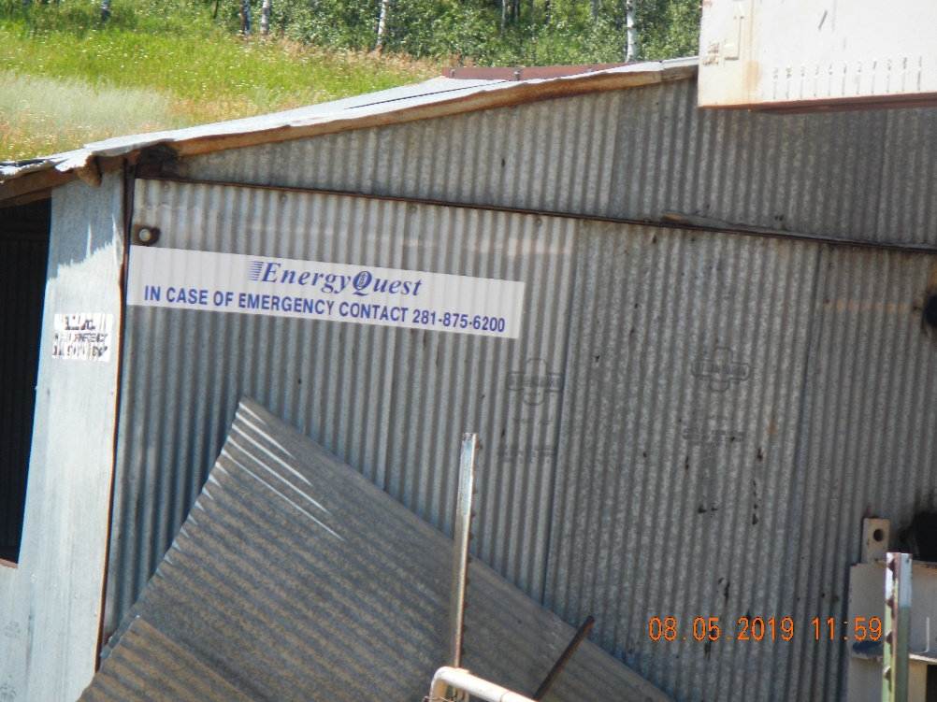
Inspection Photos
Pit Facility 113016
Well 107-06173
Inspection Date: 8/5/2019
Photos taken by Kris Neidel
Photo #1 pump shed

Slide 2
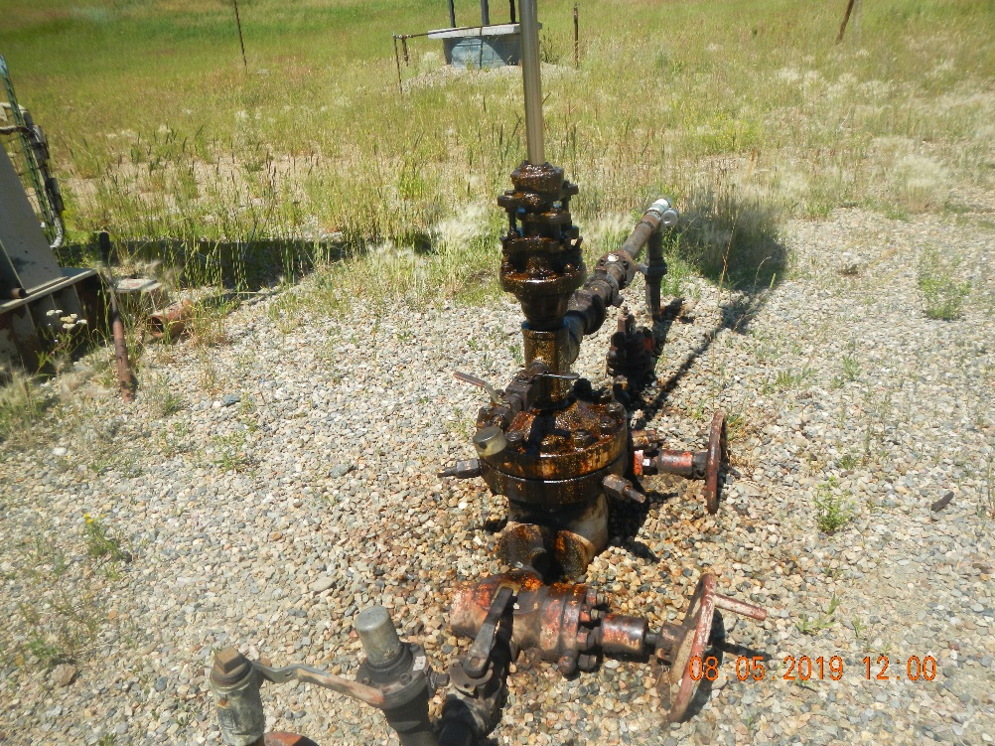
Inspection Photos
Pit Facility 113016
Well 107-06173
Inspection Date: 8/5/2019
Photos taken by Kris Neidel
Photo #2 Wellhead, leaky stuffing box

Slide 3
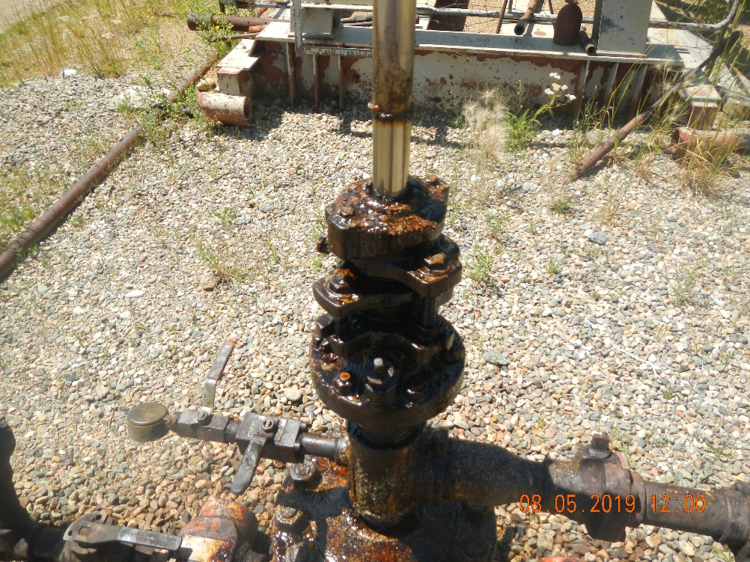
Inspection Photos
Pit Facility 113016
Well 107-06173
Inspection Date: 8/5/2019
Photos taken by Kris Neidel
Photo #3 wellhead leaky stuffingbox

Slide 4
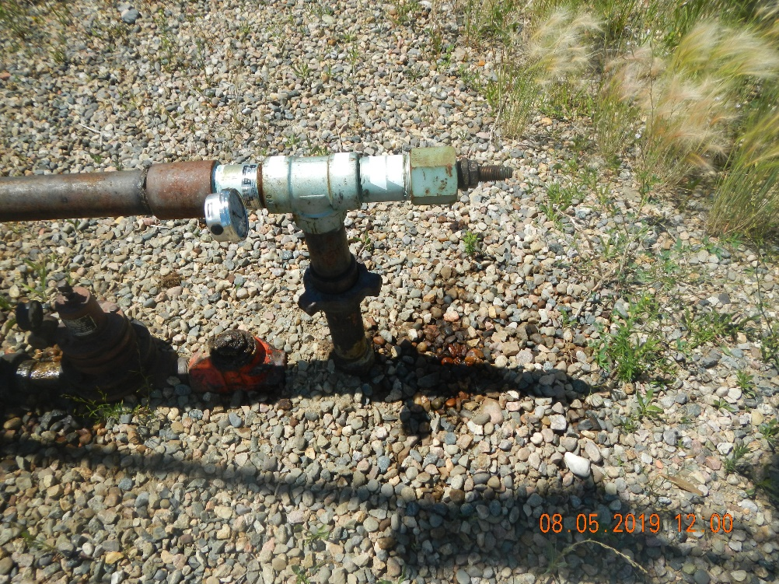
Inspection Photos
Pit Facility 113016
Well 107-06173
Inspection Date: 8/5/2019
Photos taken by Kris Neidel
Photo #4 leaky flowline

Slide 5
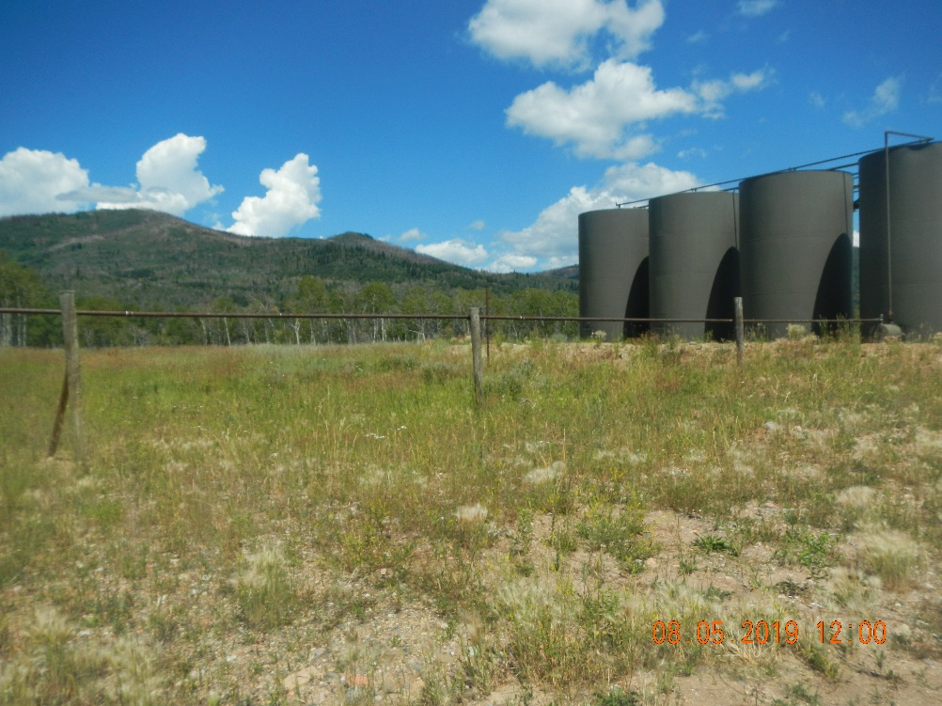
Inspection Photos
Pit Facility 113016
Well 107-06173
Inspection Date: 8/5/2019
Photos taken by Kris Neidel
Photo #5 production line to tank

Slide 6
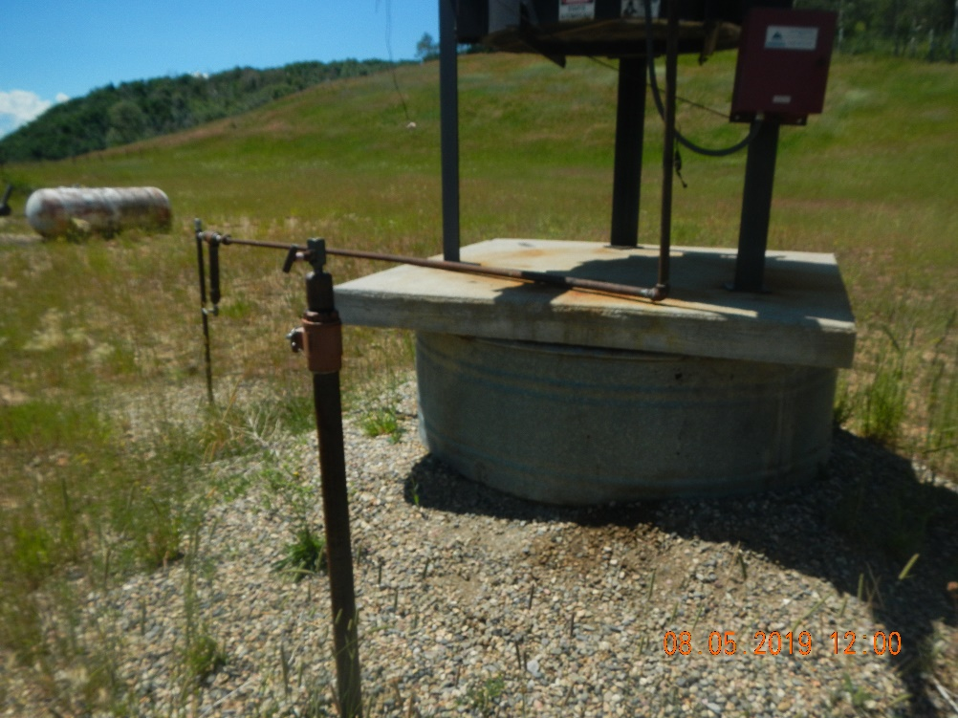
Inspection Photos
Pit Facility 113016
Well 107-06173
Inspection Date: 8/5/2019
Photos taken by Kris Neidel
Photo #6 piperiser near emission control device

Slide 7
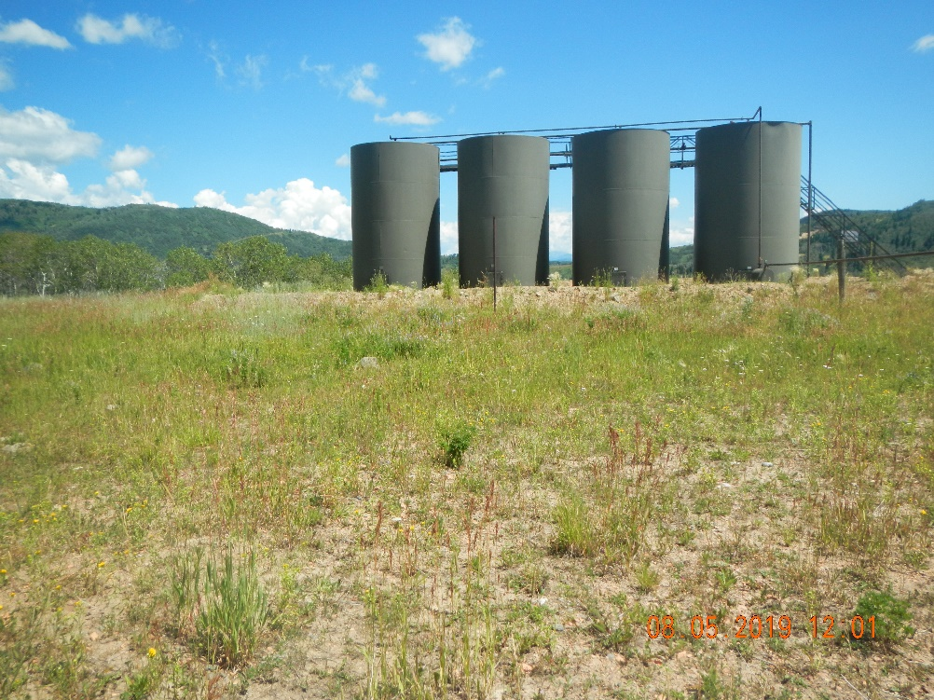
Inspection Photos
Pit Facility 113016
Well 107-06173
Inspection Date: 8/5/2019
Photos taken by Kris Neidel
Photo #7 area of old pit

Slide 8
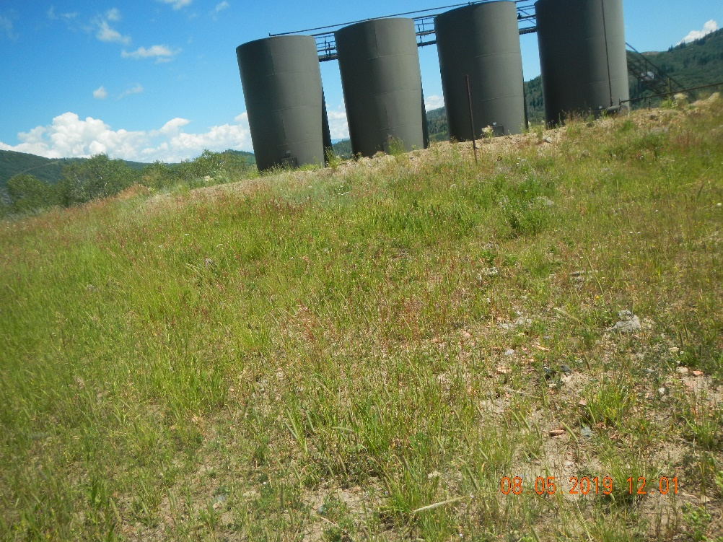
Inspection Photos
Pit Facility 113016
Well 107-06173
Inspection Date: 8/5/2019
Photos taken by Kris Neidel
Photo #8 Area of old pit

Slide 9
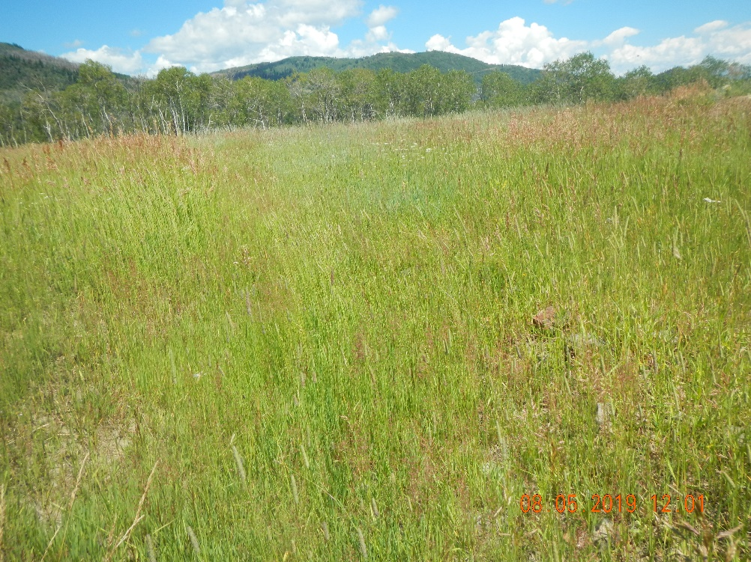
Inspection Photos
Pit Facility 113016
Well 107-06173
Inspection Date: 8/5/2019
Photos taken by Kris Neidel
Photo #9 Area of old pit, vegetation consistent with off location vegetation.

Slide 10
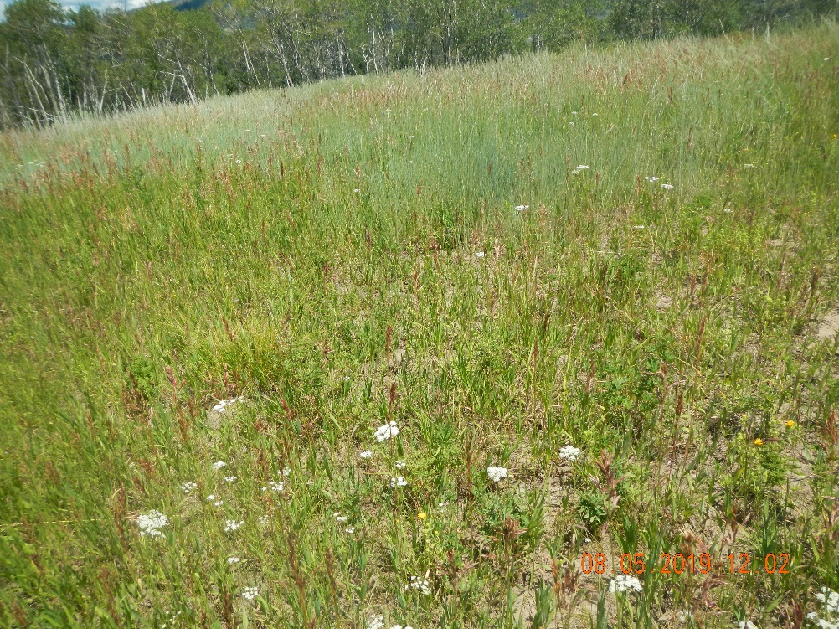
Inspection Photos
Pit Facility 113016
Well 107-06173
Inspection Date: 8/5/2019
Photos taken by Kris Neidel
Photo #10 Area of old pit, vegetation consistent with off location vegetation.

Slide 11
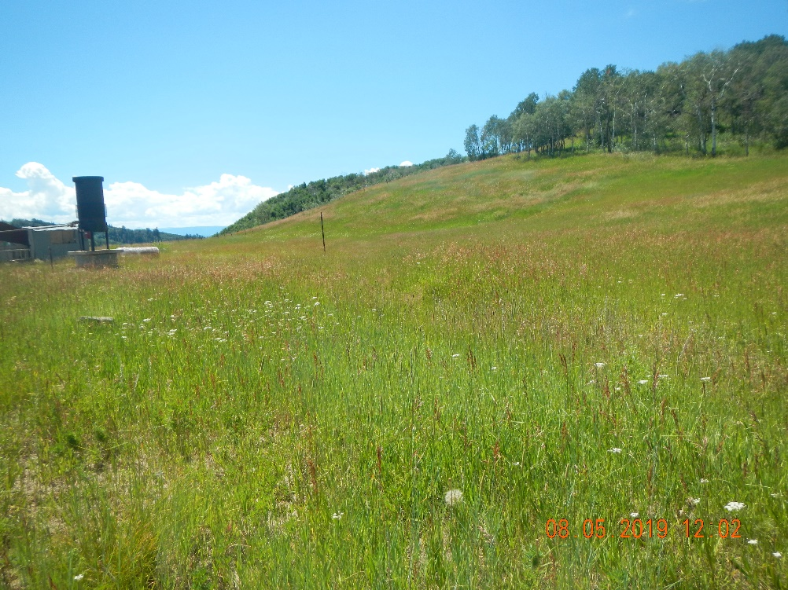
Inspection Photos
Pit Facility 113016
Well 107-06173
Inspection Date: 8/5/2019
Photos taken by Kris Neidel
Photo #11Area of old pit, vegetation consistent with off location vegetation.

Slide 12
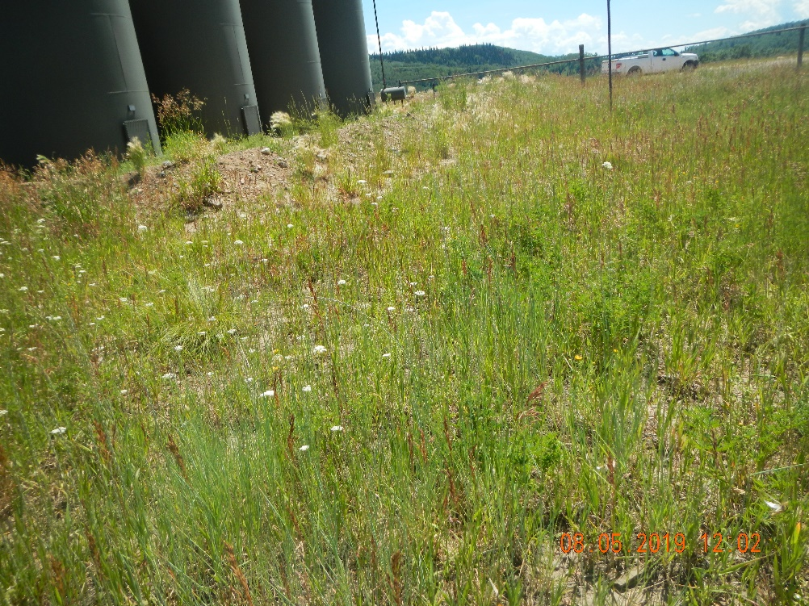
Inspection Photos
Pit Facility 113016
Well 107-06173
Inspection Date: 8/5/2019
Photos taken by Kris Neidel
Photo #12 Area behind tanks, vegetation is thinner than surrounding area.

Slide 13
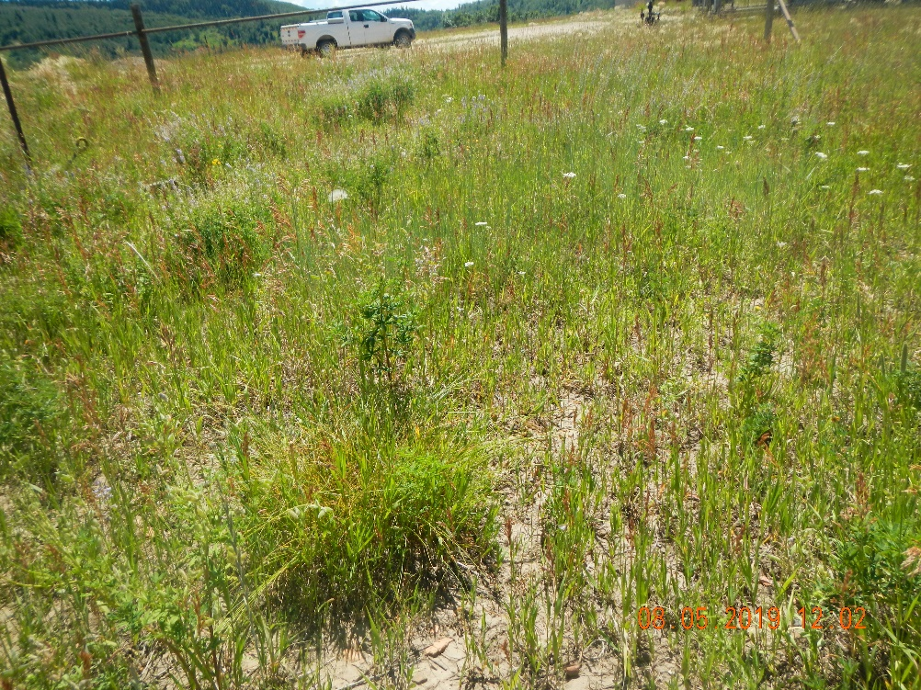
Inspection Photos
Pit Facility 113016
Well 107-06173
Inspection Date: 8/5/2019
Photos taken by Kris Neidel
Photo #13 Area behind tanks, vegetation is thinner than surrounding area.

Slide 14
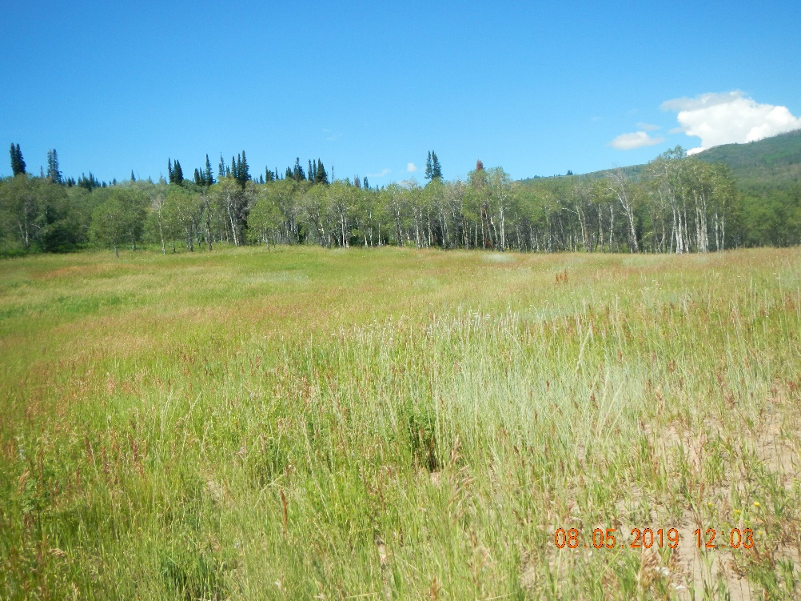
Inspection Photos
Pit Facility 113016
Well 107-06173
Inspection Date: 8/5/2019
Photos taken by Kris Neidel
Photo #14 Area behind tanks. Right of photo, vegetation is thinner than surrounding area.

Slide 15
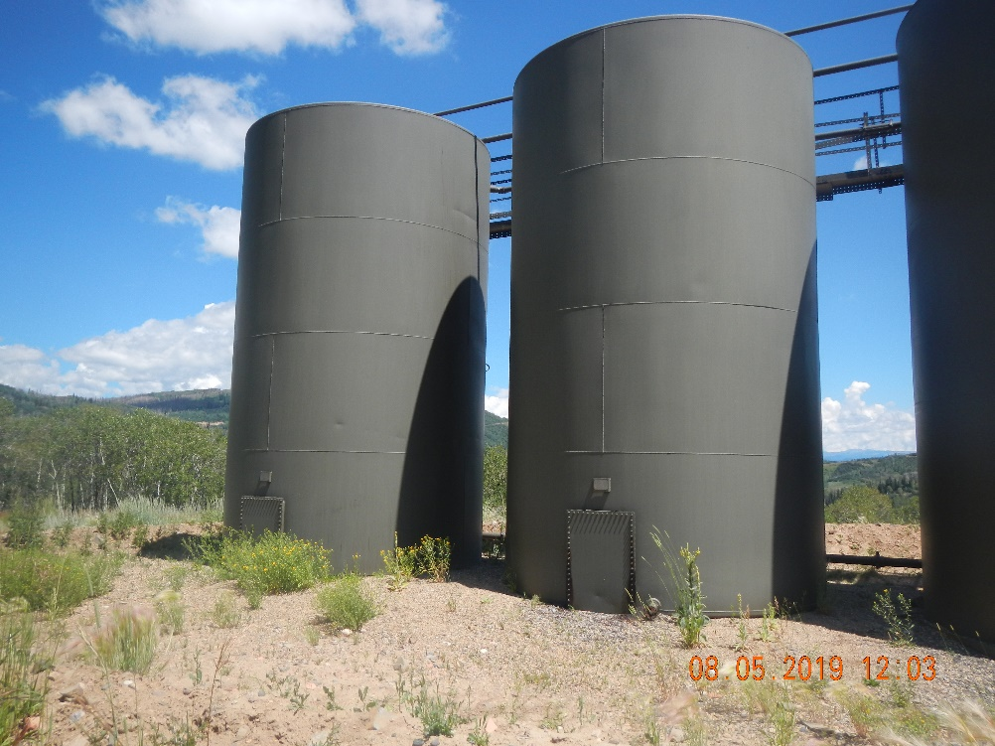
Inspection Photos
Pit Facility 113016
Well 107-06173
Inspection Date: 8/5/2019
Photos taken by Kris Neidel
Photo #15 Tank battery

Slide 16
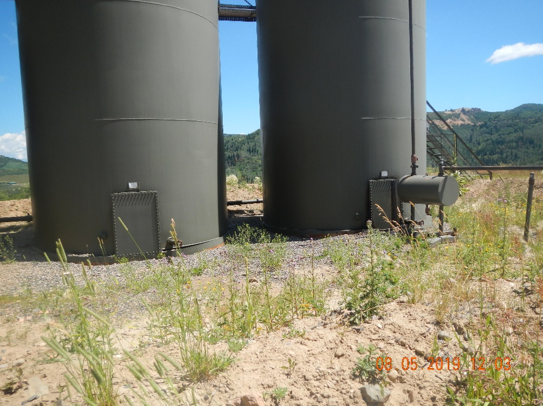
Inspection Photos
Pit Facility 113016
Well 107-06173
Inspection Date: 8/5/2019
Photos taken by Kris Neidel
Photo #16 Tank Battery

Slide 17
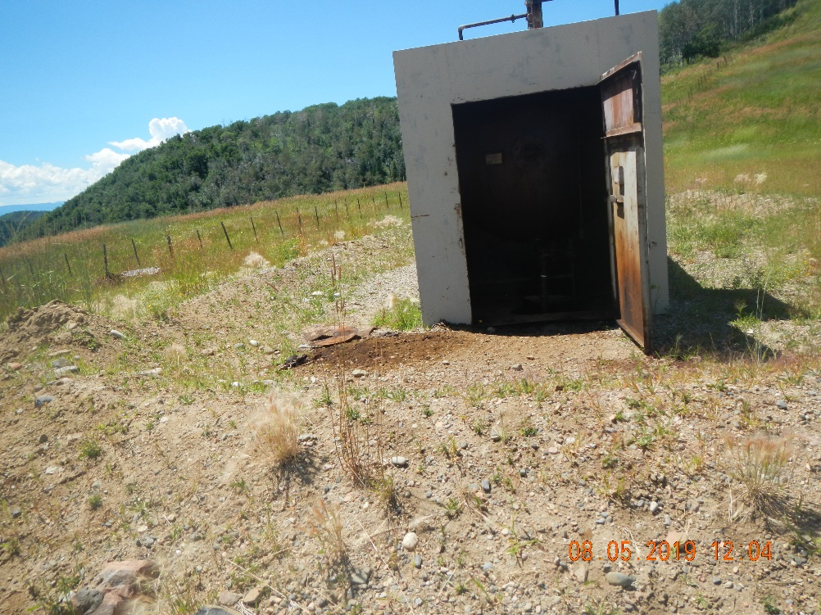
Inspection Photos
Pit Facility 113016
Well 107-06173
Inspection Date: 8/5/2019
Photos taken by Kris Neidel
Photo #17 Oil stained soil near old equipment.

Slide 18
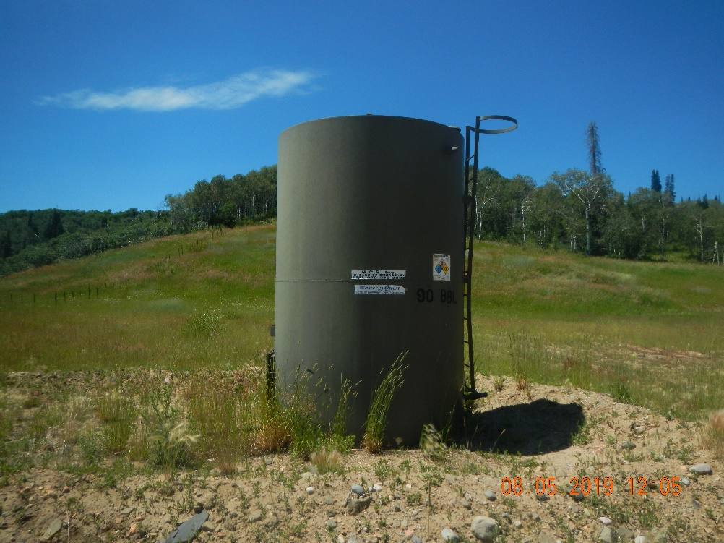
Inspection Photos
Pit Facility 113016
Well 107-06173
Inspection Date: 8/5/2019
Photos taken by Kris Neidel
Photo #18 secondary tank battery

