Slide 1
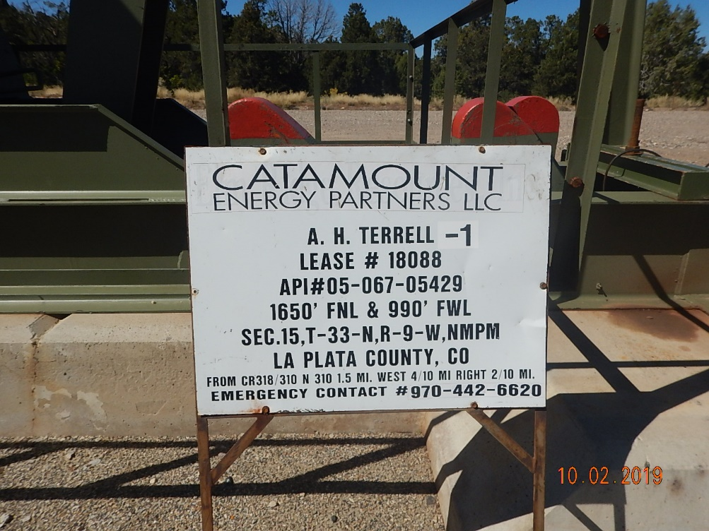
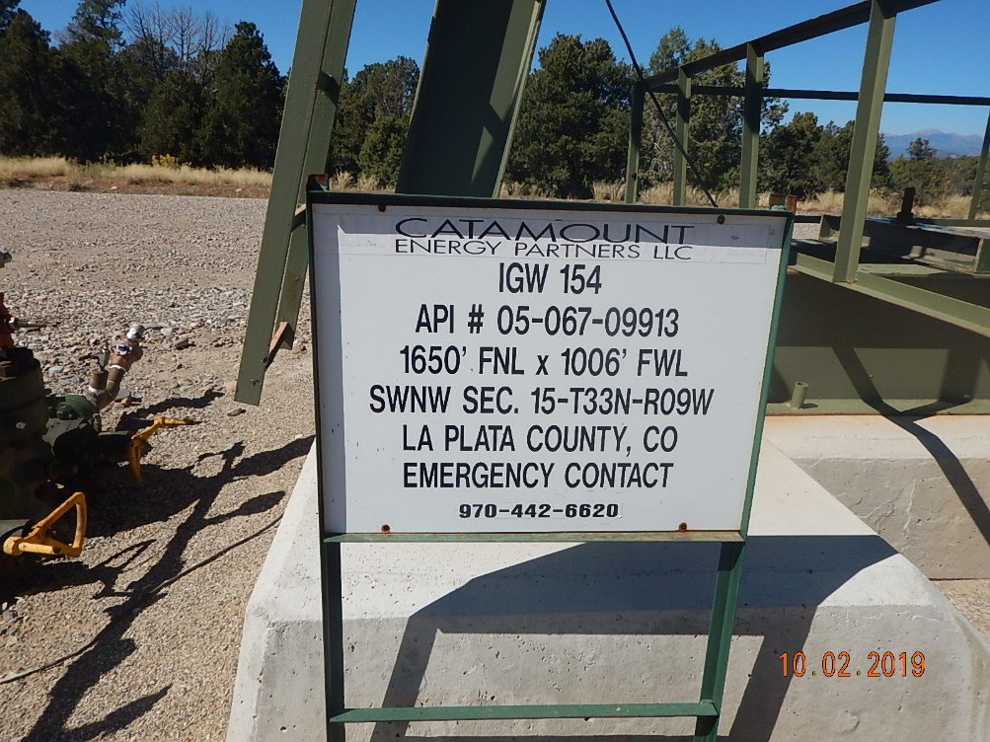
Inspection Photos
Catamount
Location Name: AH Terrell 1
Location ID: 005-067-05429
Photo #1 Update sign local EMS/911.
Phot #2 Update sign local EMS/911.

Slide 2
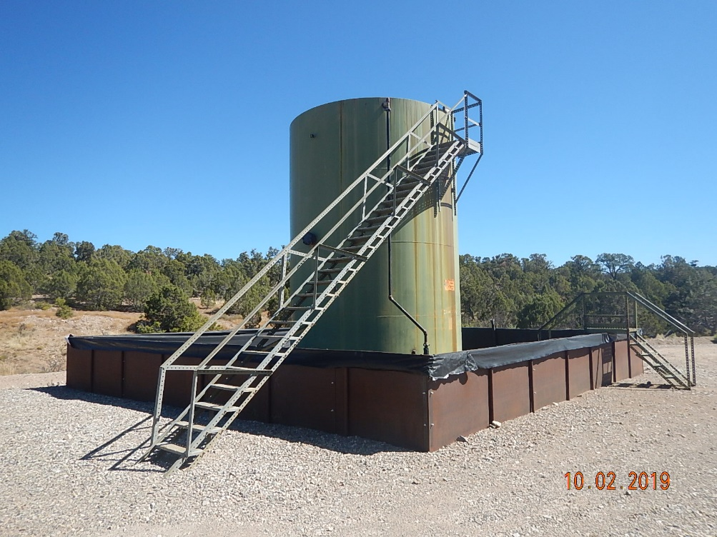
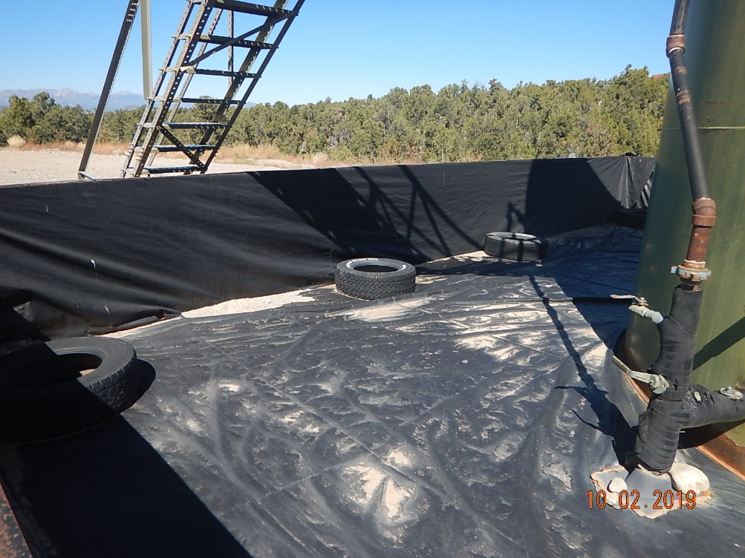
Inspection Photos
Catamount
Location Name: AH Terrell 1
Location ID: 005-067-05429
Photo #3 Tank battery and secondary containment overview.
Photo #4 Tires/trash along northern wall of containment.

Slide 3
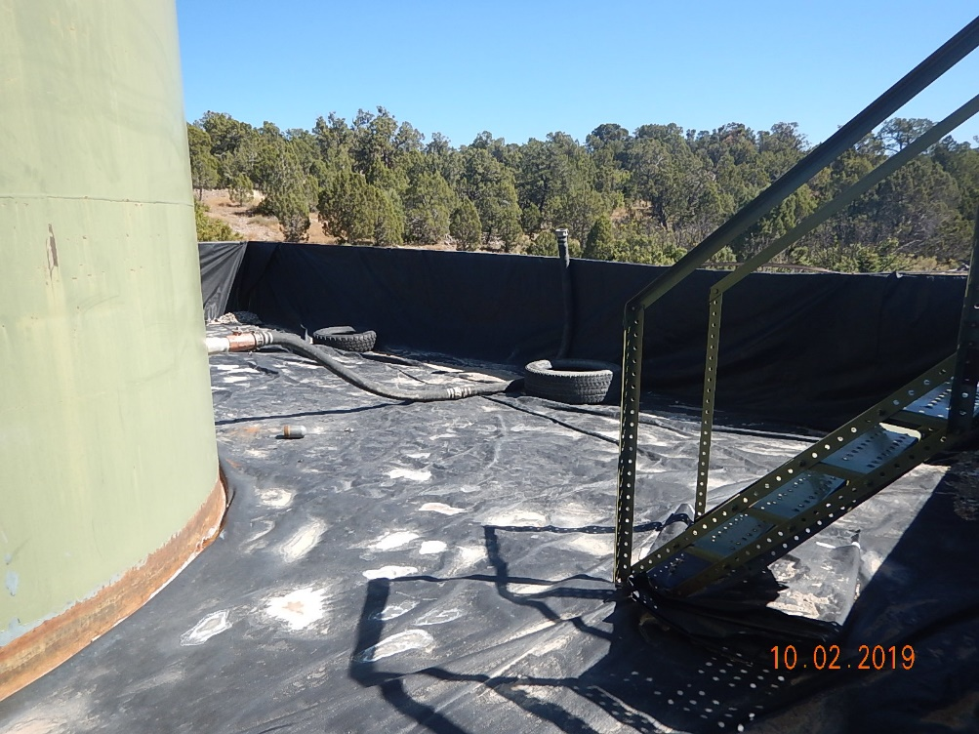
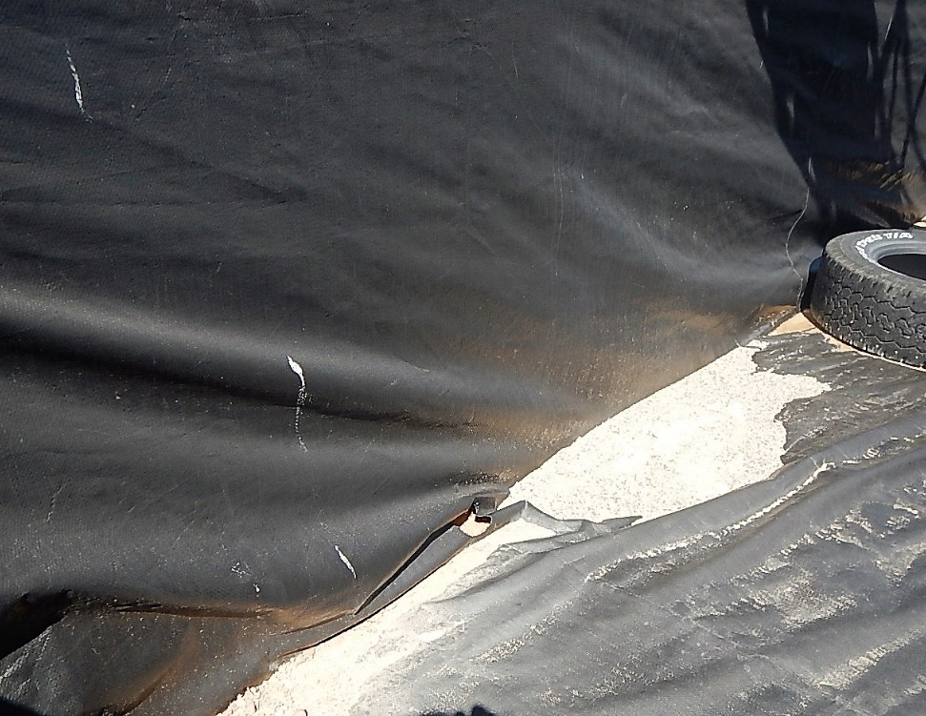
Inspection Photos
Catamount
Location Name: AH Terrell 1
Location ID: 005-067-05429
Photo #5 Tires/trash along southern wall of containment.
Photo #6 Hole in liner base along southern wall.

Slide 4
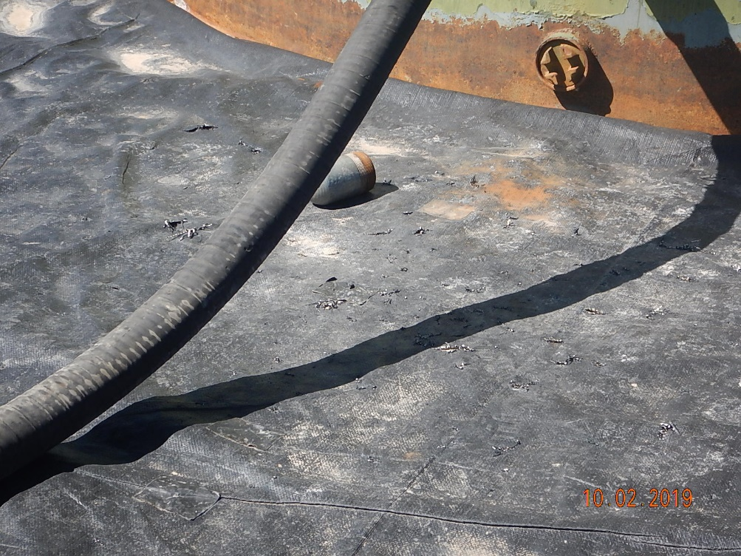
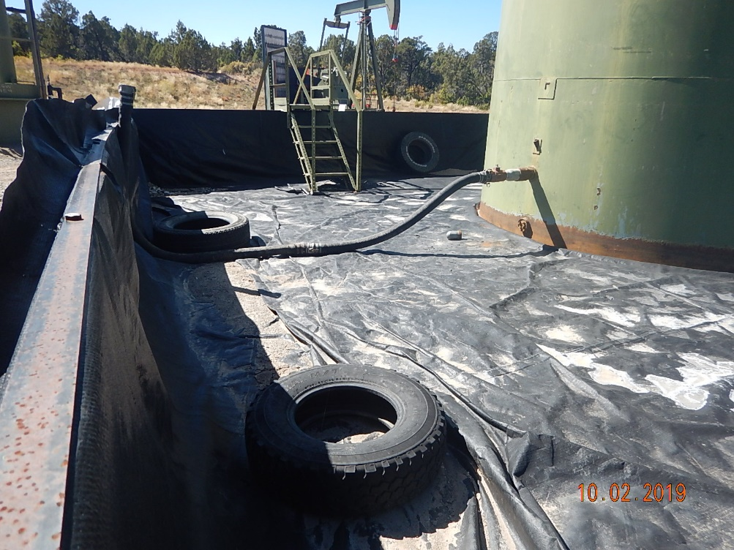
Inspection Photos
Catamount
Location Name: AH Terrell 1
Location ID: 005-067-05429
Photo #7 Multiple holes in liner base below quick disconnect hose coupling on tank.
Photo #8 Tires/trash along southern and western walls of containment.

