Slide 1
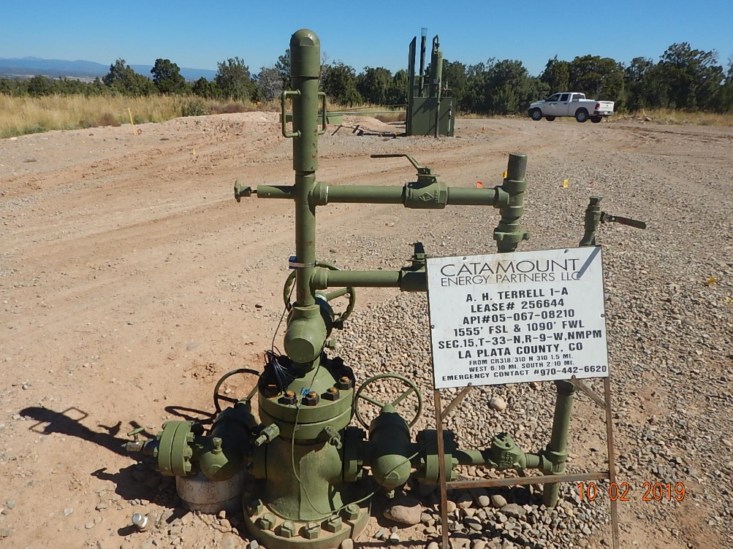
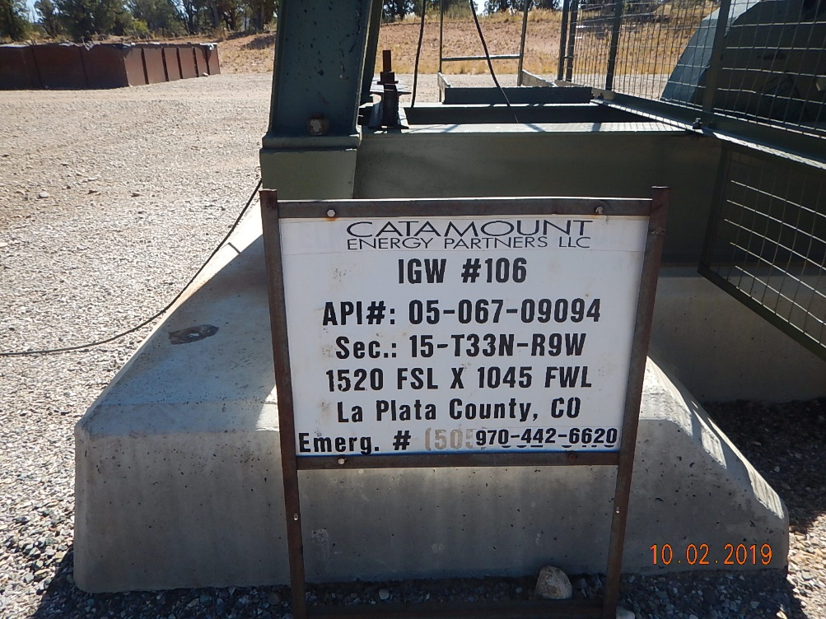
Inspection Photos
Catamount
Location Name: AH Terrell 1-A
Location ID: 005-067-08210
Photo #1 Update sign local EMS/911.
Photo #2 Update sign local EMS/911.

Slide 2
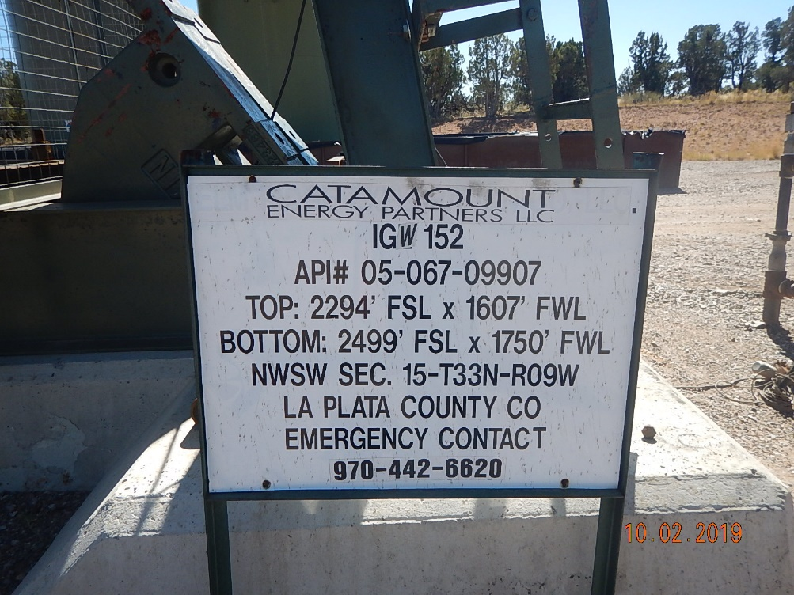
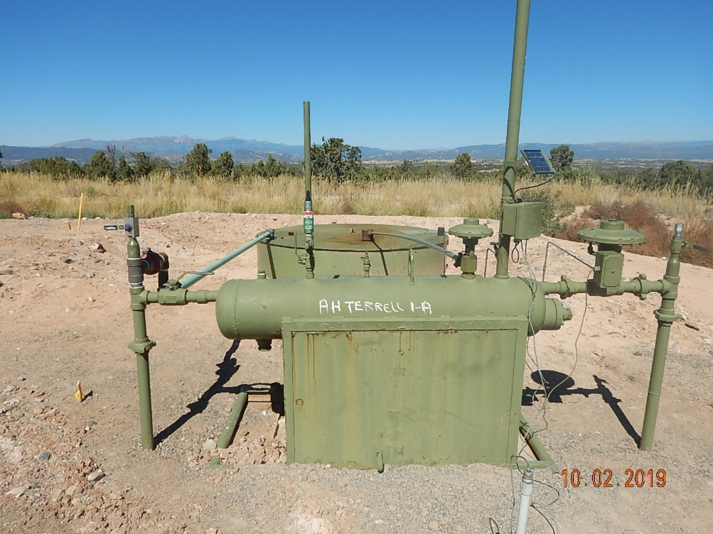
Inspection Photos
Catamount
Location Name: AH Terrell 1-A
Location ID: 005-067-08210
Photo #3 Update sign local EMS/911.
Photo #4 Produced water tank with no labels/placards.

Slide 3
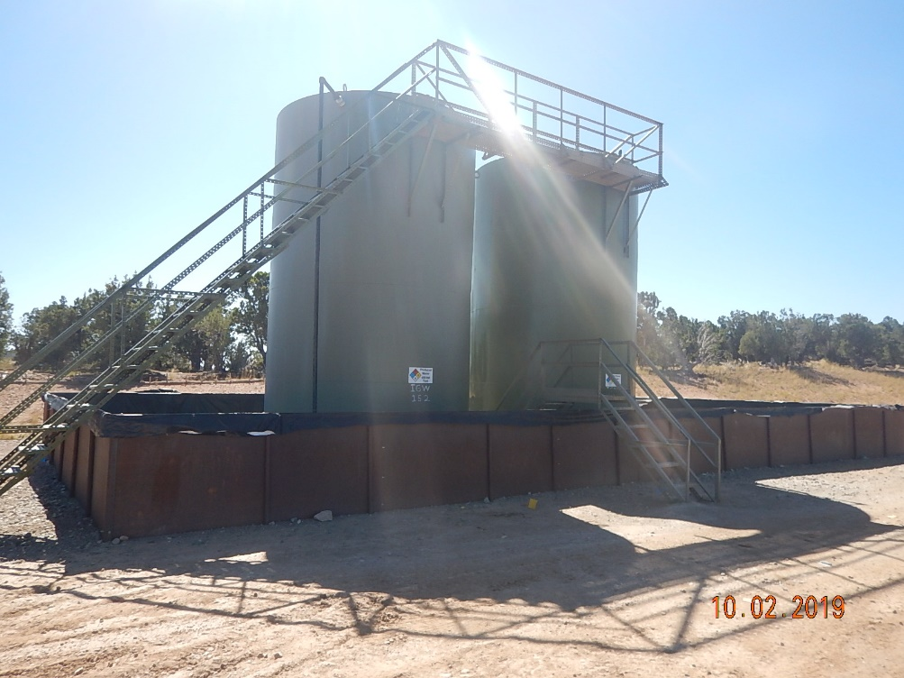
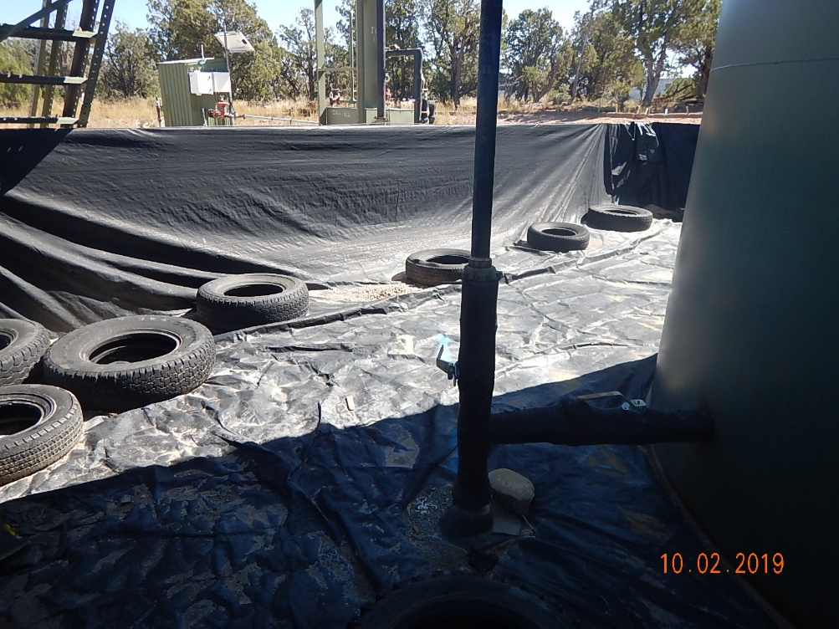
Inspection Photos
Catamount
Location Name: AH Terrell 1-A
Location ID: 005-067-08210
Photo #5 Tank battery and containment overview.
Photo #6 Tires/trash along eastern wall of containment.

Slide 4
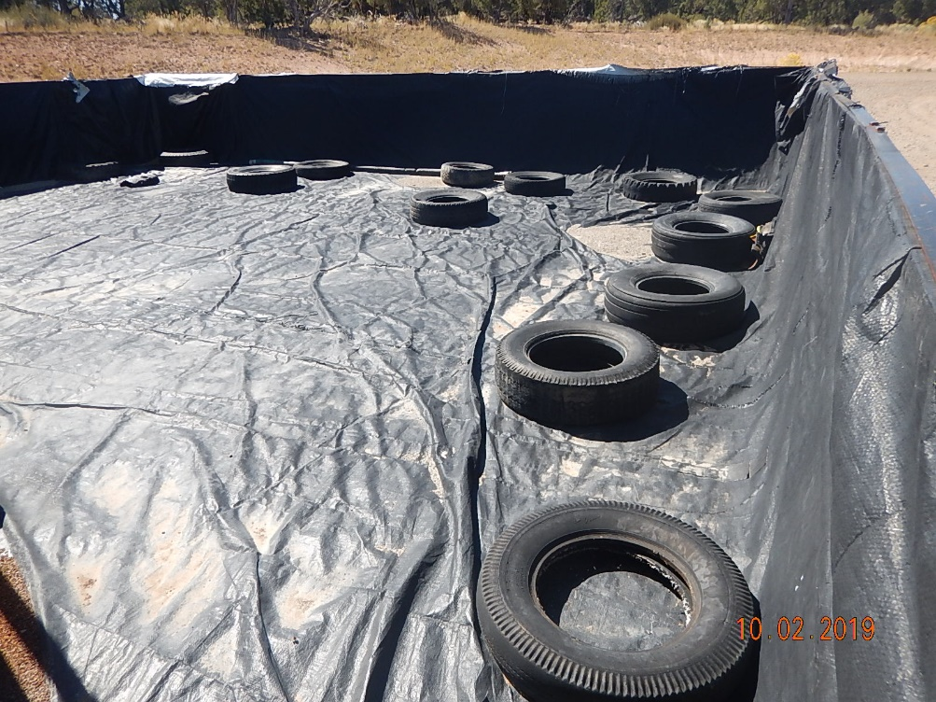
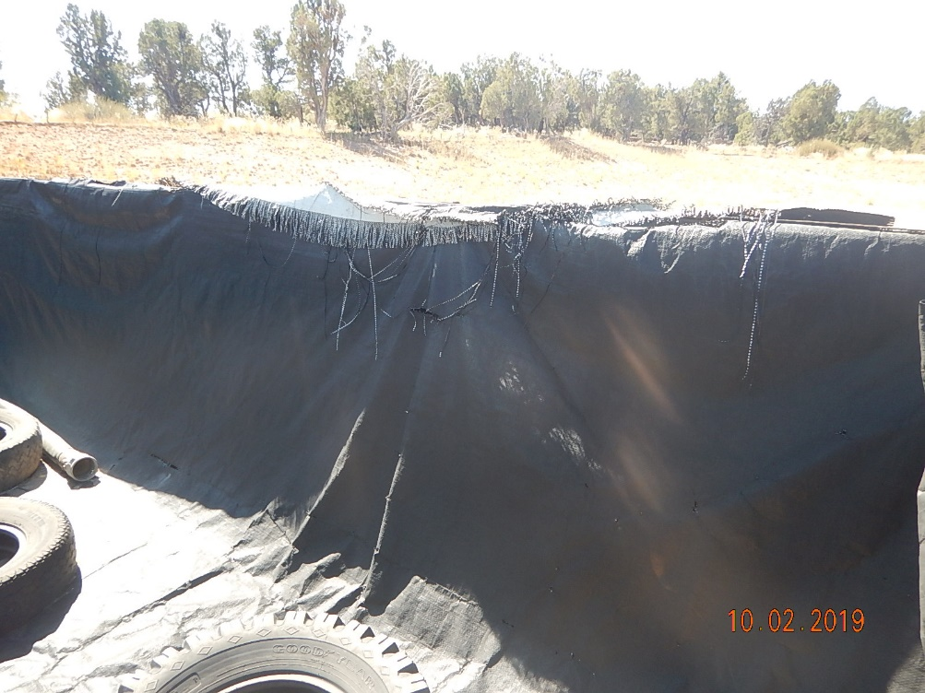
Inspection Photos
Catamount
Location Name: AH Terrell 1-A
Location ID: 005-067-08210
Photo #7 Tires/trash along northern and western sides of containment. Rip/tear in liner.
Photo #8 Rips/tears/holes in liner along western portions of containment.

Slide 5
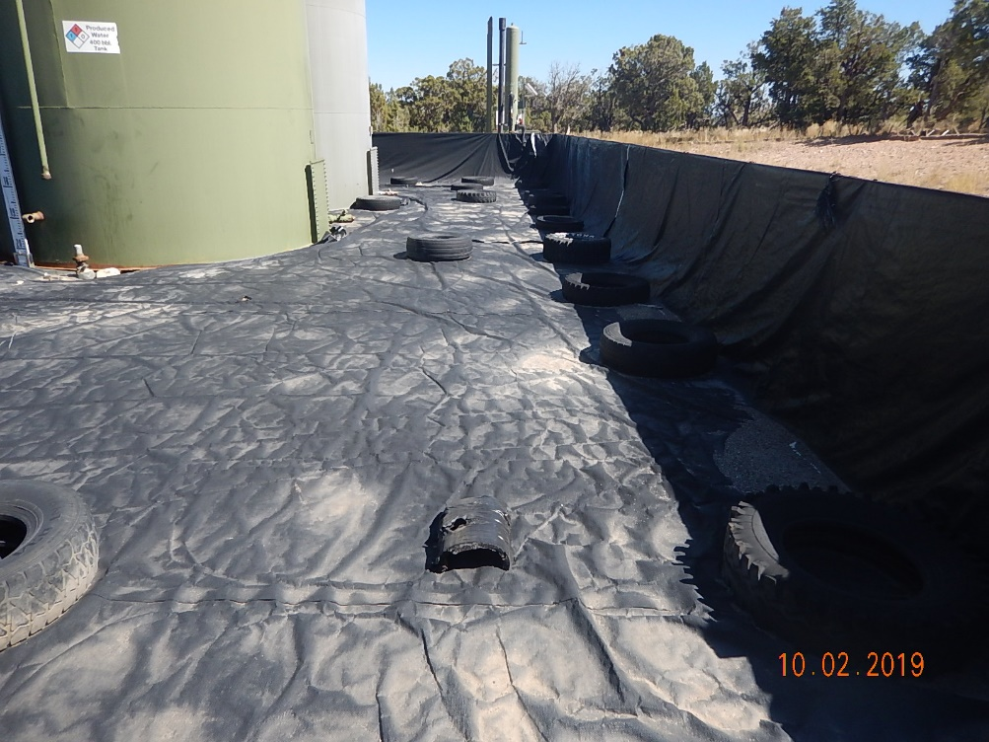
Inspection Photos
Catamount
Location Name: AH Terrell 1-A
Location ID: 005-067-08210
Photo #9 Tires/trash along southern containment wall.

