Slide 1
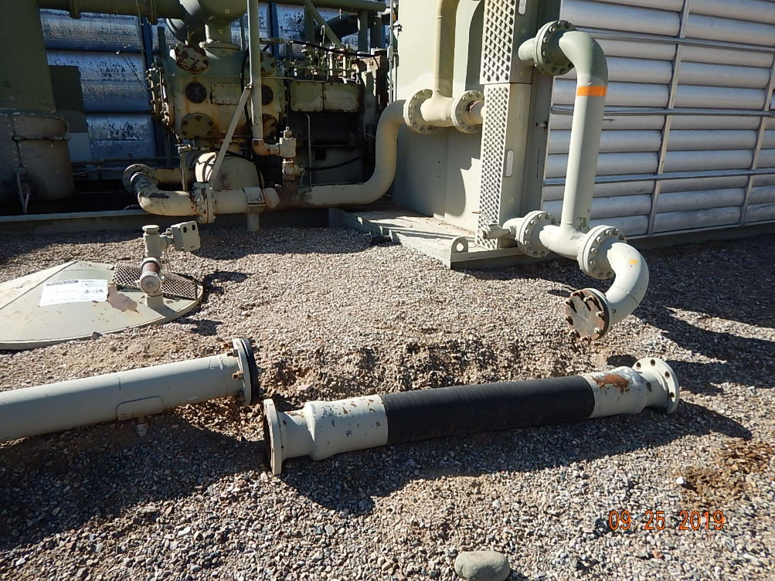
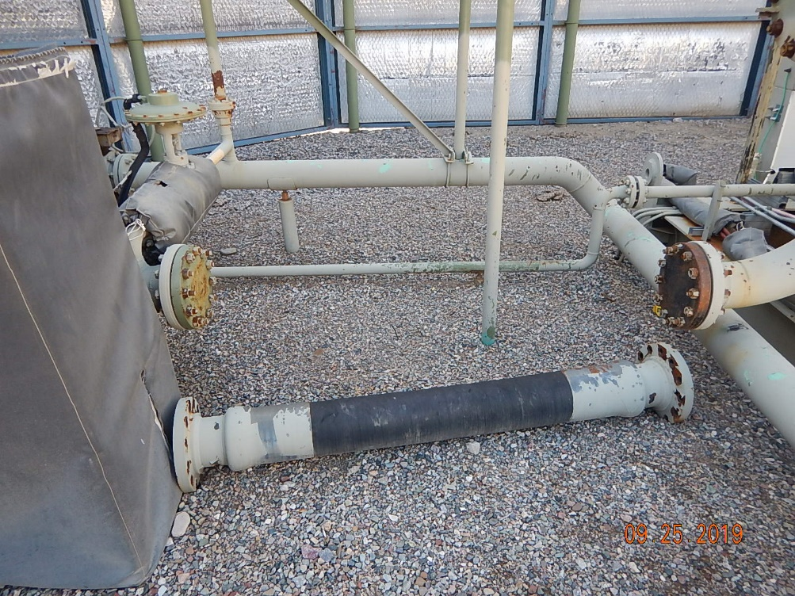
Inspection Photos
BP
Location Name: Cyrus Johnson A1
Location ID:005-067-07465
Photo #1 Disconnected flowlines from compressor discharge and blind flanges installed.
Photo #2 Disconnected flowlines from compressor suction and blind flanges installed.

Slide 2
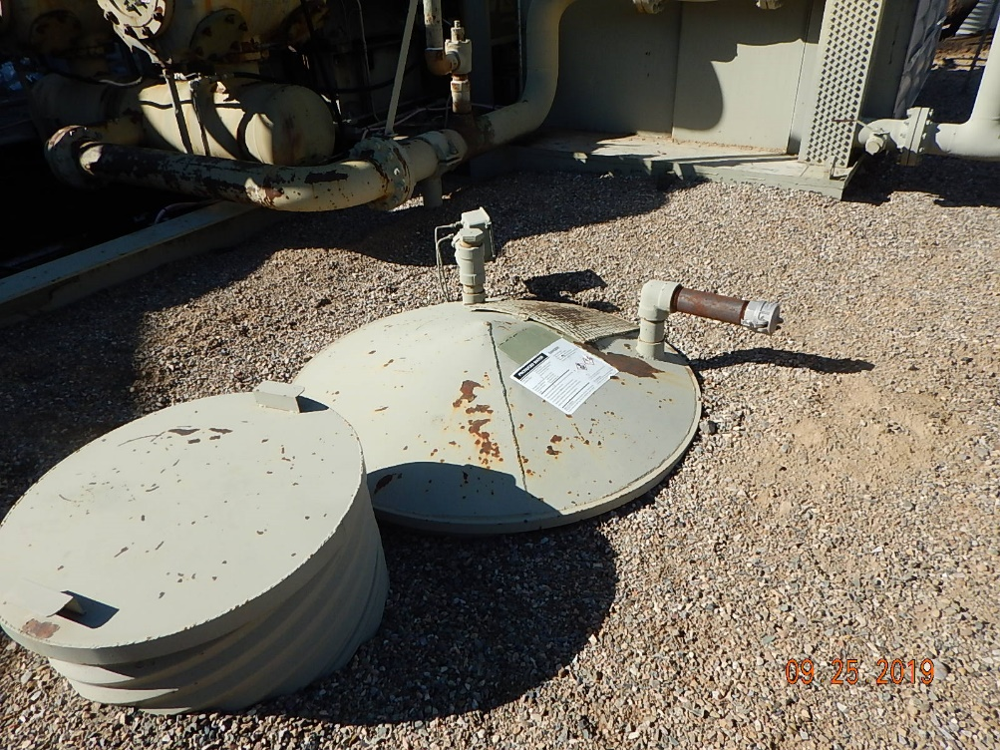
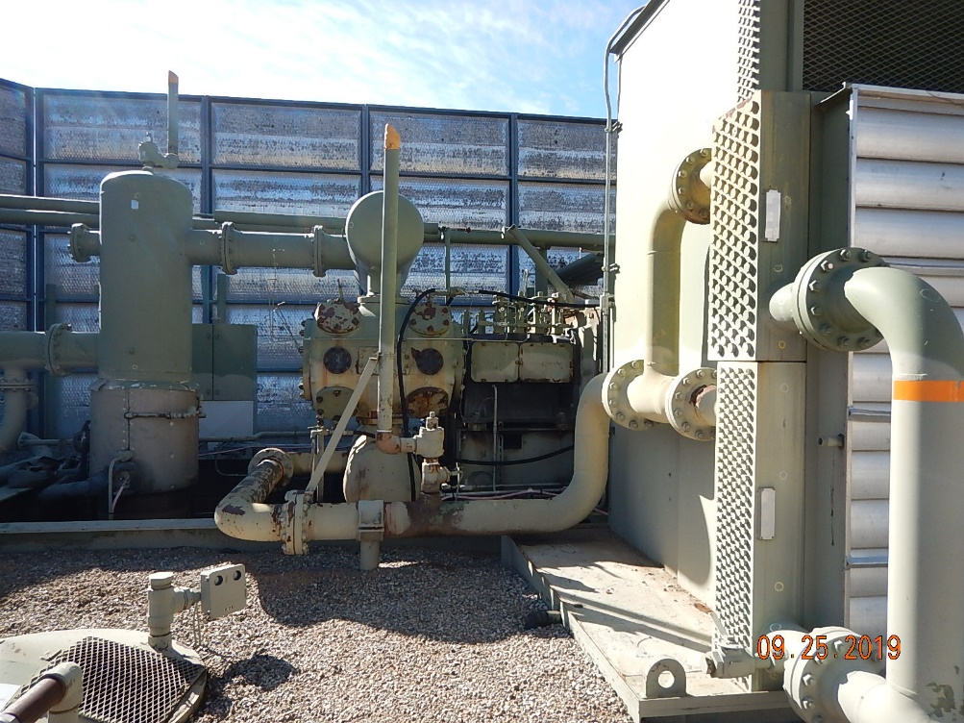
Inspection Photos
BP
Location Name: Cyrus Johnson A1
Location ID:005-067-07465
Photo #3 Compressor PVB not in use.
Photo #4 Compressor and cooler bay not in use.

Slide 3
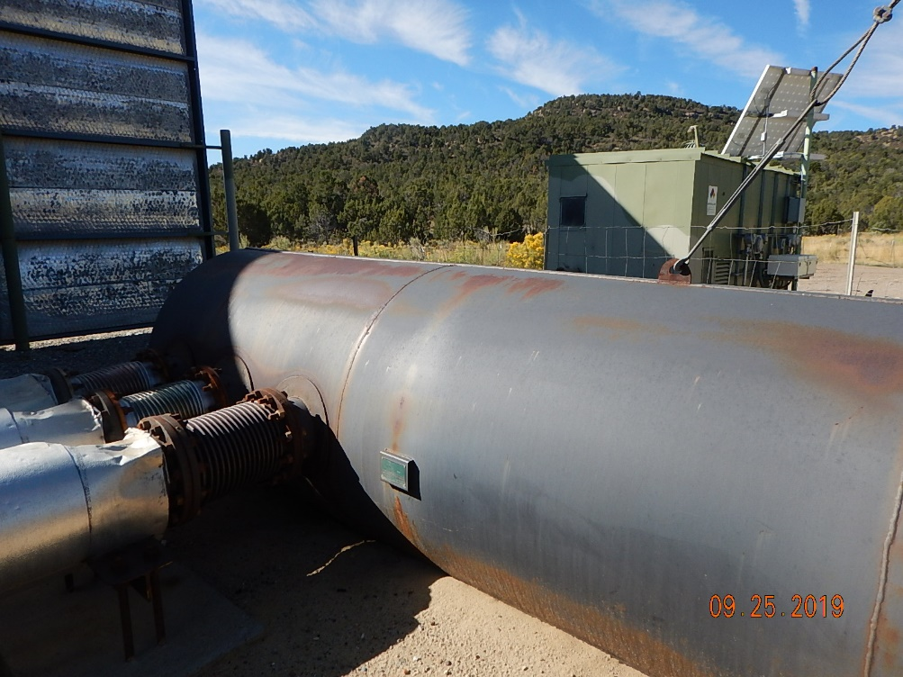
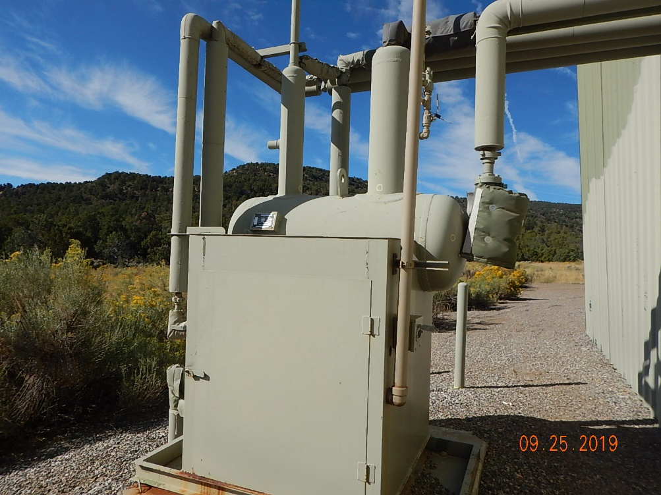
Inspection Photos
BP
Location Name: Cyrus Johnson A1
Location ID:005-067-07465
Photo #5 Compressor exhaust manifold and muffler not in use.
Photo #6 Compressor knockout pot and flowlines not in use.

