Slide 1
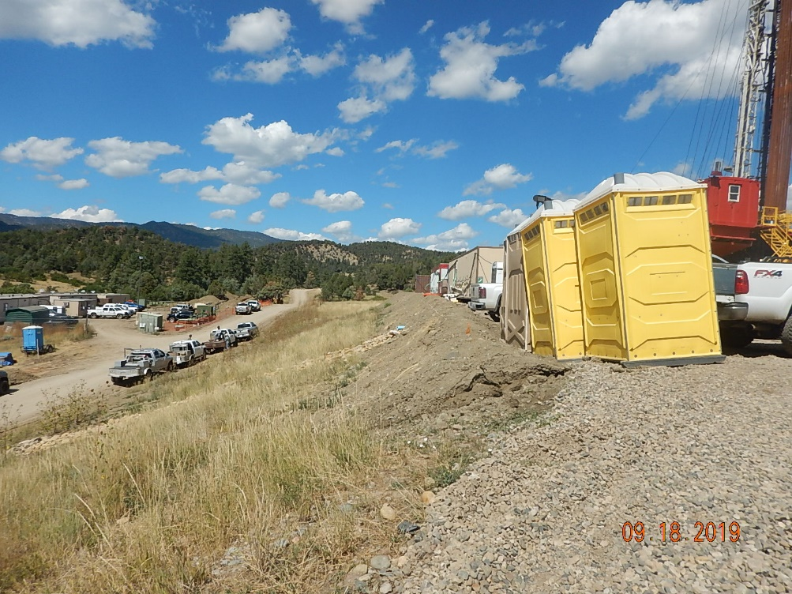
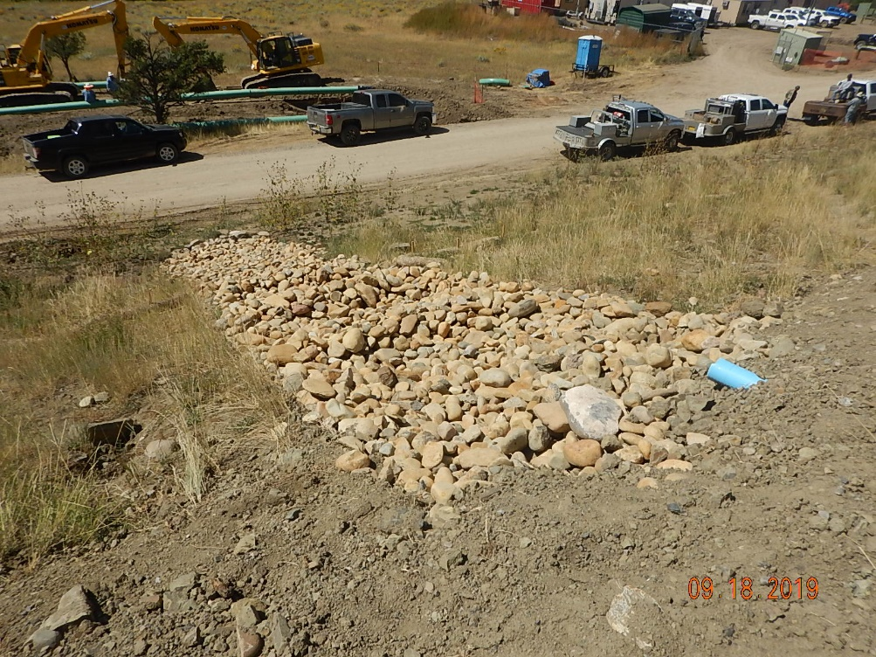
Inspection Photos
Catamount
Location Name: Tabor #1
Location ID: 005-007-06220
#1 Southwest corner of location looking North.
#2 Stormwater control along Western berm of project area.

Slide 2
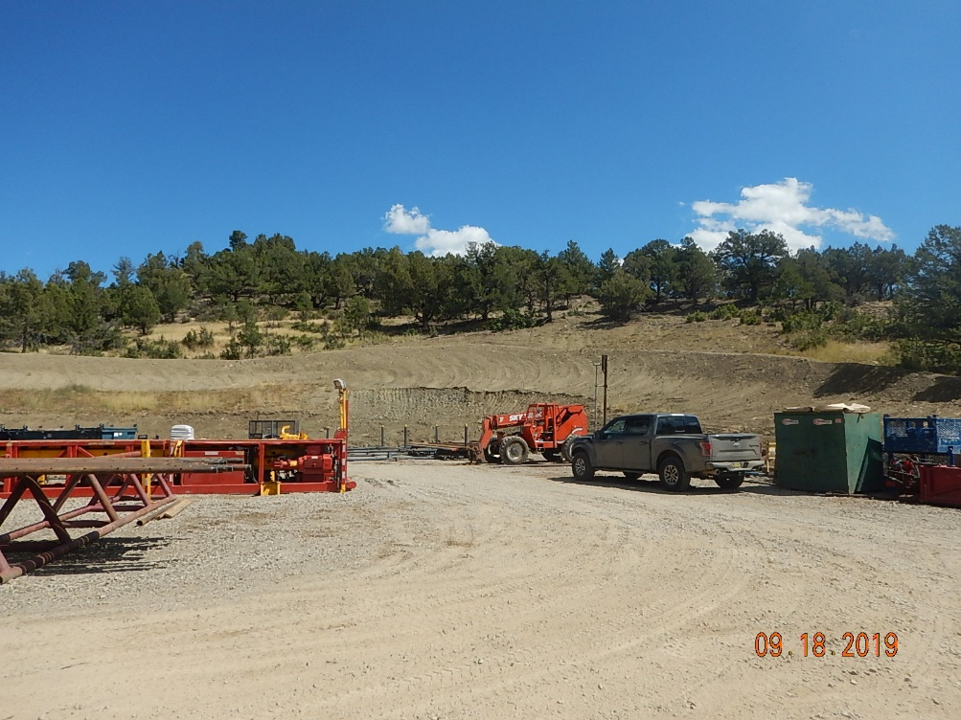
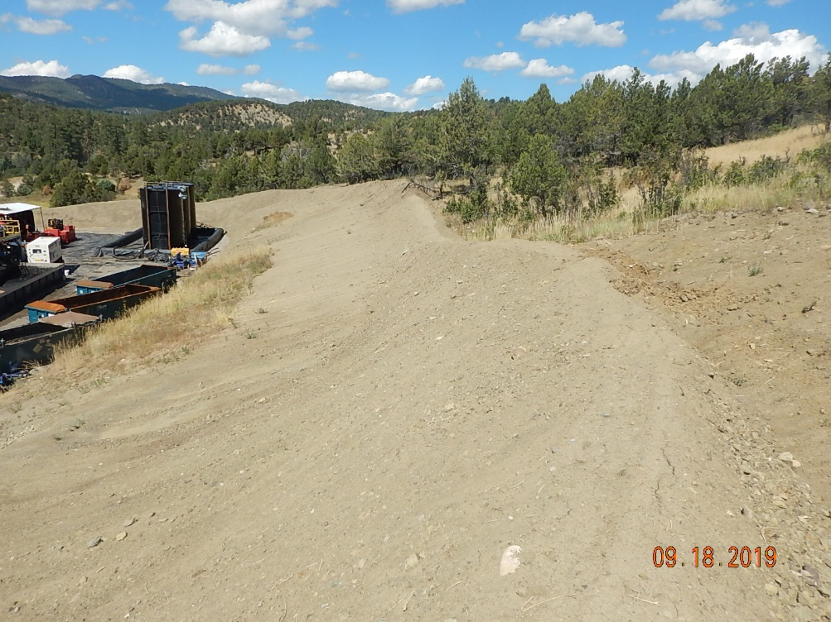
Inspection Photos
Catamount
Location Name: Tabor #1
Location ID: 005-007-06220
#3 Southwest corner of location looking to the East.
#4 Southeast corner of project area looking North along cut slope and berm.

Slide 3
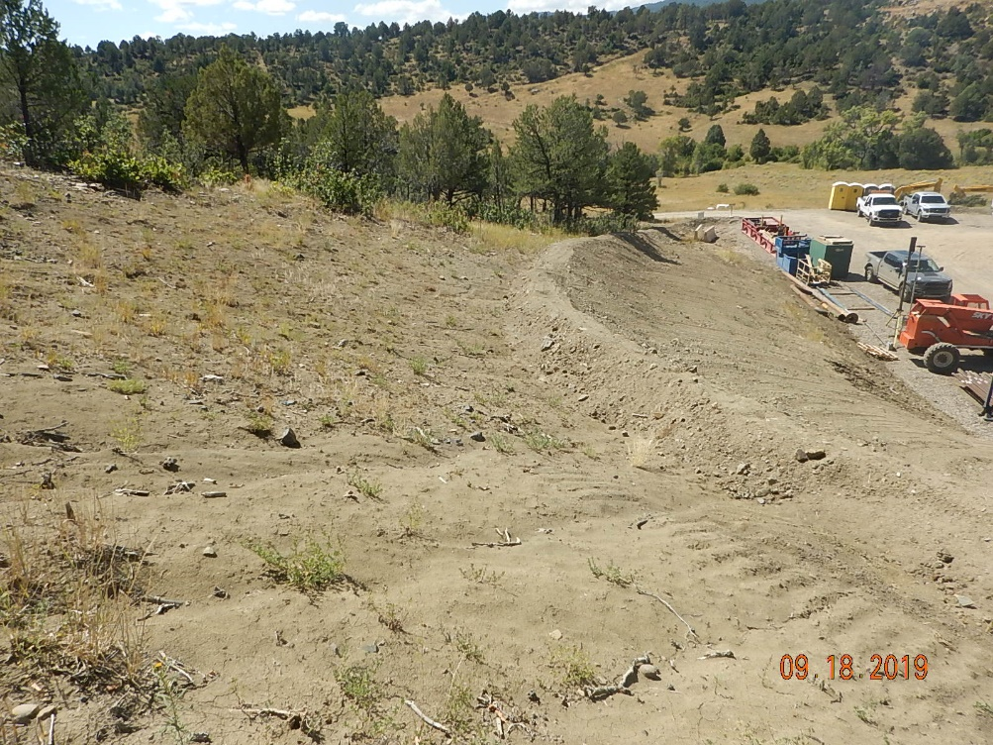
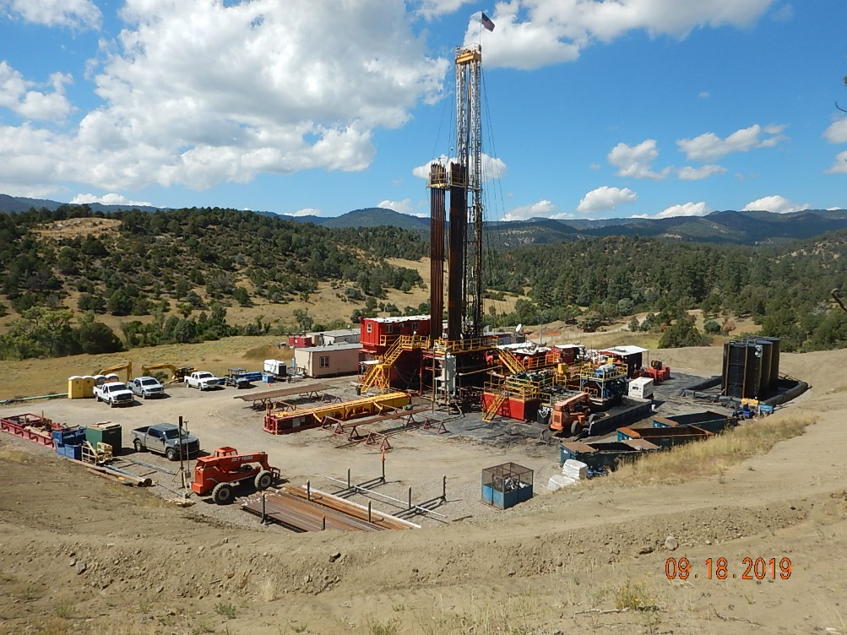
Inspection Photos
Catamount
Location Name: Tabor #1
Location ID: 005-007-06220
#5 Southeast corner of project area looking Southwest along cut slope and berm.
Overview of project area.

