Slide 1
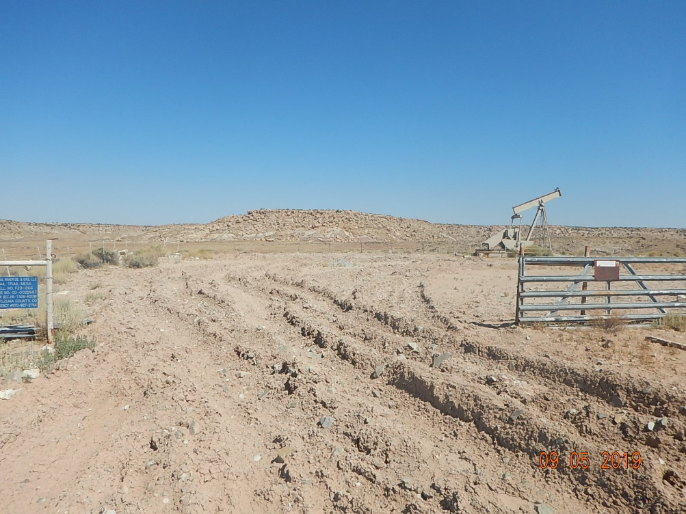
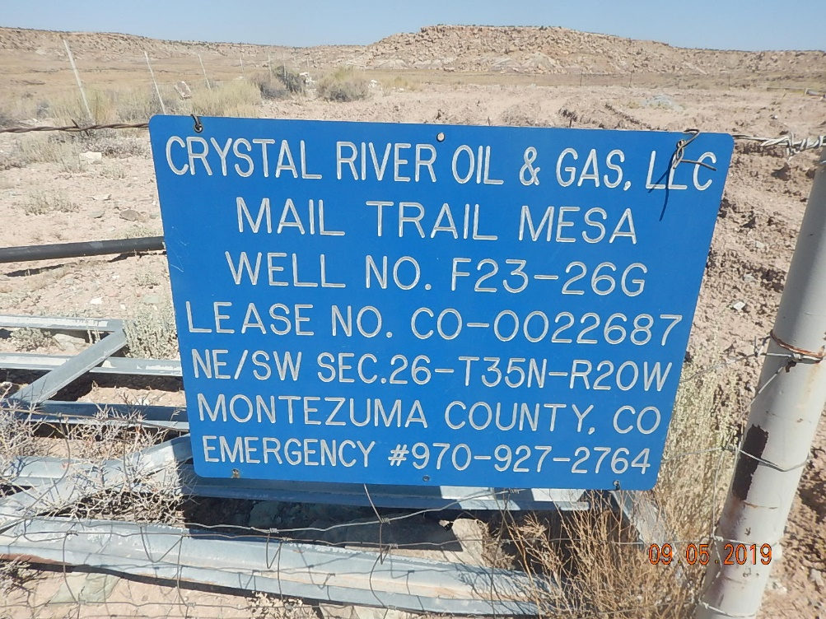
Inspection Photo
KC Resources
Mail Trail Mesa F23-26G
API: 05-083-06494
Photo #1 Location entrance heavily rutted.
Photo #2 Location sign posted at entrance does not reflect current operator. Contact information reflects KC resource when dialed.

Slide 2
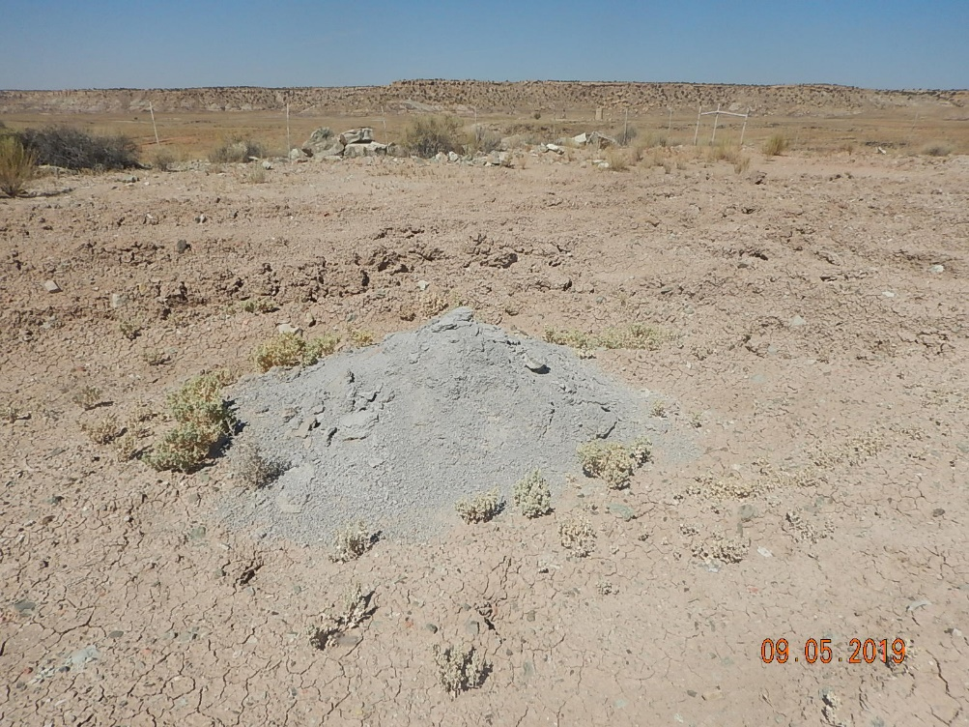
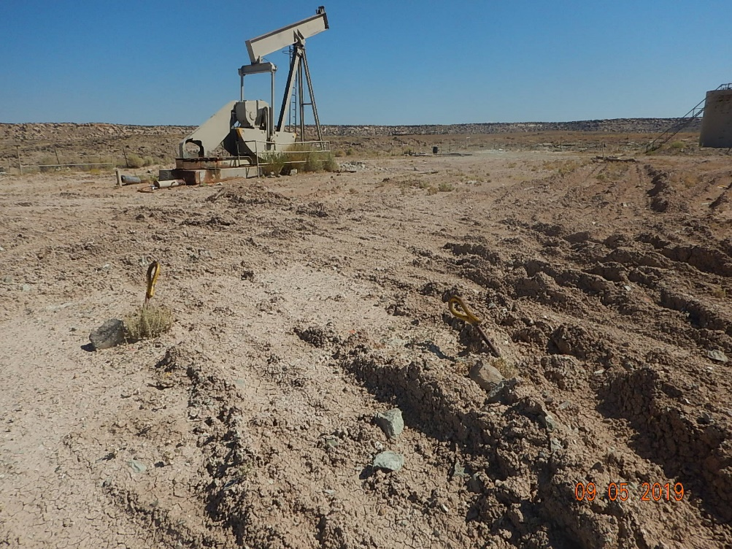
Inspection Photo
KC Resources
Mail Trail Mesa F23-26G
API: 05-083-06494
Photo #3 Cement pile left from plugging operations.
Photo #4 Unused equipment onsite. Heavily rutted location.

Slide 3
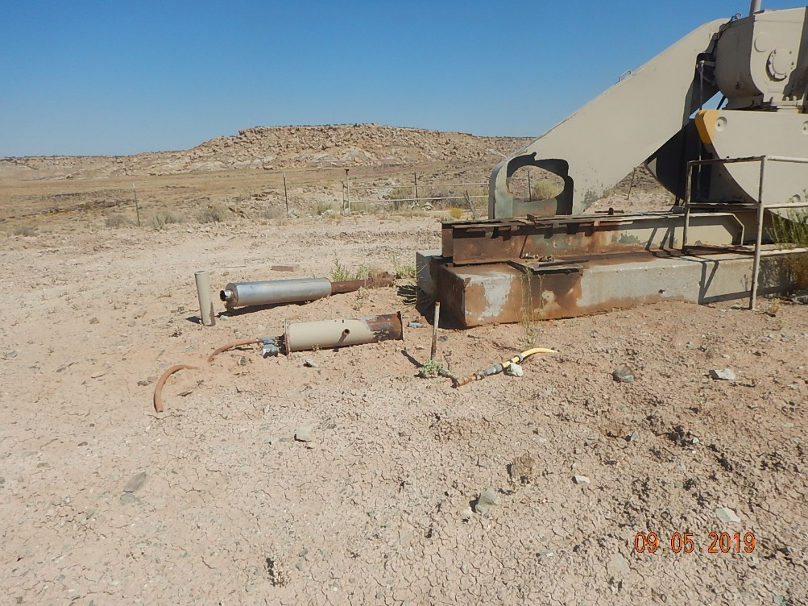
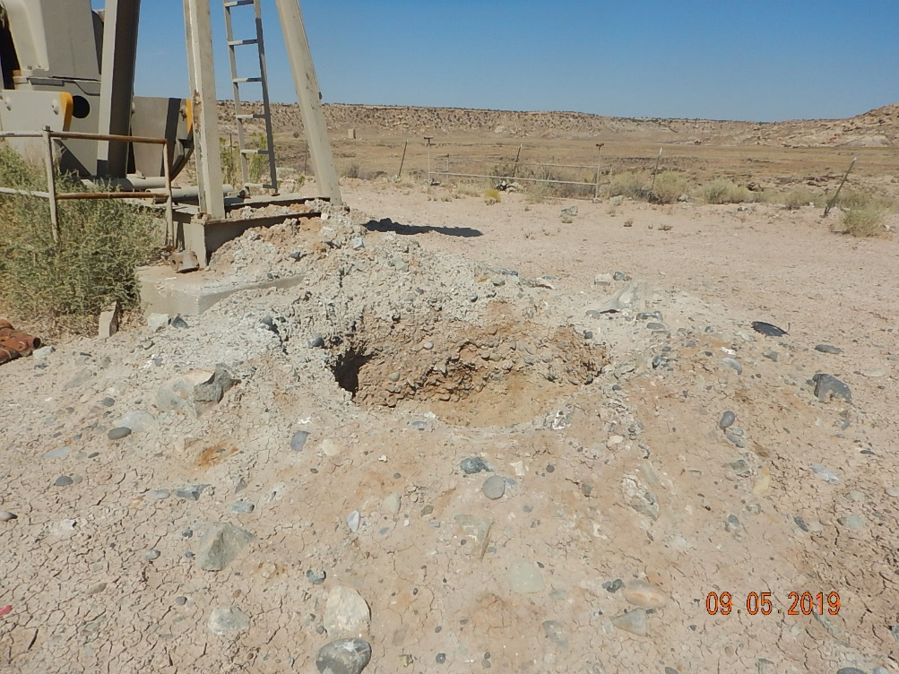
Inspection Photo
KC Resources
Mail Trail Mesa F23-26G
API: 05-083-06494
Photo #5 Driver removed with unused flowlines and equipment.
Photo #6 Open hole where wellhead was plugged.

Slide 4
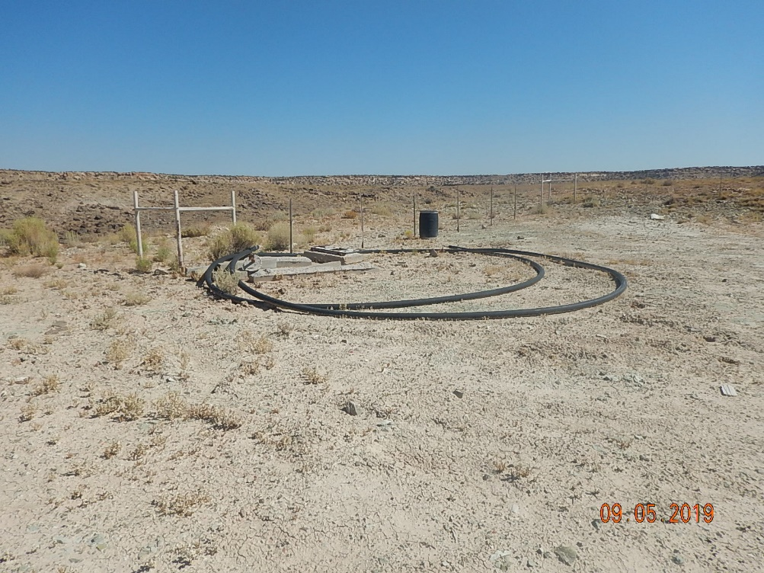
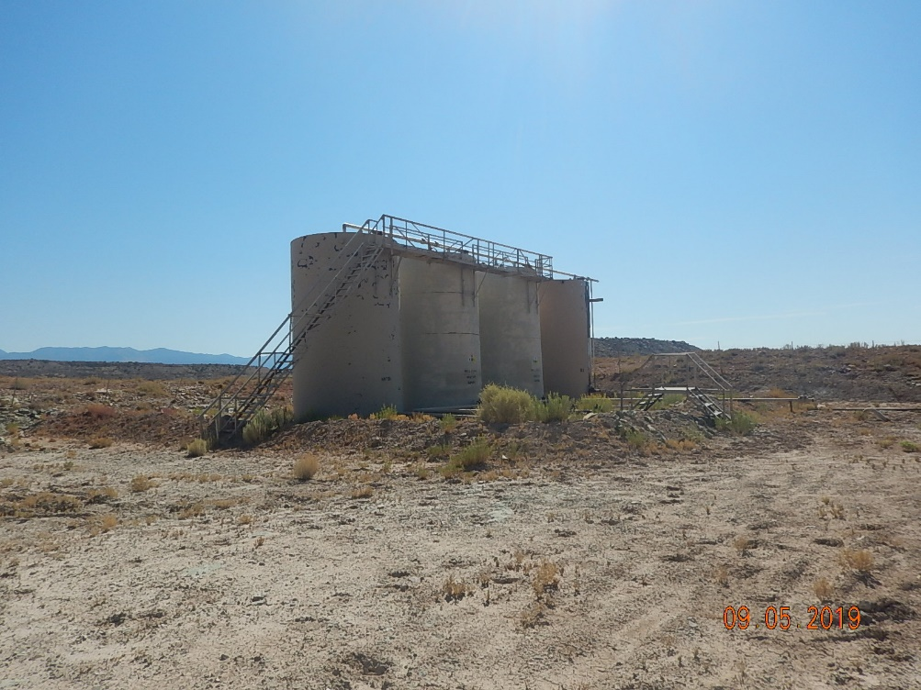
Inspection Photo
KC Resources
Mail Trail Mesa F23-26G
API: 05-083-06494
Photo #7 Debris on location.
Photo#8 Tank battery on location.

Slide 5
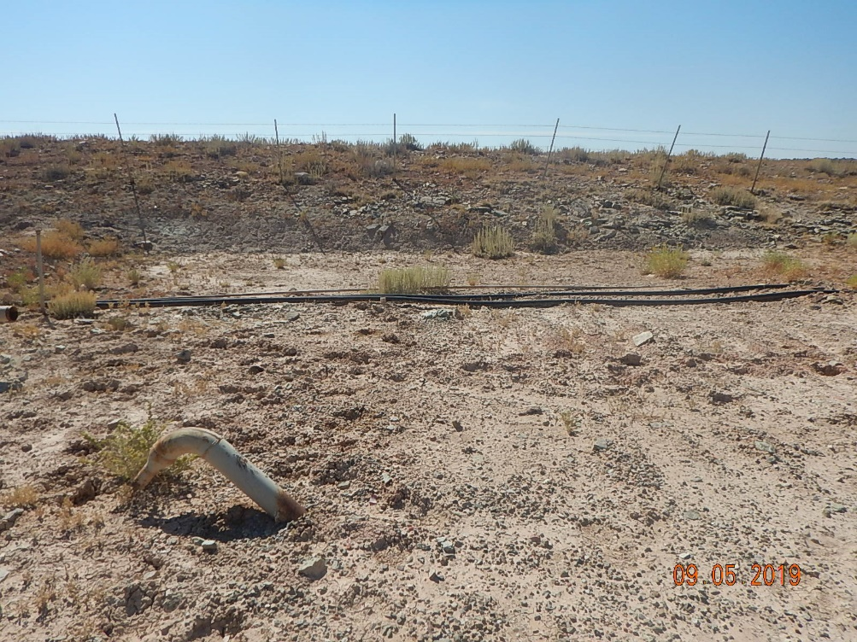
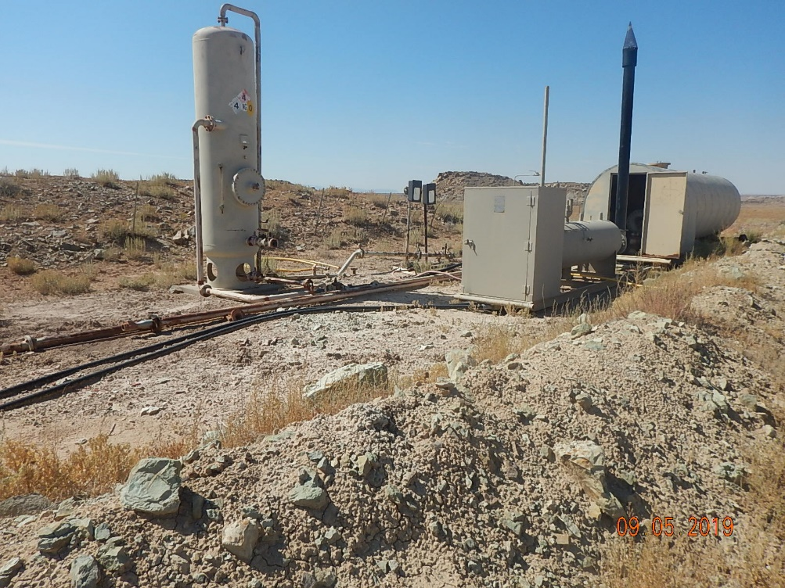
Inspection Photo
KC Resources
Mail Trail Mesa F23-26G
API: 05-083-06494
Photo #9 Unused flowlines on location.
Photo #10 Unused equipment and flowlines on location.

Slide 6
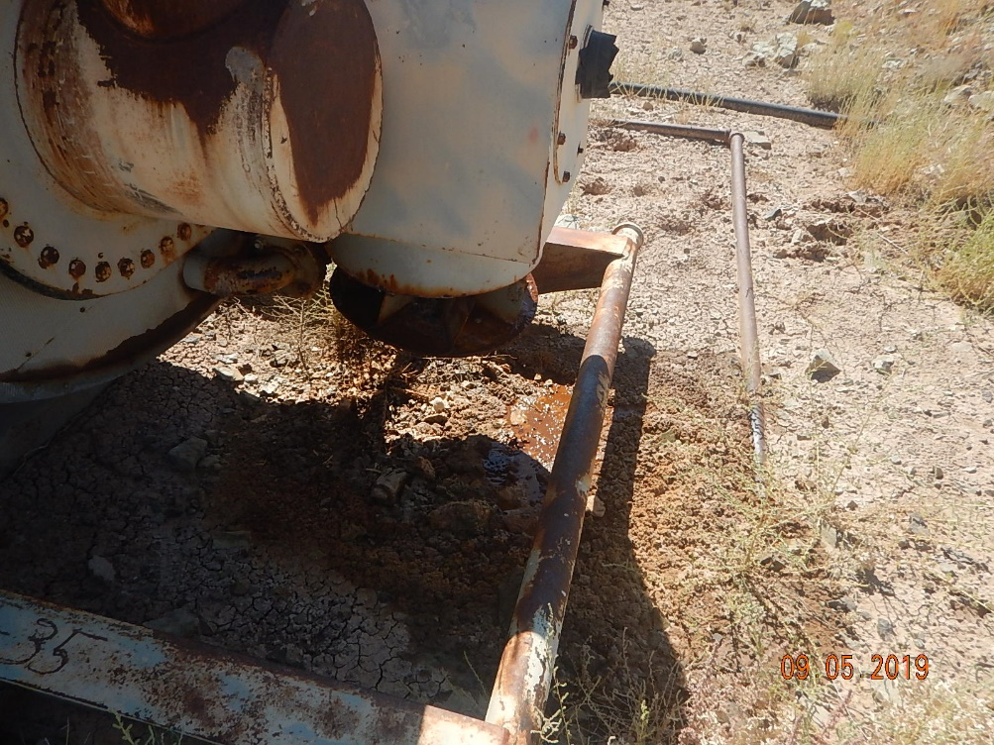
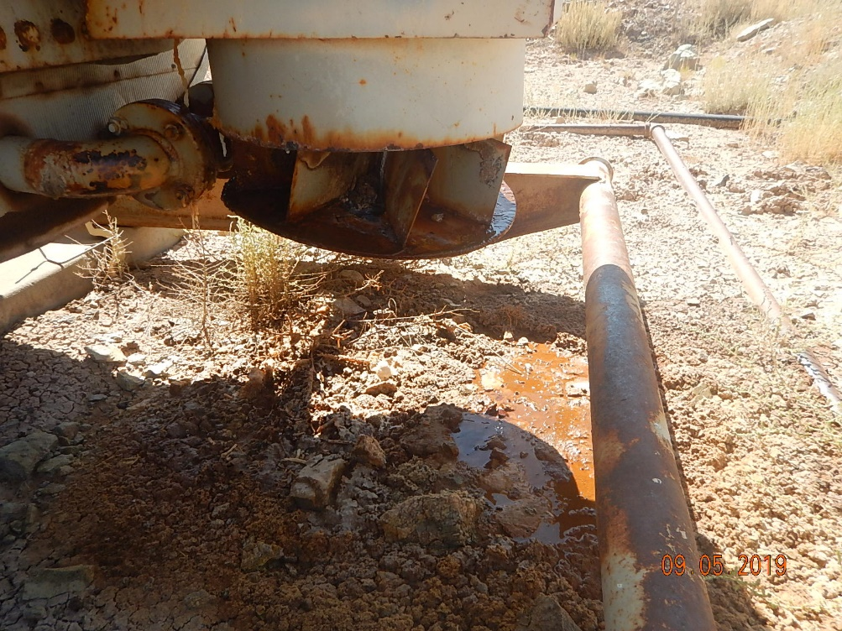
Inspection Photo
KC Resources
Mail Trail Mesa F23-26G
API: 05-083-06494
Photo #11 Separator leaking fluid out on ground.
Photo #12 Fluid leak from separator.

Slide 7
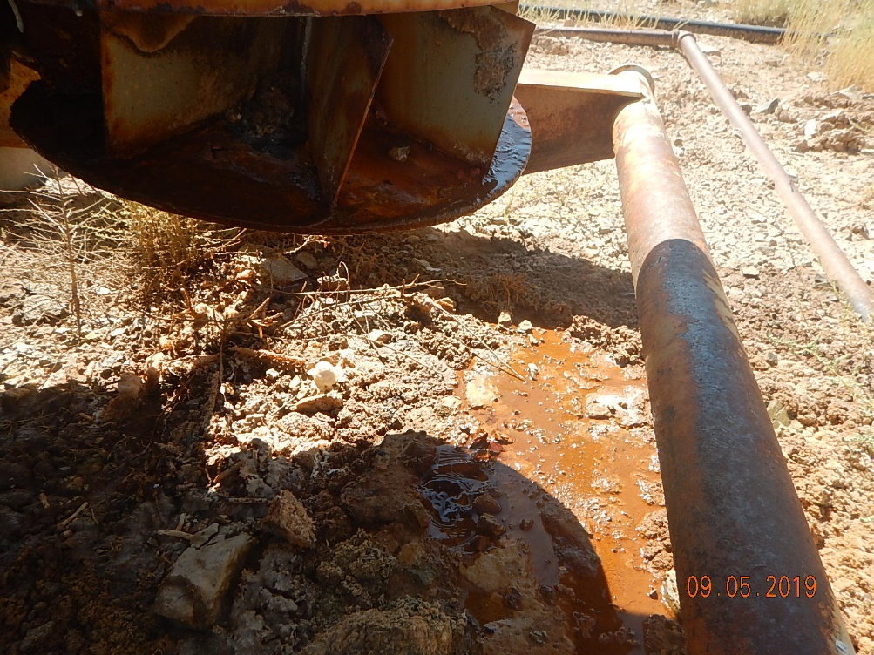
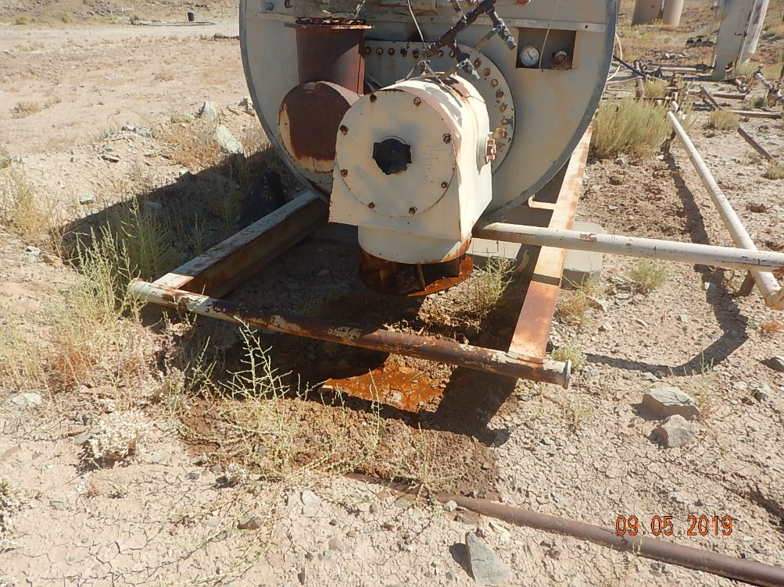
Inspection Photo
KC Resources
Mail Trail Mesa F23-26G
API: 05-083-06494
Photo #13 Separator leaking fluid.
Photo #14 Standing fluid on ground from separator leak.

Slide 8
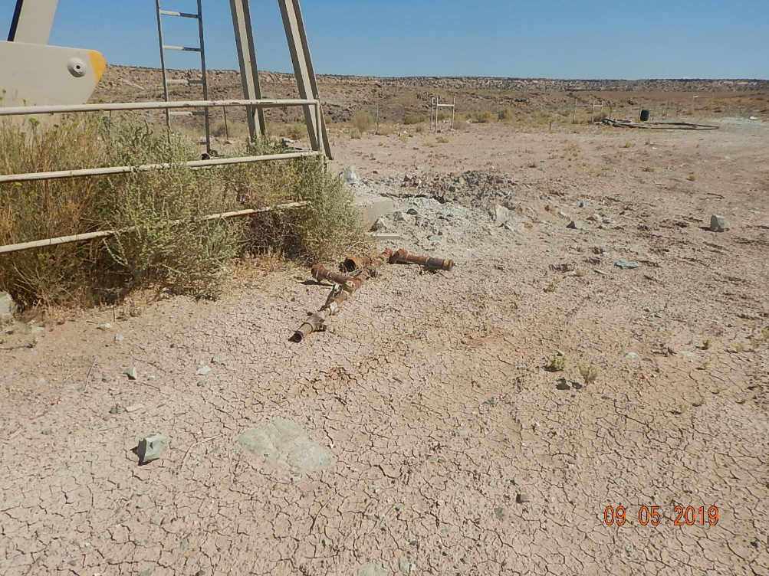
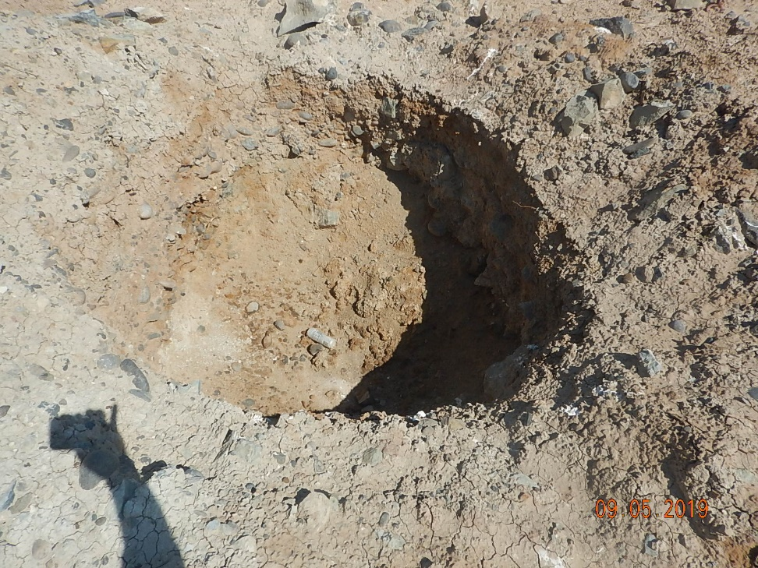
Inspection Photo
KC Resources
Mail Trail Mesa F23-26G
API: 05-083-06494
Photo #15 Unused valves and piping.
Photo #16 Wellhead hole, with below grade marker.

