Slide 1
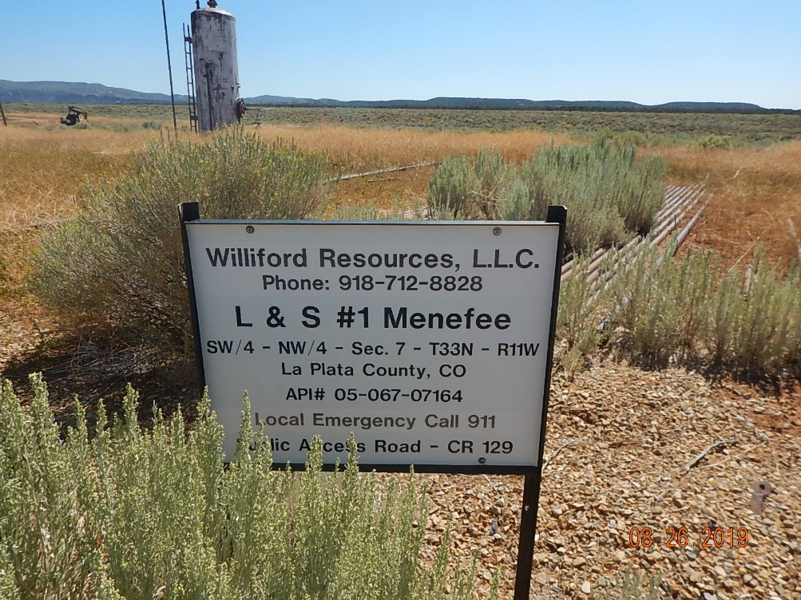
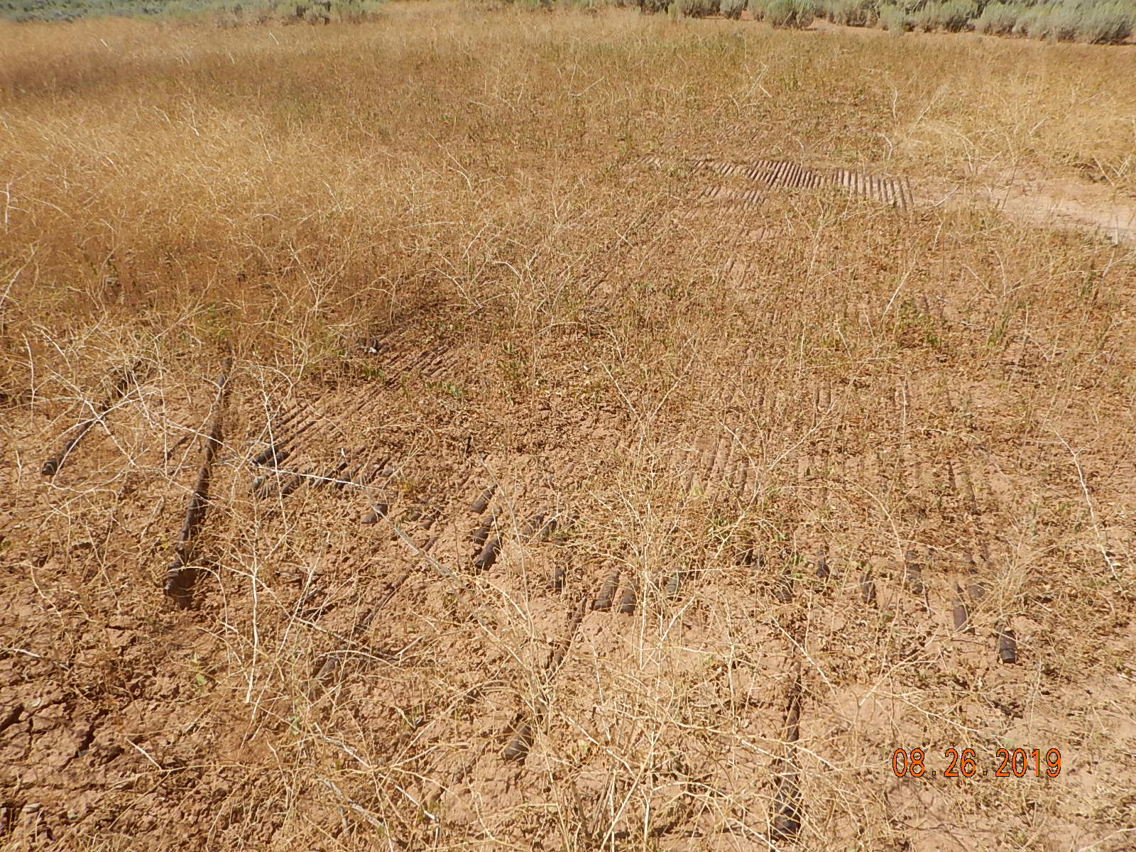
Inspection Photos
Long & Schluter 1 Menefee
API: 05-067-07164
Location
Unused equipment.

Slide 2
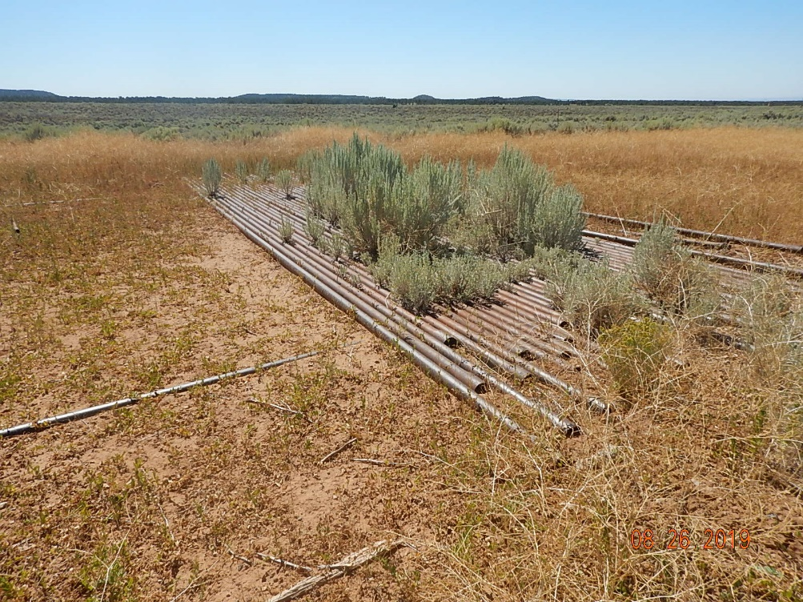
Inspection Photos
Long & Schluter 1 Menefee
API: 05-067-07164
Unused equipment.

