Slide 1
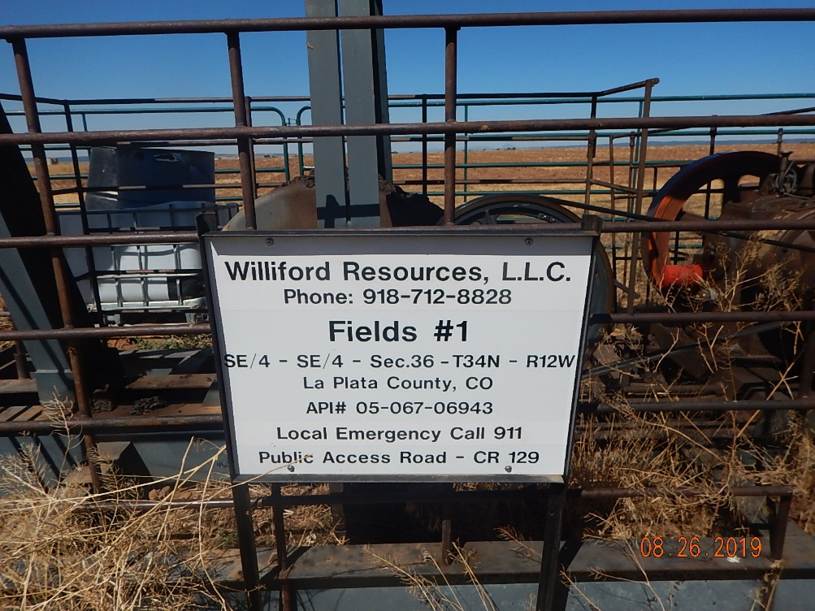
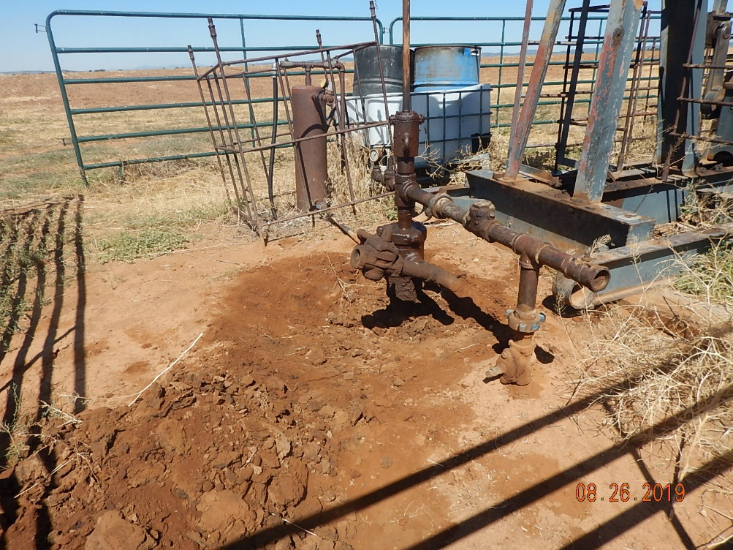
Inspection Photos
Fields 1
API: 05-067-06943
Location.
Stained soil around wellhead.

Slide 2
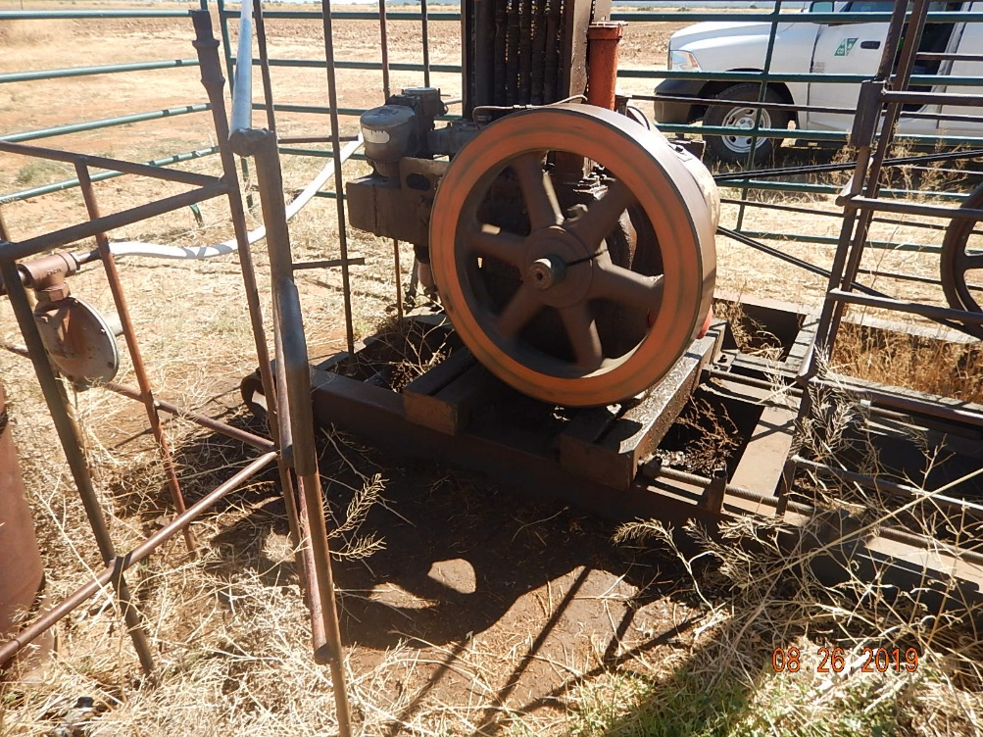
Inspection Photos
Fields 1
API: 05-067-06943
Stained soil around engine.

