Slide 1
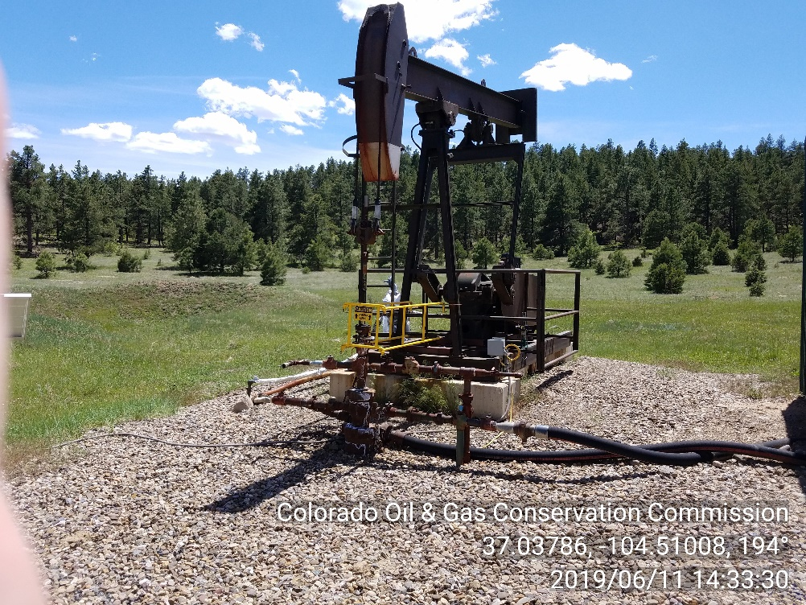
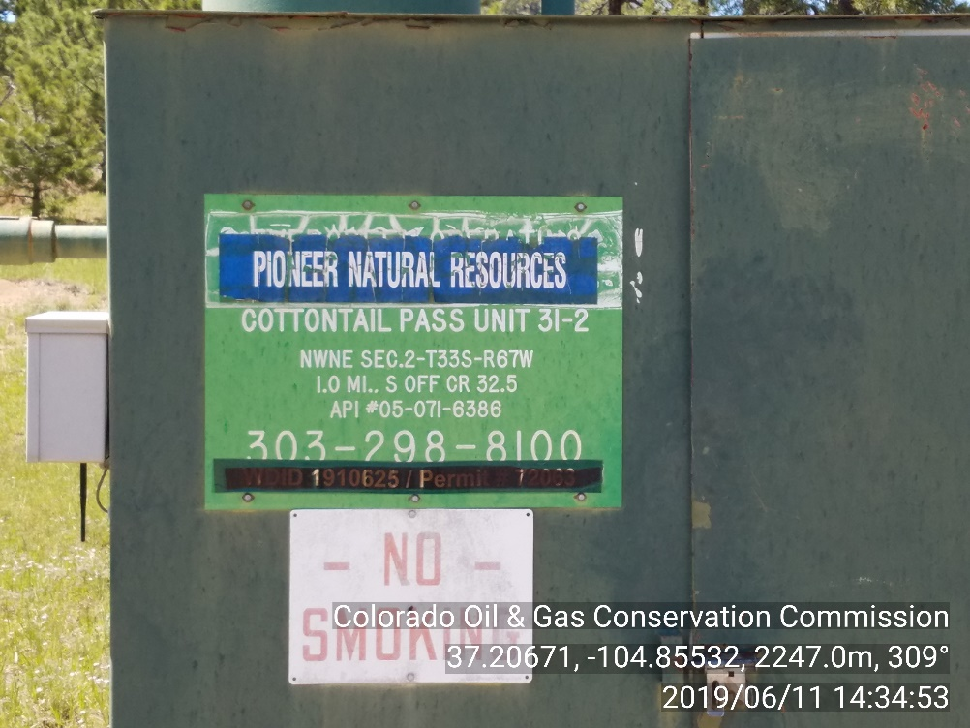
Inspection Photos
Location Name: COTTONTAIL PASS UNIT 31-2
API#: 05-071-06386
INSP. #: 695100854
PHOTO 1: WELLHEAD
PHOTO 2: WELL SIGN/ CURRENT OPERATOR IS NOT POSTED ON WELL SIGN. 911 IS NOT INCLUDED IN EMERGENCY CONTACT. COMPLY WITH 210.b. CA DATE 7/11/19.

Slide 2
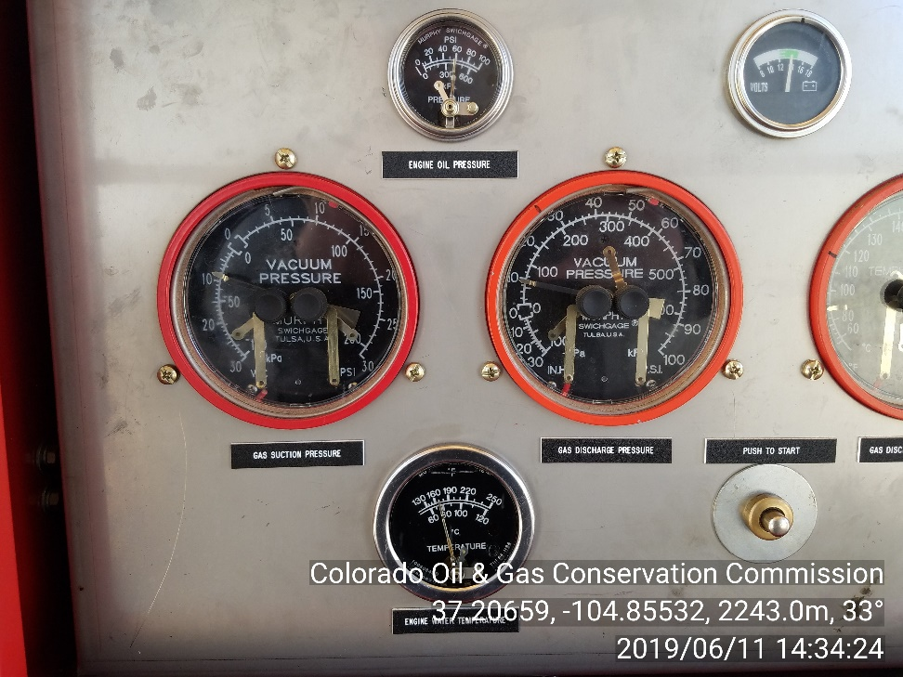
Inspection Photos
Location Name: COTTONTAIL PASS UNIT 31-2
API#: 05-071-06386
INSP. #: 695100854
PHOTO 3: Vacuum pump observed on well without COGCC approval. Provide COGCC with documentation showing approval of use of vacuum pump. CA DATE 6/26/19

