Slide 1
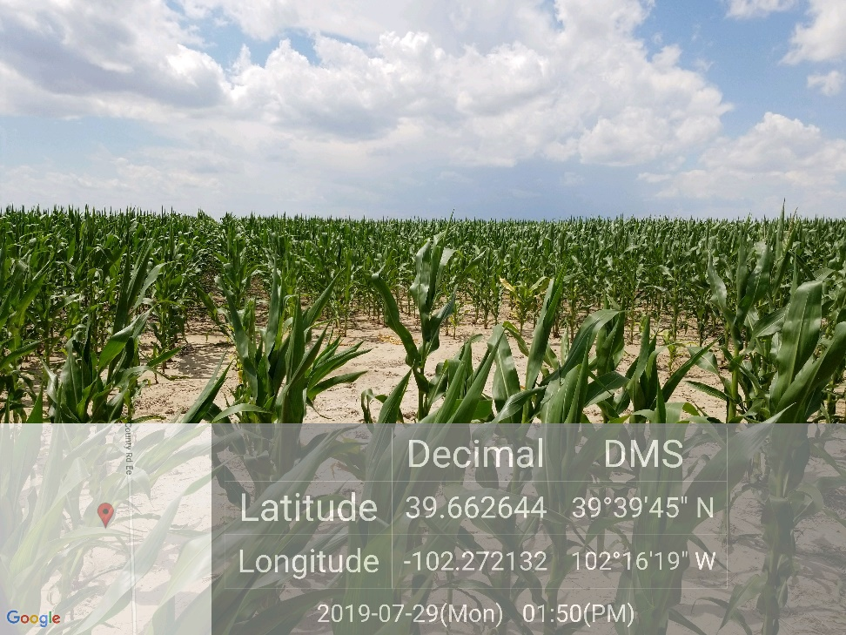
Inspection Photo
Location Name: Beckman 34-9
API: 05-125-10060
1. Location photo

