Slide 1
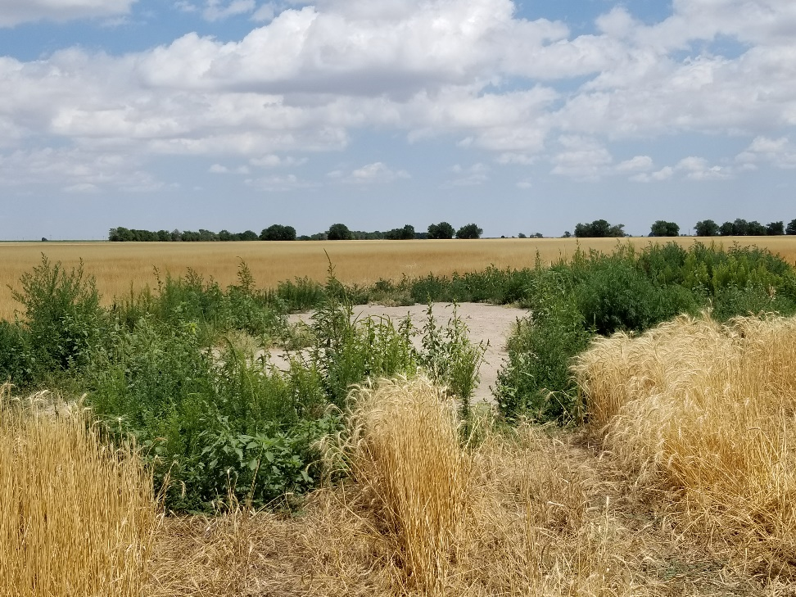
Inspection Photo
Location Name: Clarke 26-12
API: 05-125-10038
1. Location photo

