Slide 1
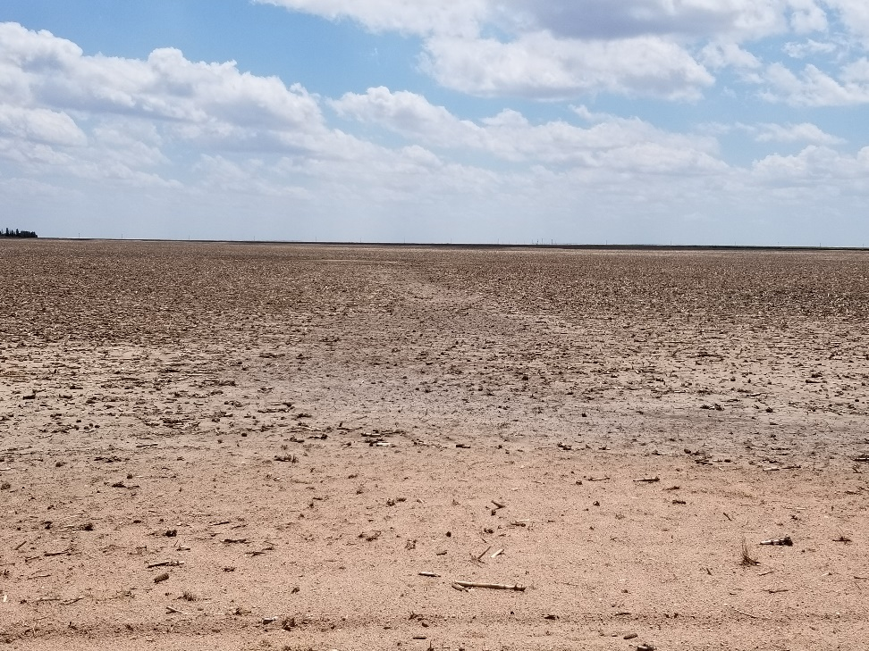
Inspection Photo
Location Name: Farmer 26-4
API: 05-125-10040
1. Location photo

