Slide 1
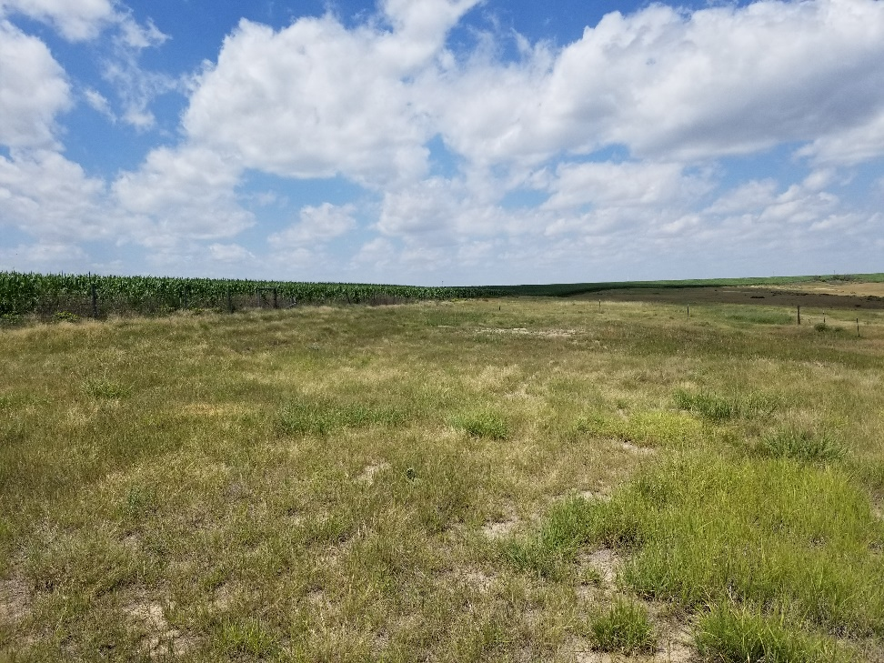
Inspection Photo
Location Name: Adamson 12-27143
API: 05-125-08684
1. Location photo

