Slide 1
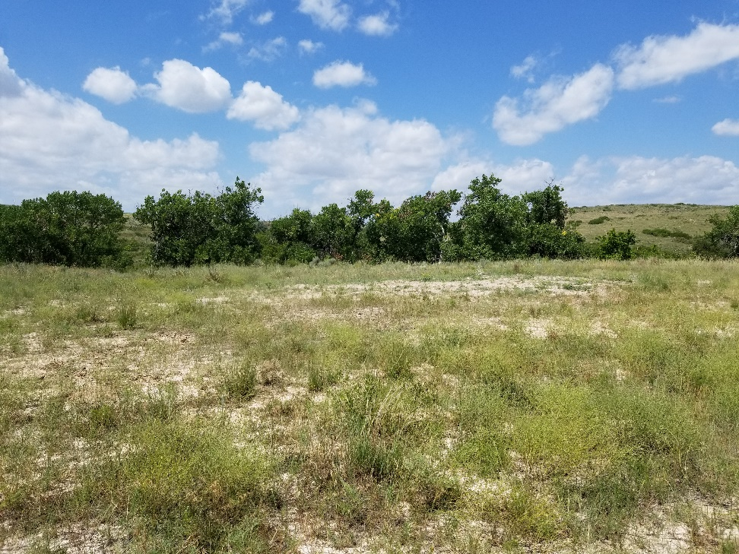
Inspection Photo
Location Name: Adamson 27-7
API: 05-125-09408
1. Location photo

