Slide 1
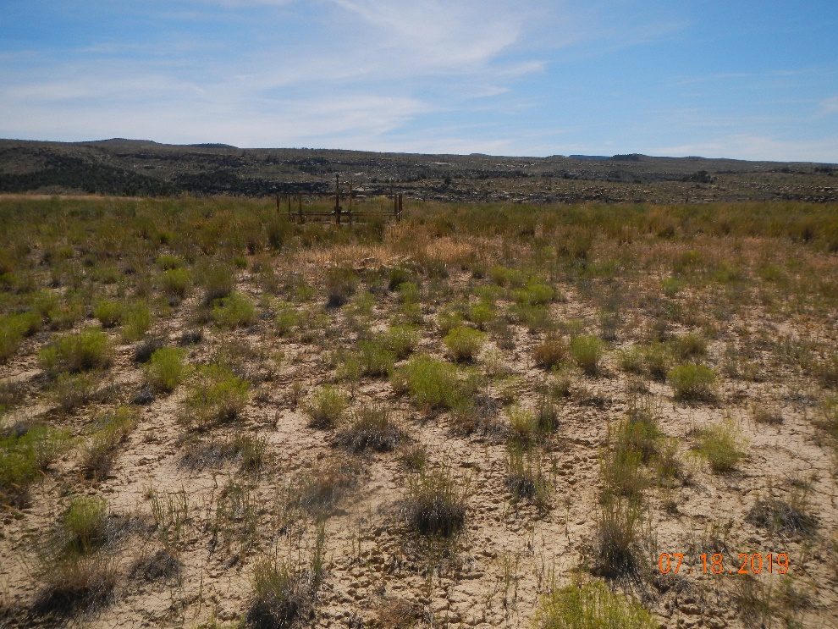
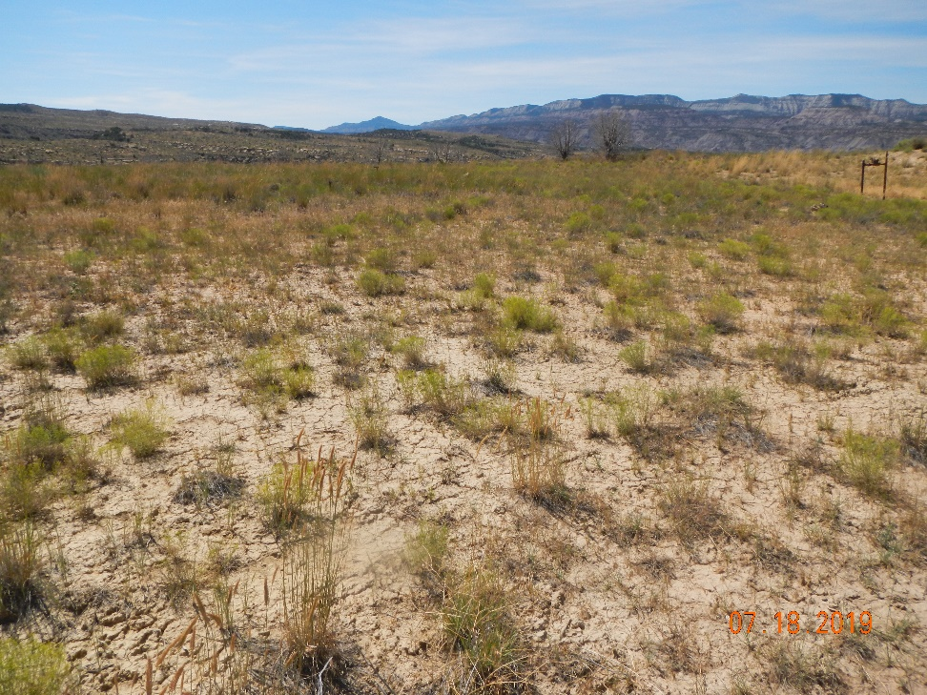
Maralex Resources Inc.
API # 05-077-08293
Inspection # 696600347
Photo #1 Photo Of location
Photo #2 Photo Of location from entrance

Slide 2
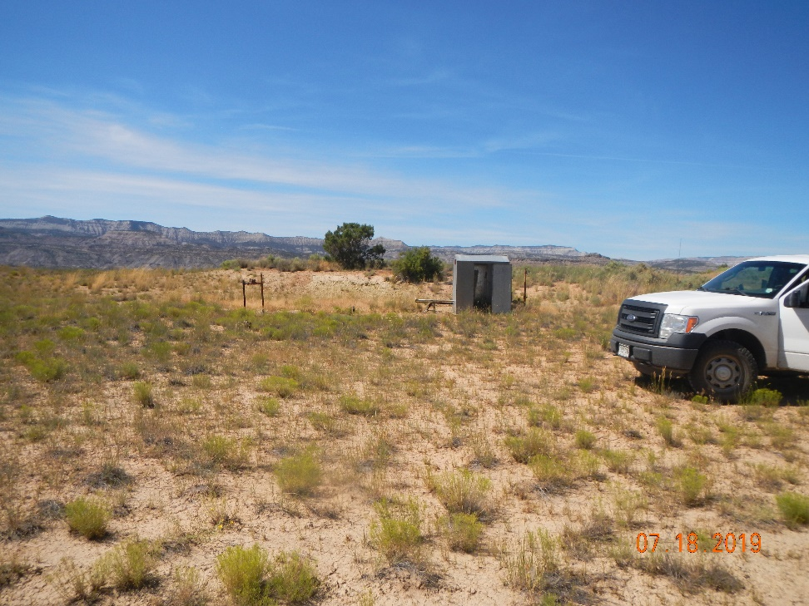
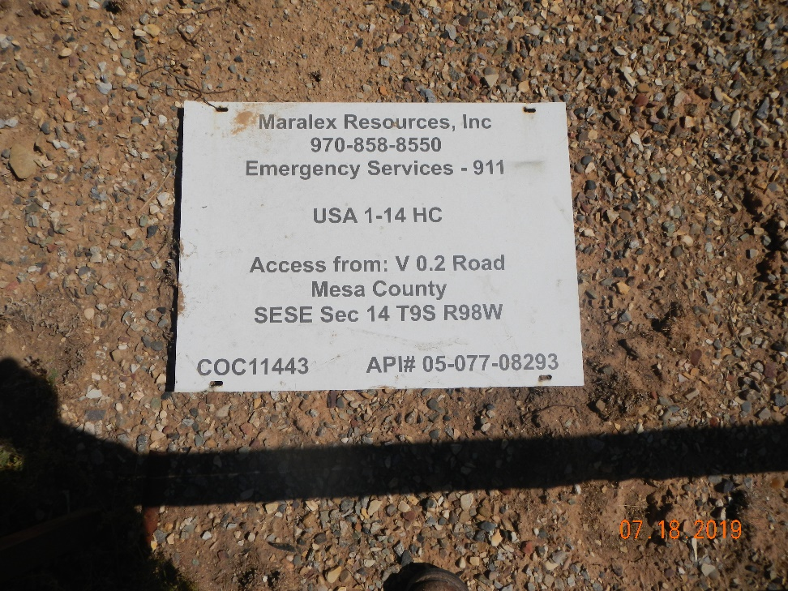
Maralex Resources Inc.
API # 05-077-08293
Inspection # 696600347
Photo #3 Photo of location from access road
Photo #4 Battery sign on ground at wellhead

Slide 3
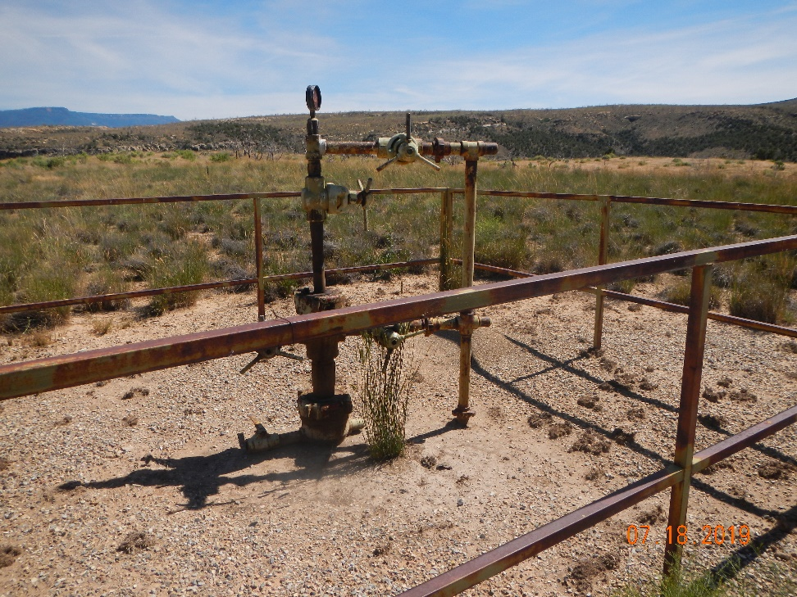
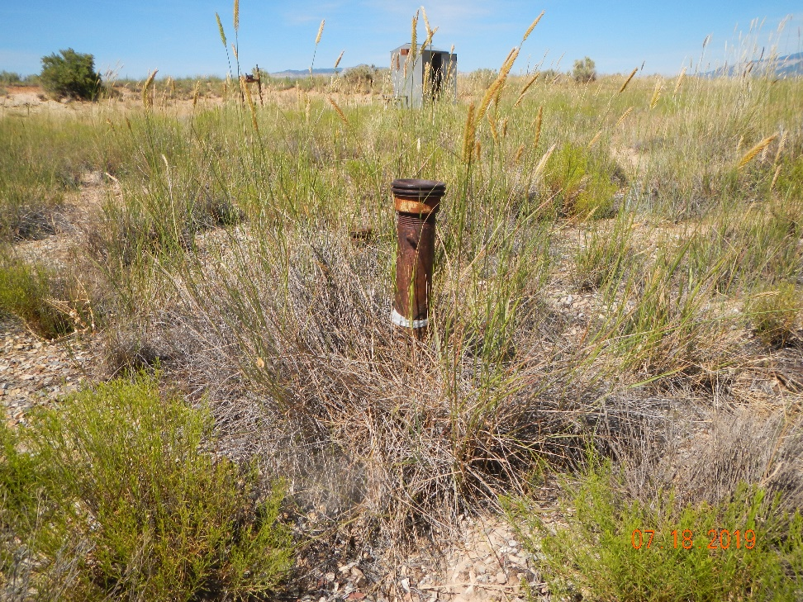
Maralex Resources Inc.
API # 05-077-08293
Inspection # 696600347
Photo #5 Wellhead remains on location
Photo #6 Unmarked risers on location

Slide 4
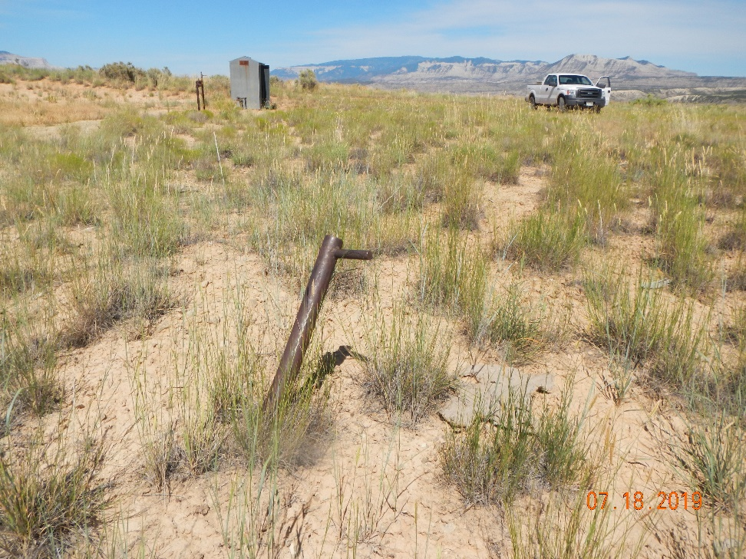
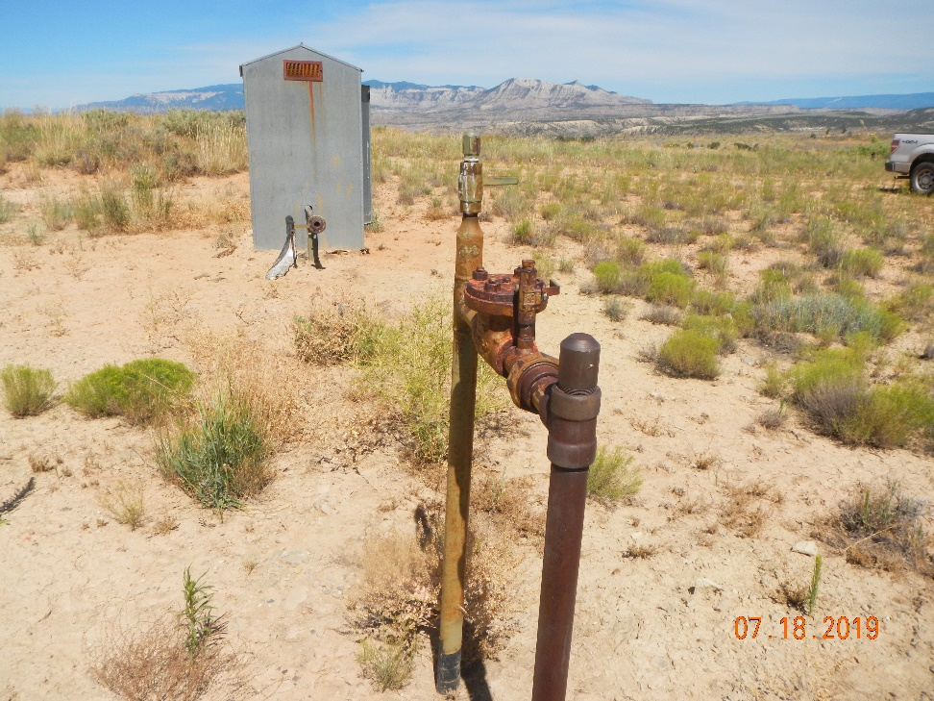
Maralex Resources Inc.
API # 05-077-08293
Inspection # 696600347
Photo #7 Deadman on location not marked
Photo #8 Risers on location not marked

