Slide 1
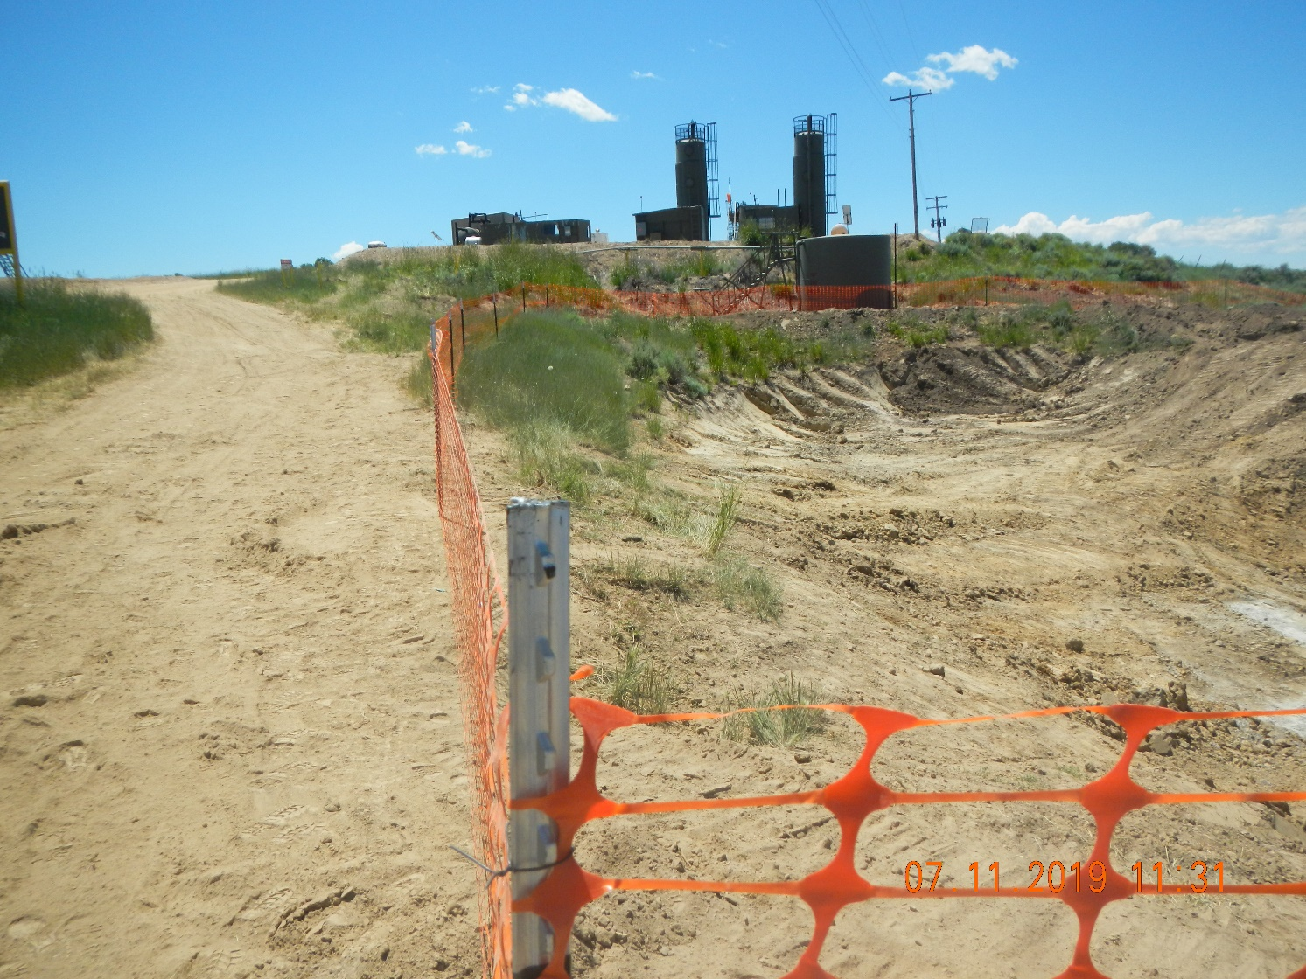
Inspection Photos
Location: facility 116704
Remediation # 11554
Inspection Date: 7/11/2019
Photos taken by Kris Neidel
Photo #1 looking South. The area in the photo appears to have a rock bottom. The rock falls off to the right of the photo (to the west.

Slide 2
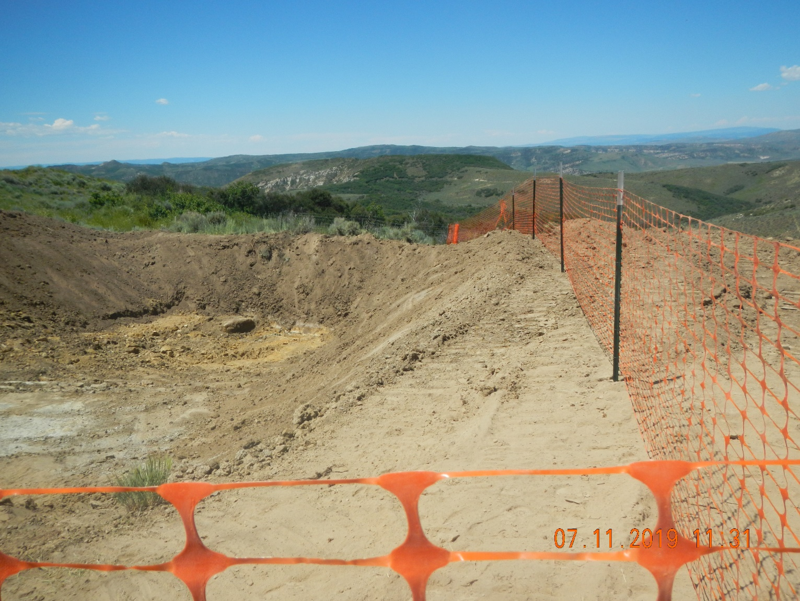
Inspection Photos
Location: facility 116704
Remediation # 11554
Inspection Date: 7/11/2019
Photos taken by Kris Neidel
Photo #2 Looking south. South end of the pit is where the rock bottom falls off and pit bottom appears to be a sandstone.

Slide 3
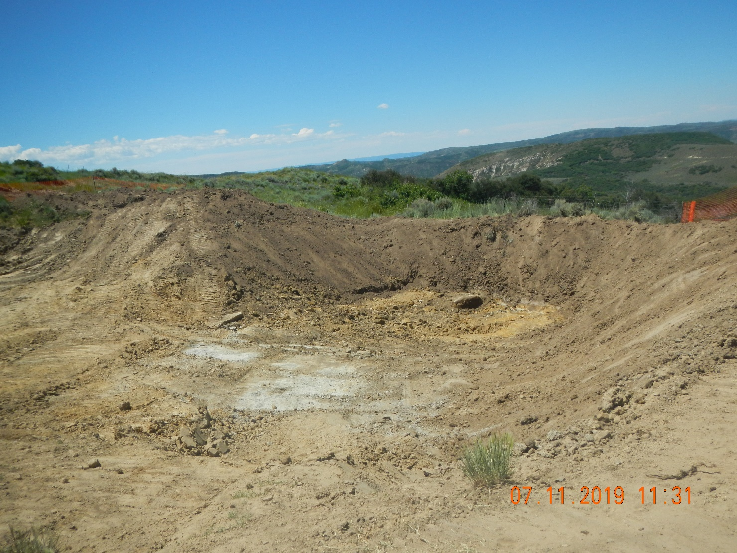
Inspection Photos
Location: facility 116704
Remediation # 11554
Inspection Date: 7/11/2019
Photos taken by Kris Neidel
Photo #3 Looking west. Note rock in forground.

Slide 4
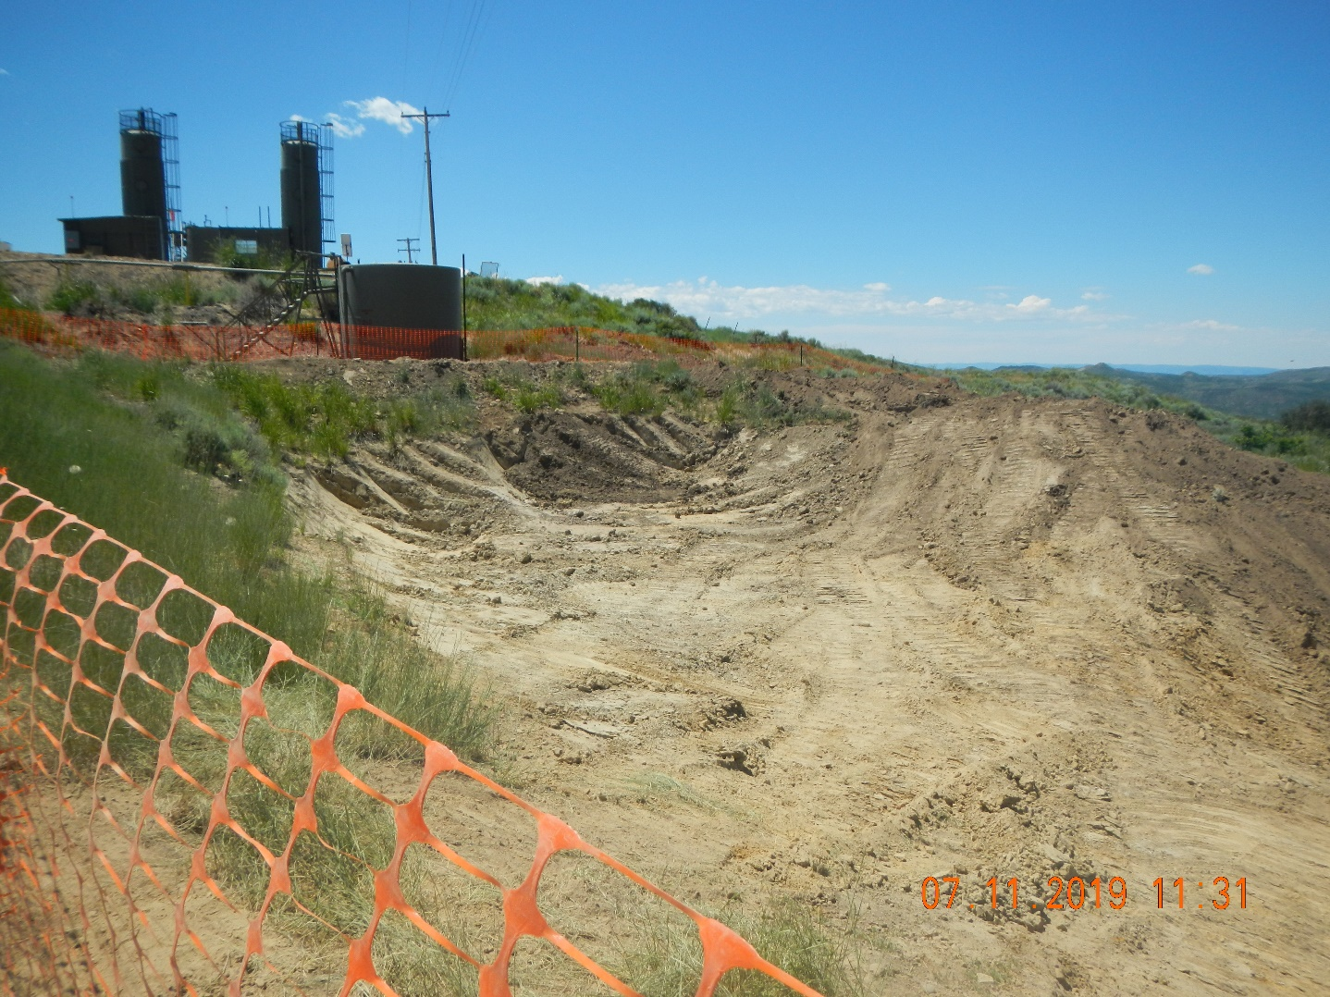
Inspection Photos
Location: facility 116704
Remediation # 11554
Inspection Date: 7/11/2019
Photos taken by Kris Neidel
Photo #4 Looking west, southwest. Eastern fence, side of pit in foreground)

Slide 5
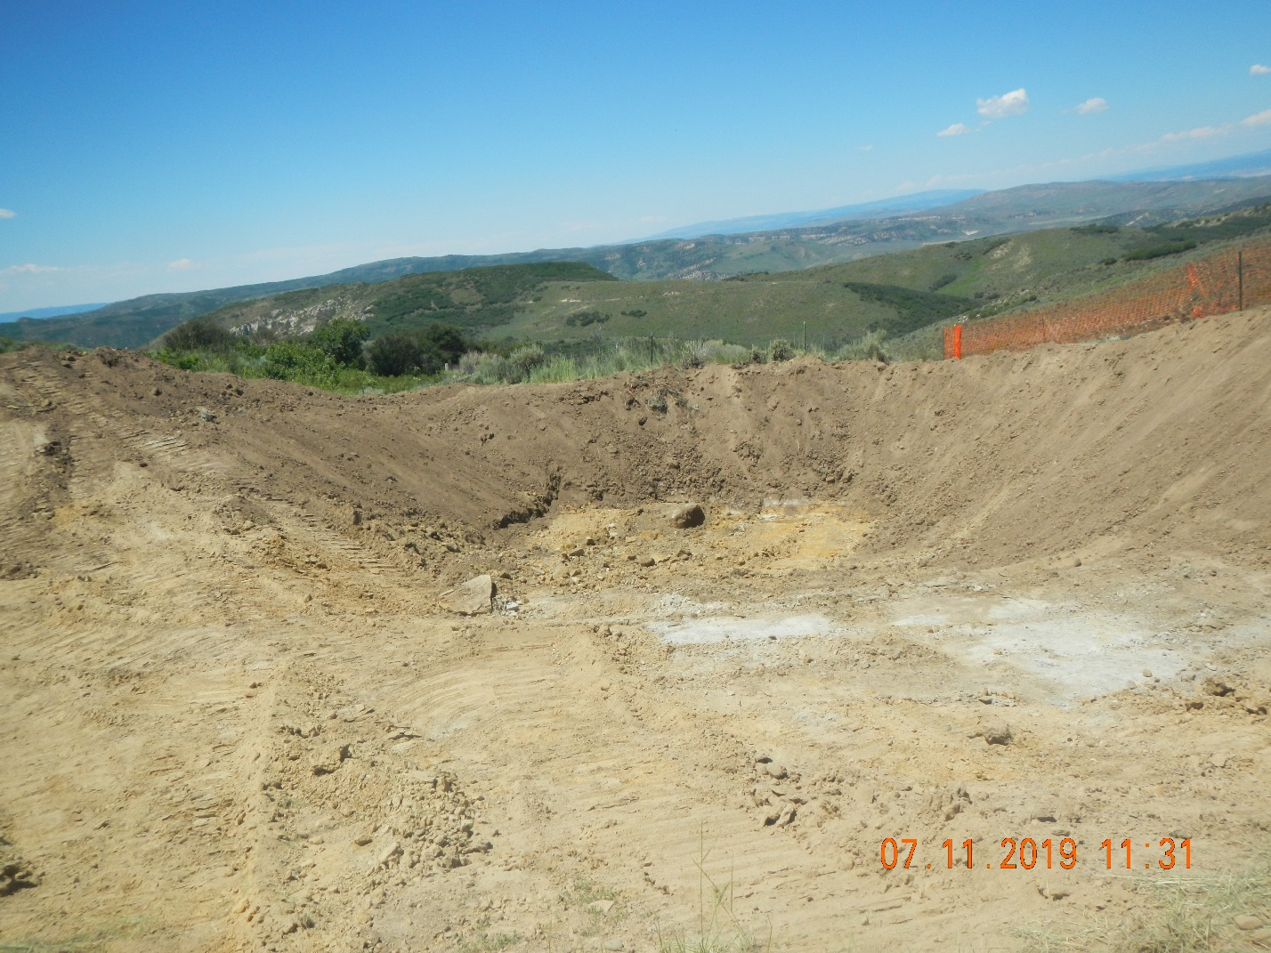
Inspection Photos
Location: facility 116704
Remediation # 11554
Inspection Date: 7/11/2019
Photos taken by Kris Neidel
Photo #5 Looking west.

Slide 6
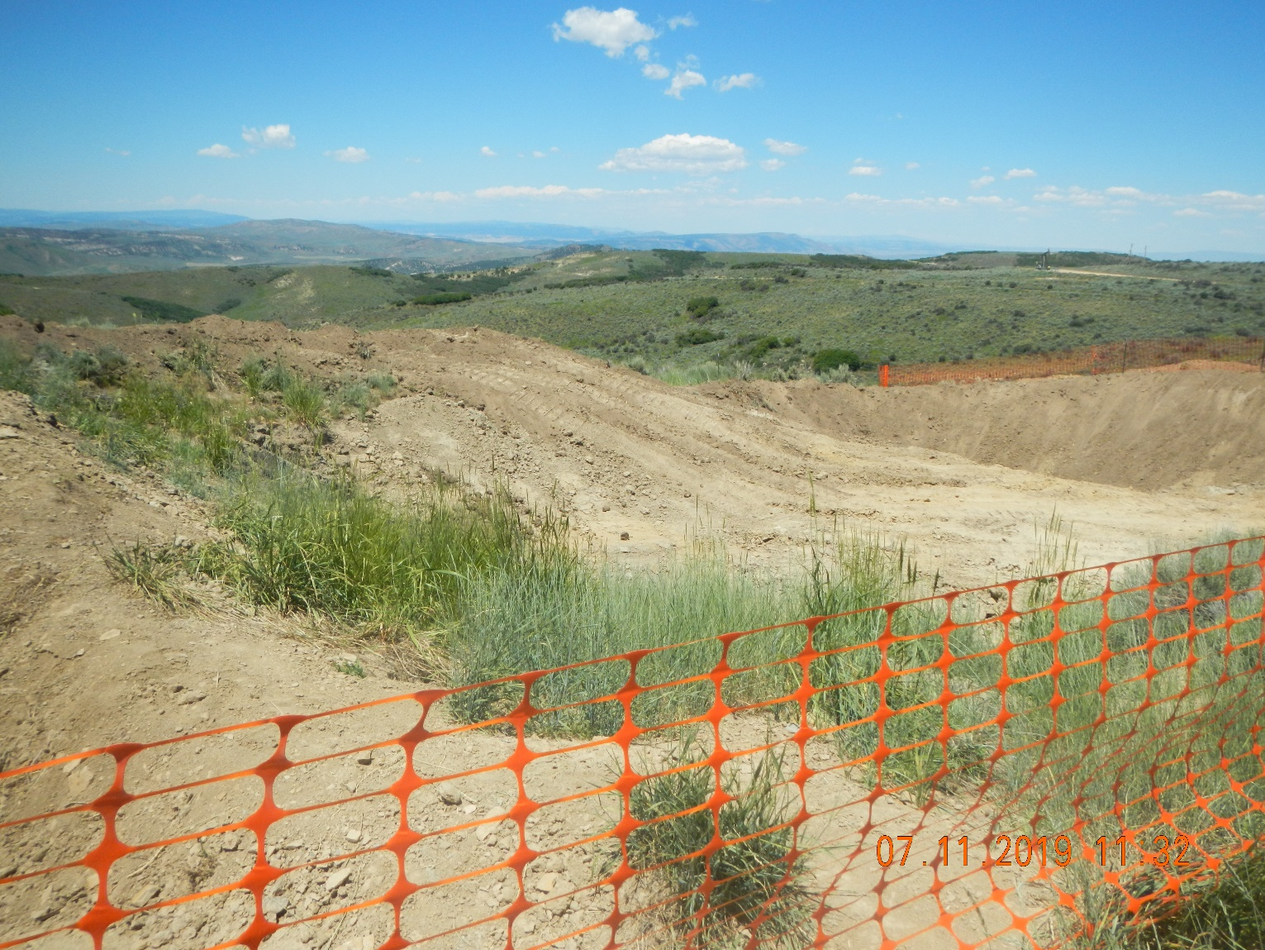
Inspection Photos
Location: facility 116704
Remediation # 11554
Inspection Date: 7/11/2019
Photos taken by Kris Neidel
Photo #6 Looking Northwest, standing on east side of pit.

Slide 7
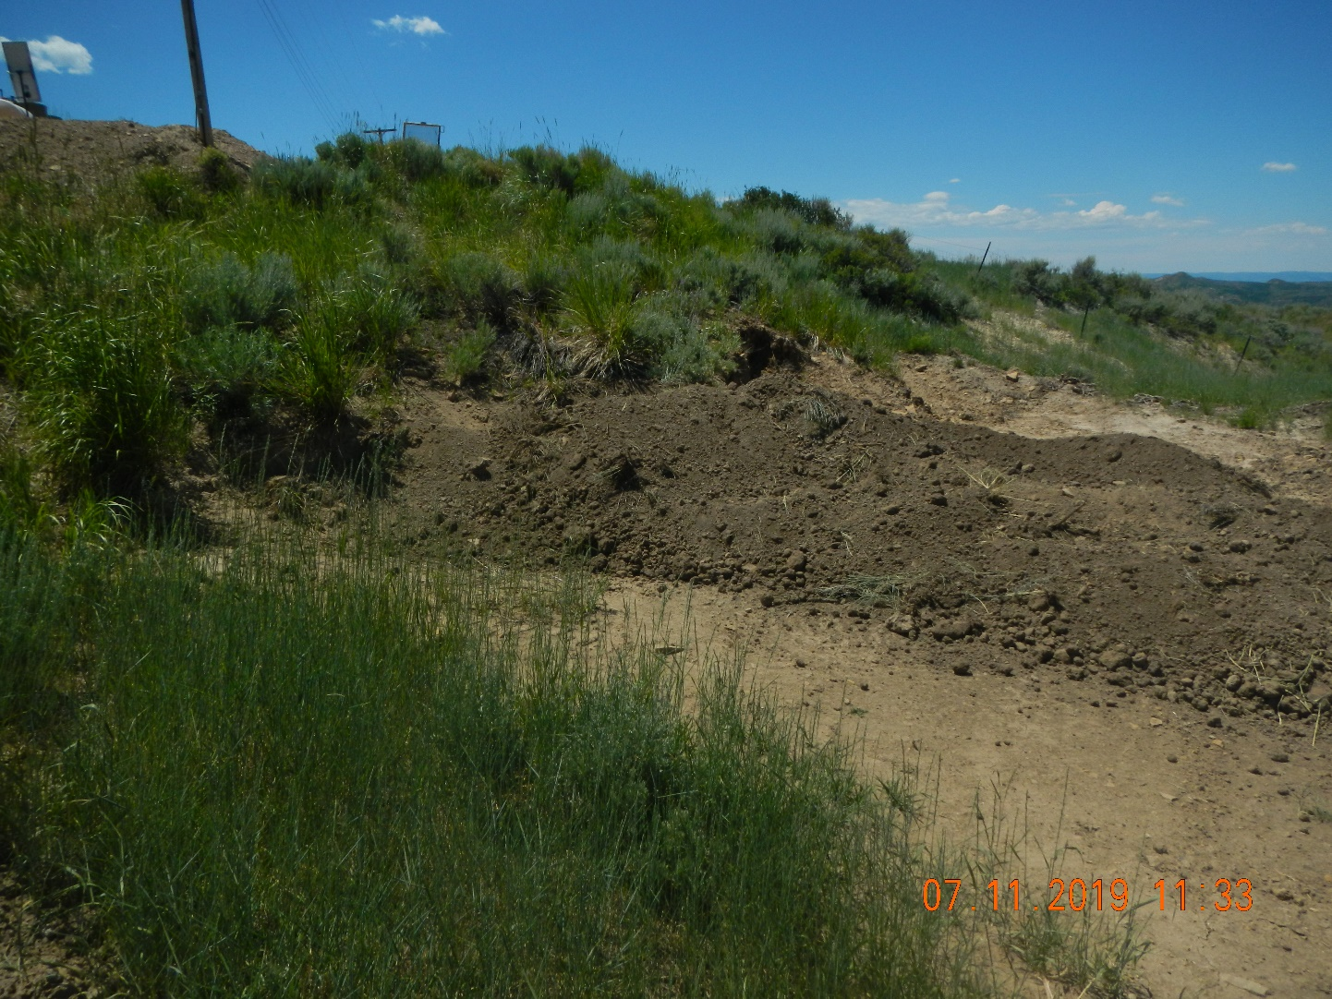
Inspection Photos
Location: facility 116704
Remediation # 11554
Inspection Date: 7/11/2019
Photos taken by Kris Neidel
Photo #7 south end of pit, looking west.

Slide 8
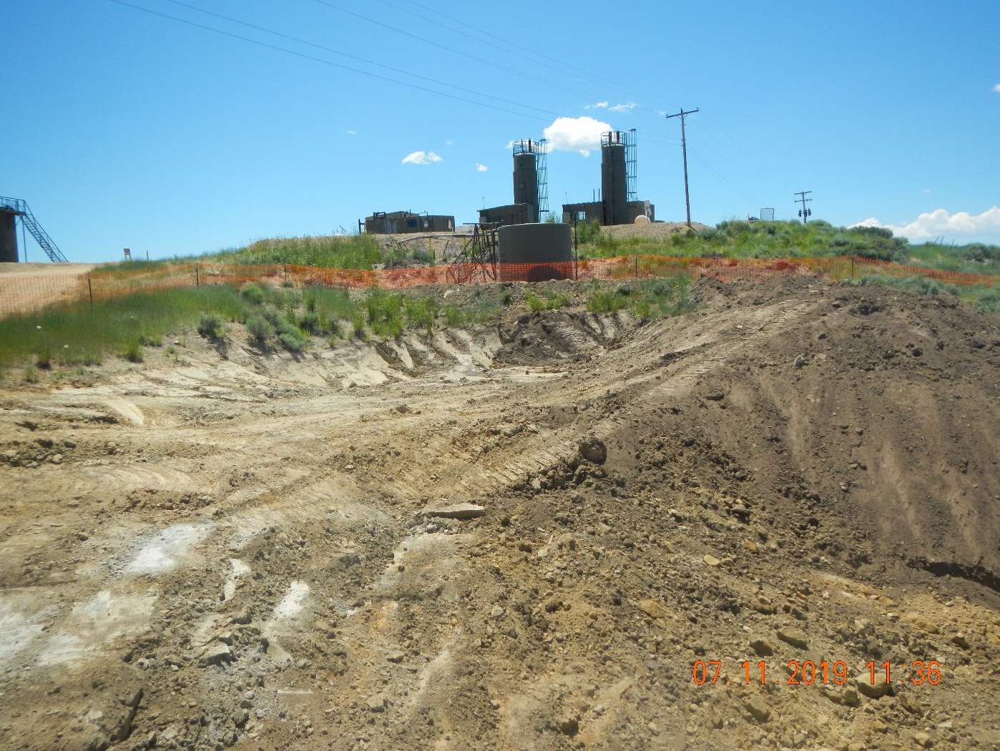
Inspection Photos
Location: facility 116704
Remediation # 11554
Inspection Date: 7/11/2019
Photos taken by Kris Neidel
Photo #8 looking south from north end.

Slide 9
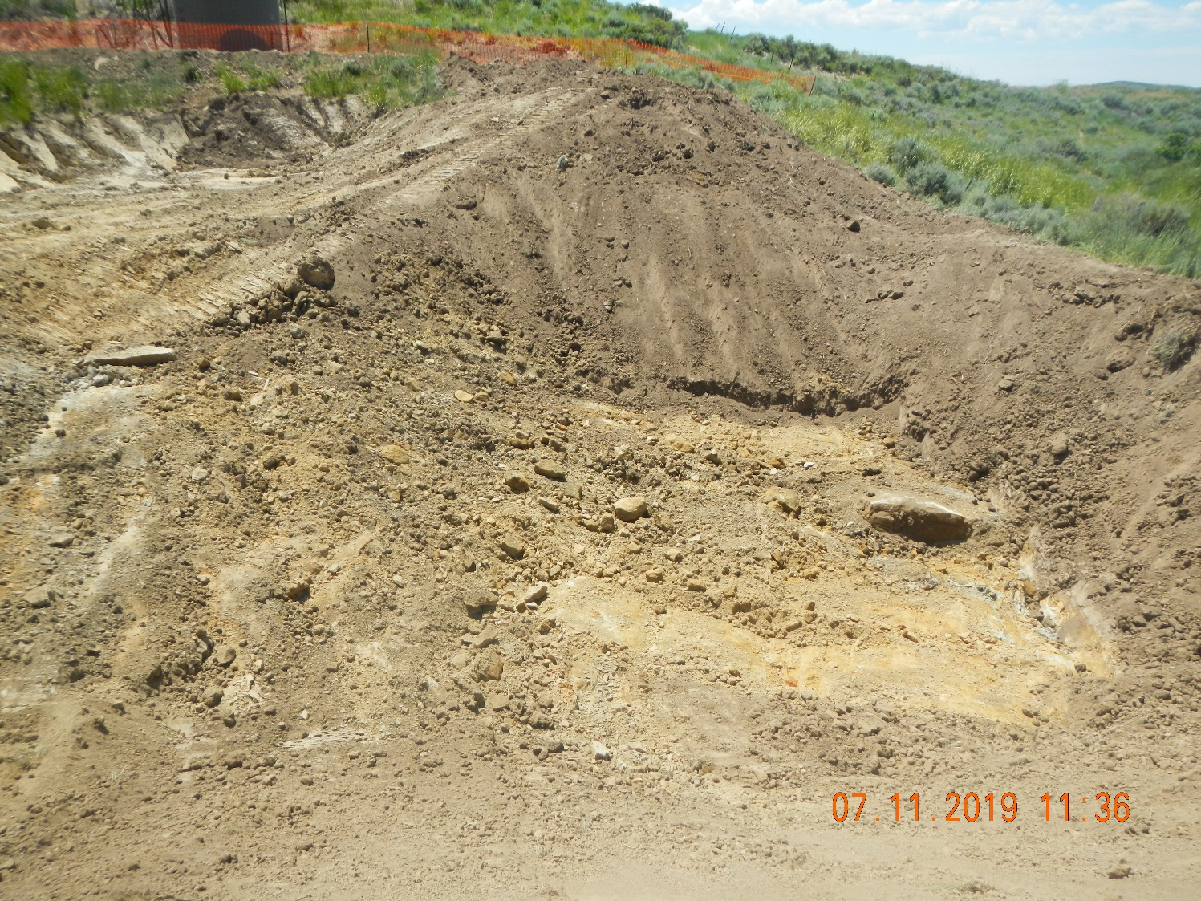
Inspection Photos
Location: facility 116704
Remediation # 11554
Inspection Date: 7/11/2019
Photos taken by Kris Neidel
Photo # 9. looking south from north end.

Slide 10
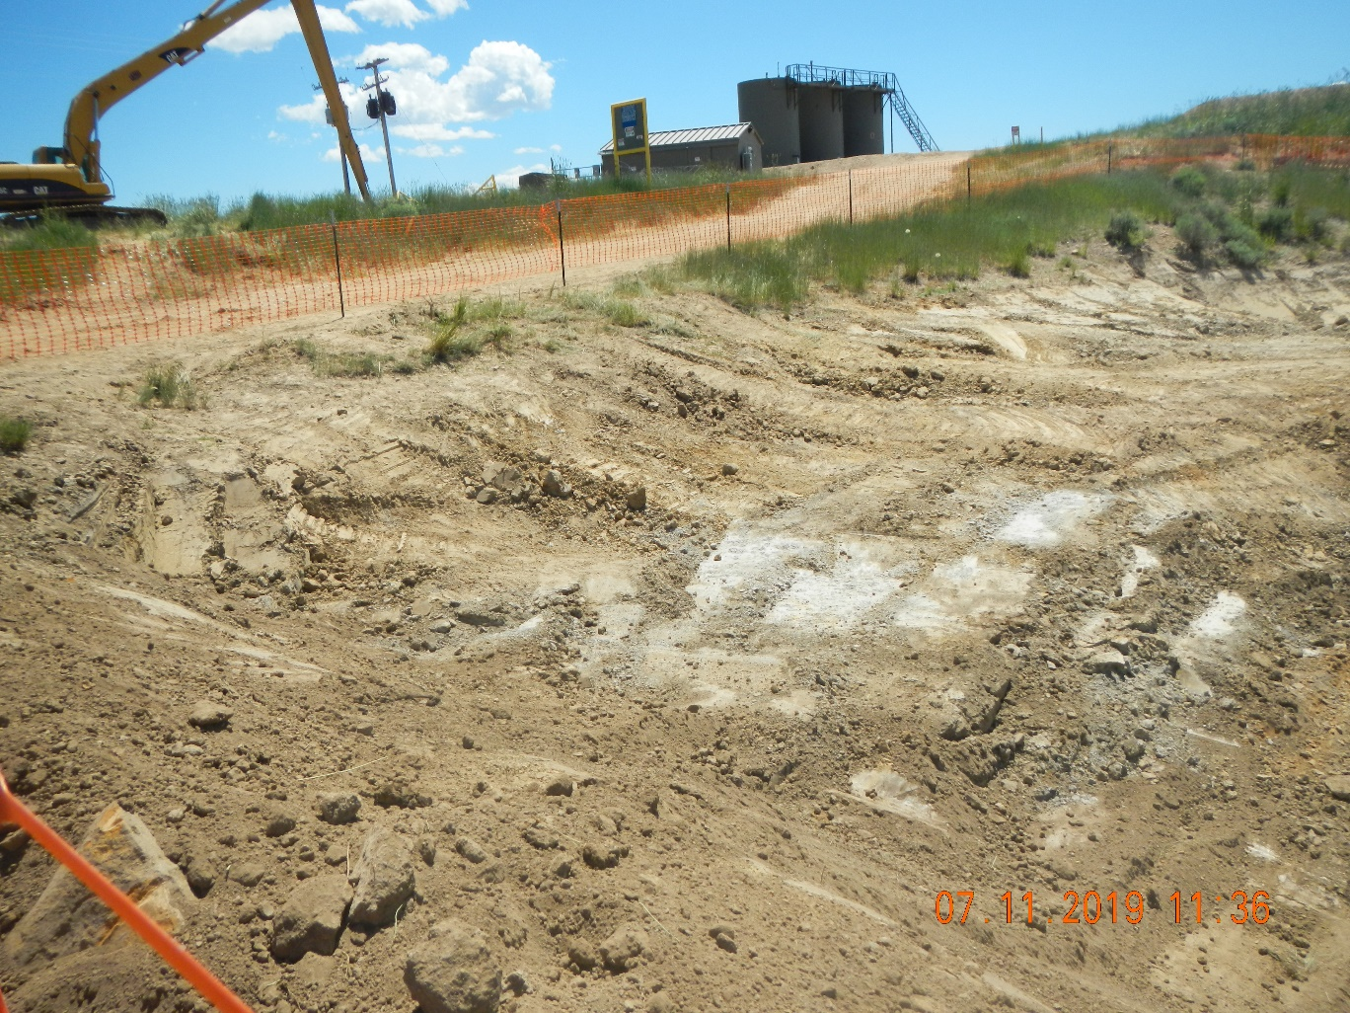
Inspection Photos
Location: facility 116704
Remediation # 11554
Inspection Date: 7/11/2019
Photos taken by Kris Neidel
Photo #10 looking southwest from north side of pit.

