Slide 1
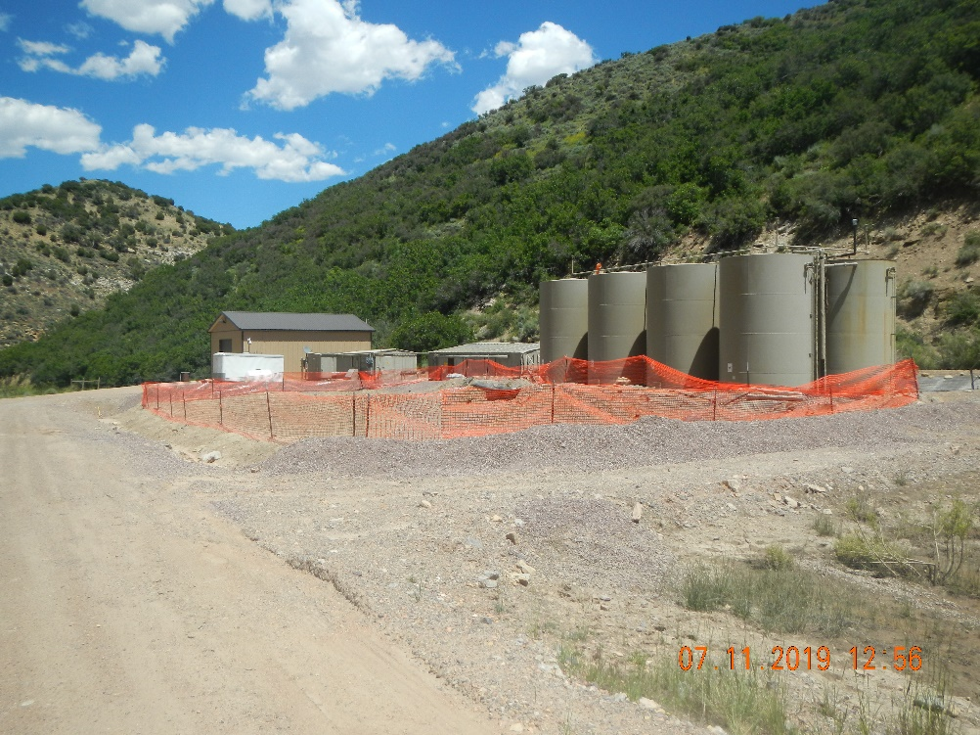
Inspection Photos
Location: facility 116704
Remediation # 11554
Inspection Date: 7/11/2019
Photos taken by Kris Neidel
Photo #1 Area inside construction fence is excavation area.

Slide 2
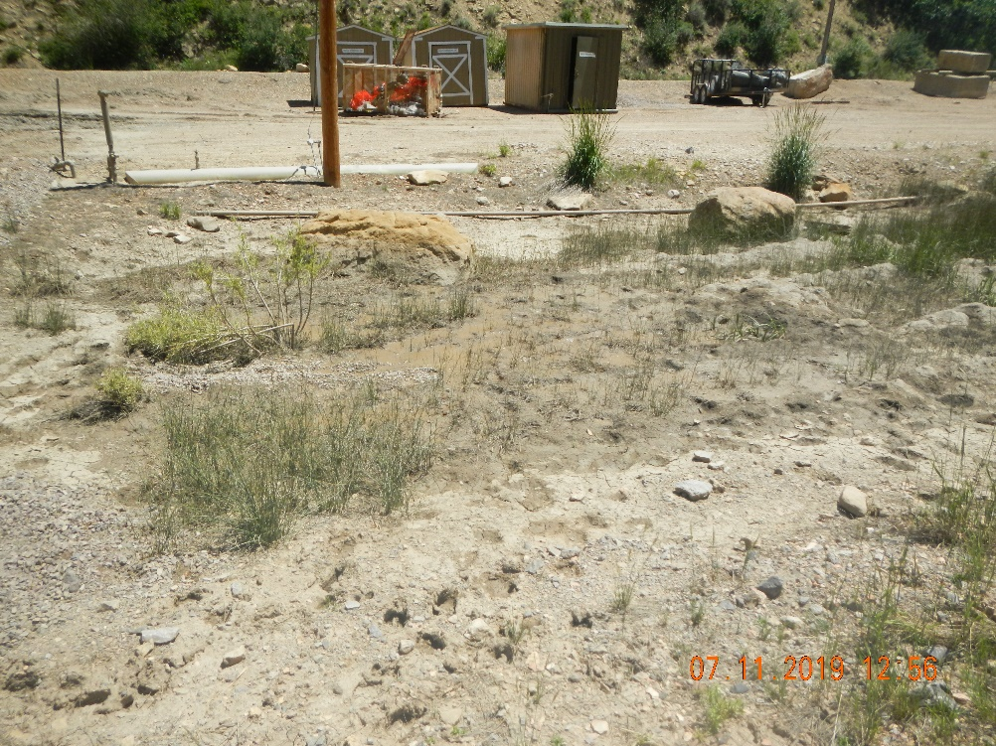
Inspection Photos
Location: facility 116704
Remediation # 11554
Inspection Date: 7/11/2019
Photos taken by Kris Neidel
Photo #2 is taken looking east, just south of the excavation. This area appears to have a seep of water.

Slide 3
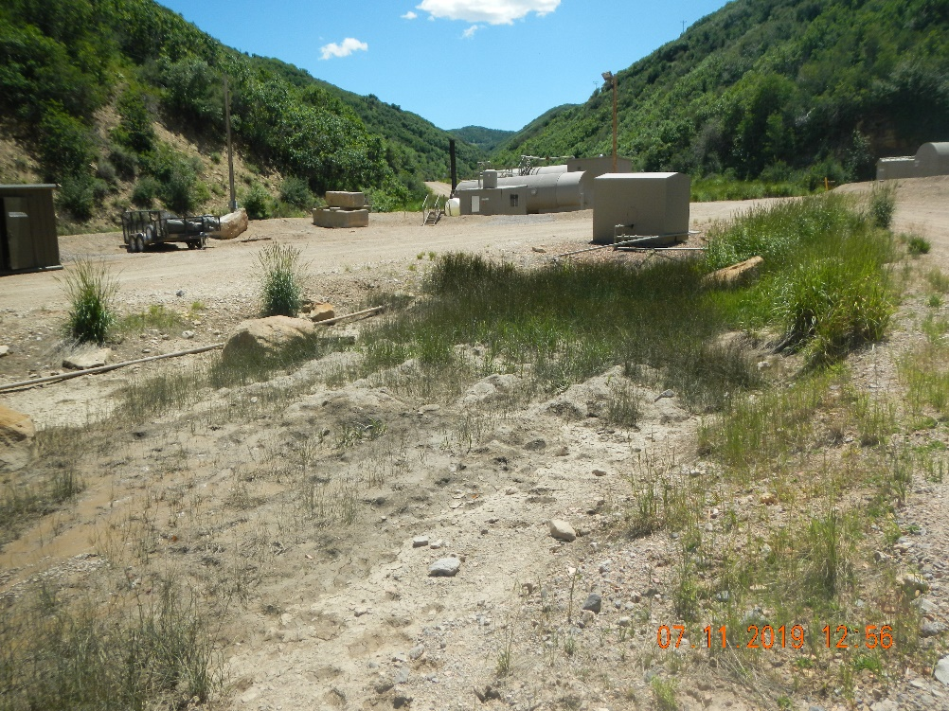
Inspection Photos
Location: facility 116704
Remediation # 11554
Inspection Date: 7/11/2019
Photos taken by Kris Neidel
Photo #3 Looking south, photo is further south of photo #2

Slide 4
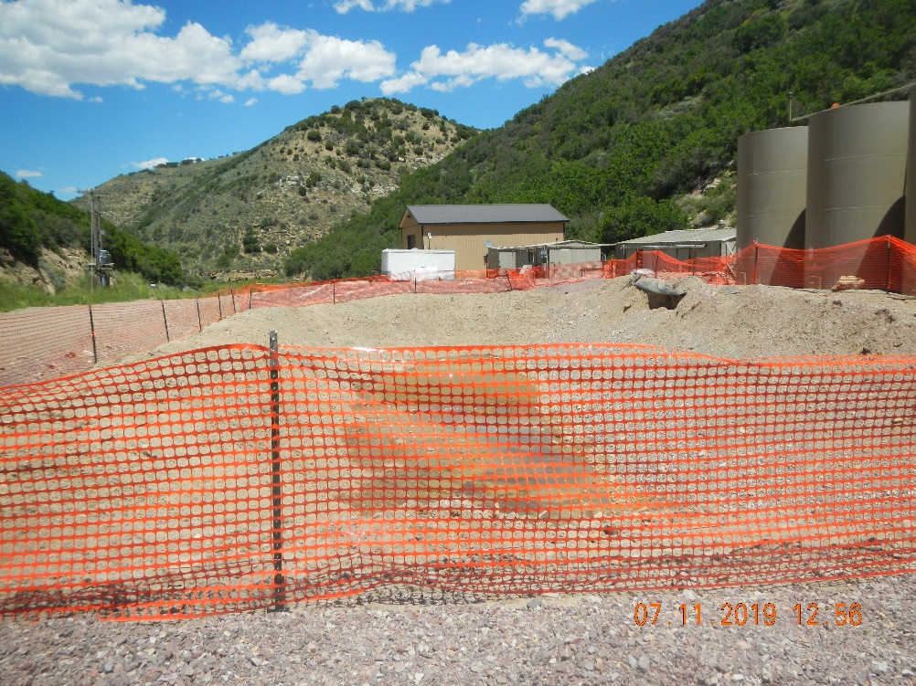
Inspection Photos
Location: facility 116704
Remediation # 11554
Inspection Date: 7/11/2019
Photos taken by Kris Neidel
Photo #4 standing on south end of excavation

Slide 5
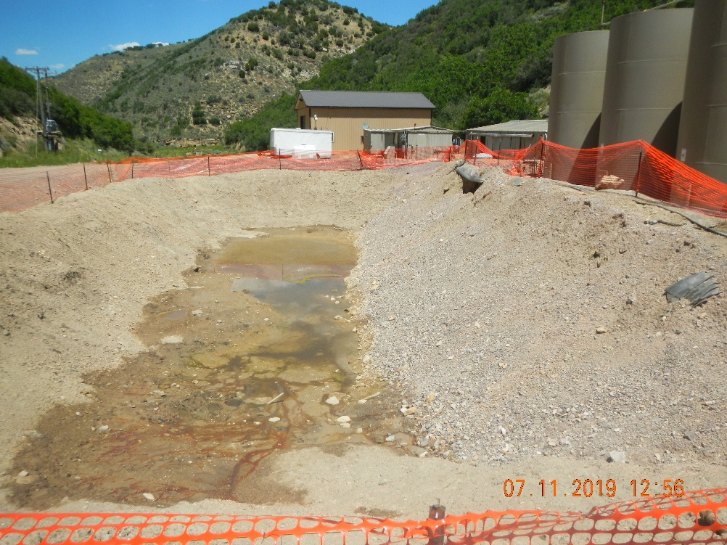
Inspection Photos
Location: facility 116704
Remediation # 11554
Inspection Date: 7/11/2019
Photos taken by Kris Neidel
Photo #5 looking north

Slide 6
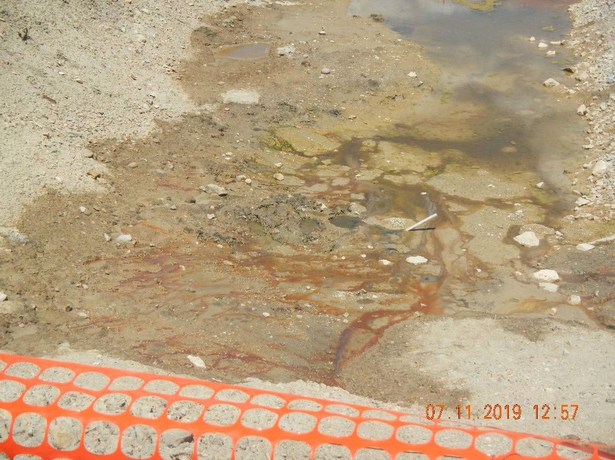
Inspection Photos
Location: facility 116704
Remediation # 11554
Inspection Date: 7/11/2019
Photos taken by Kris Neidel
Photo #6 close up of pit bottom

Slide 7
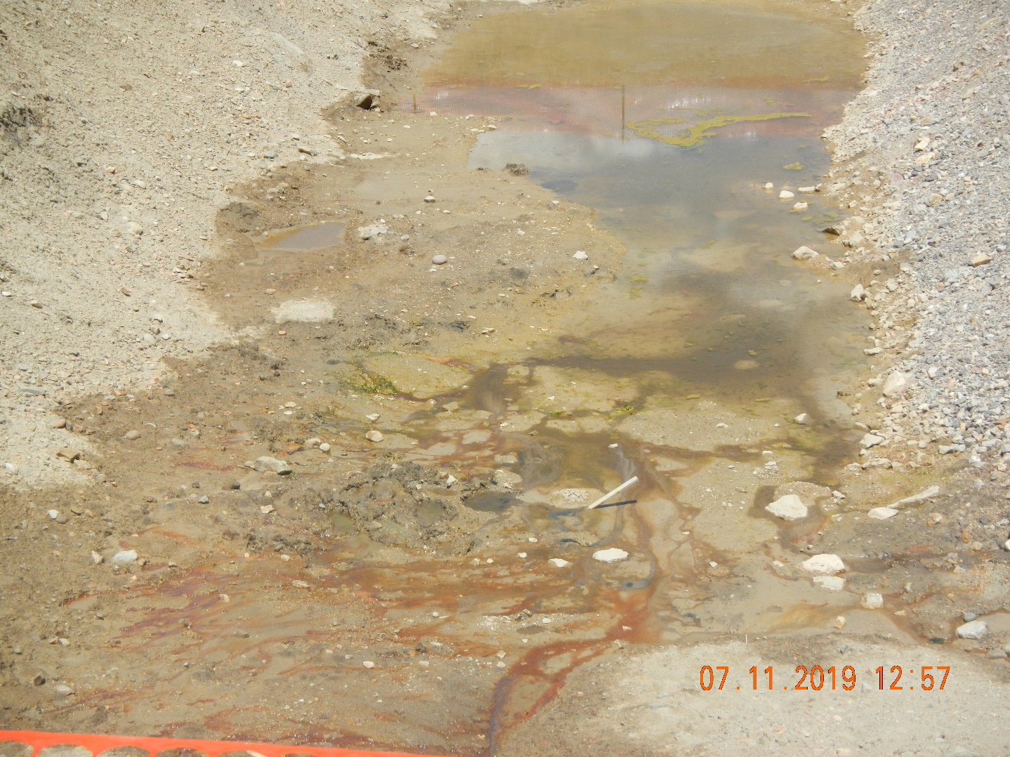
Inspection Photos
Location: facility 116704
Remediation # 11554
Inspection Date: 7/11/2019
Photos taken by Kris Neidel
Photo #7 close up of pit bottom

Slide 8
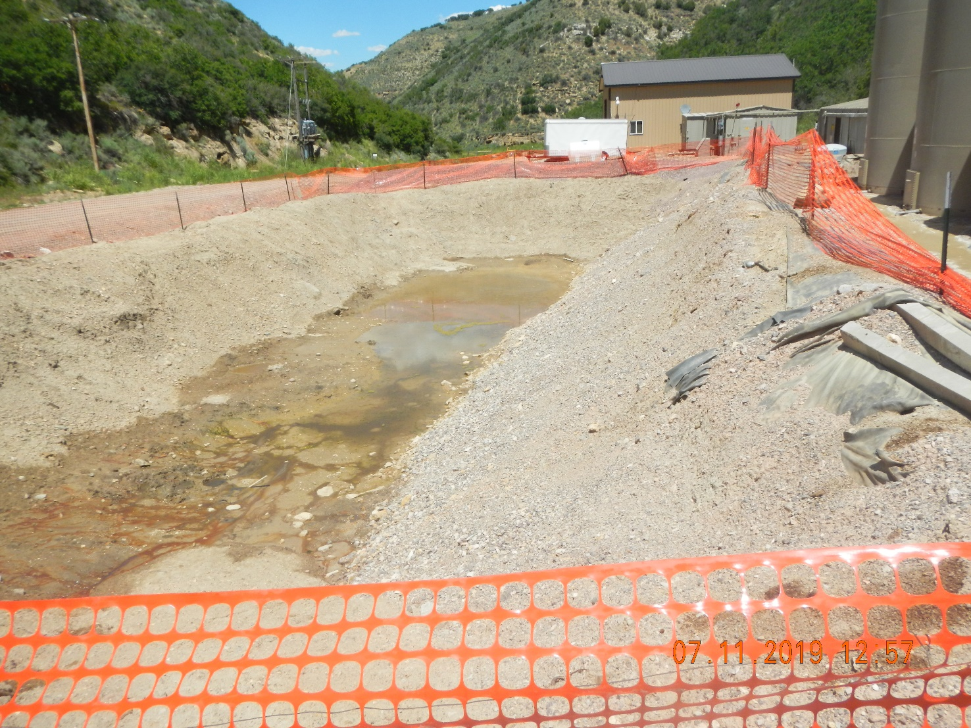
Inspection Photos
Location: facility 116704
Remediation # 11554
Inspection Date: 7/11/2019
Photos taken by Kris Neidel
Photo #8 looking north

Slide 9
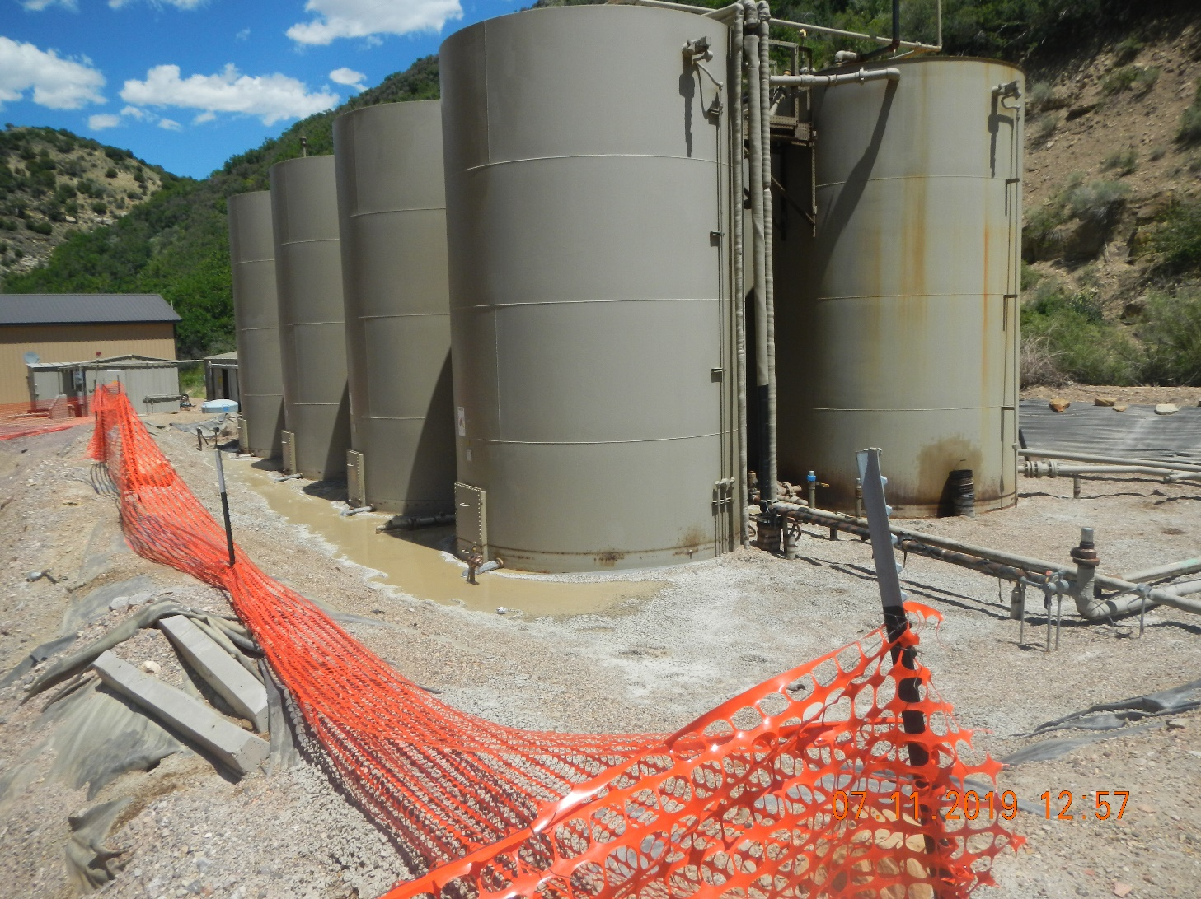
Inspection Photos
Location: facility 116704
Remediation # 11554
Inspection Date: 7/11/2019
Photos taken by Kris Neidel
Photo #9 adjacent tank battery.

Slide 10
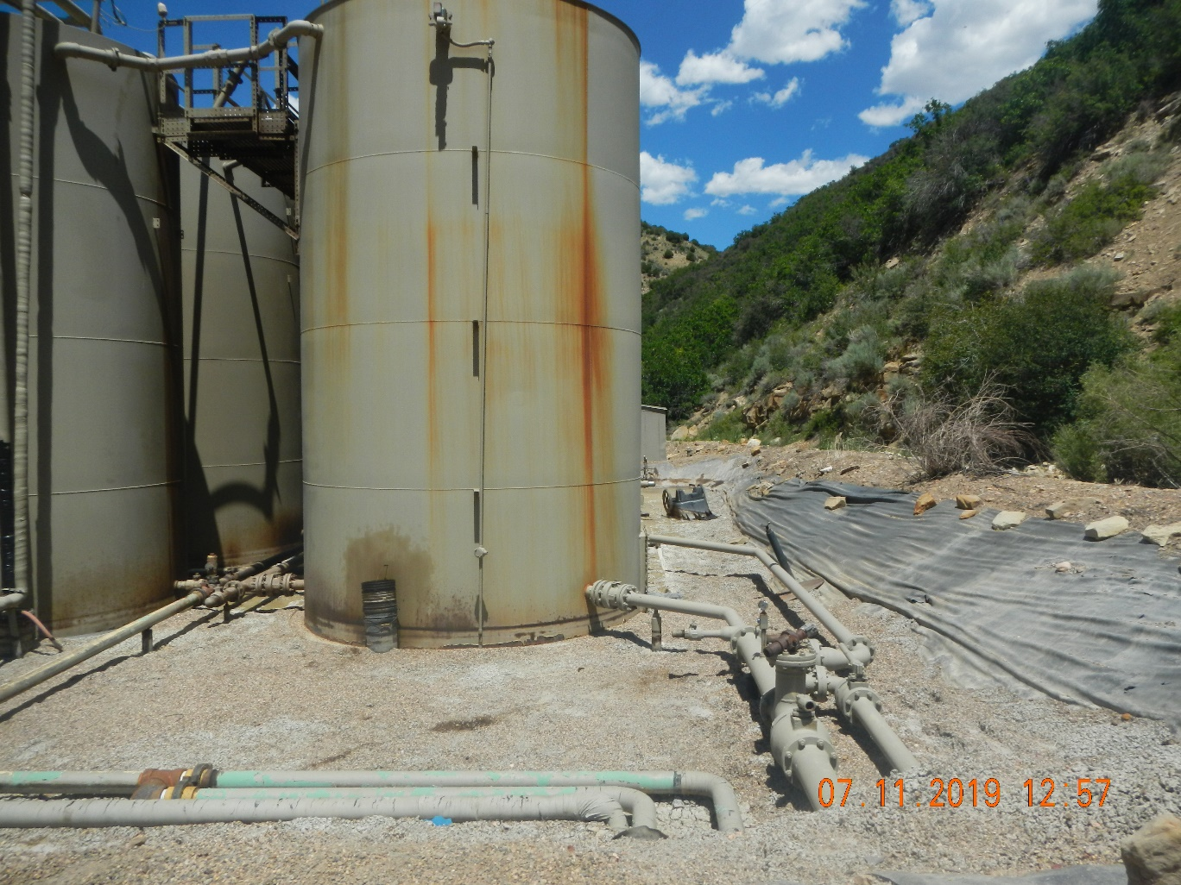
Inspection Photos
Location: facility 116704
Remediation # 11554
Inspection Date: 7/11/2019
Photos taken by Kris Neidel
Photo #10 looking north adjacent tank battery

Slide 11
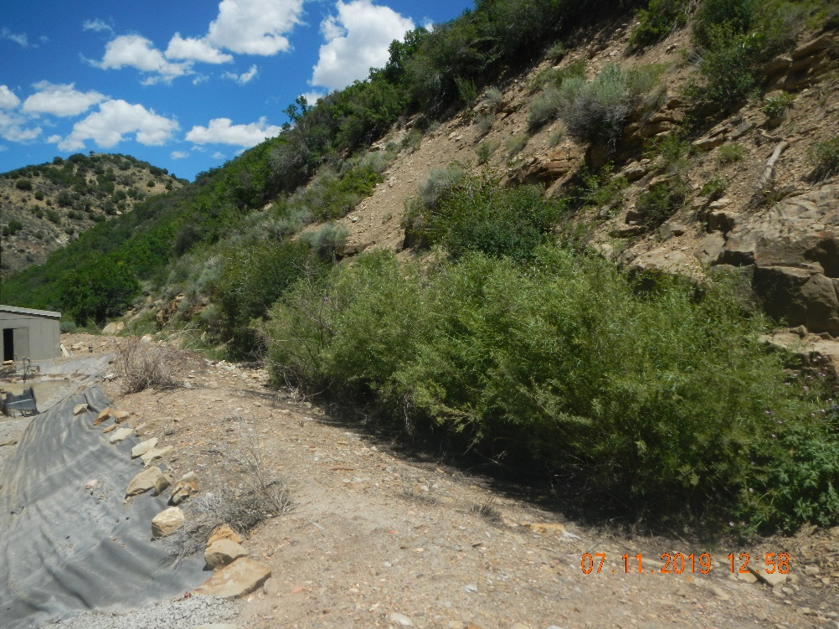
Inspection Photos
Location: facility 116704
Remediation # 11554
Inspection Date: 7/11/2019
Photos taken by Kris Neidel
Photo #11 photo looking north, taken to the right of photo 10

Slide 12
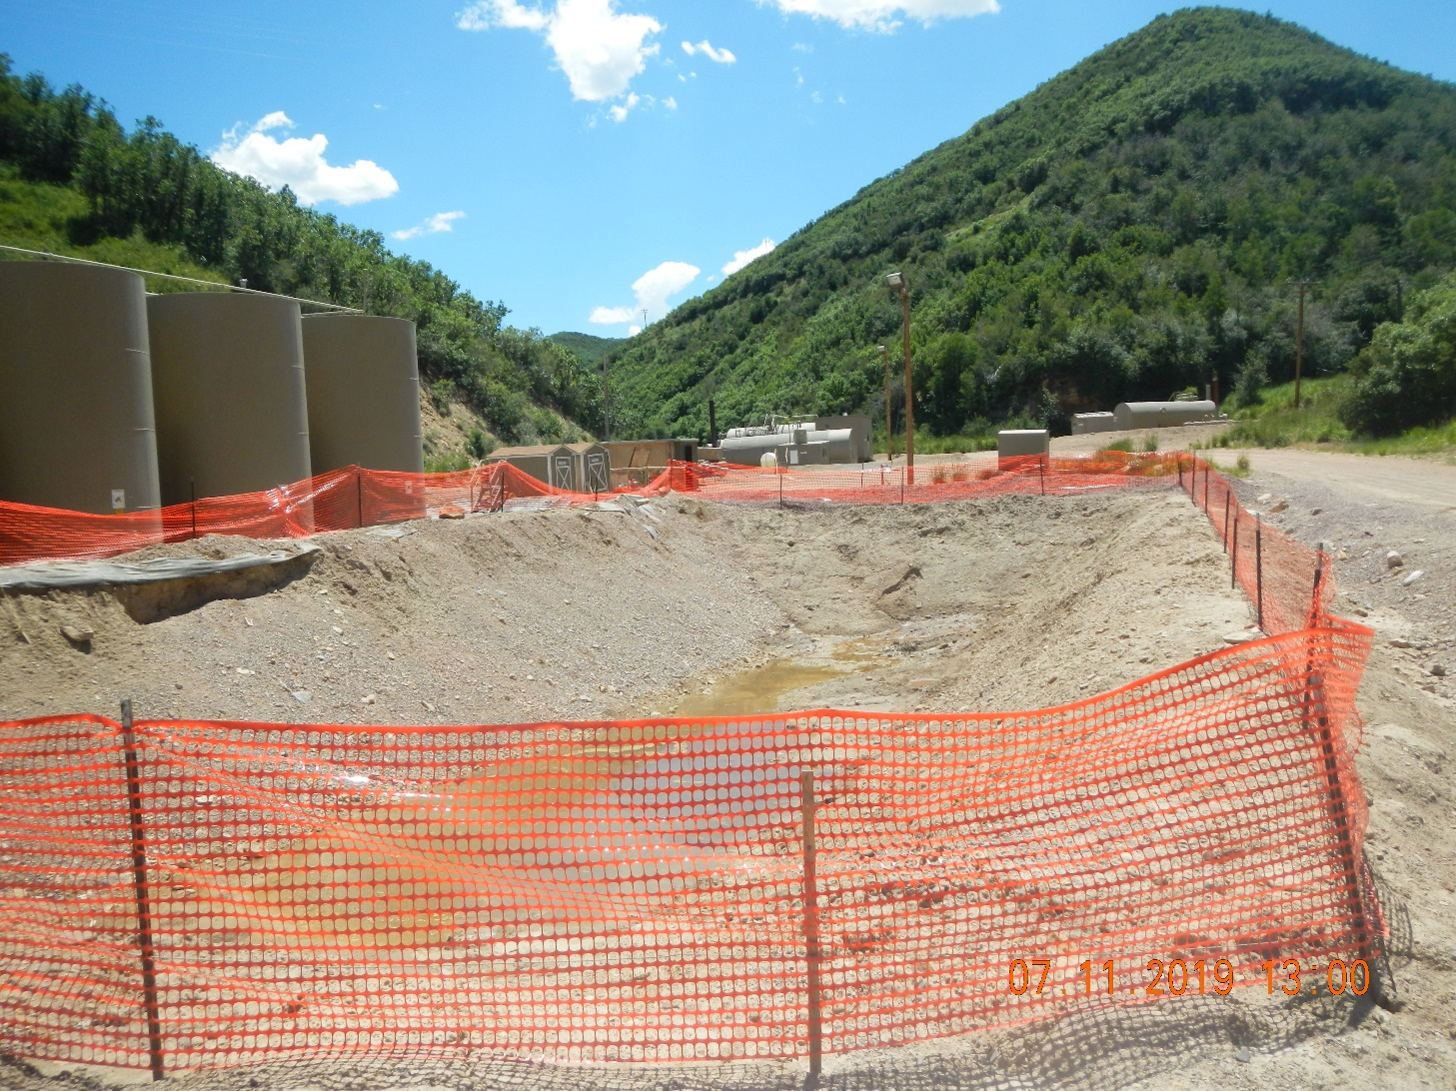
Inspection Photos
Location: facility 116704
Remediation # 11554
Inspection Date: 7/11/2019
Photos taken by Kris Neidel
Photo #12 looking south

Slide 13
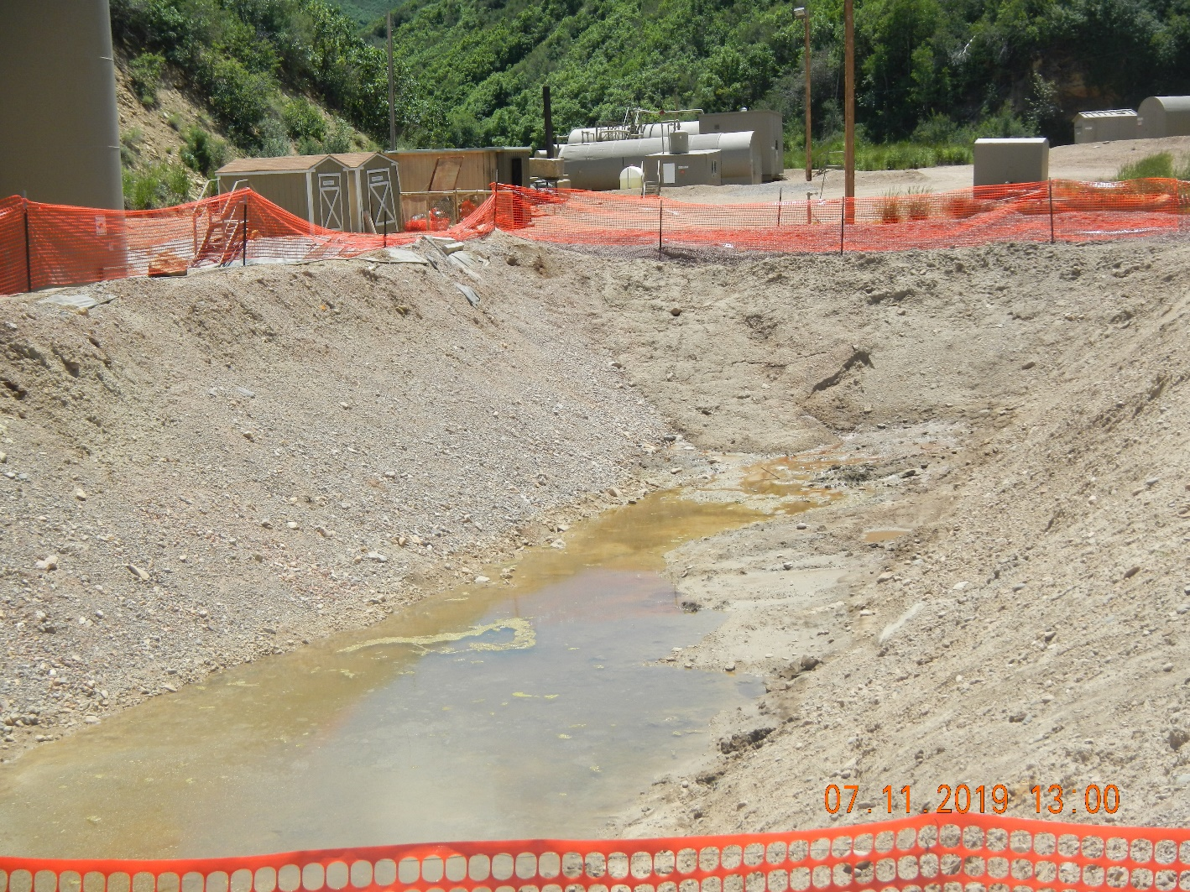
Inspection Photos
Location: facility 116704
Remediation # 11554
Inspection Date: 7/11/2019
Photos taken by Kris Neidel
Photo #13 looking south

