Slide 1
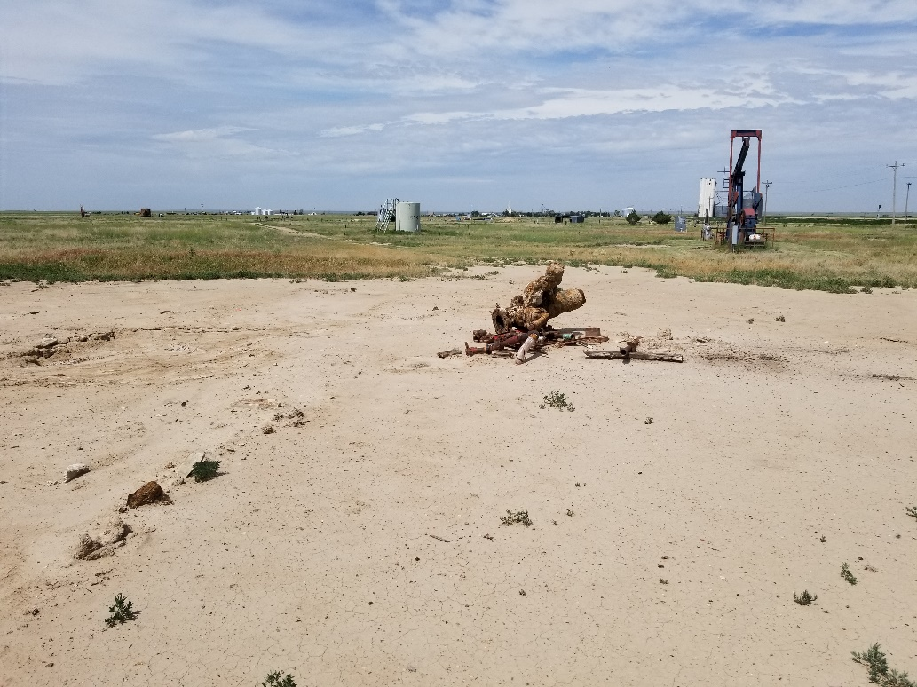
Inspection Photo
Location Name: Muir E J 1
API: 05-061-06084
Wellhead is cut and well is plugged

