Slide 1
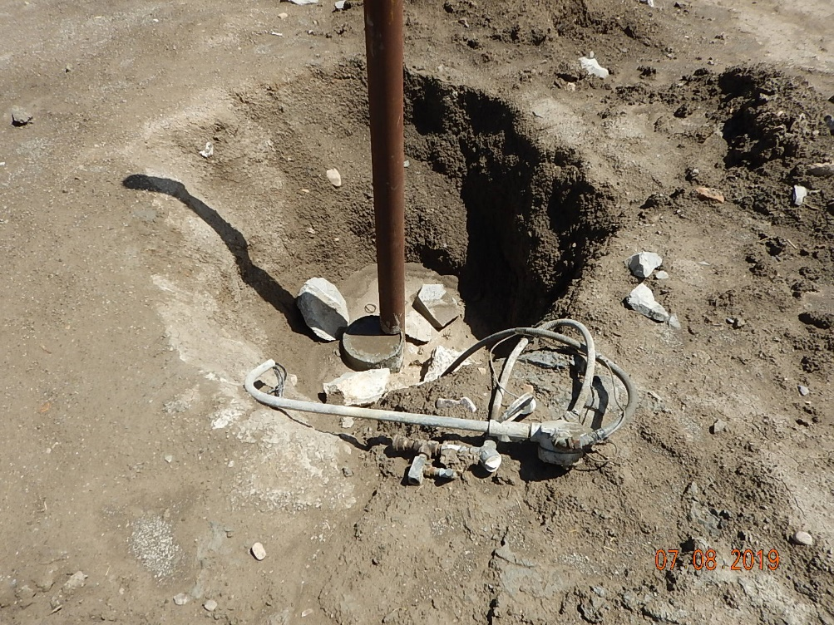
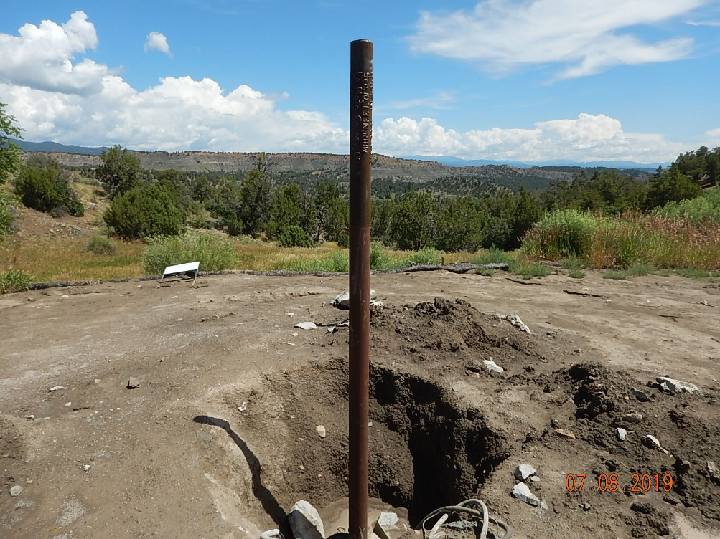
Inspection Photos
DL GOULD FLUME CANYON 2
API: 05-067-06117
Dryhole marker and unused equipment wiring.
Dryhole marker.

Slide 2
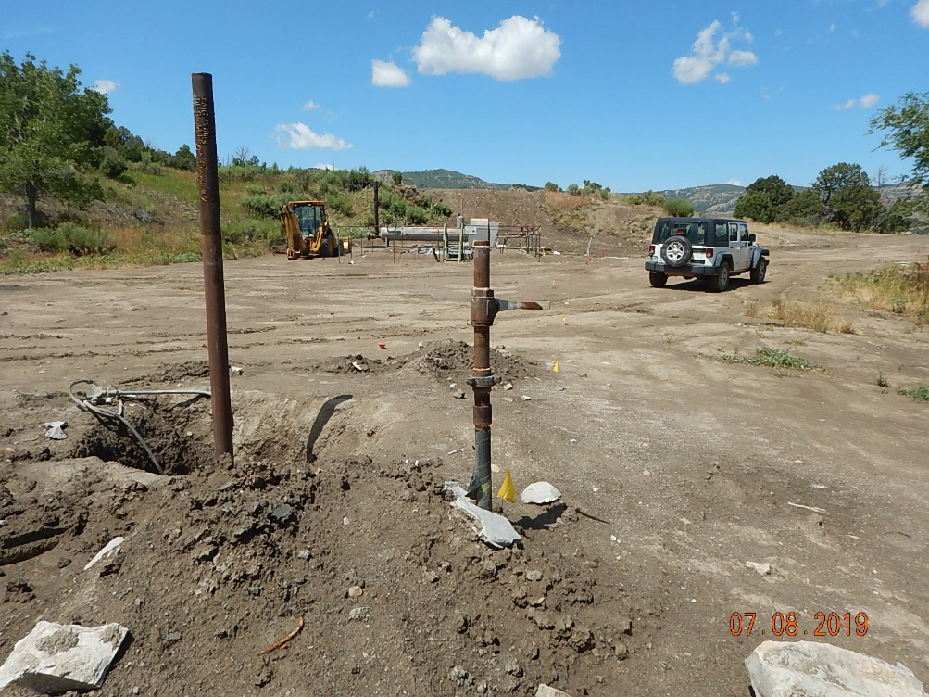
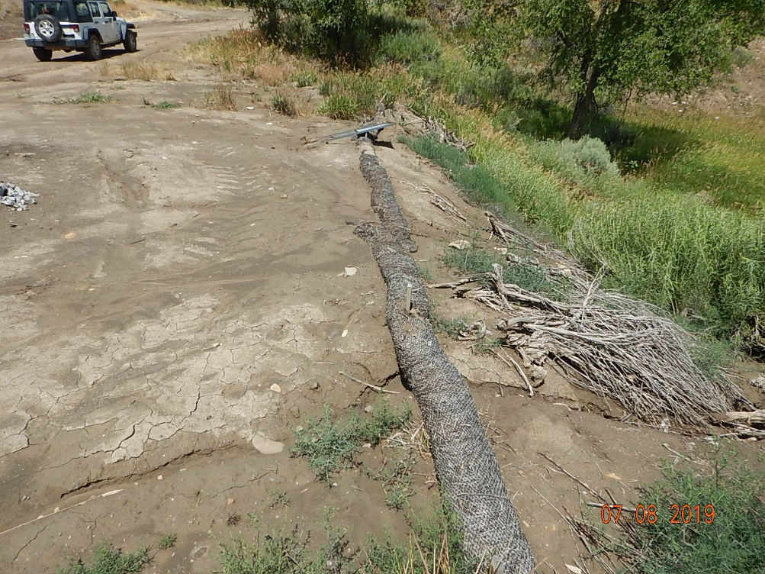
Inspection Photos
DL GOULD FLUME CANYON 2
API: 05-067-06117
2” Unused flowline from wellhead to separator.
Stormwater BMP’s inadequate.

Slide 3
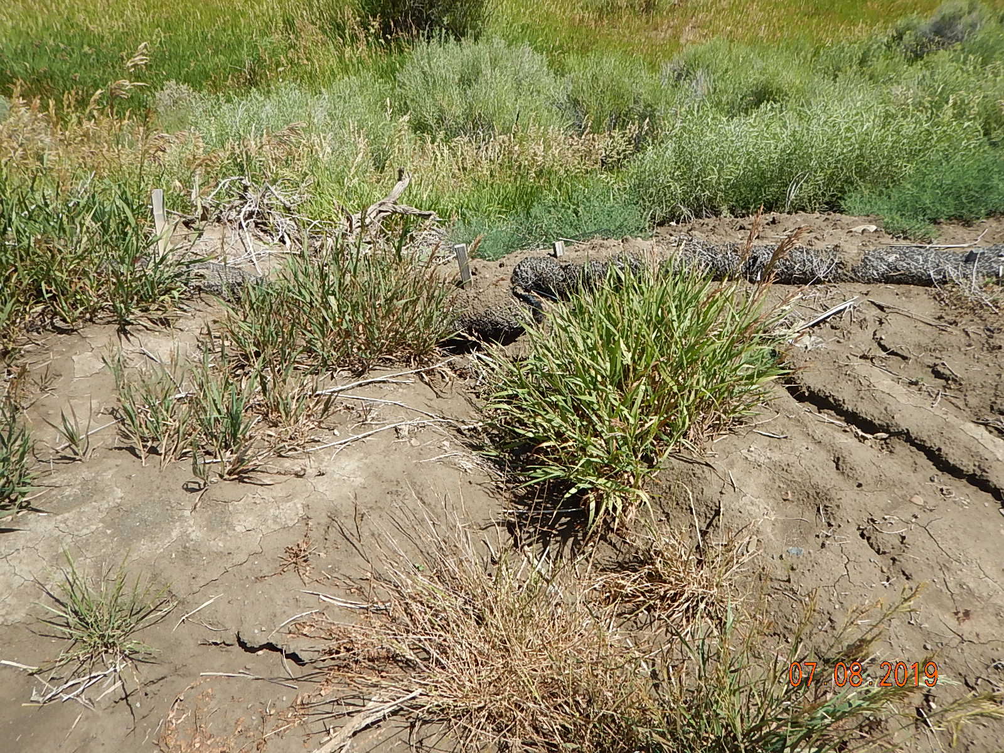
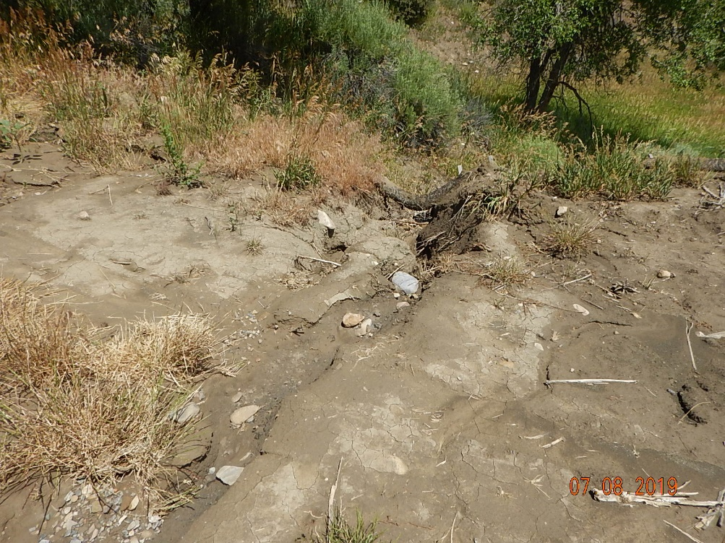
Inspection Photos
DL GOULD FLUME CANYON 2
API: 05-067-06117
Stormwater BMP’s inadequate. Erosion and channeling under waddles offsite.
Stormwater BMP’s inadequate. Erosion and channeling under waddles offsite.

Slide 4
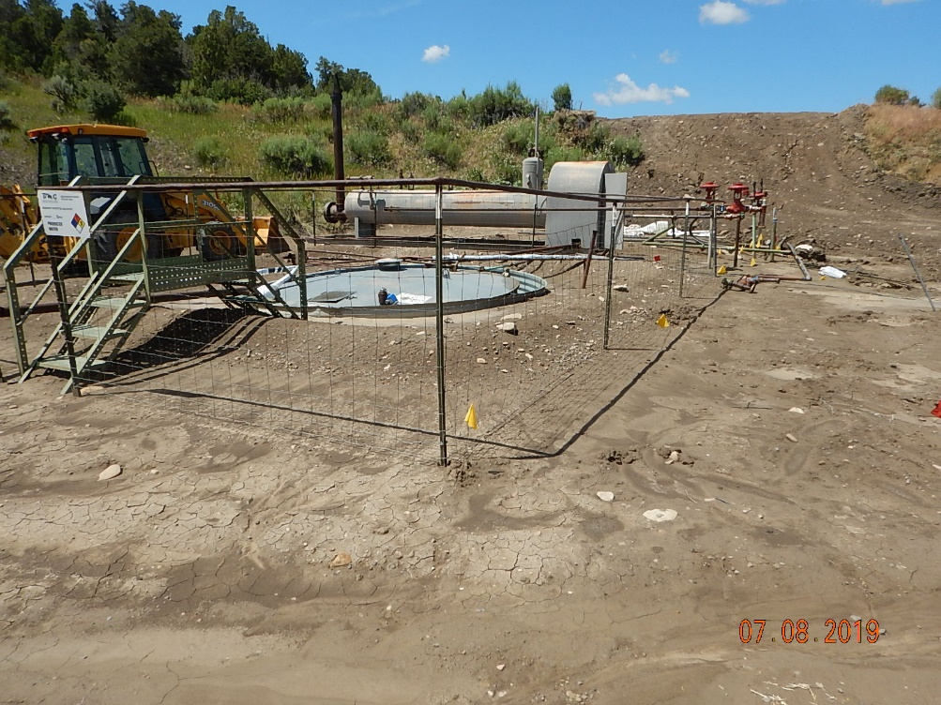
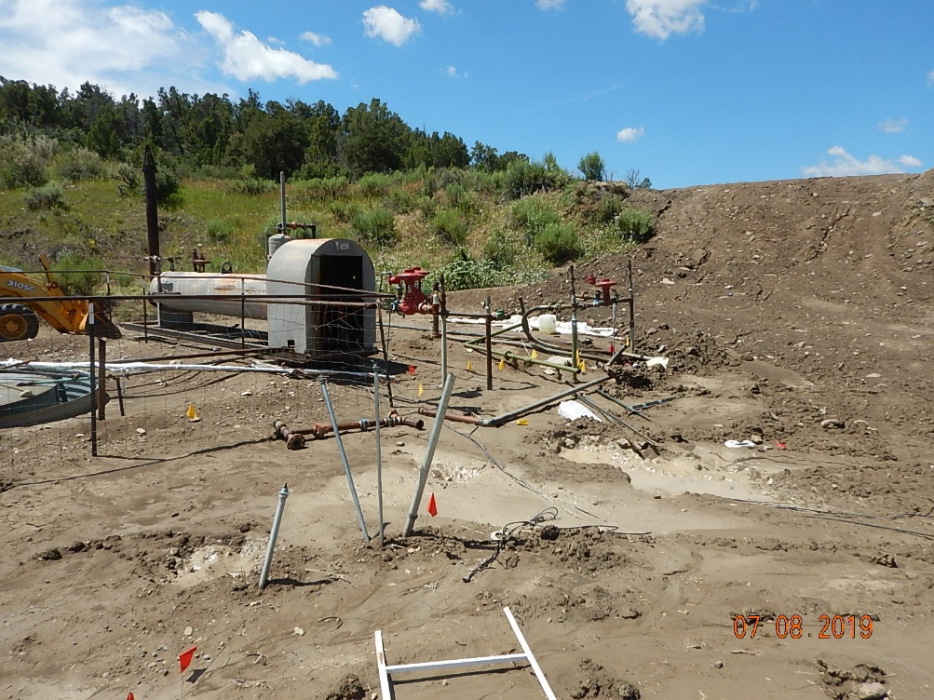
Inspection Photos
DL GOULD FLUME CANYON 2
API: 05-067-06117
Unused equipment produced water tank.
Unused equipment separator and flowline piping.

Slide 5
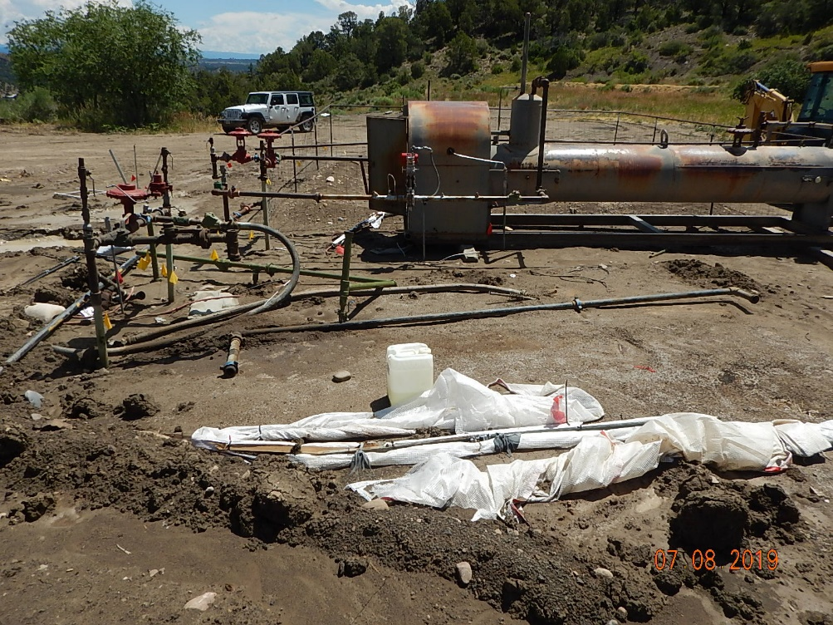
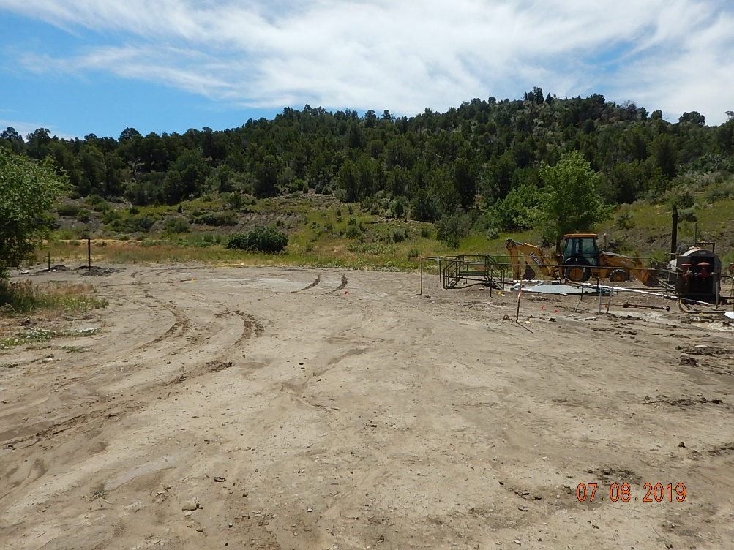
Inspection Photos
DL GOULD FLUME CANYON 2
API: 05-067-06117
Compressor was removed, unused flowlines and debris from compressor, unused piping, fittings and hoses.
Location overview.

