Slide 1
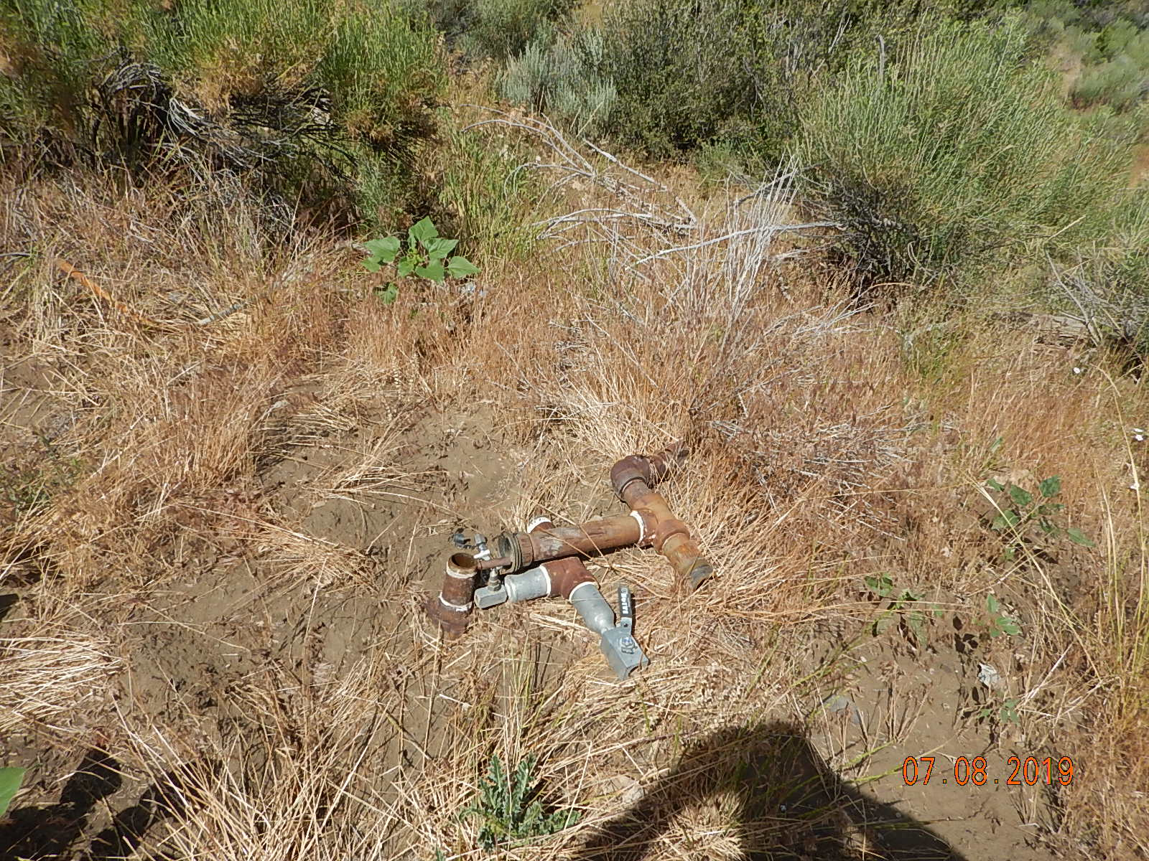
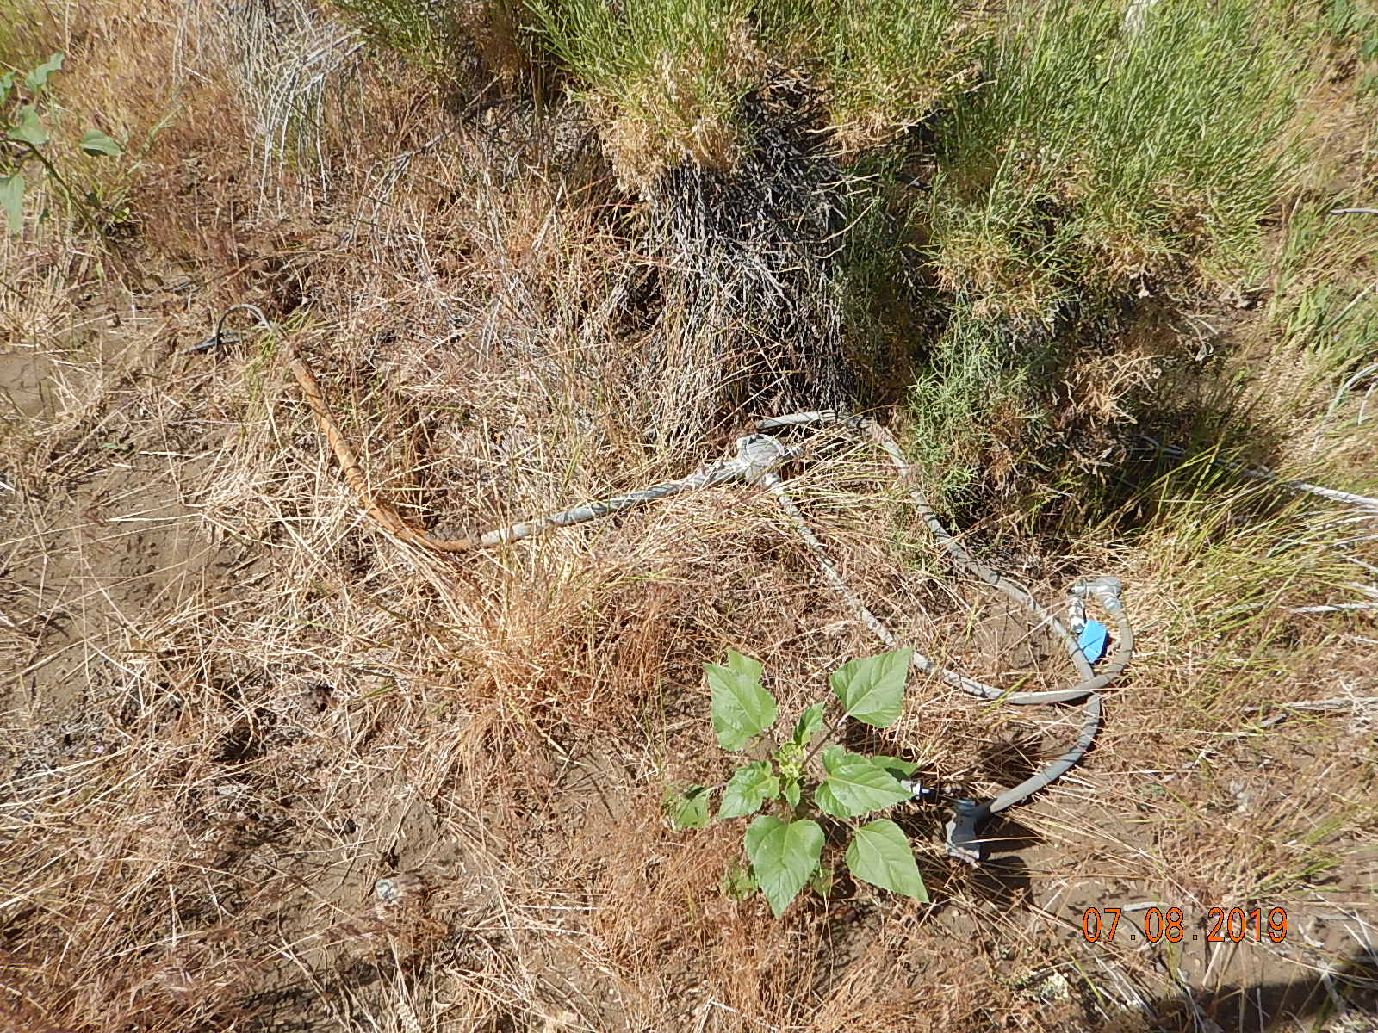
Inspection Photos
UTE #6
API: 05-067-06175
Unused equipment off north side of location.
Unused equipment off north side of location.

Slide 2
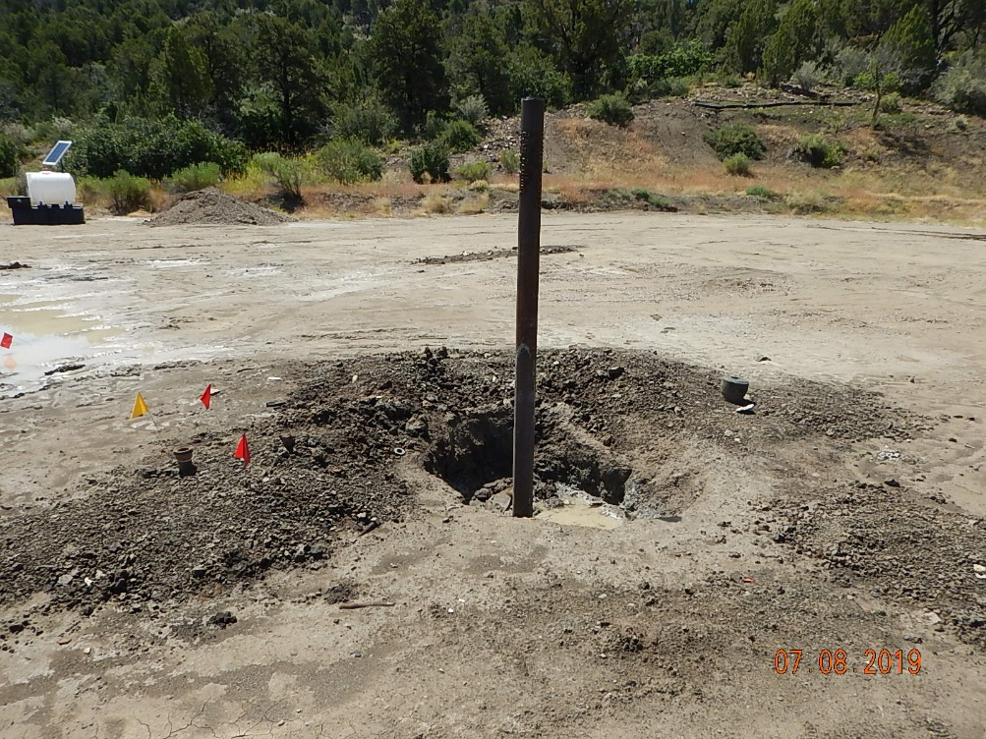
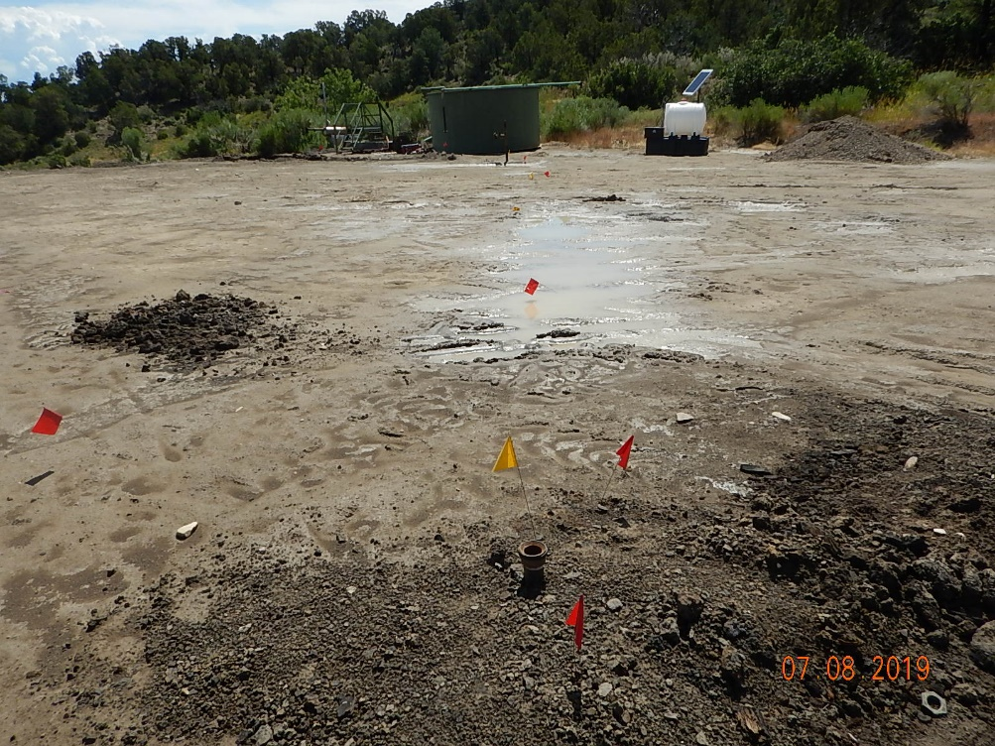
Inspection Photos
UTE #6
API: 05-067-06175
Dryhole marker, debris, nuts/studs around marker.
2” unused flowline from dryhole marker across location.

Slide 3
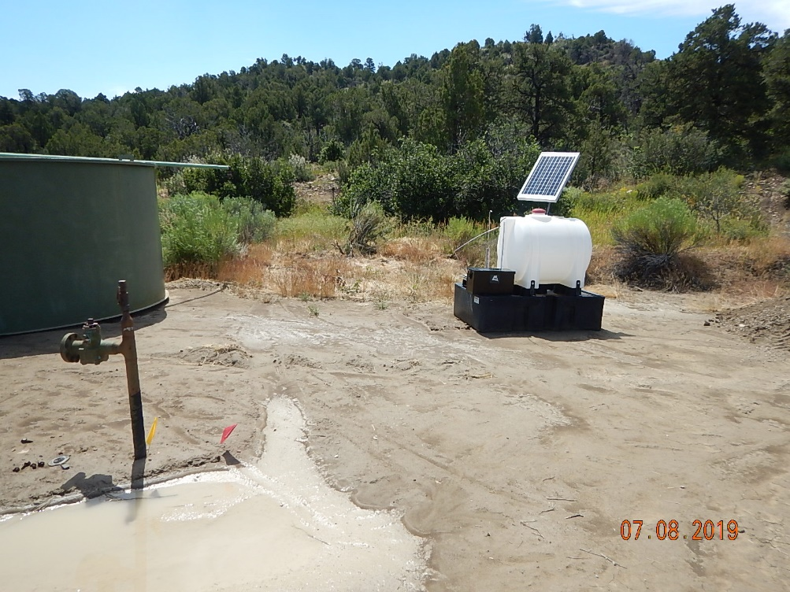
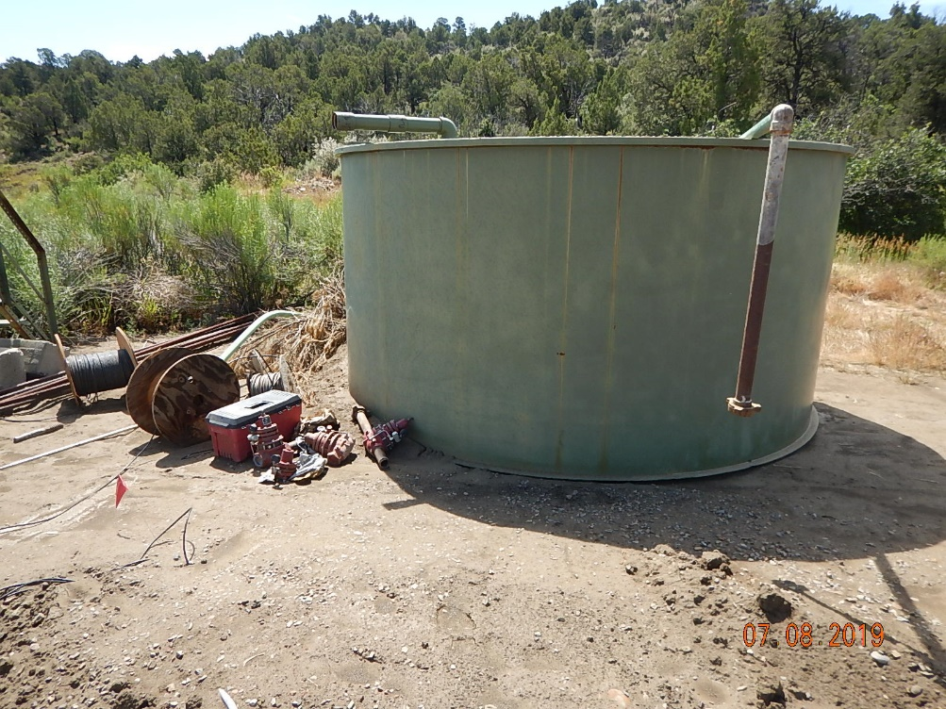
Inspection Photos
UTE #6
API: 05-067-06175
Unused equipment and other end of unused flowline.
Unused tank, valves, wire spool debris, piping.

Slide 4
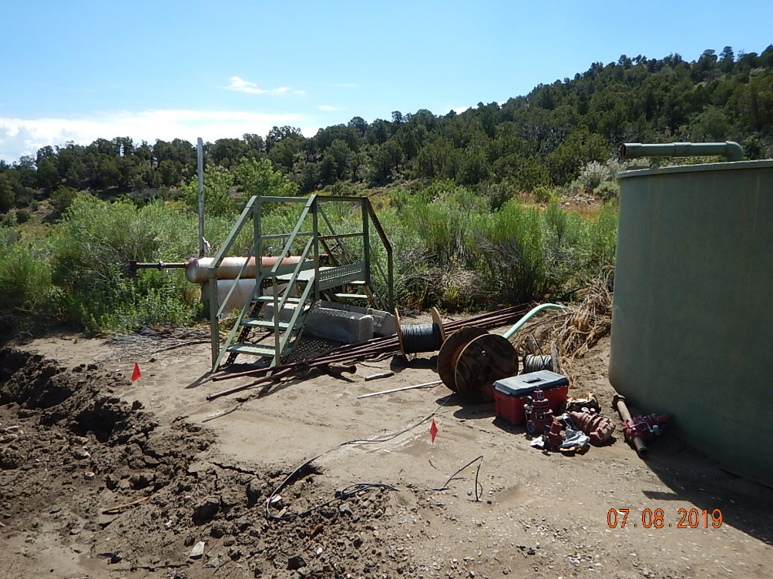
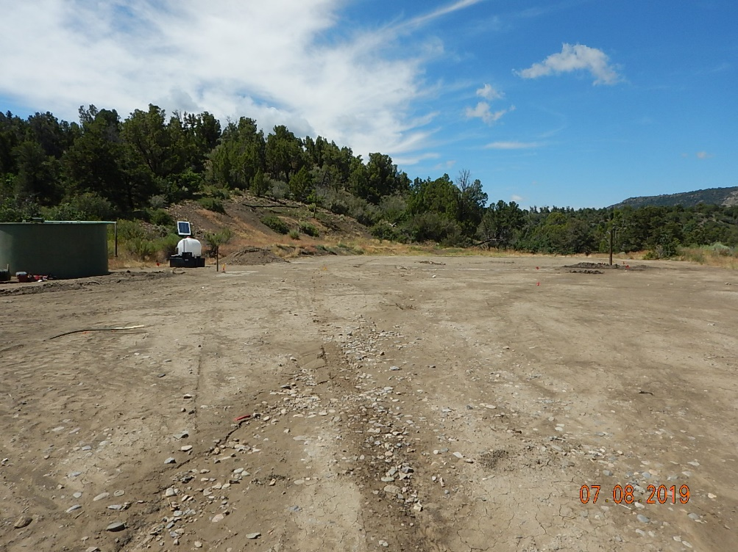
Inspection Photos
UTE #6
API: 05-067-06175
Unused piping, stairs, concrete debris, horizontal separator.
Location overview.

