Slide 1
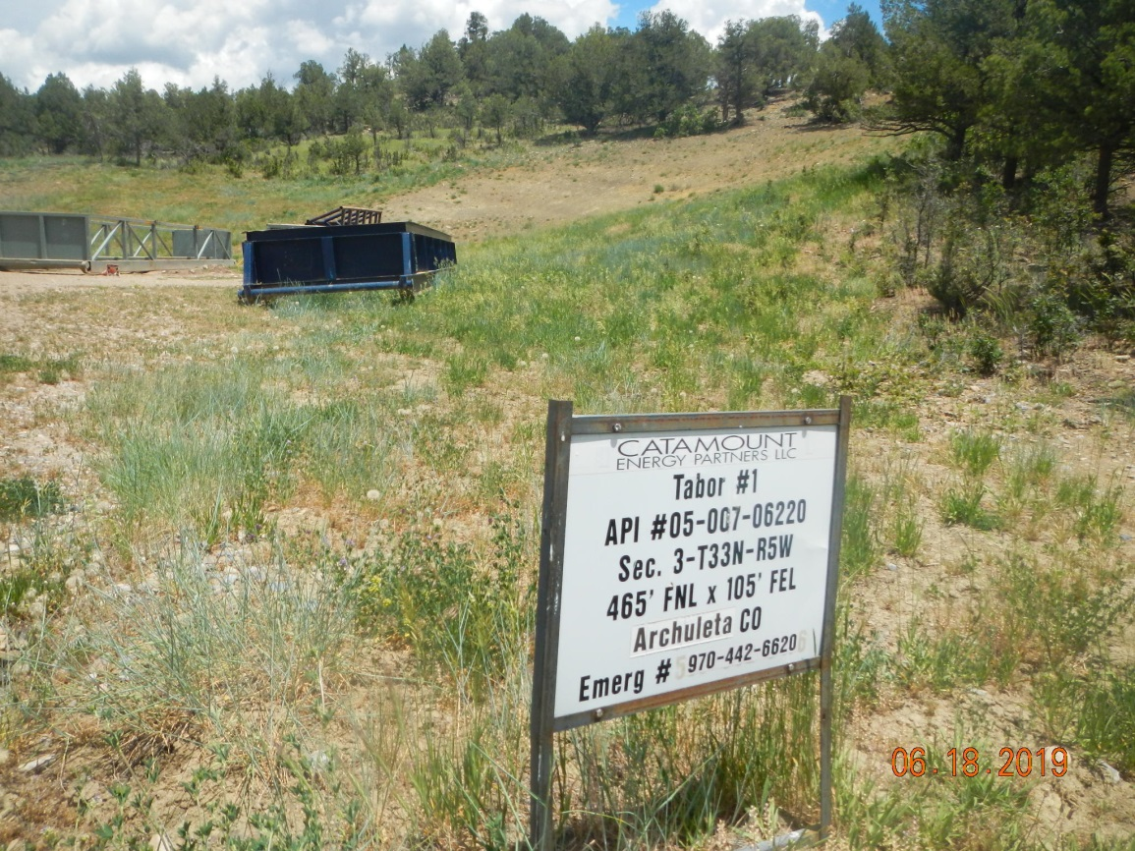
Inspection Photos
Location Name:
Location ID:

Slide 2
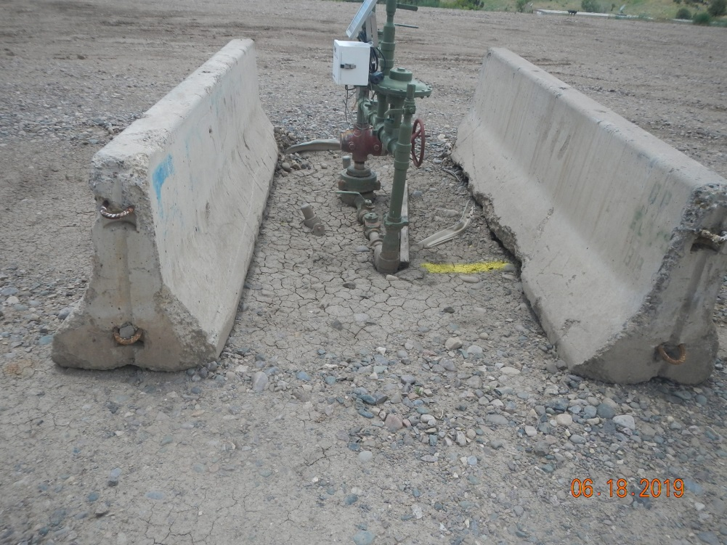
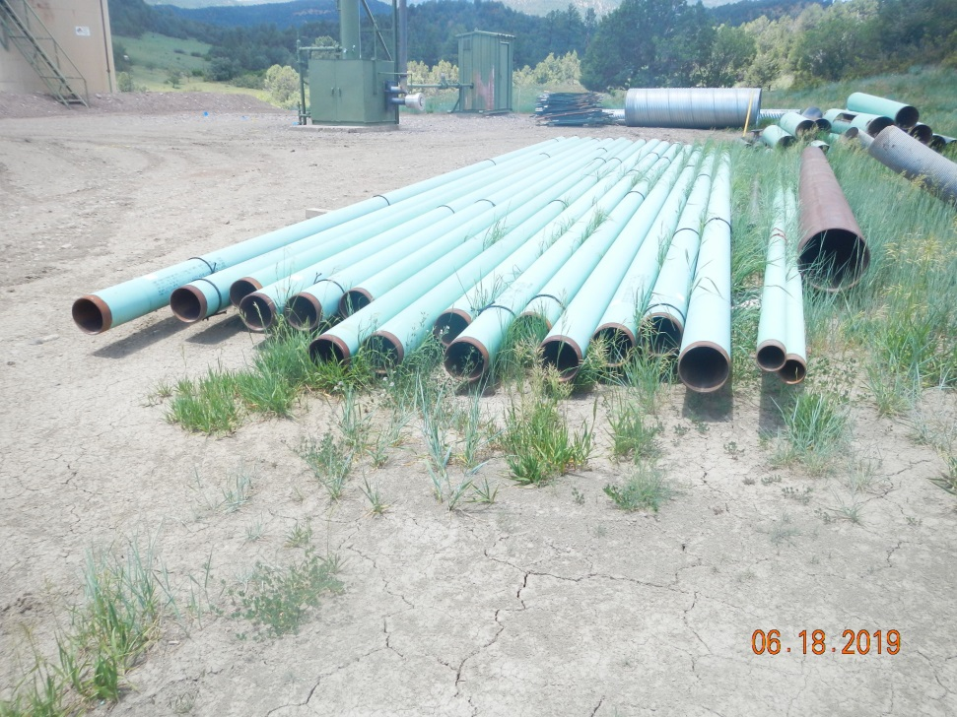
Inspection Photos
Location Name: Tabor 1
API number: 007-6220
Wellhead
Production equipment and stored supplies

Slide 3
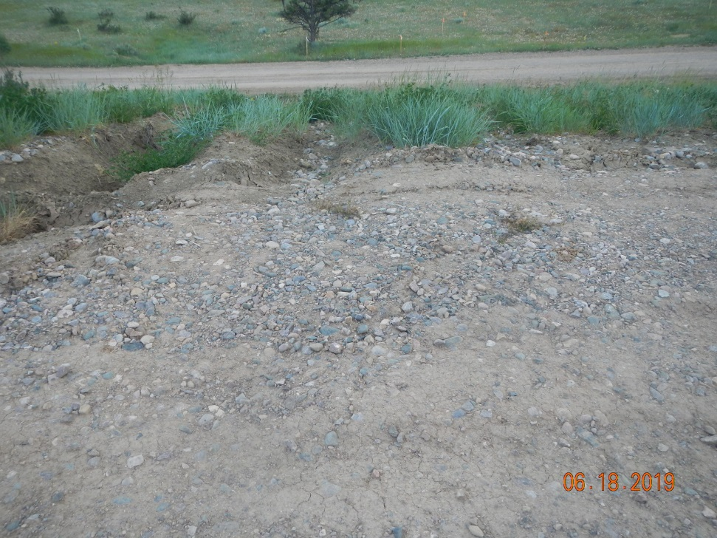
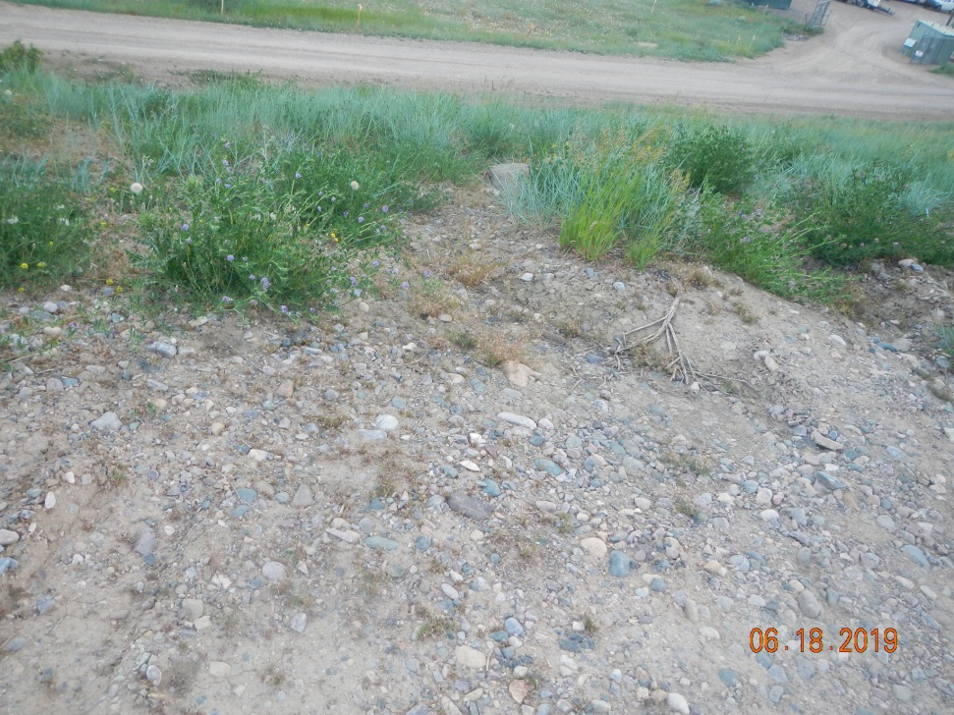
Inspection Photos
Location Name: Tabor 1
API number: 007-6220
Erosion channels south edge of location
Erosion off south edge of pad

Slide 4
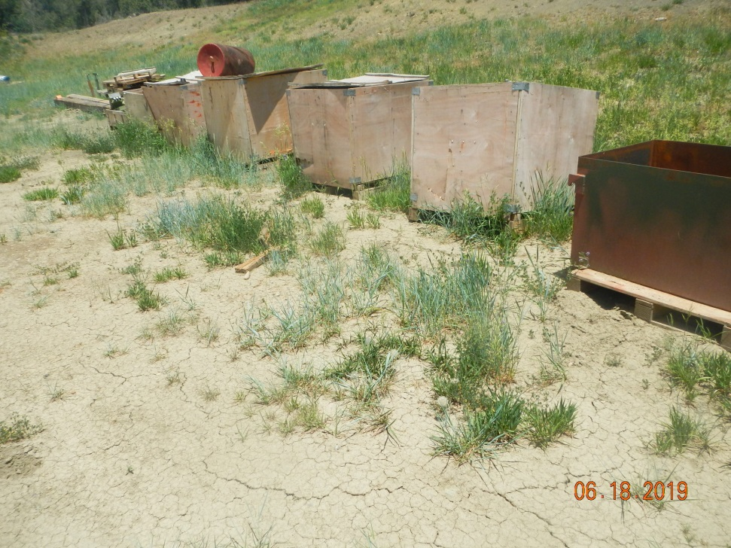
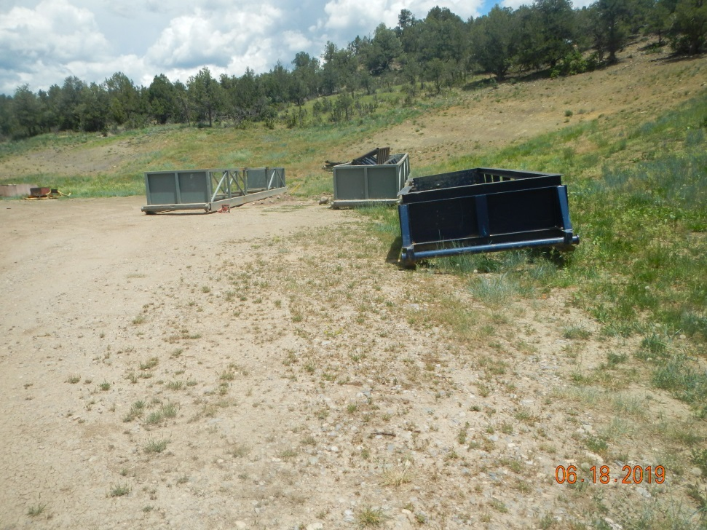
Inspection Photos
Location Name: Tabor 1
API number: 007-6220
Storage boxes with parts, equipment and used pigs
Empty pipe bins presumably from drilling operation. Also cut slope interim rec area in background

Slide 5
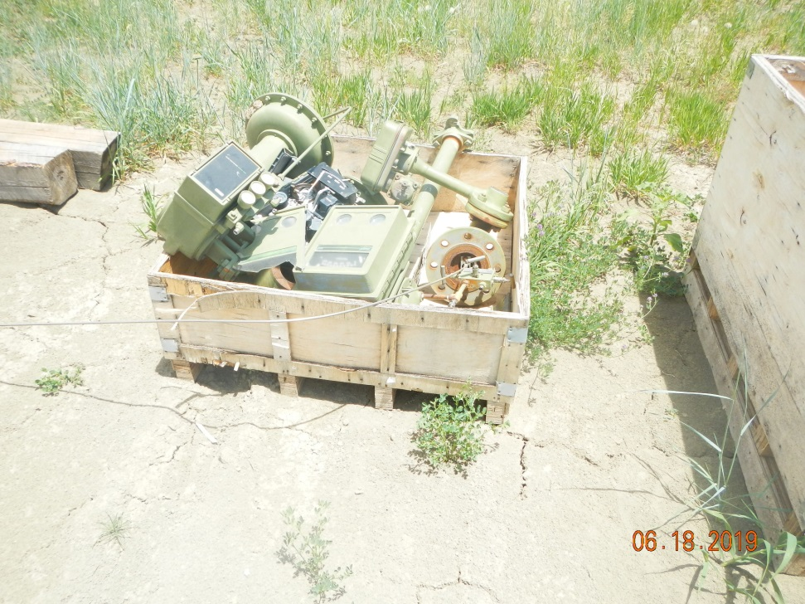
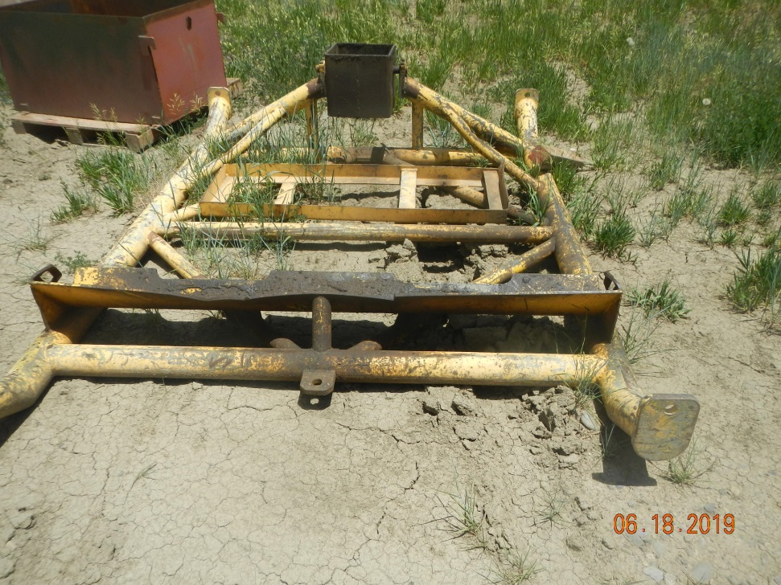
Inspection Photos
Location Name: Tabor 1
API number: 007-6220
Separator/process parts
Grease covered equipment skid

Slide 6
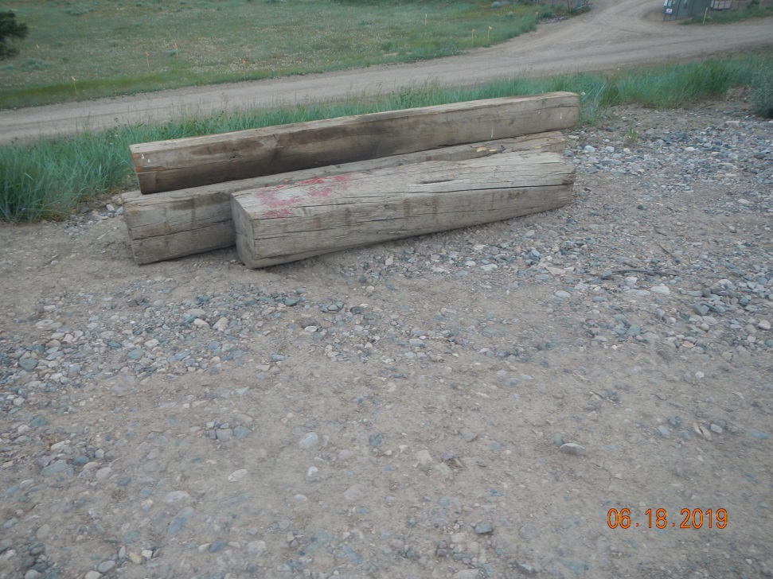
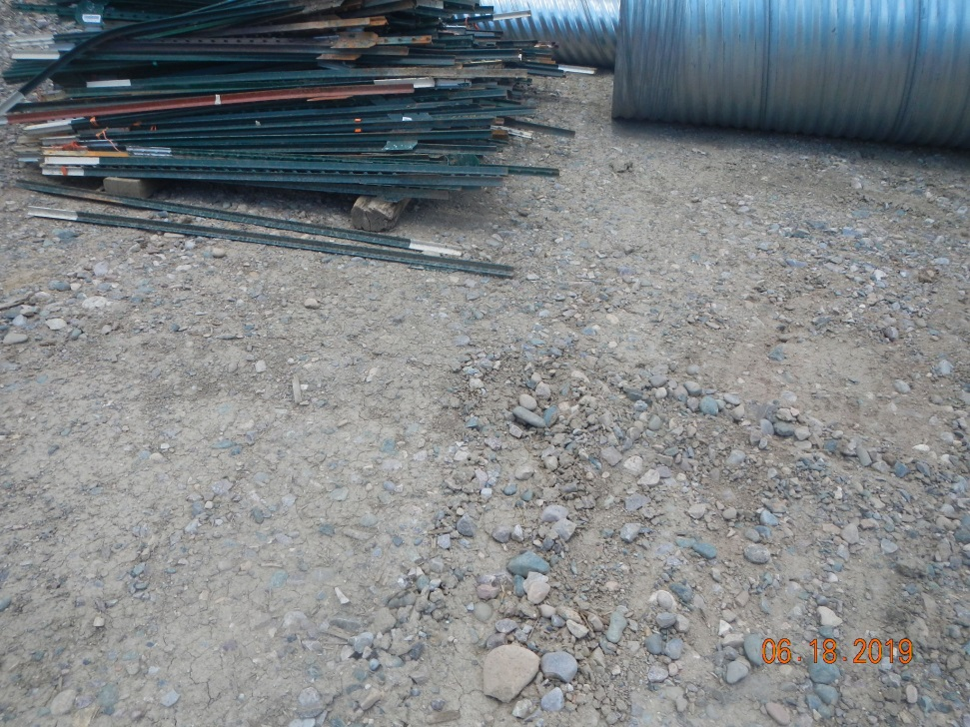
Inspection Photos
Location Name: Tabor 1
API number: 007-6220
storage
storage

