Slide 1
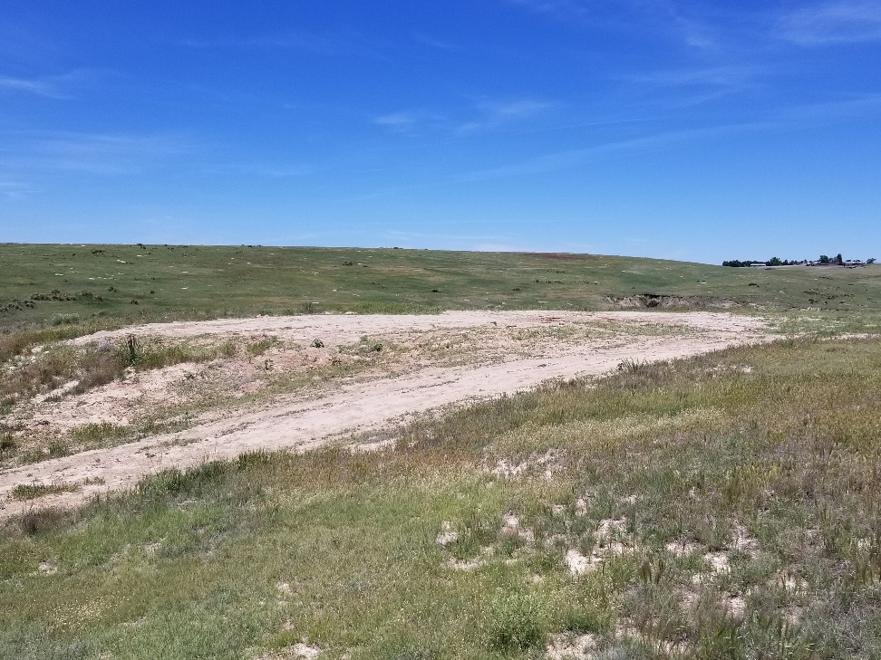
Inspection Photo
Location Name: Morris 3-3
API: 05-125-09761
1. Location photo

