Slide 1
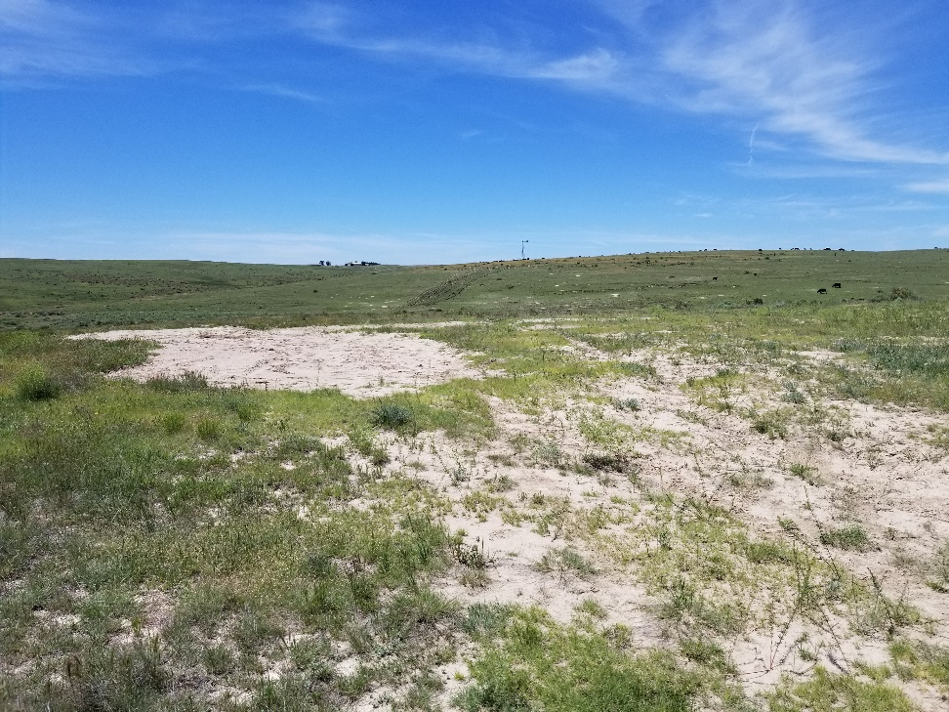
Inspection Photo
Location Name: Morris 3-5
API: 05-125-09760
1. Location photo

