Slide 1
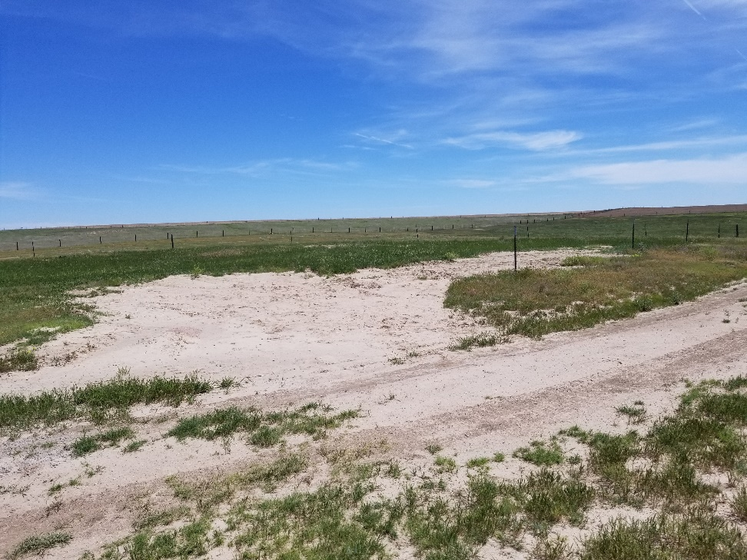
Inspection Photo
Location Name: Like 3-10
API: 05-125-09755
1. Location photo

