Slide 1
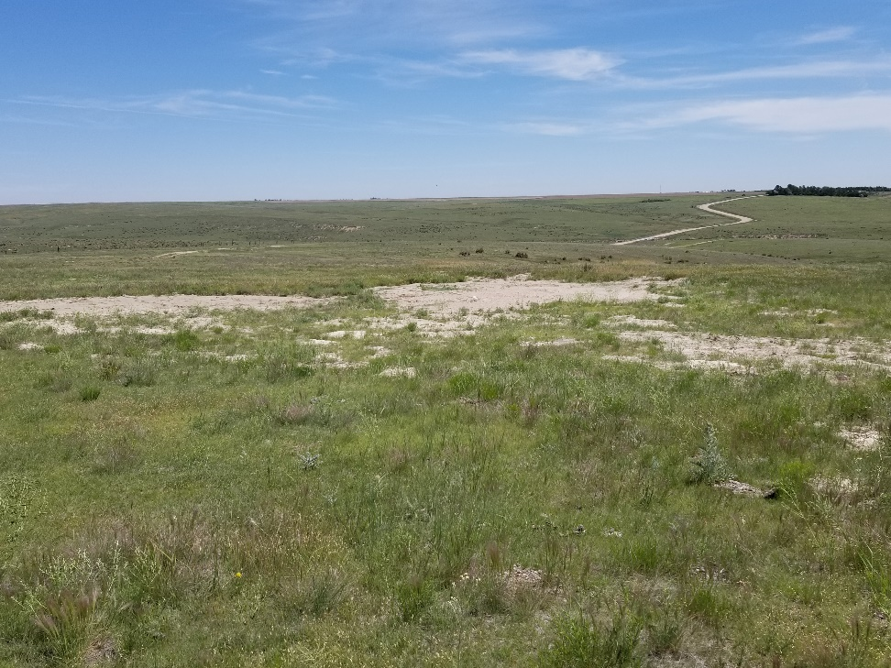
Inspection Photo
Location Name: Brenner 10-4
API: 05-125-09758
1. Location photo

