Slide 1
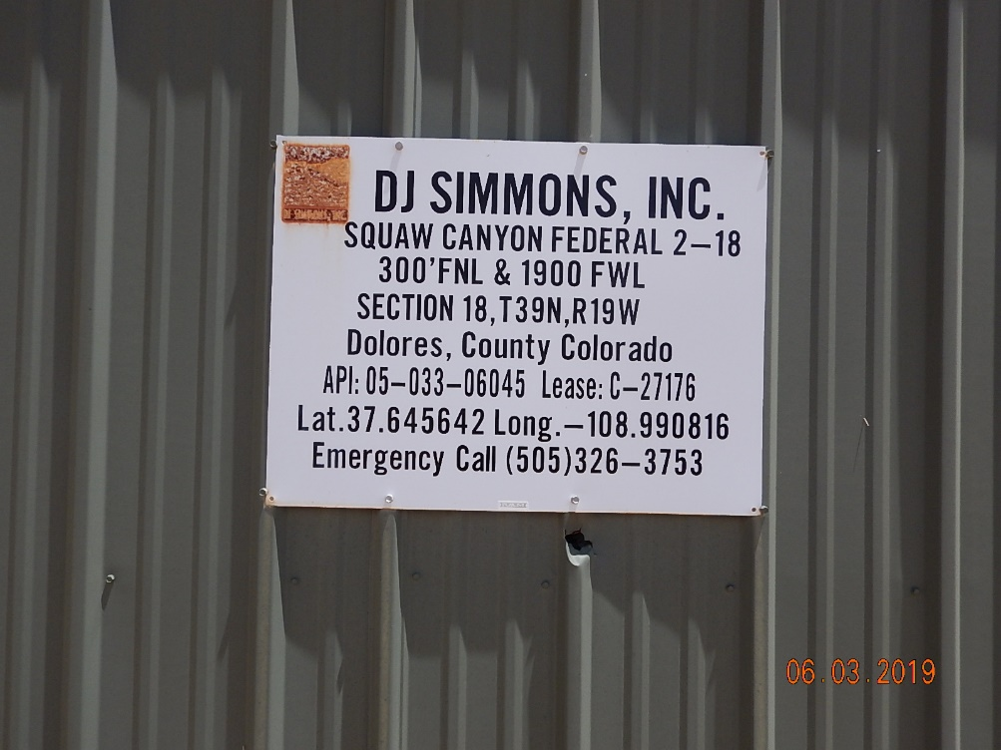
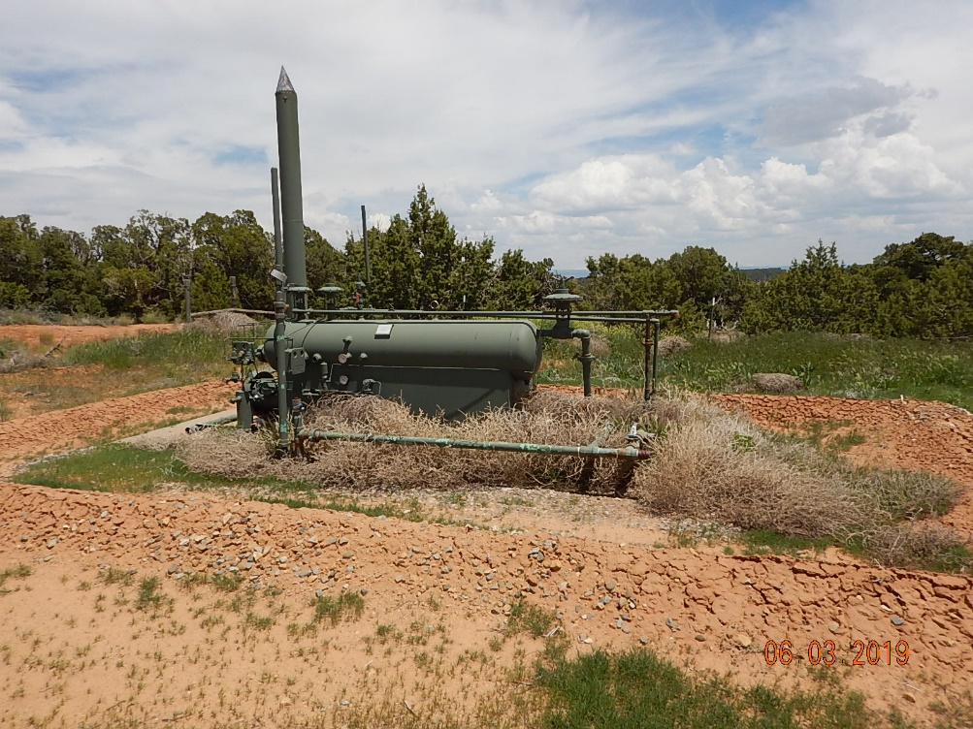
Inspection Photos
Squaw Canyon Federal 2-18
API: 05-033-06045
#1 Location.
#2 Weeds grown in around fired equipment.

Slide 2
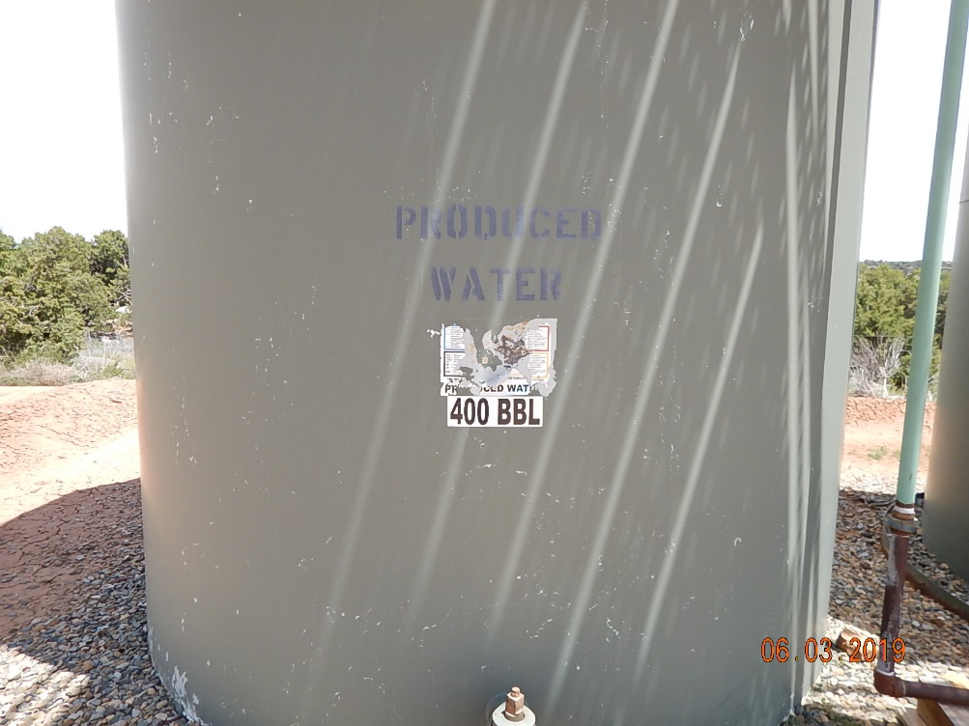
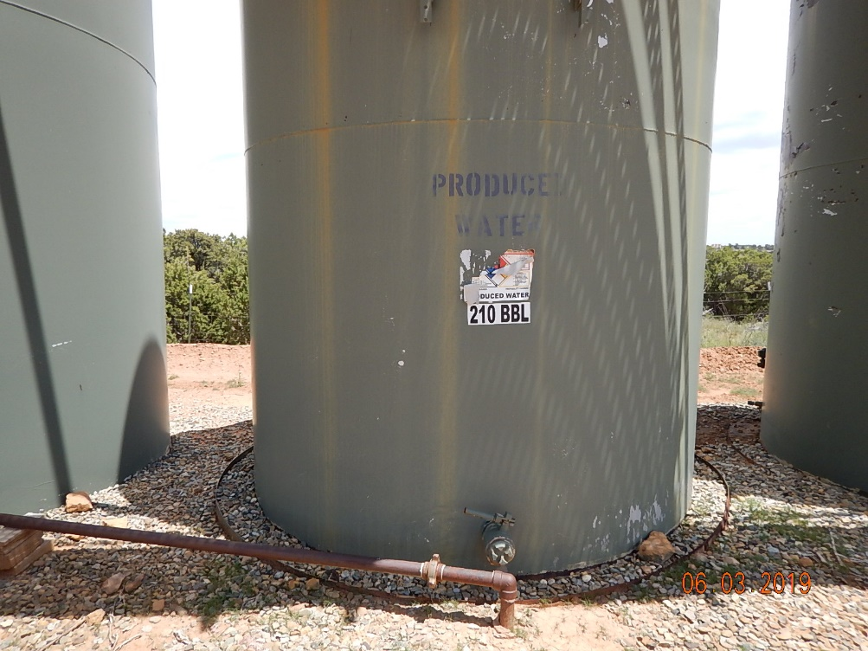
Inspection Photos
Squaw Canyon Federal 2-18
API: 05-033-06045
#3 Tank labeling.
#4 Tank labeling.

Slide 3
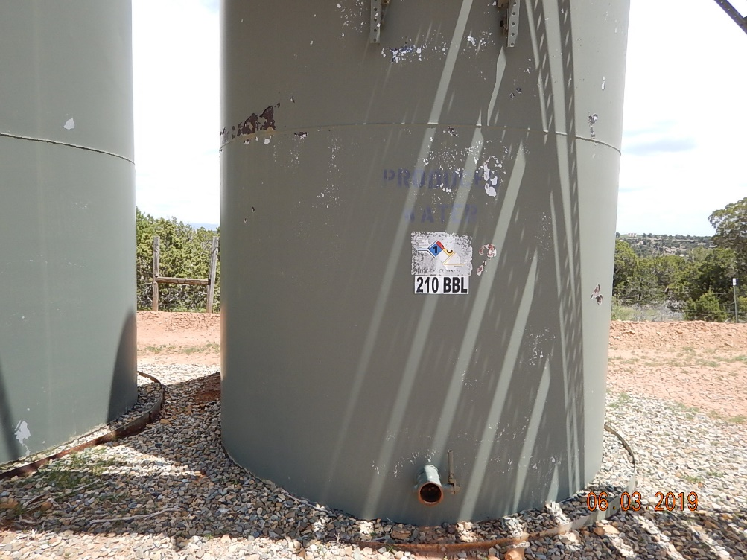
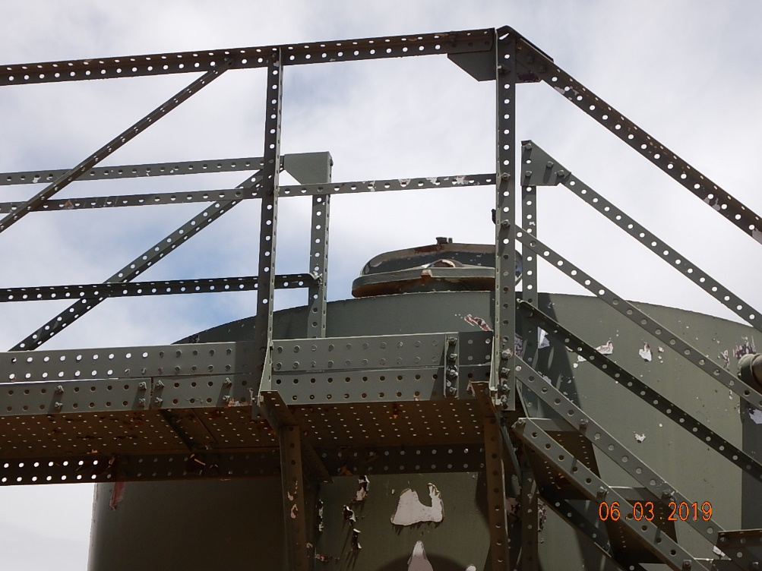
Inspection Photos
Squaw Canyon Federal 2-18
API: 05-033-06045
#5 Tank labeling.
#6 Thief hatch open.

Slide 4
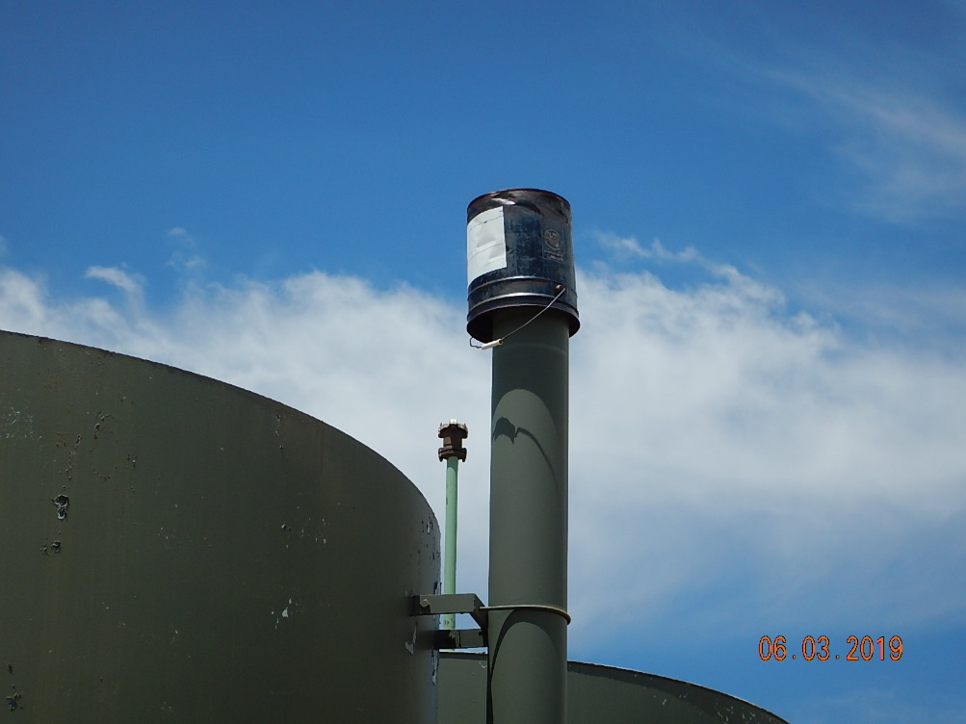
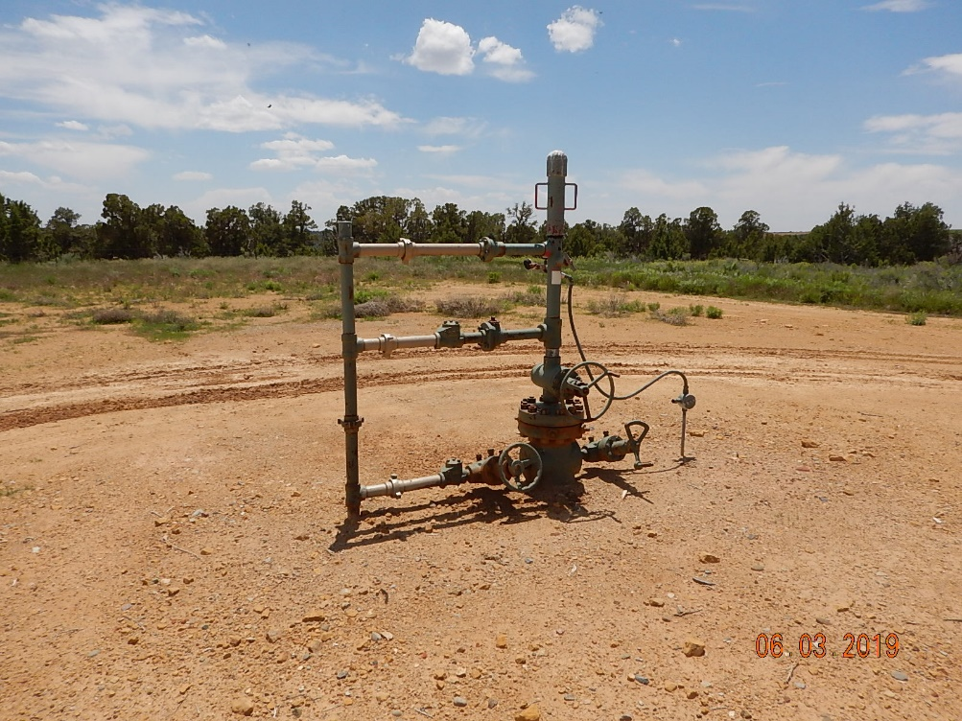
Inspection Photos
Squaw Canyon Federal 2-18
API: 05-033-06045
#7 Improper wildlife protection.
#8 Wellhead.

