Slide 1
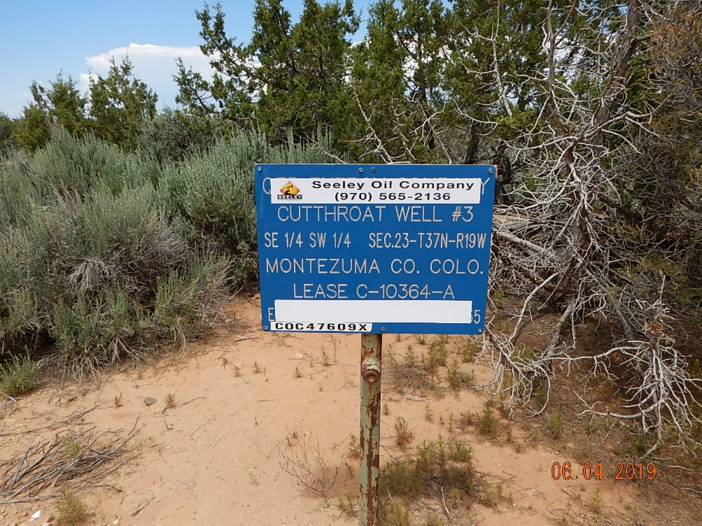
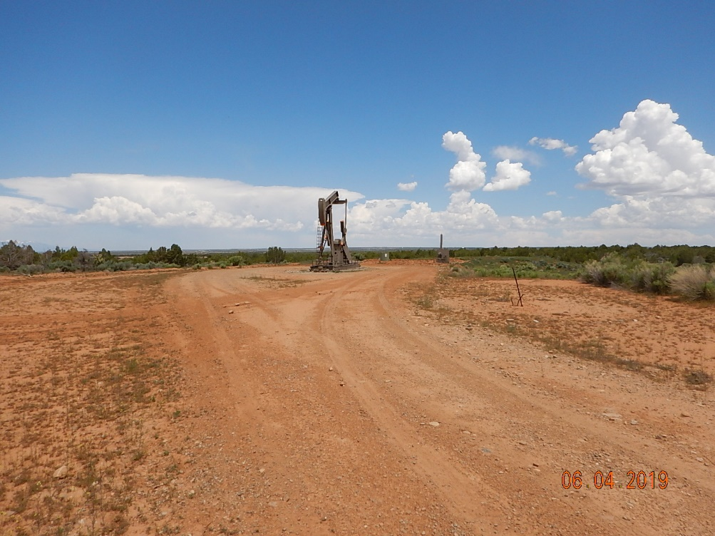
Inspection Photos
Cutthroat Unit #3
API: 05-083-06446
#1 Location Sign.
#2 Location.

Slide 2
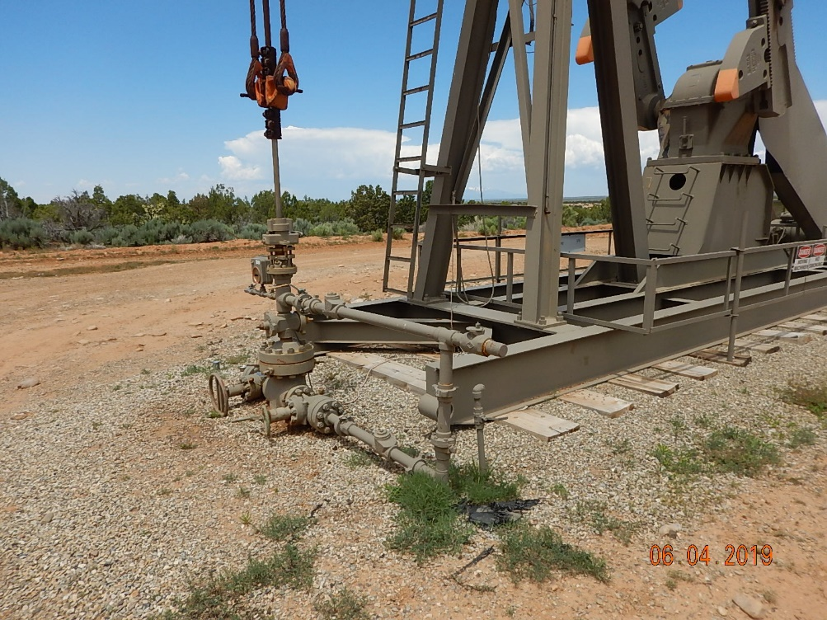
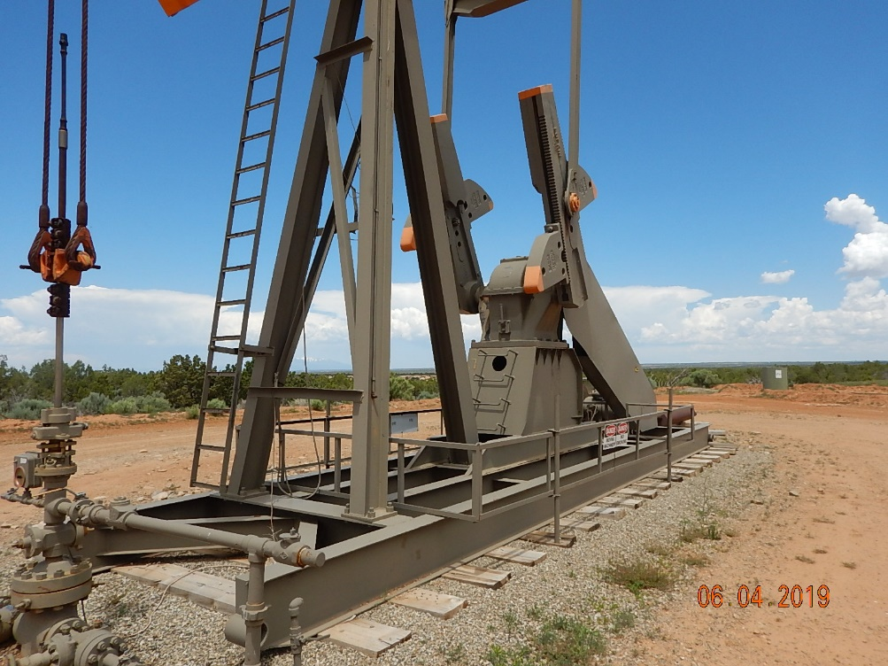
Inspection Photos
Cutthroat Unit #3
API: 05-083-06446
#3 Wellhead.
#4 Pumpjack.

Slide 3
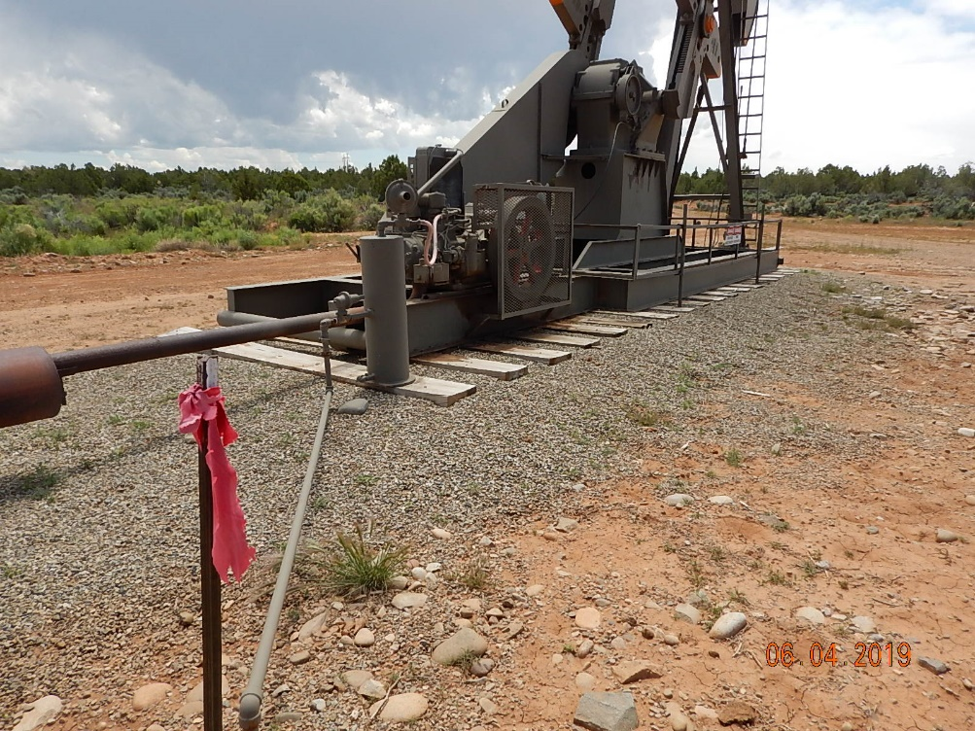
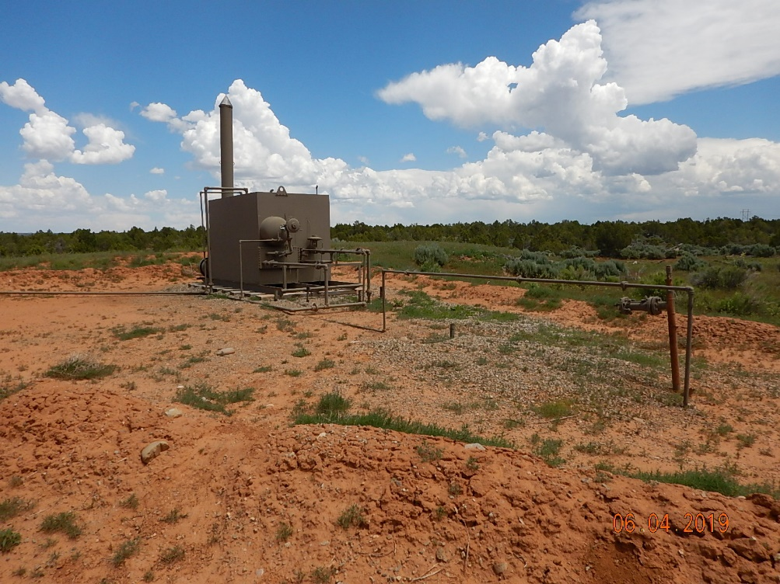
Inspection Photos
Cutthroat Unit #3
API: 05-083-06446
#5 Pumpjack.
#6 Equipment.

Slide 4
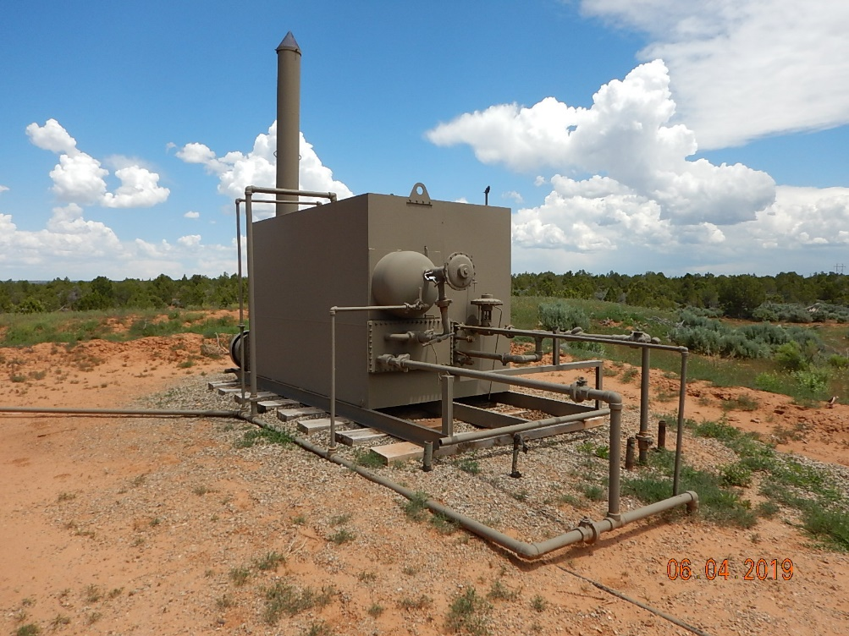
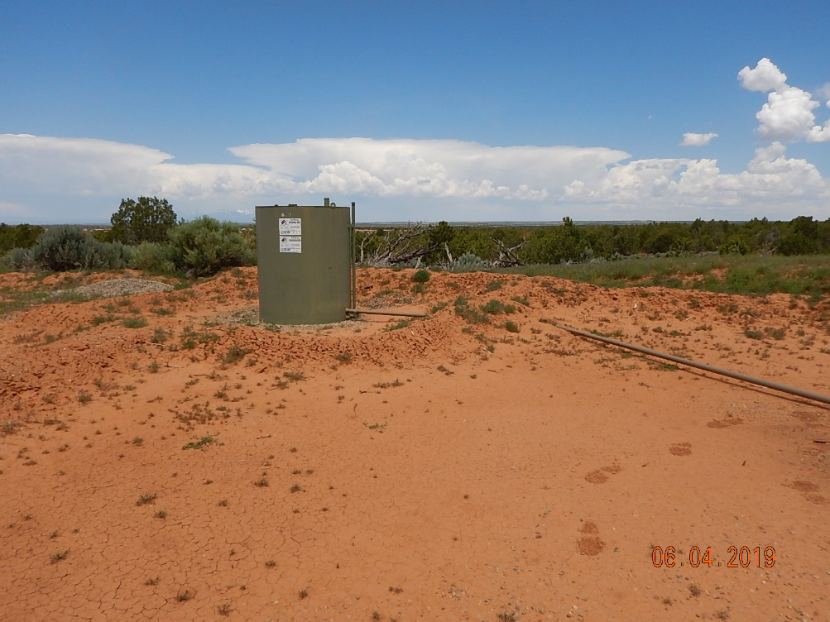
Inspection Photos
Cutthroat Unit #3
API: 05-083-06446
#7 Equipment.
#8 Inadequate secondary containment berms along northwestern side and tank labeling does not reflect current operator.

Slide 5
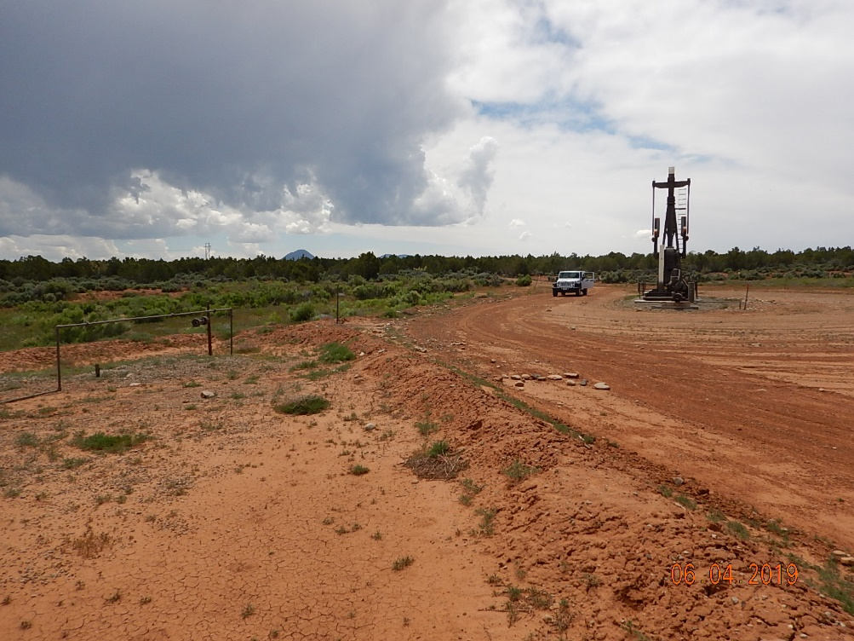
Inspection Photos
Cutthroat Unit #3
API: 05-083-06446
#9 Location.

