Slide 1
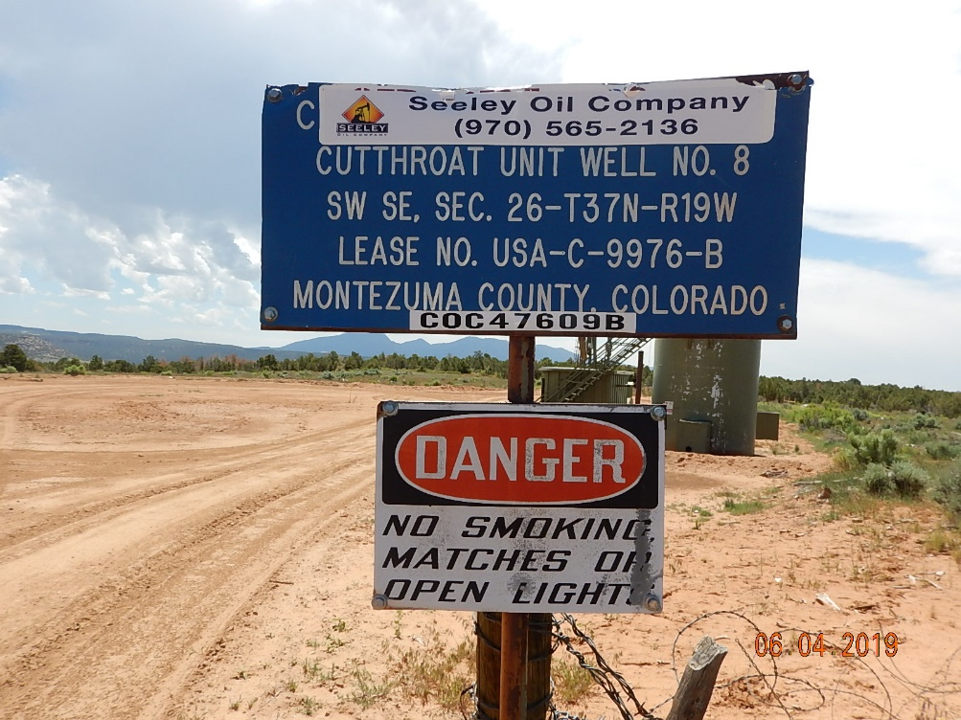
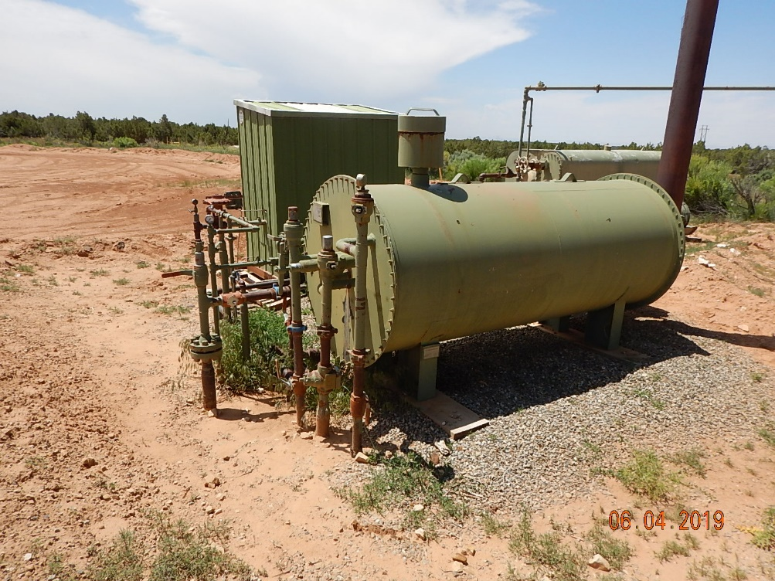
Inspection Photos
Cutthroat Unit #8
API: 05-083-06524
#1 Location.
#2 Equipment.

Slide 2
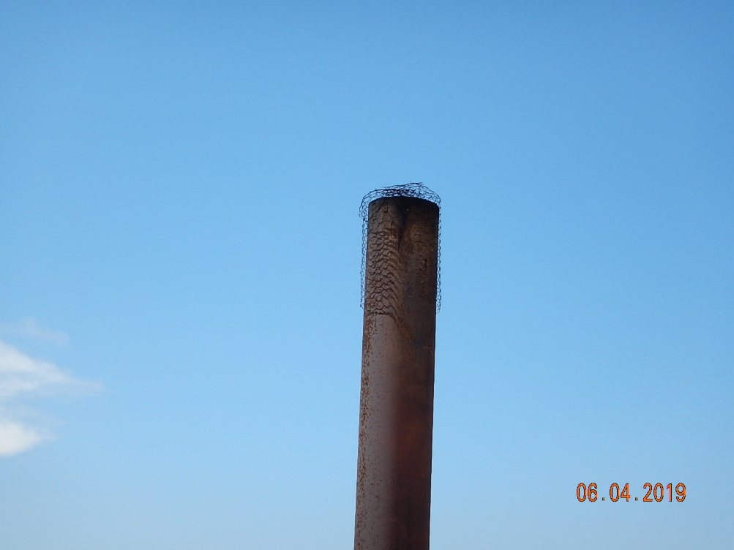
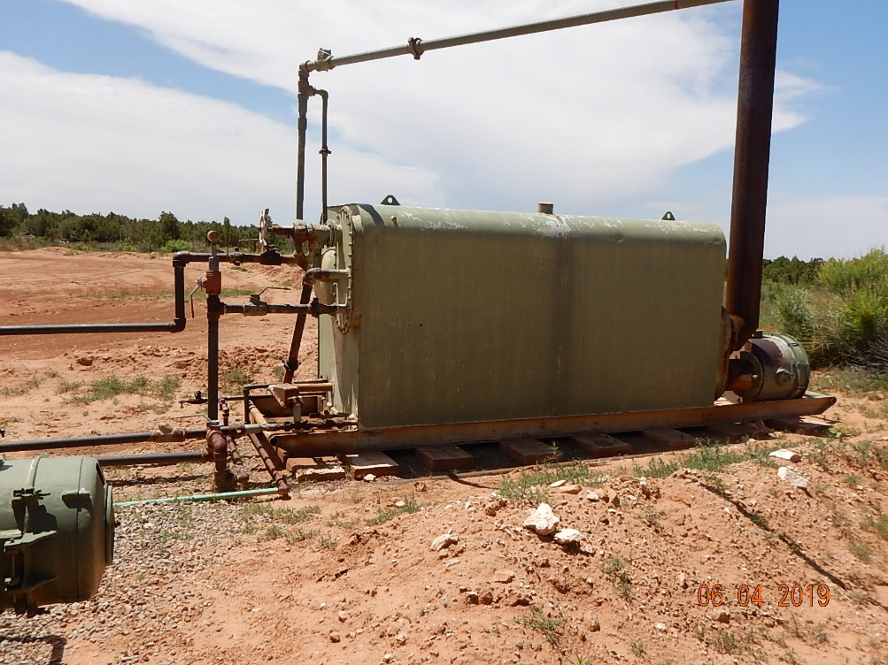
Inspection Photos
Cutthroat Unit #8
API: 05-083-06524
#3 Inadequate wildlife protection on Separator stack.
#4 Separator.

Slide 3
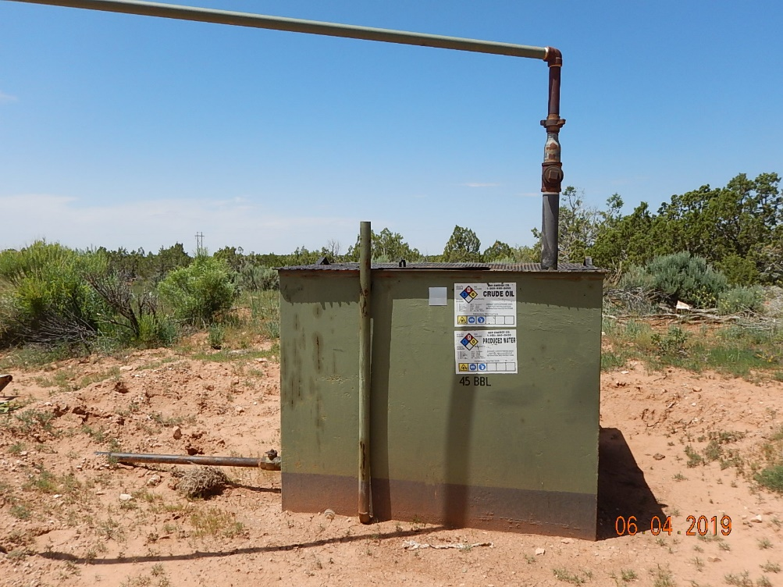
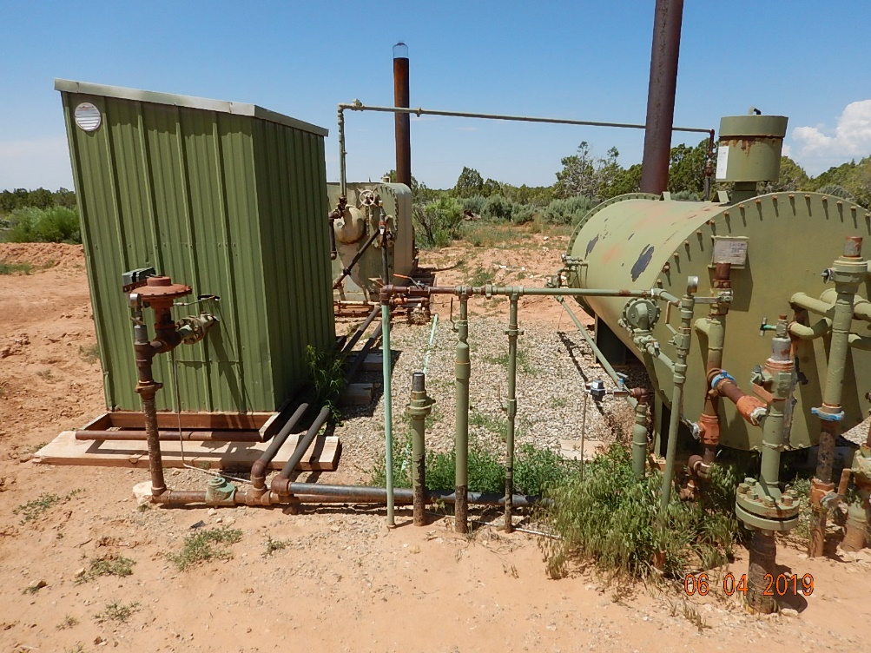
Inspection Photos
Cutthroat Unit #8
API: 05-083-06524
#5 Inadequate Secondary containment berms around tank and labeling does not reflect current operator.
#6 Weeds around equipment.

Slide 4
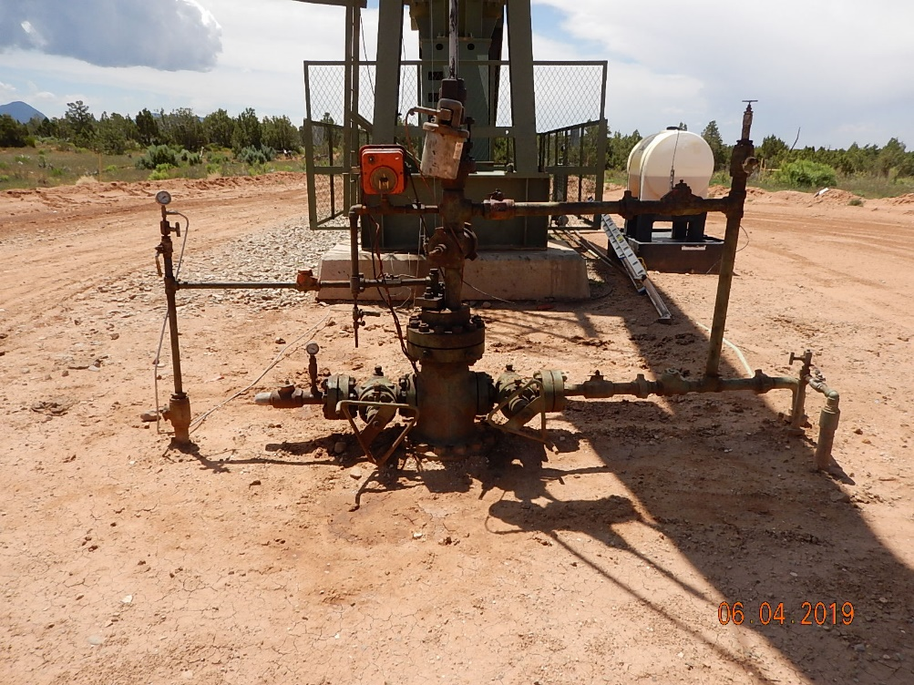
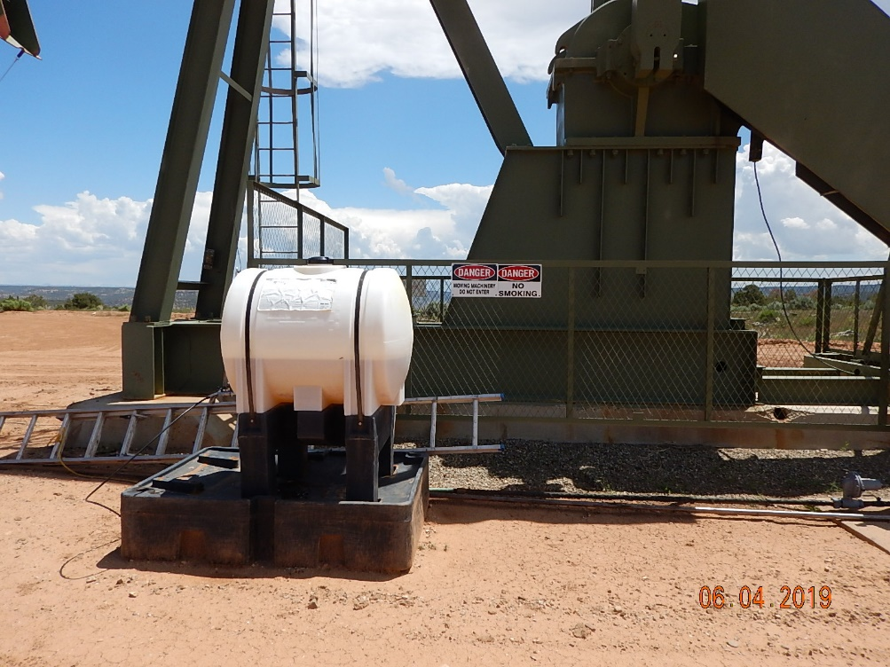
Inspection Photos
Cutthroat Unit #8
API: 05-083-06524
#7 Stained soil around wellhead.
#8 Chemical injection with spill prevention.

Slide 5
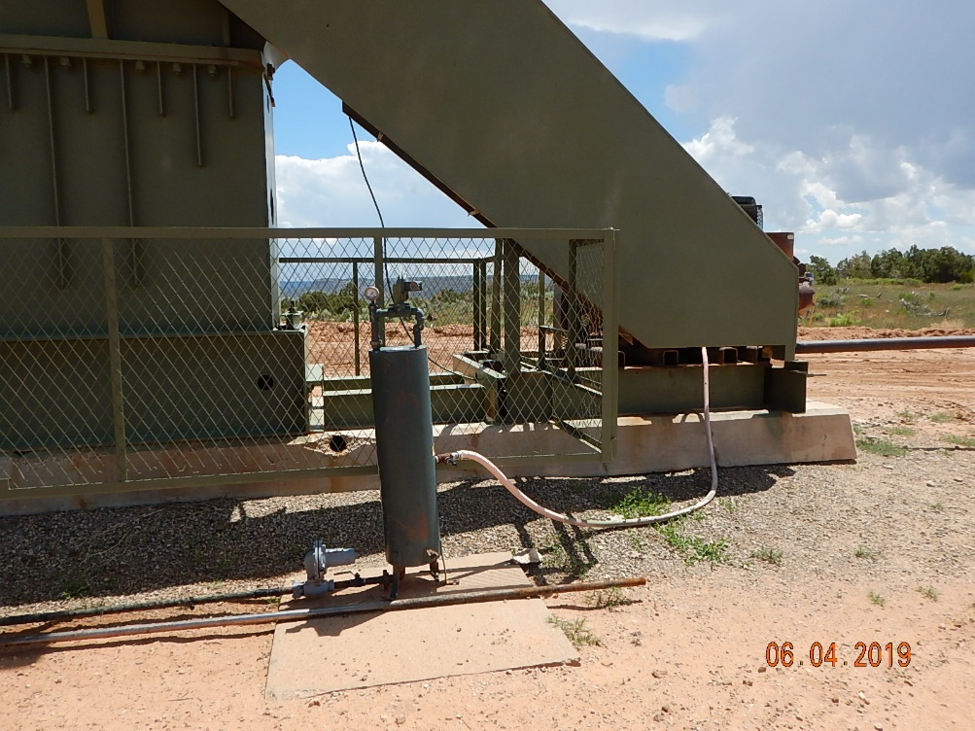
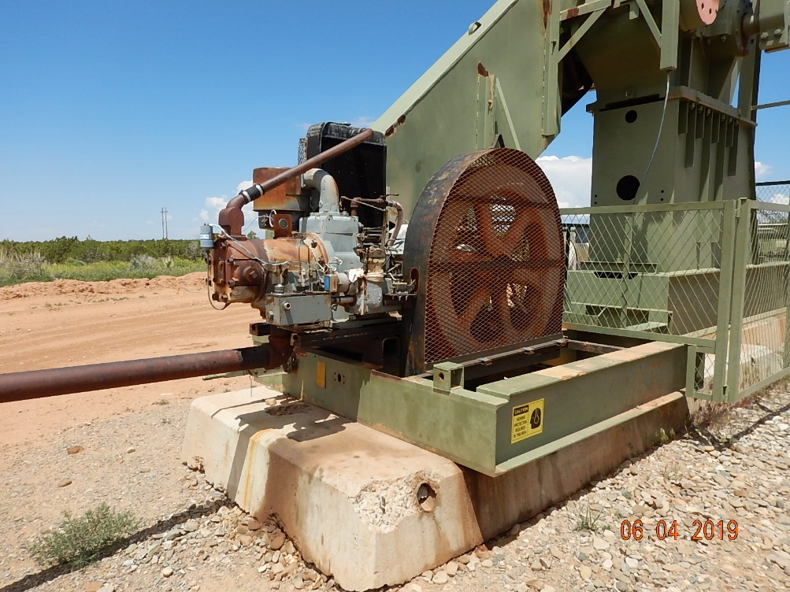
Inspection Photos
Cutthroat Unit #8
API: 05-083-06524
#9 Pumpjack
#10 Pumpjack engine.

Slide 6
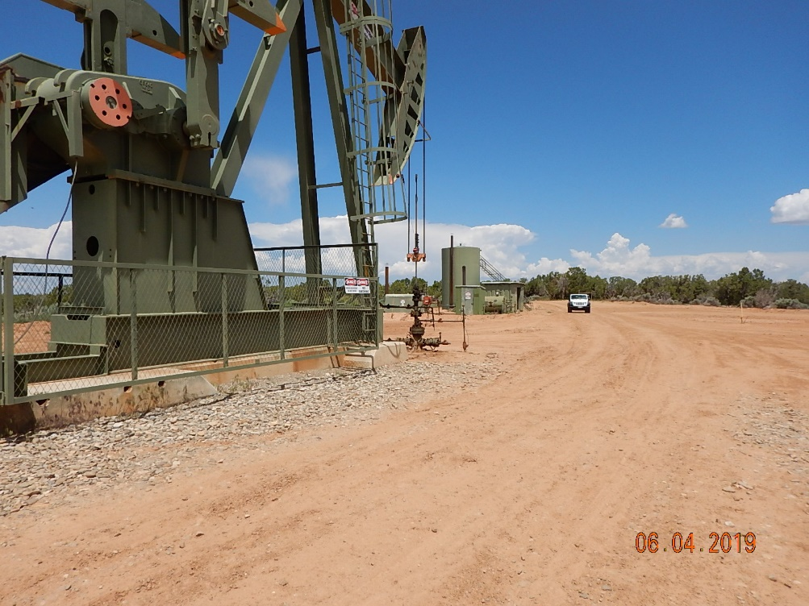
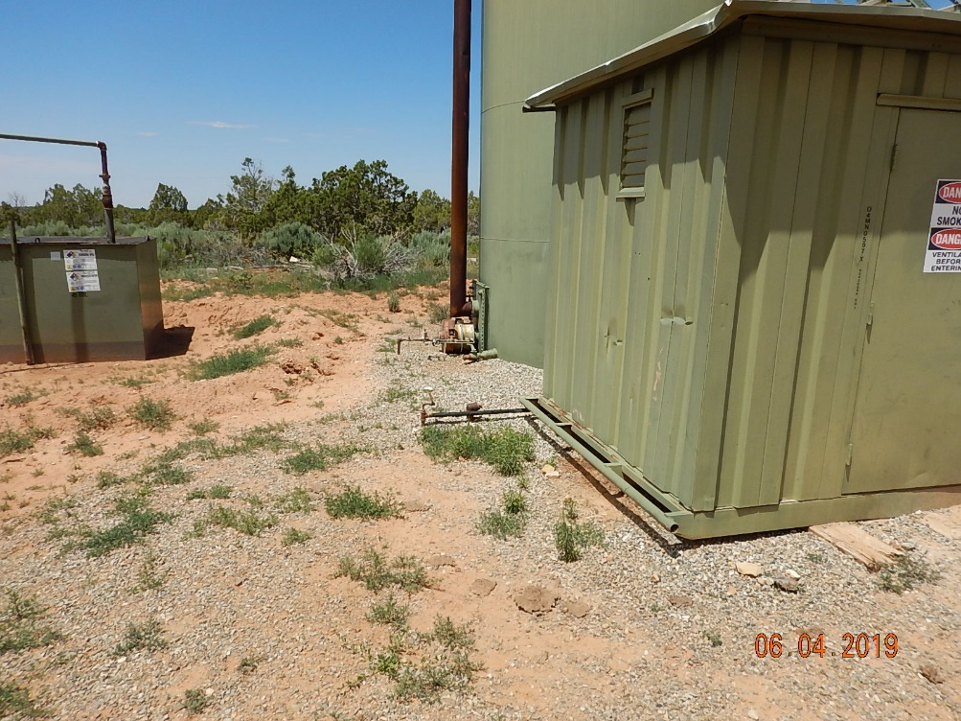
Inspection Photos
Cutthroat Unit #8
API: 05-083-06524
#11 Location.
#12 Equipment.

Slide 7
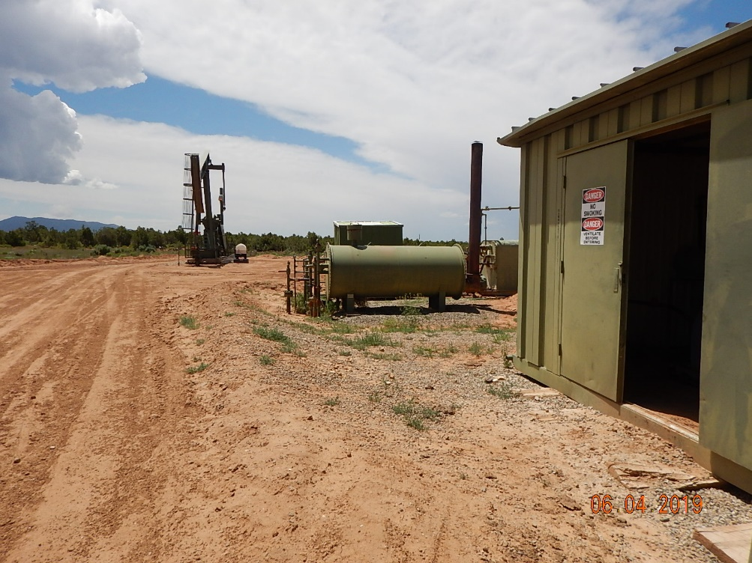
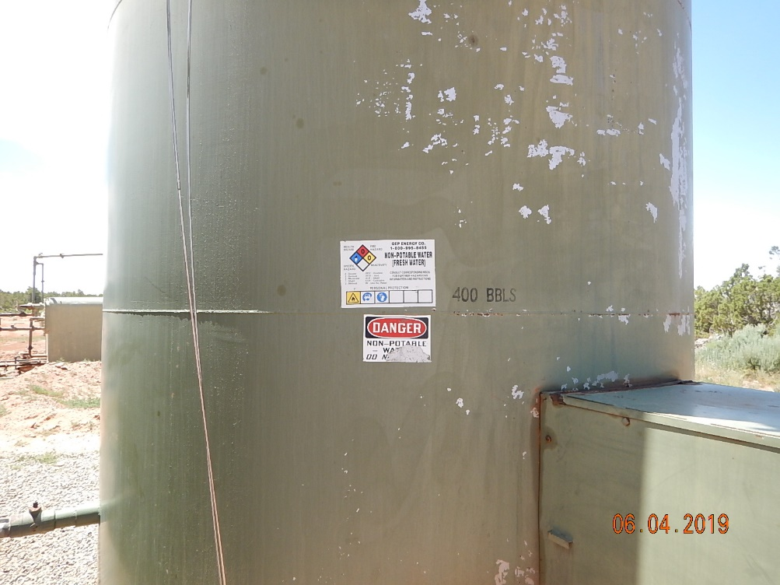
Inspection Photos
Cutthroat Unit #8
API: 05-083-06524
#13 Location.
#14 Tank labeling does not reflect current operator.

Slide 8
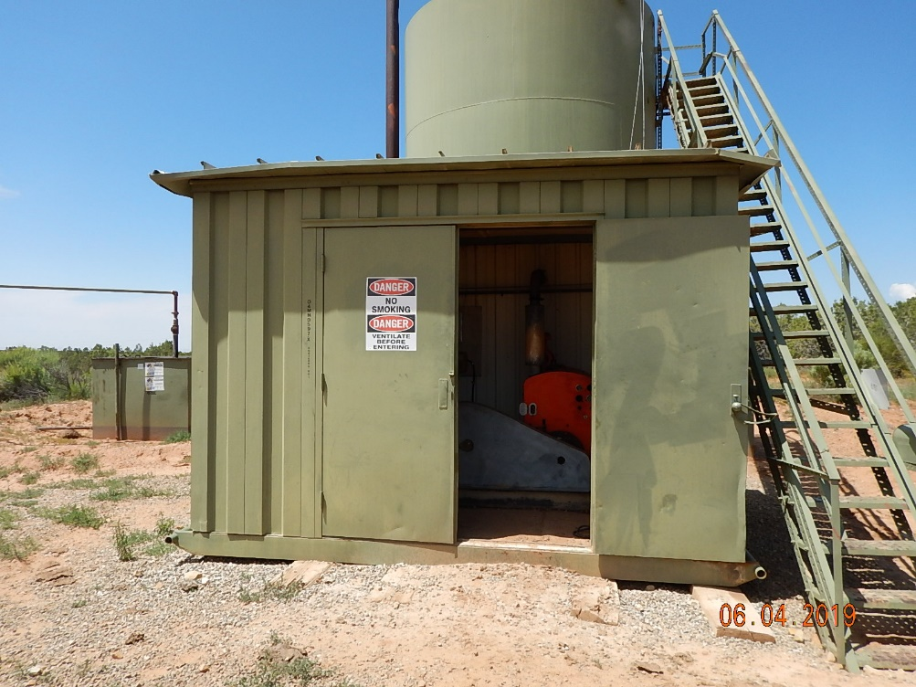
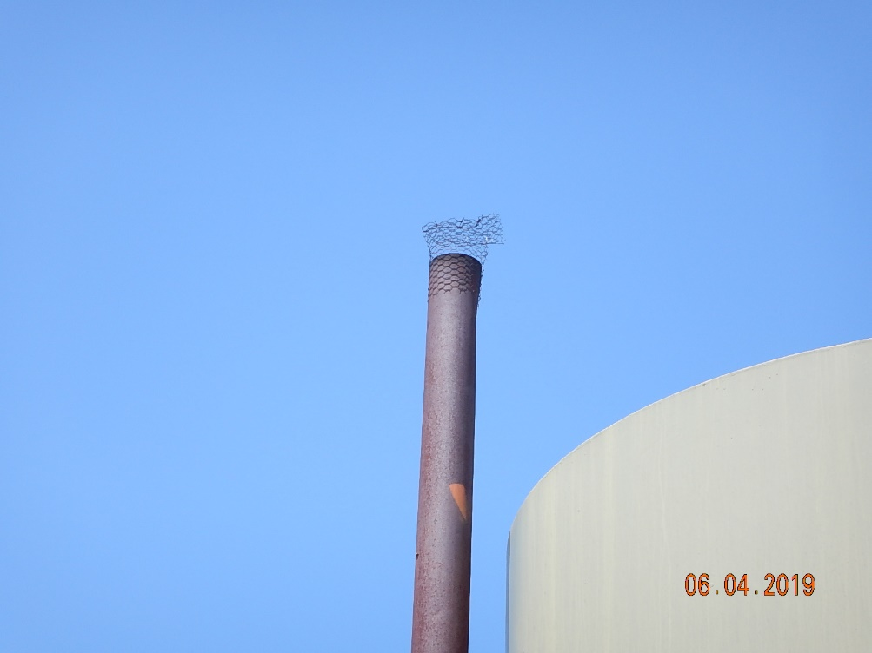
Inspection Photos
Cutthroat Unit #8
API: 05-083-06524
#15 Equipment shed.
#16 Inadequate wildlife protection on heated tank.

