Slide 1
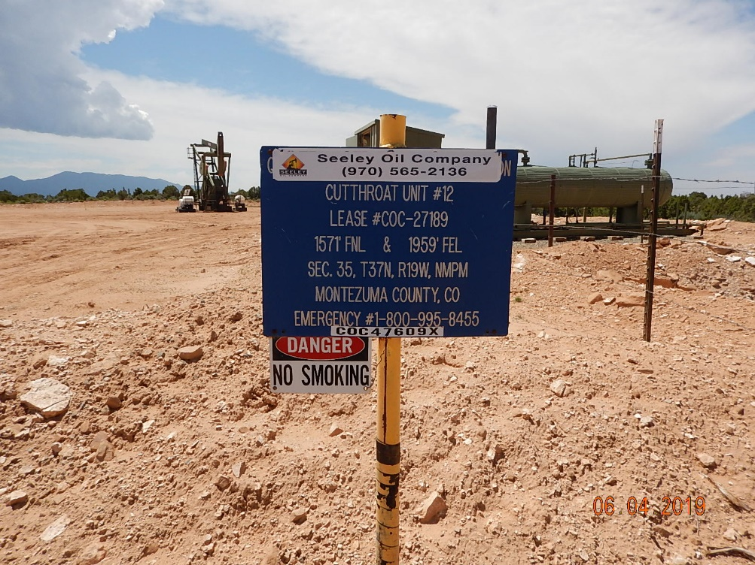
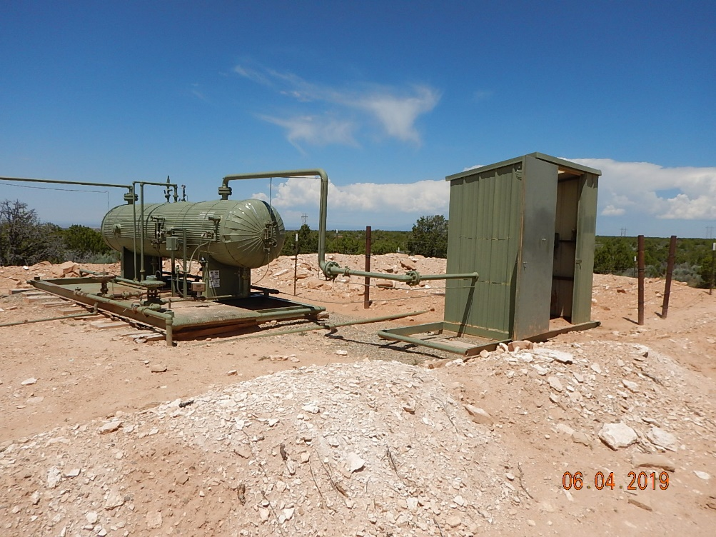
Inspection Photos
Cutthroat Unit #12
API: 05-083-06591
#1 Location.
#2 Equipment.

Slide 2
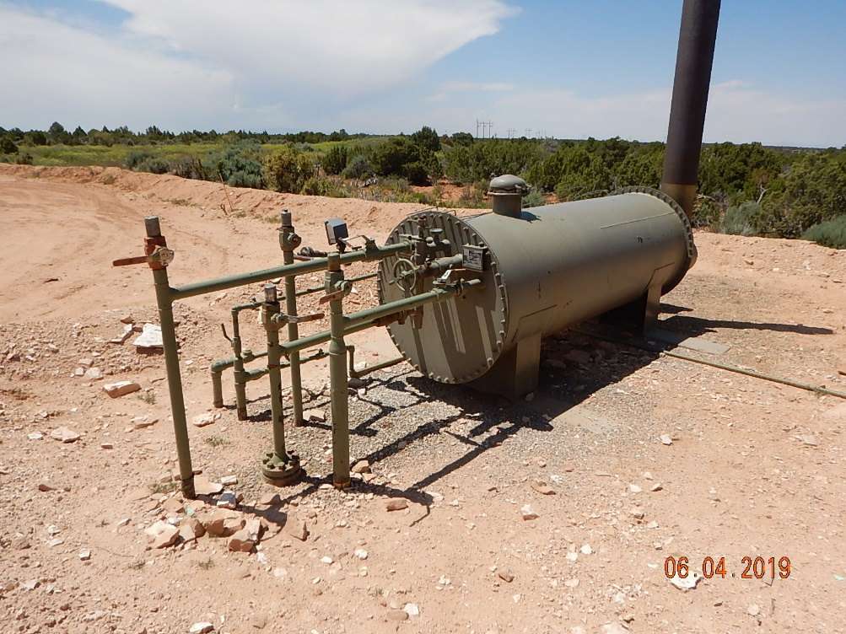
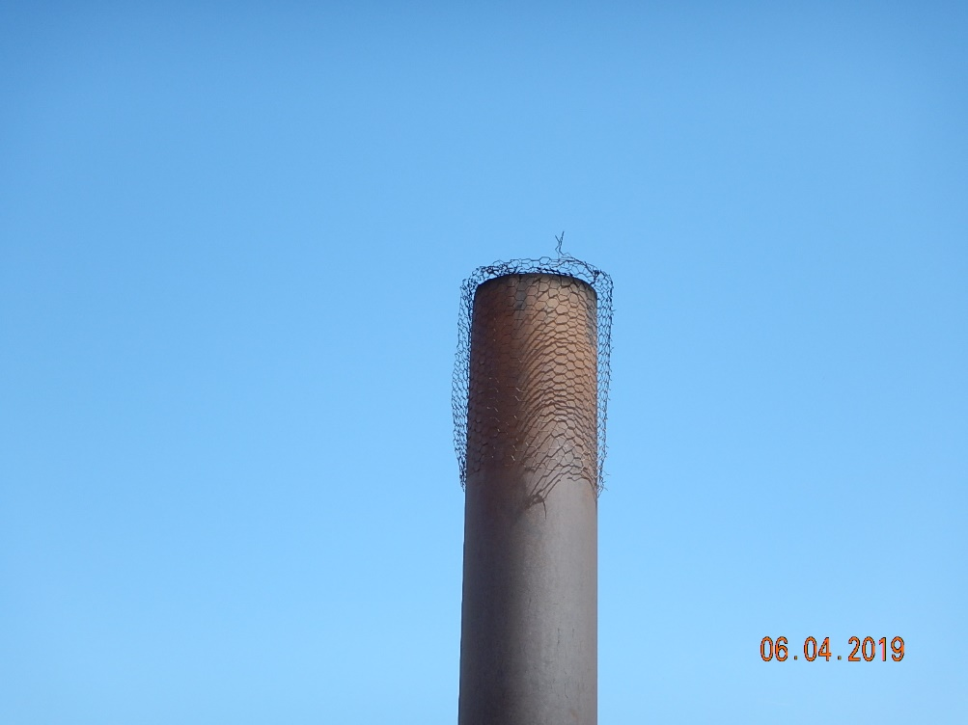
Inspection Photos
Cutthroat Unit #12
API: 05-083-06591
#3 Separator.
#4 Inadequate wildlife protection, bird protector on separator stack has hole on top.

Slide 3
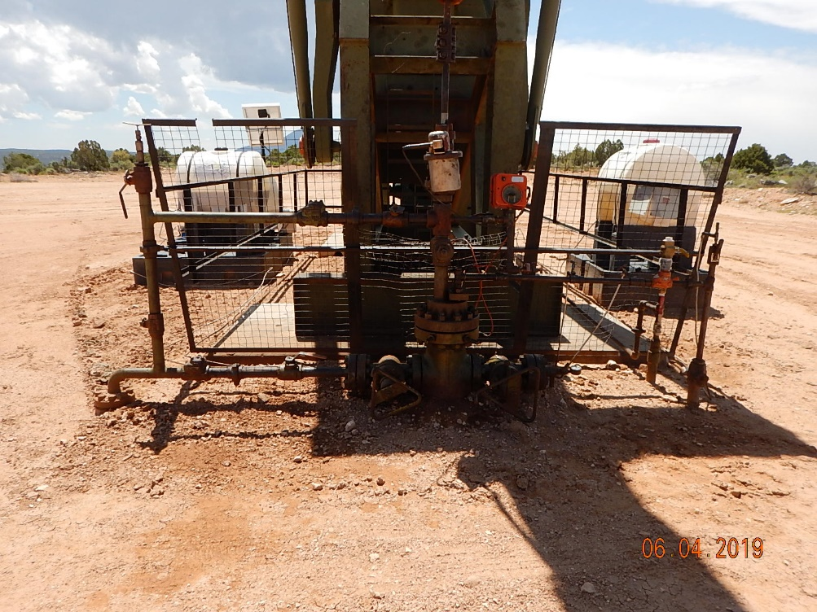
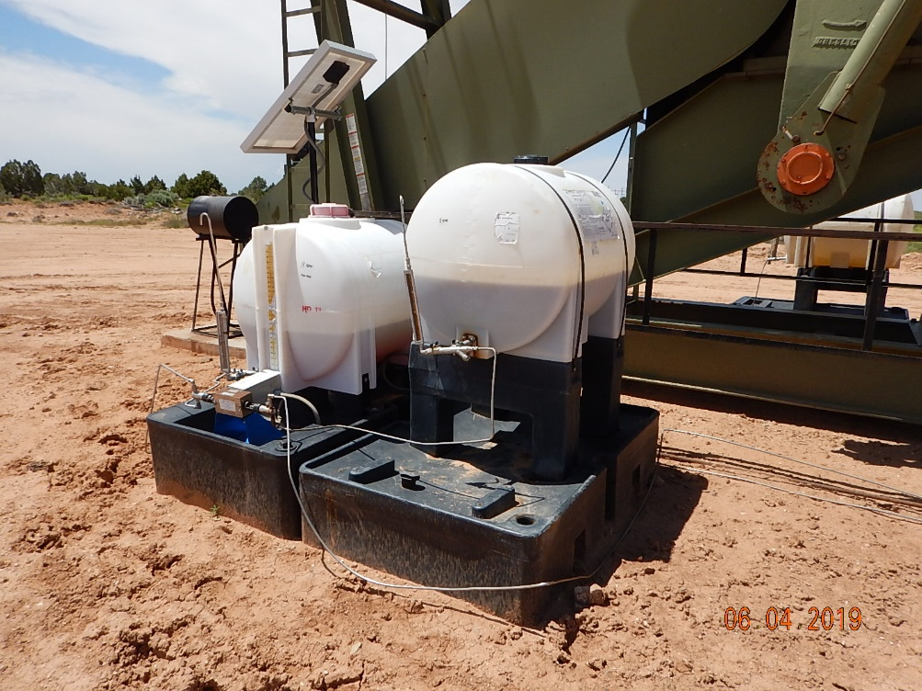
Inspection Photos
Cutthroat Unit #12
API: 05-083-06591
#5 Stained soil around wellhead.
#6 Chemical injection with spill prevention.

Slide 4
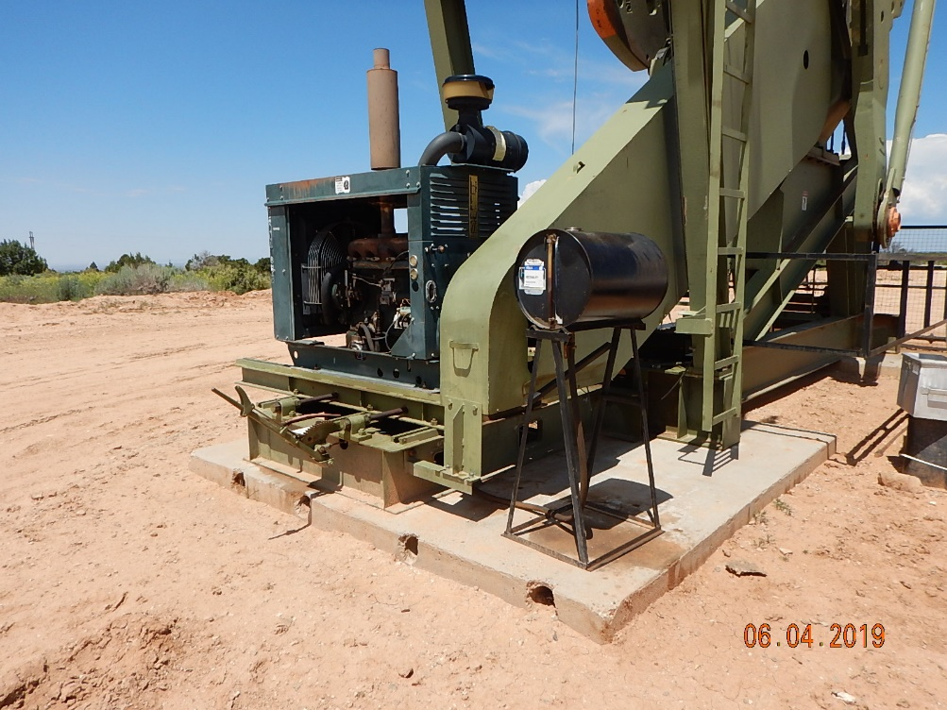
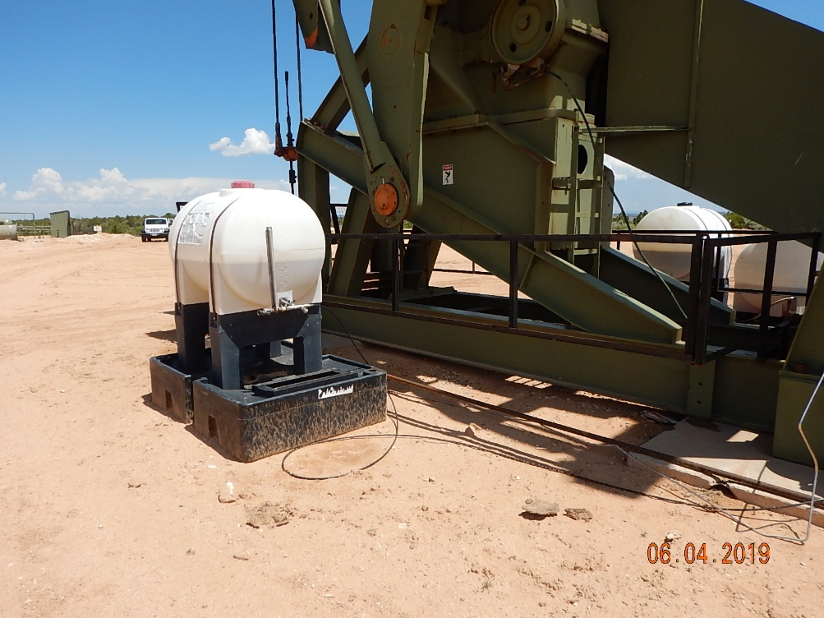
Inspection Photos
Cutthroat Unit #12
API: 05-083-06591
#7 engine oil day tank with no spill prevention.
#8 Chemical injection with spill prevention.

Slide 5
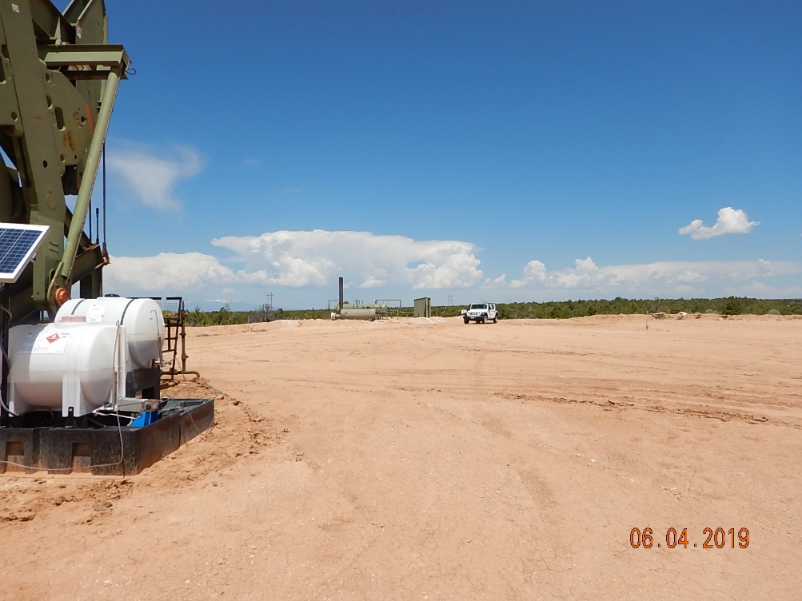
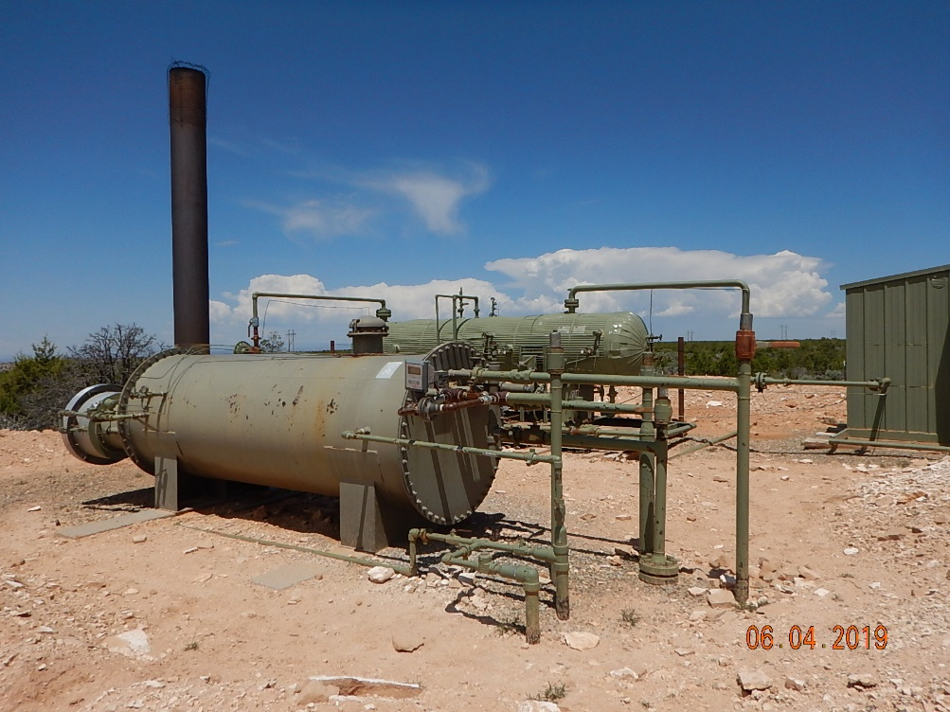
Inspection Photos
Cutthroat Unit #12
API: 05-083-06591
#9 Location.
#10 Equipment.

Slide 6
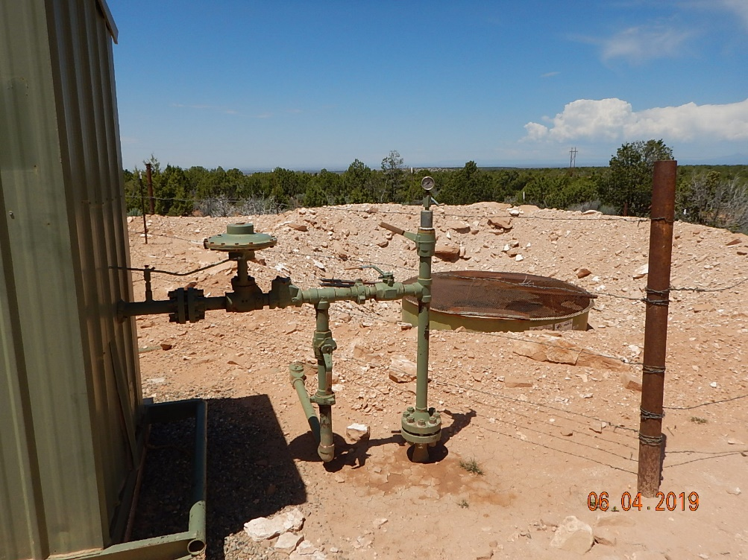
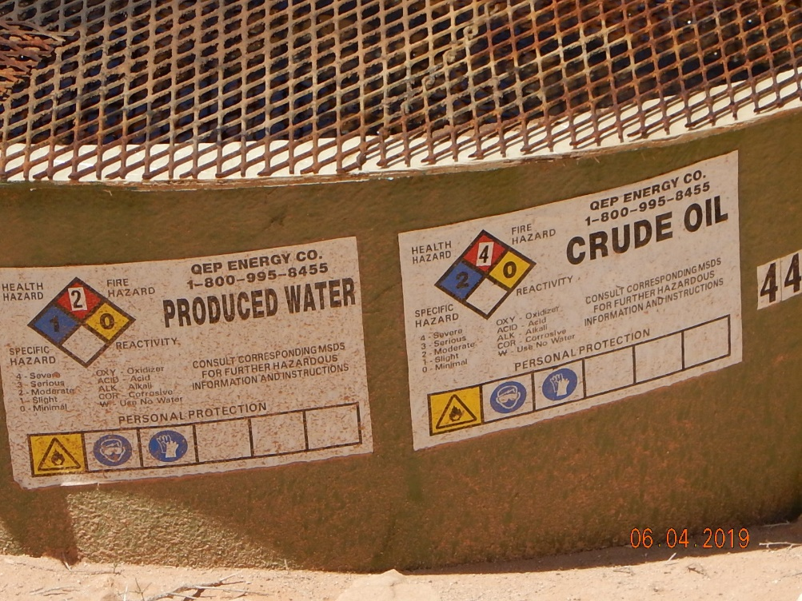
Inspection Photos
Cutthroat Unit #12
API: 05-083-06591
#11 Crude oil/produced water tank.
#12 Tank labeling not reflecting current operator.

Slide 7
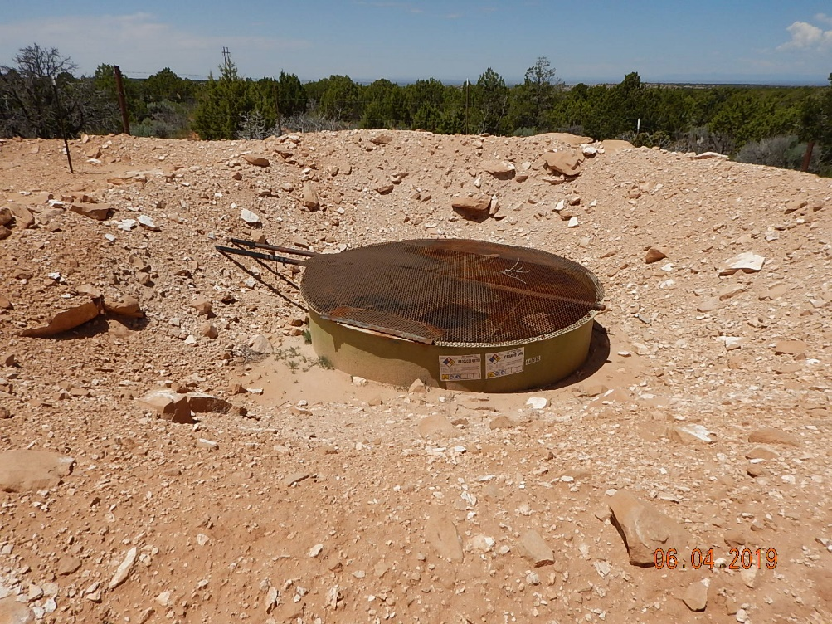
Inspection Photos
Cutthroat Unit #12
API: 05-083-06591
#13 Tank and secondary containment.

