Slide 1
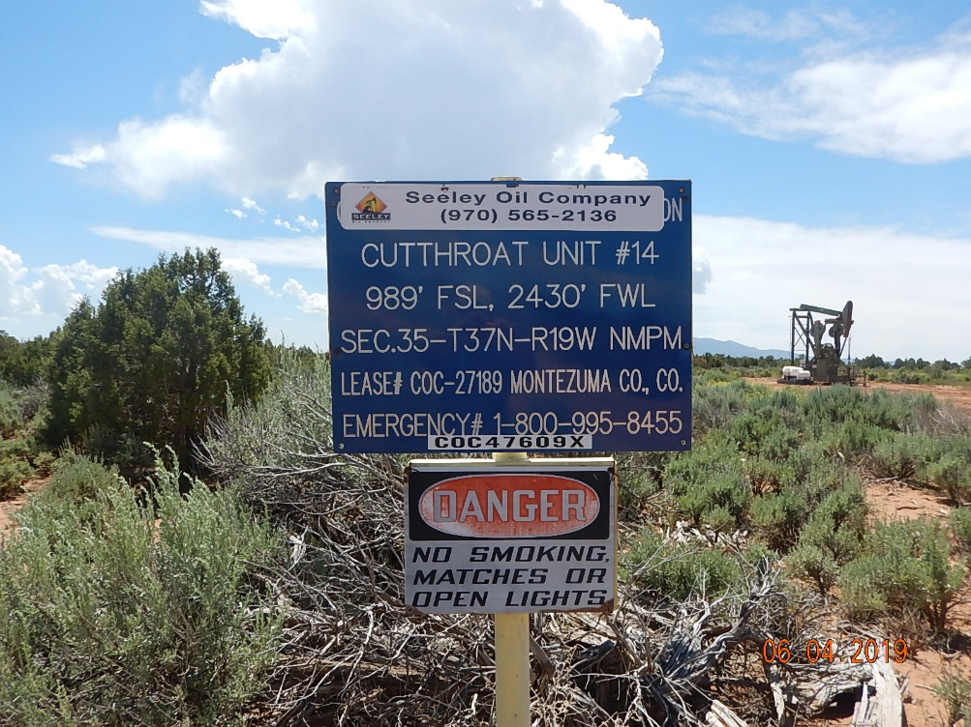
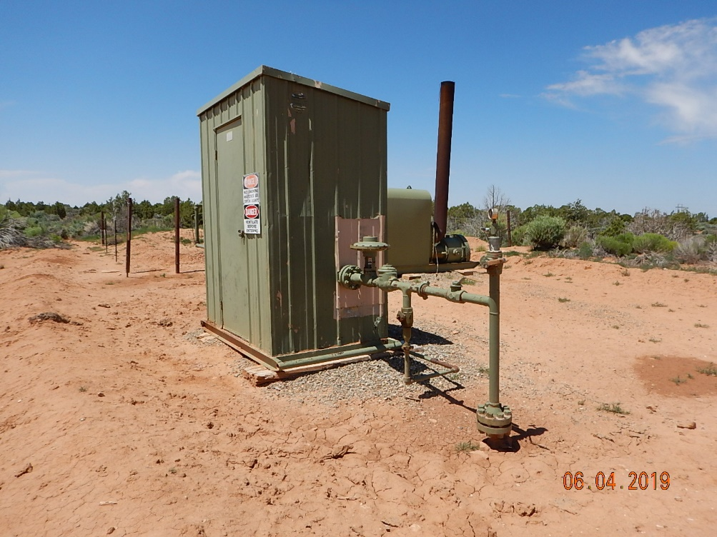
Inspection Photos
Cutthroat Unit #14
API: 05-083-06595
#1 Location.
#2 Meter house.

Slide 2
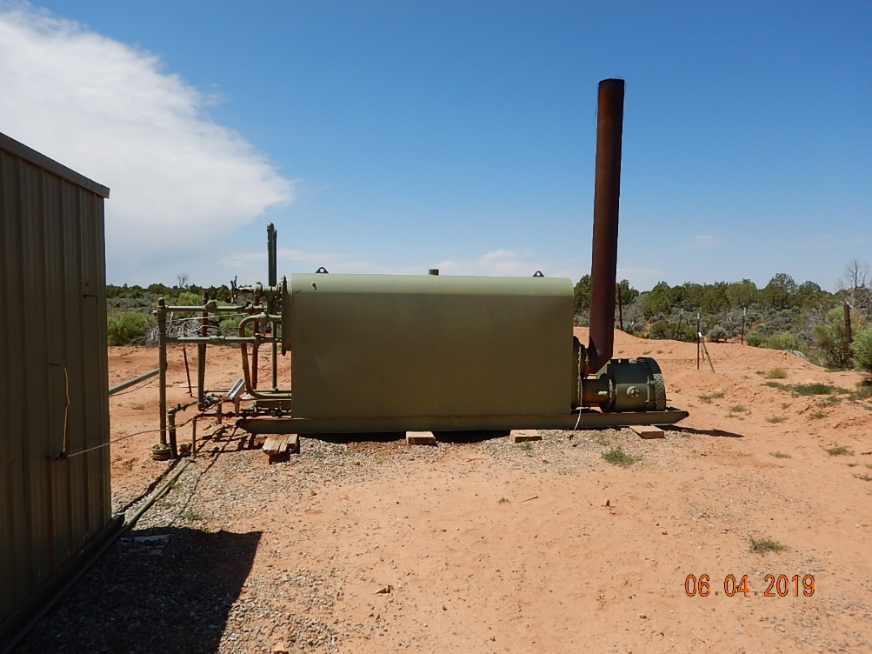
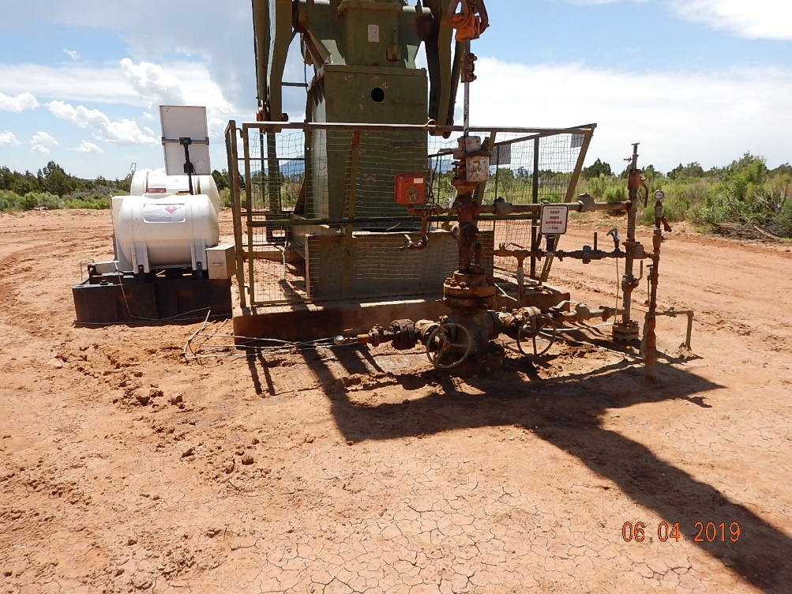
Inspection Photos
Cutthroat Unit 14
API: 05-083-06595
#3 Separator.
#4 Wellhead.

Slide 3
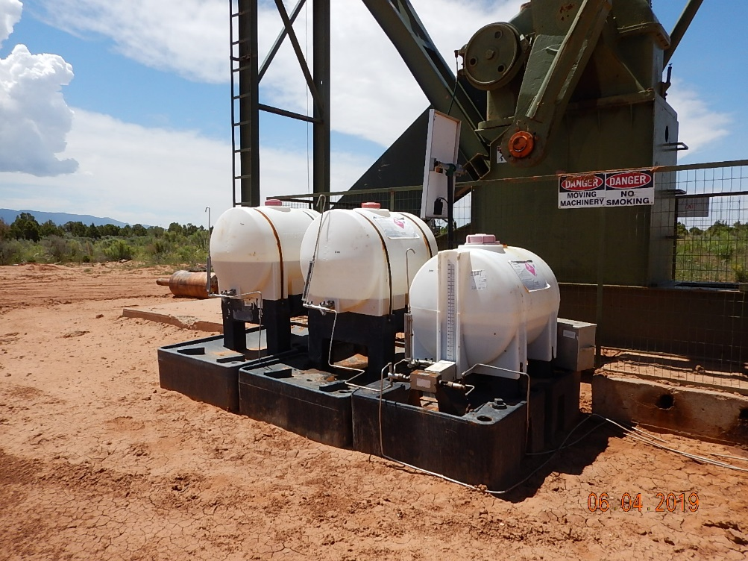
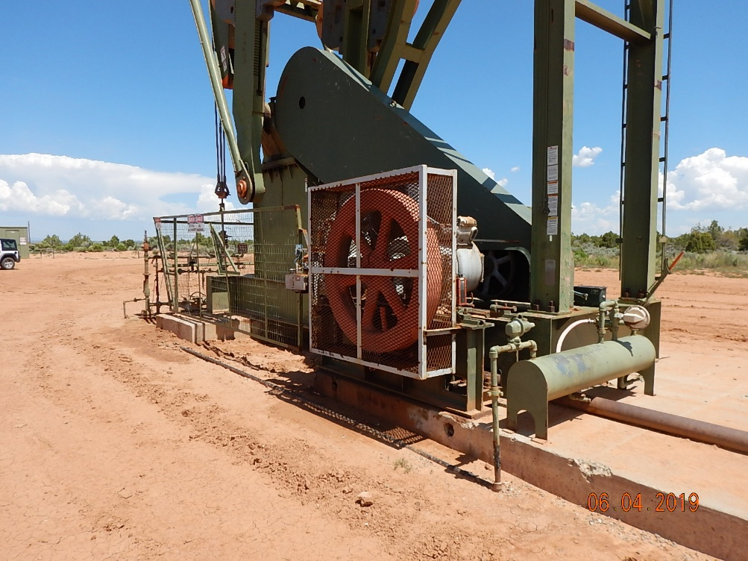
Inspection Photos
Cutthroat Unit 14
API: 05-083-06595
#5 Chemical injection with spill prevention.
#6 Pumpjack.

Slide 4
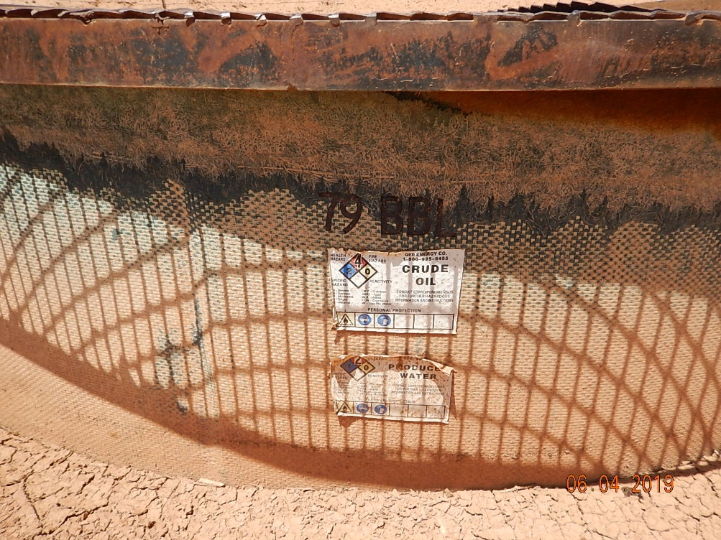
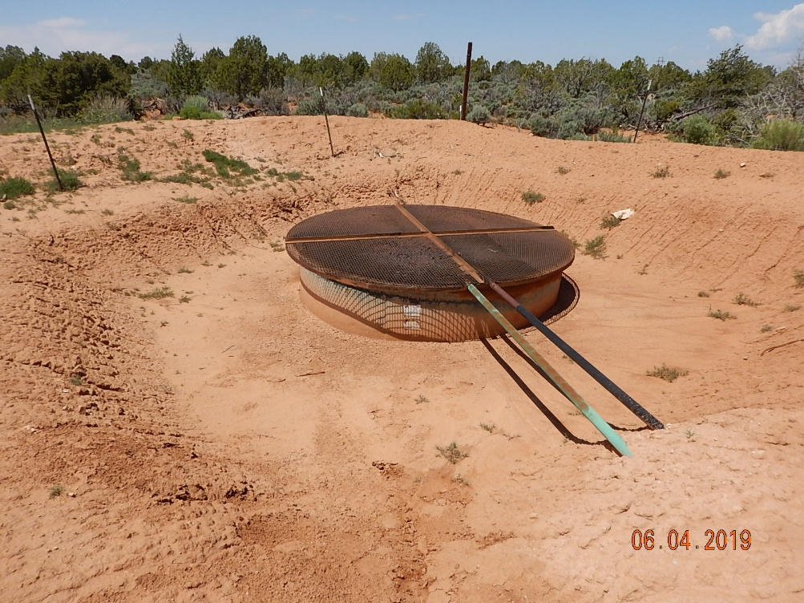
Inspection Photos
Cutthroat Unit 14
API: 05-083-06595
#7 Used oil/produced water tank labeling inadequate and does not reflect current operator.
#8 Used oil/produced water tank and containment.

