Slide 1
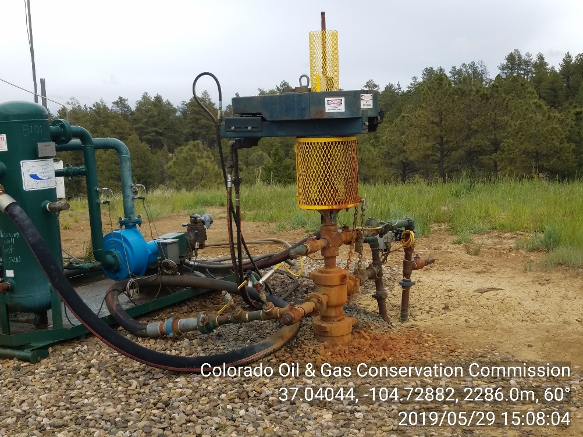
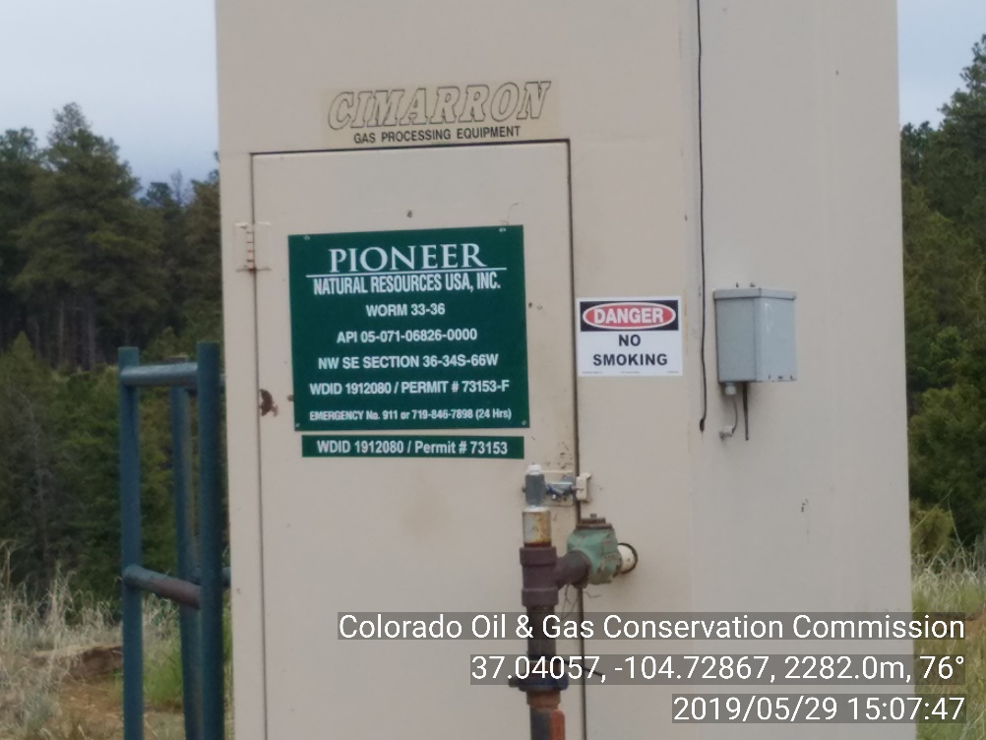
Inspection Photos
Location Name: WORM 33-36
API #: 05-071-06826
INSP. #:695100754
PHOTO 1: WELLHEAD/ IMPACTED SOIL AROUND WELLHEAD. Remove and dispose impacted material in approved manner, service and maintain equipment and self inspect to prevent recurrence of conditions per 1002.f(2) and 907“ CA DATE 6/29/19
PHOTO 2: CURRENT OPERATOR NOT POSTED ON WELL SIGN. CHANGE OPERATOR NAME TO CURRENT OPERATOR IN ACCORDANCE WITH RULE 210. CA DATE 7/29/19

Slide 2
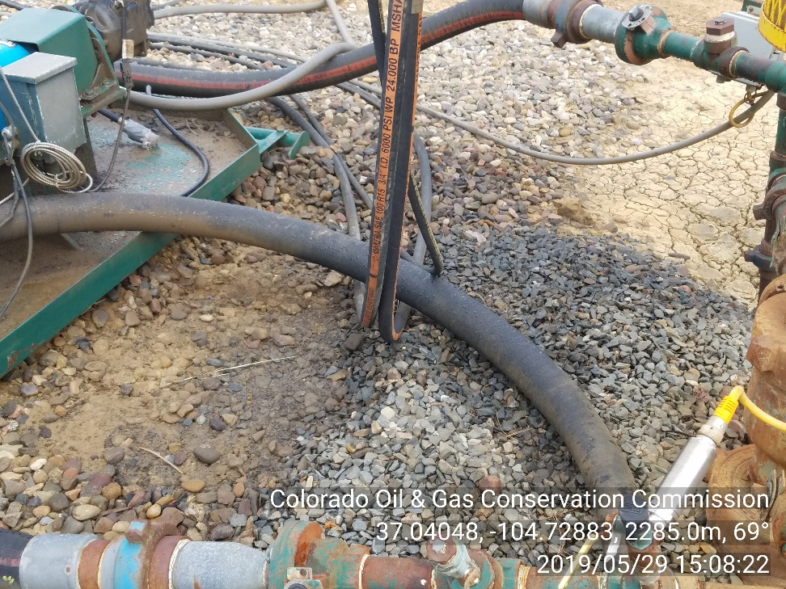
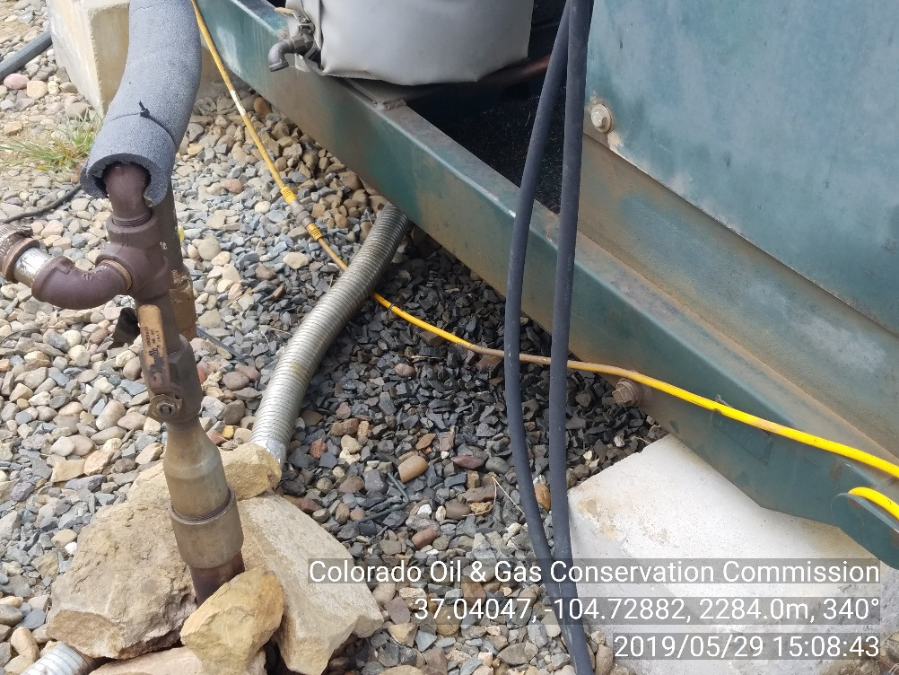
Inspection Photos
Location Name: WORM 33-36
API #: 05-071-06826
INSP. #:695100754
PHOTO 3: IMPACTED SOIL AROUND COMPRESSOR SKID. Remove and dispose impacted material in approved manner, service and maintain equipment and self inspect to prevent recurrence of conditions per 1002.f(2) and 907“ CA DATE 6/29/19
PHOTO 4:: IMPACTED SOIL AROUND ENGINE SKID. Remove and dispose impacted material in approved manner, service and maintain equipment and self inspect to prevent recurrence of conditions per 1002.f(2) and 907“ CA DATE 6/29/19

Slide 3
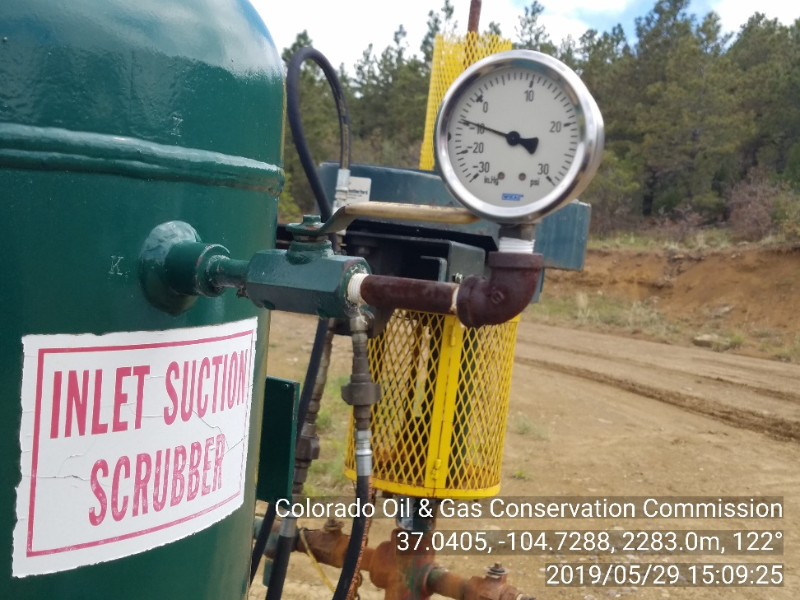
Inspection Photos
Location Name: WORM 33-36
API #: 05-071-06826
INSP. #:695100754
PHOTO 5: Vacuum pump observed on well without COGCC approval. Provide COGCC with documentation showing approval of use of vacuum pump. Ca date 6/13/19

