Slide 1
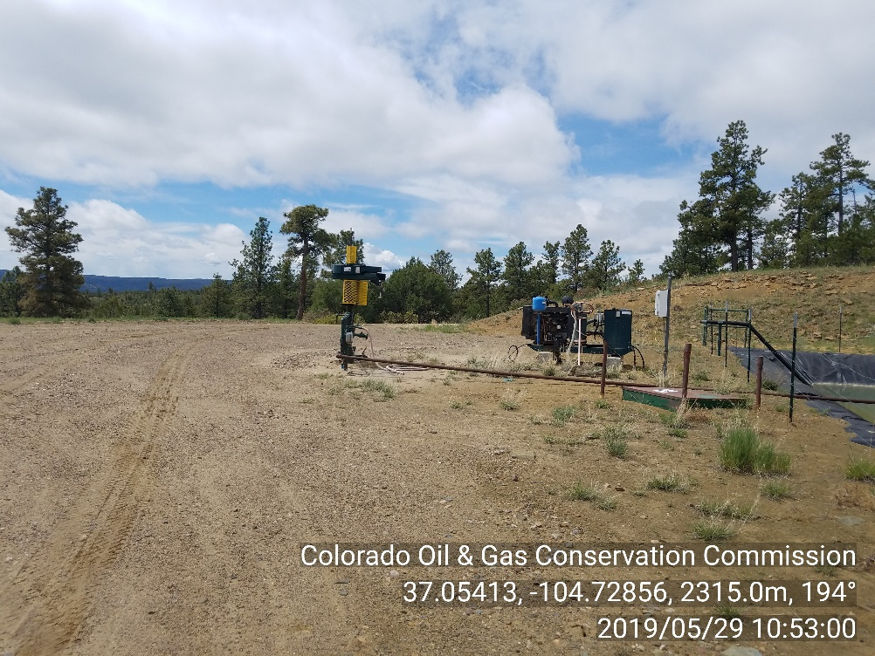
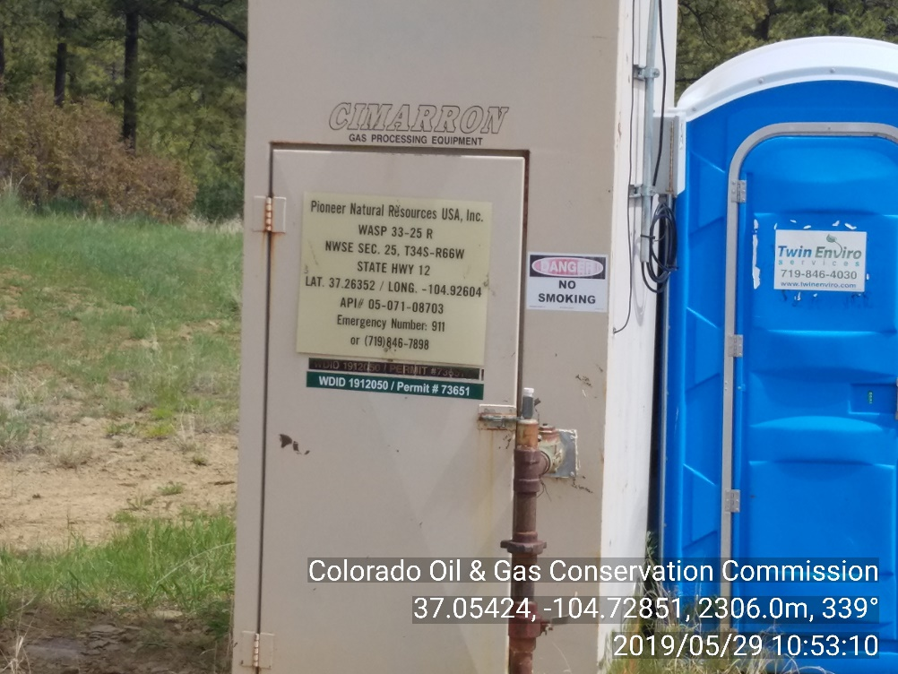
Inspection Photos
Location Name: WASP 33-25 R
API #: 05-071-08703
INSP. #:695100741
PHOTO 1: WELLHEAD
PHOTO 2: WELL SIGN

