Slide 1
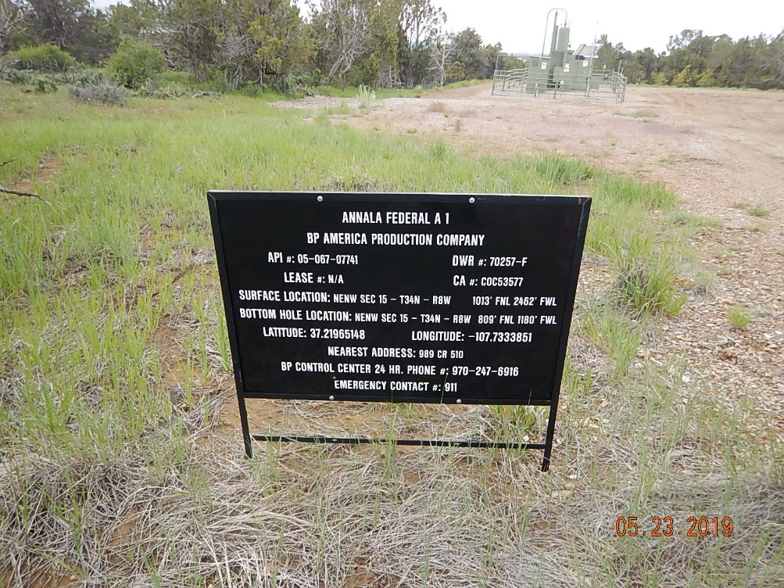
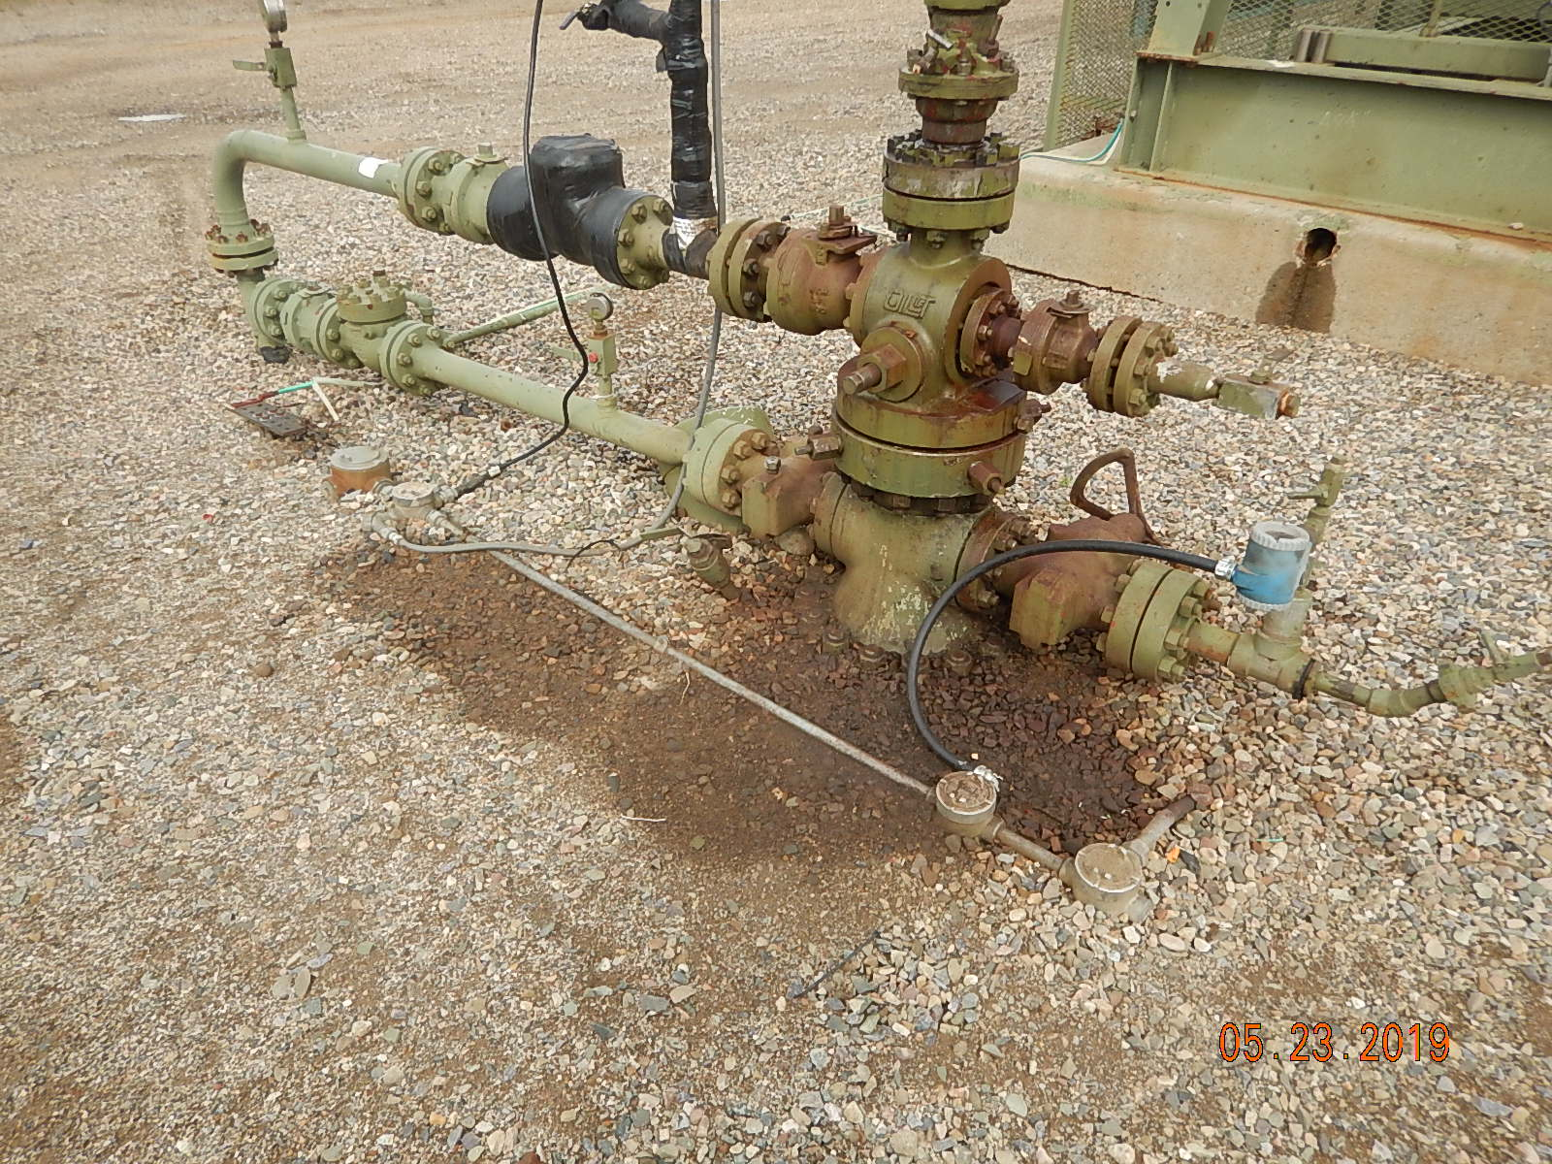
Inspection Photos
Annala Federal A1
API: 05-067-07741
#1 Location.
#2 Stained soil/gravel around wellhead.

Slide 2
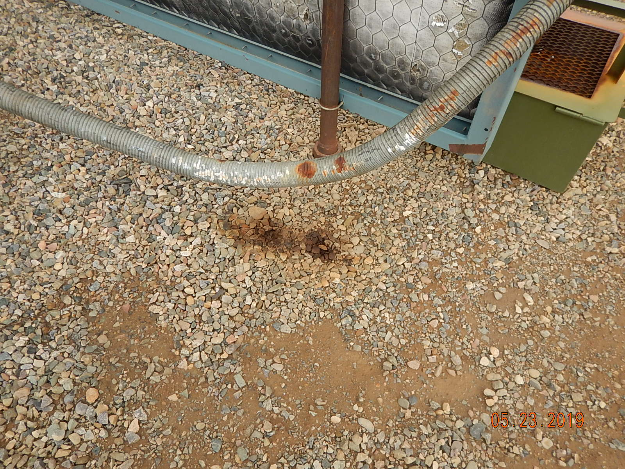
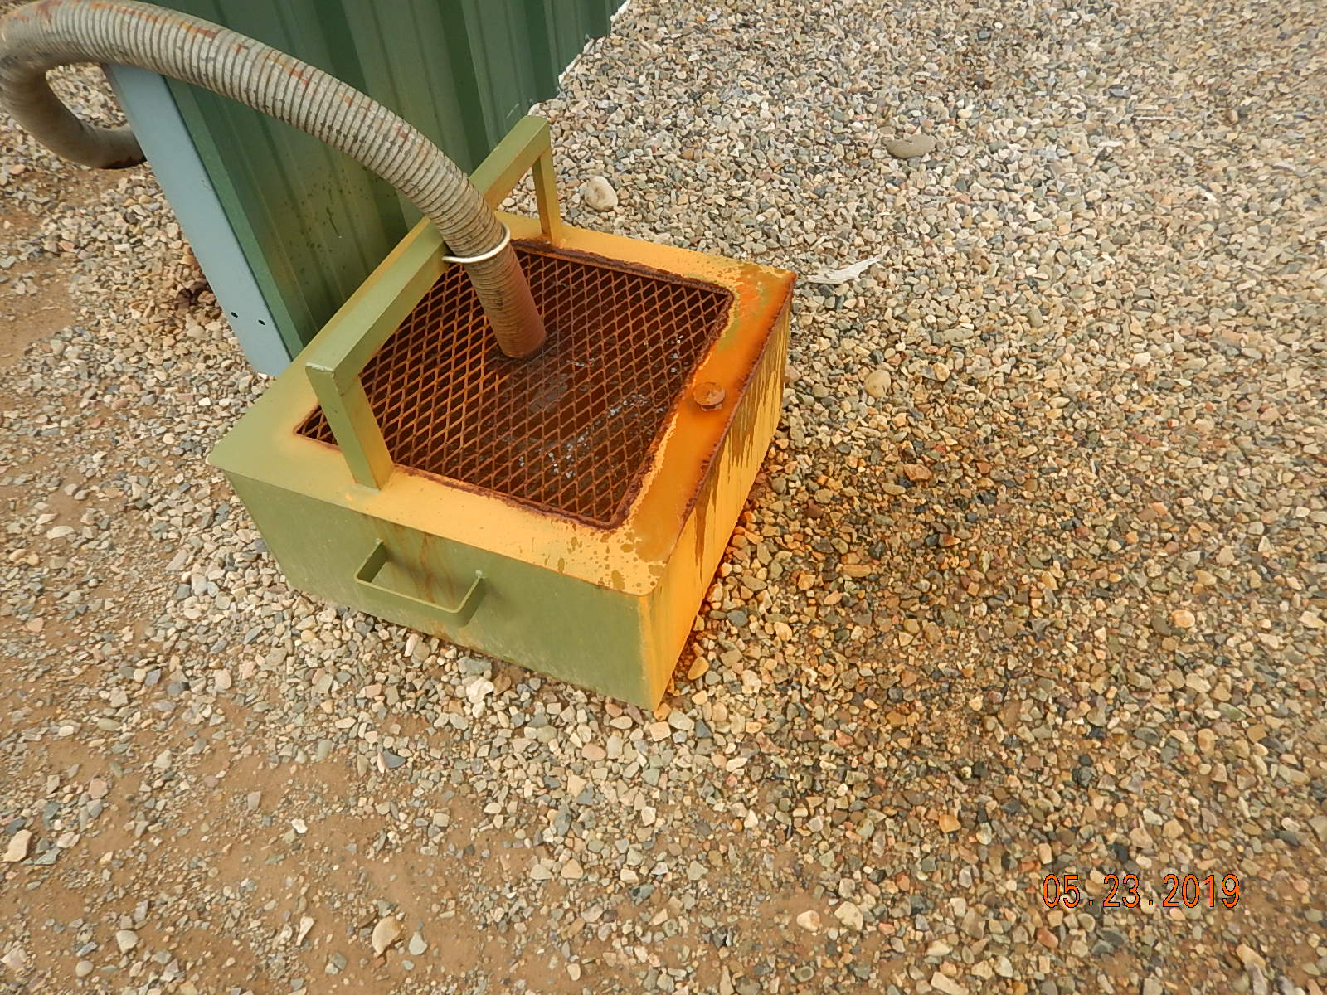
Inspection Photos
Annala Federal A1
API: 05-067-07741
#3 Stained soil/gravel spotting from exhaust leak.
#4 Catch pan for exhaust muffler.

Slide 3
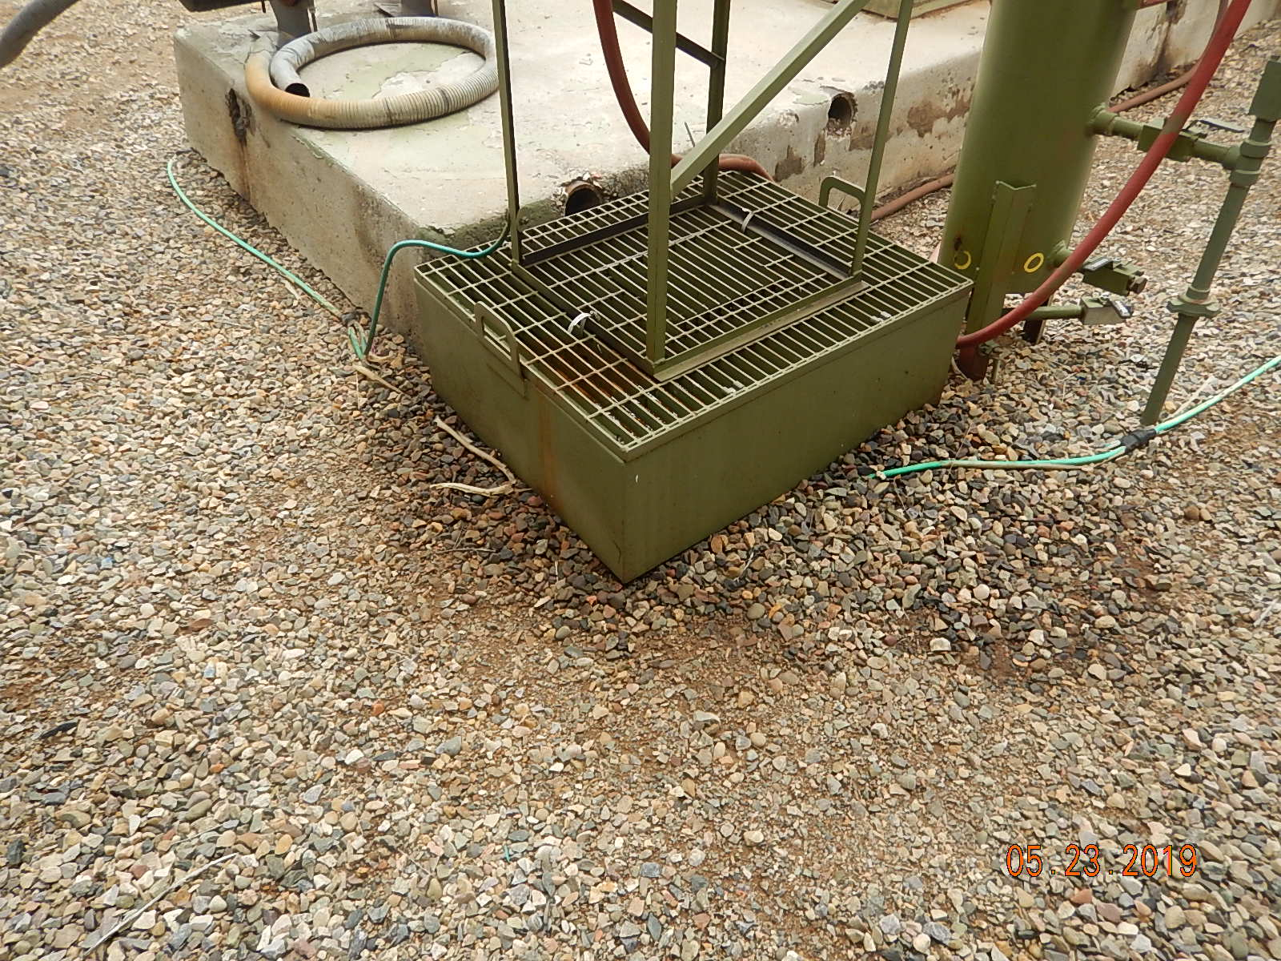
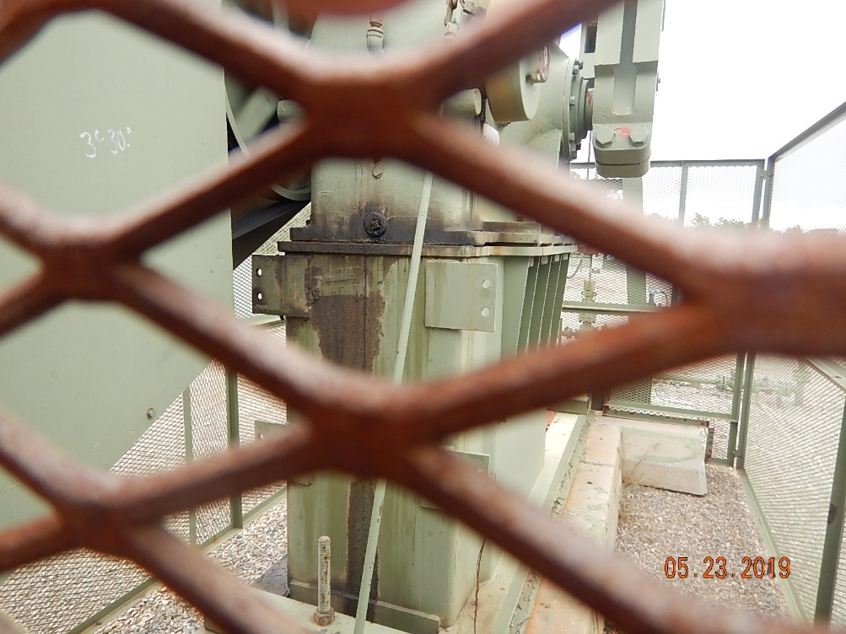
Inspection Photos
Annala Federal A1
API: 05-067-07741
#5 Stained soil/gravel around engine oil day tank.
#6 Oily waste from pumpjack gearbox drain plug.

Slide 4
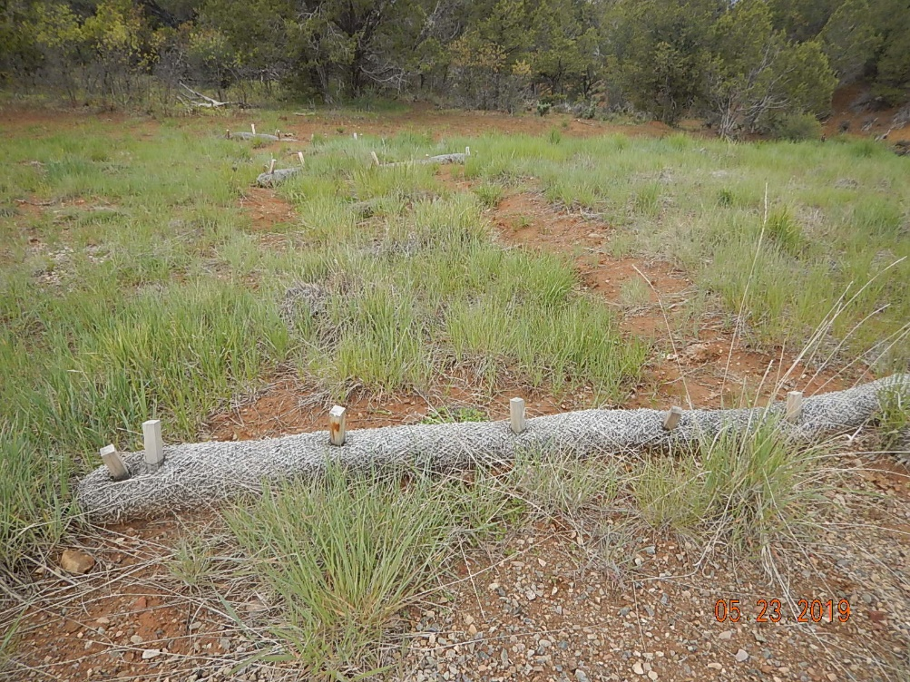
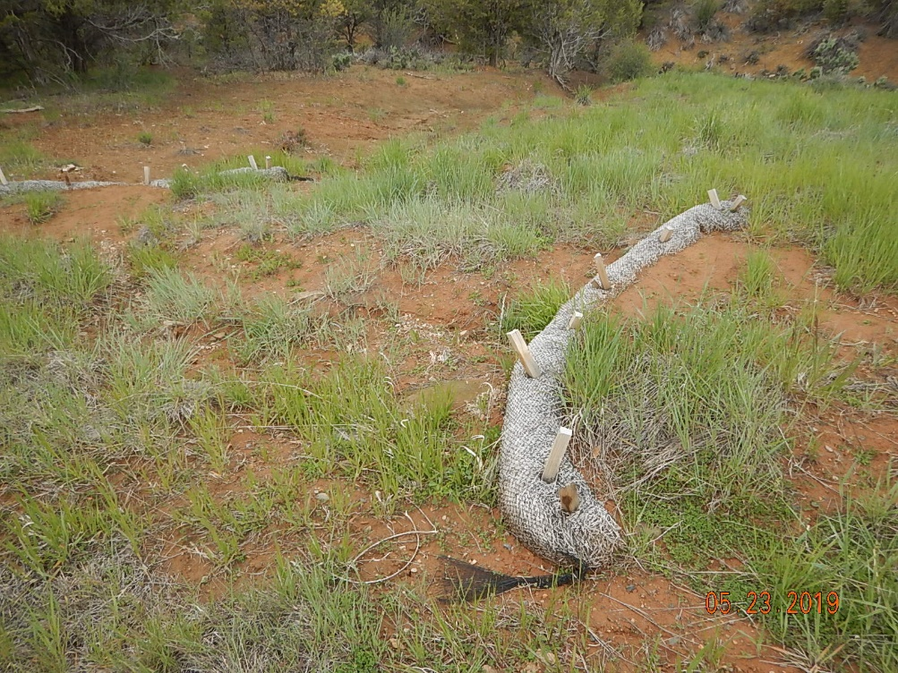
Inspection Photos
Annala Federal A1
API: 05-067-07741
#7 Stormwater BMP’s
#8 Stormwater BMP’s not functioning or maintained.

Slide 5
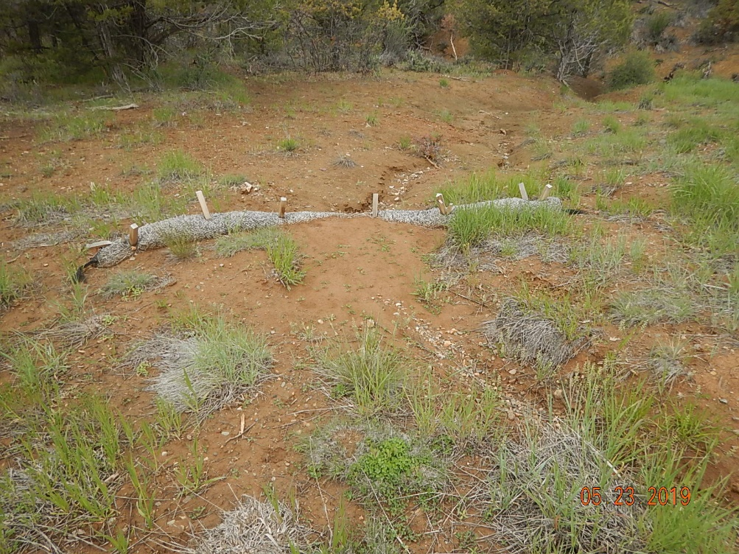
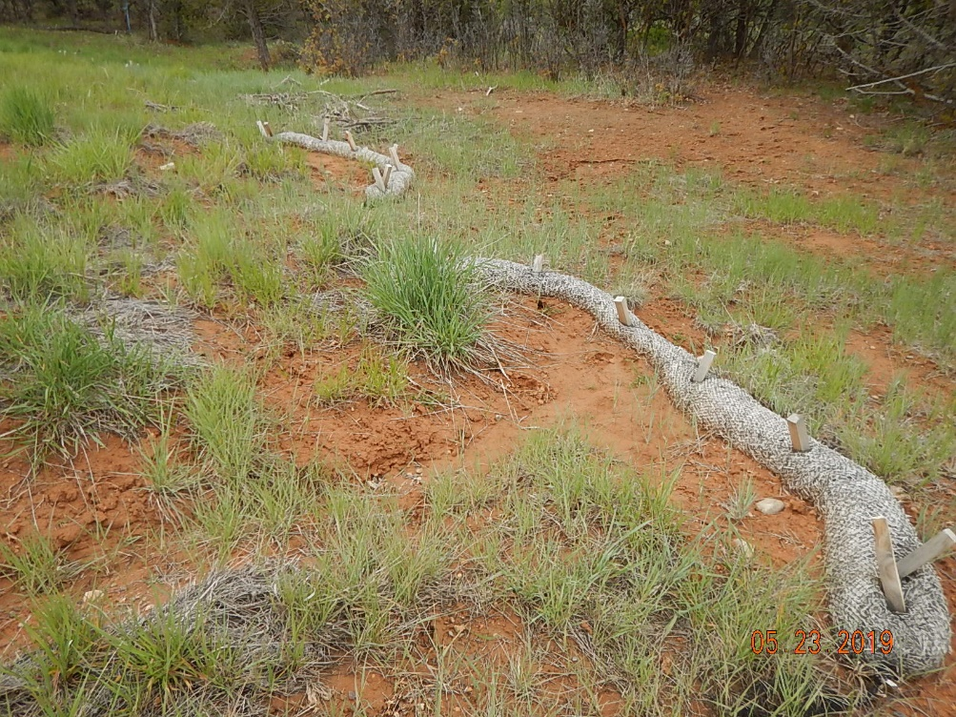
Inspection Photos
Annala Federal A1
API: 05-067-07741
#9 Stormwater BMP’s not functioning or maintained, erosion channel from reclamation area.
#10 Stormwater BMP’s not functioning or maintained.

Slide 6
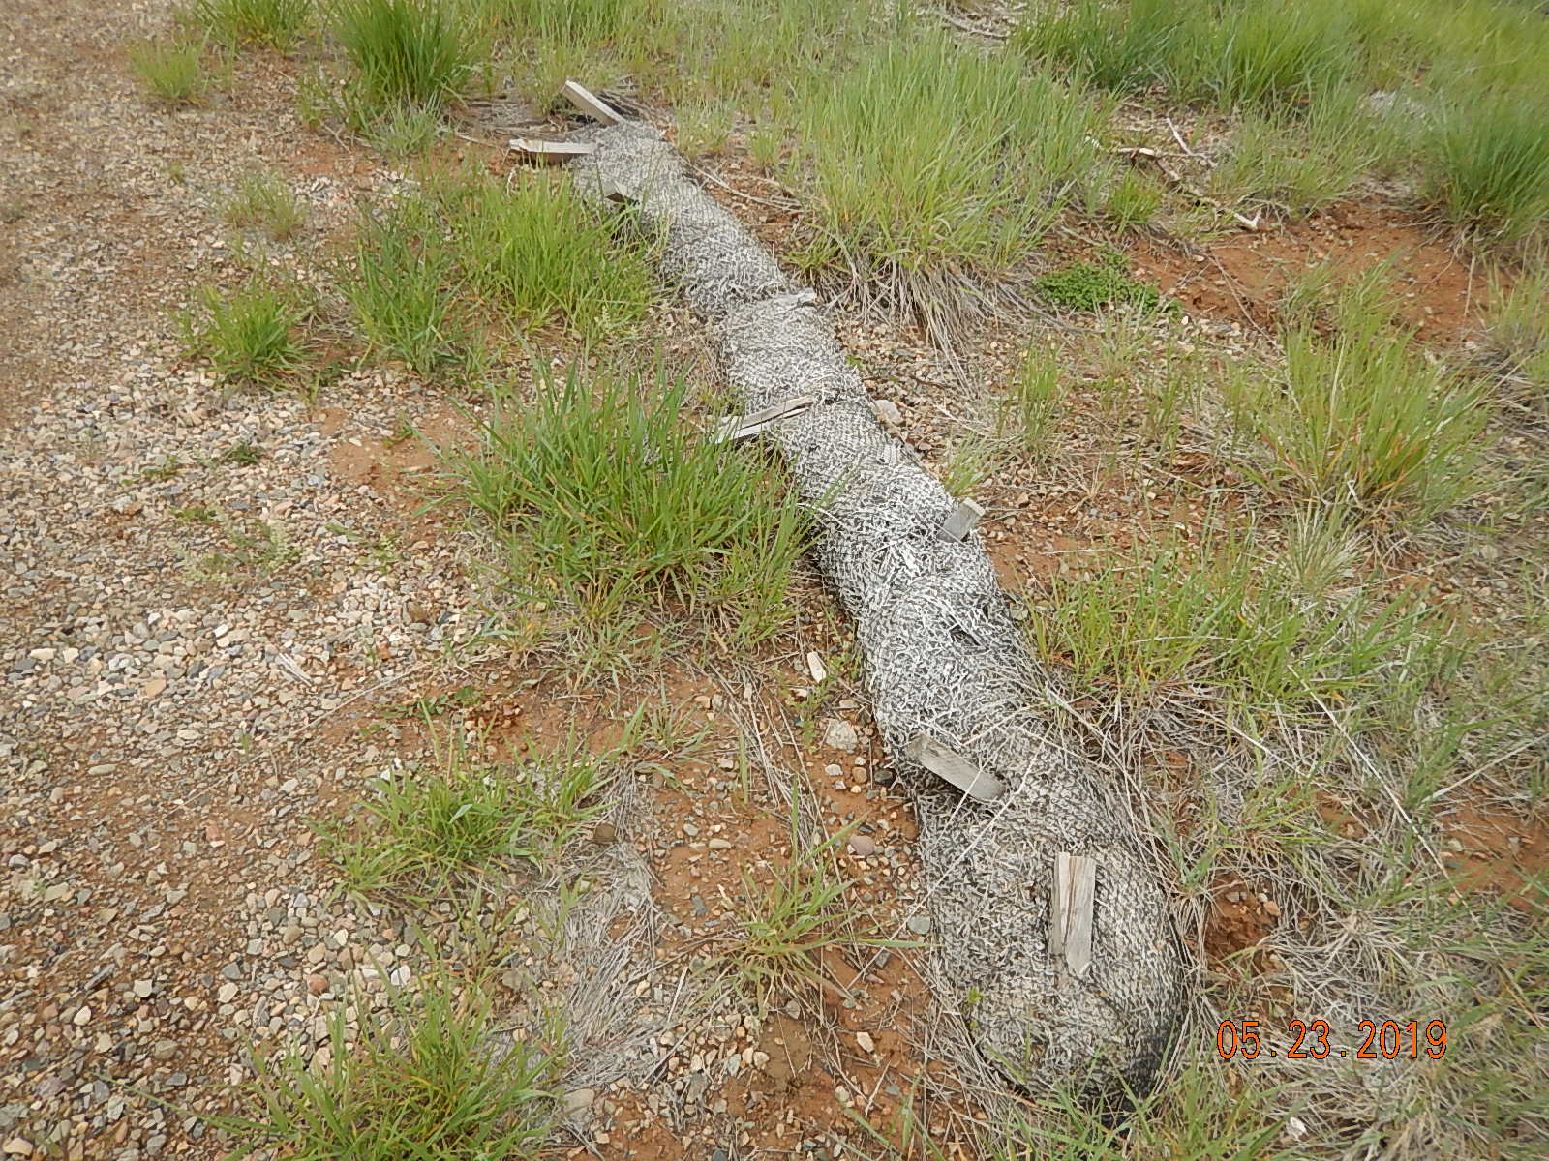
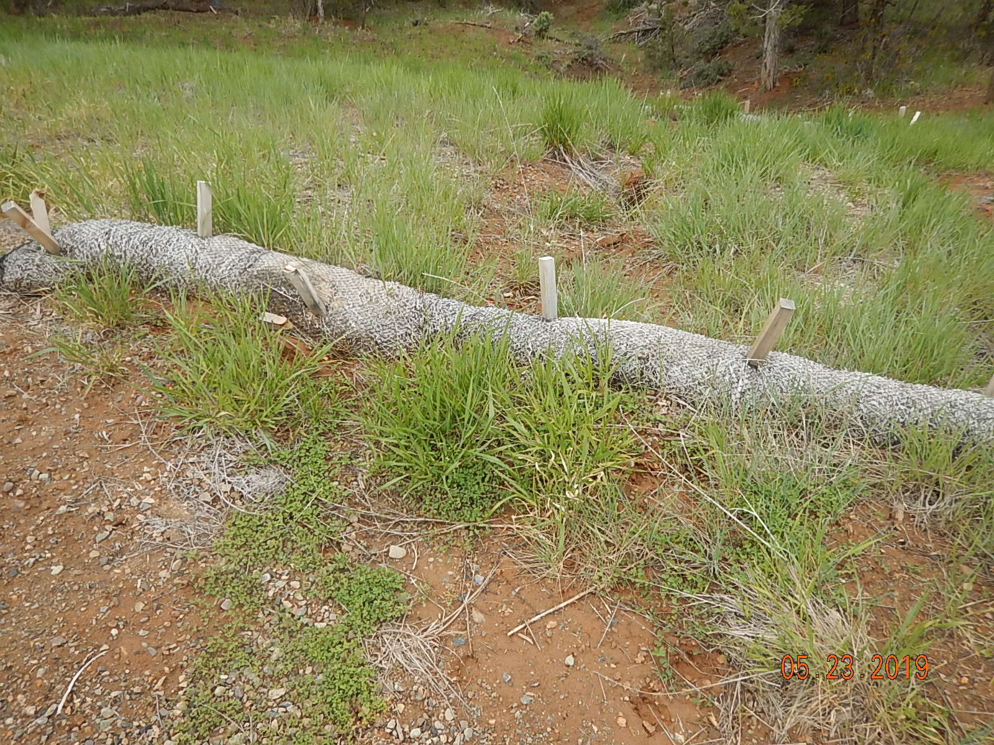
Inspection Photos
Annala Federal A1
API: 05-067-07741
#11 Waddle not functioning and is trash.
#12 Waddle not functioning and is trash.

Slide 7
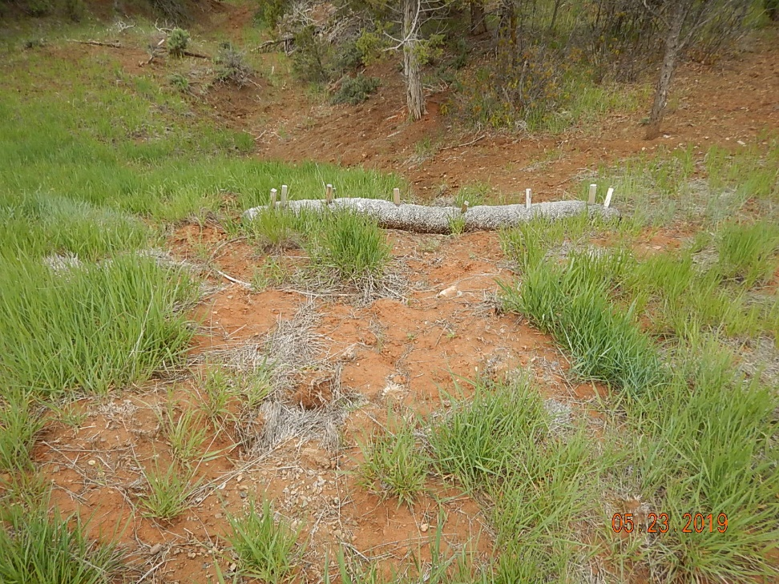
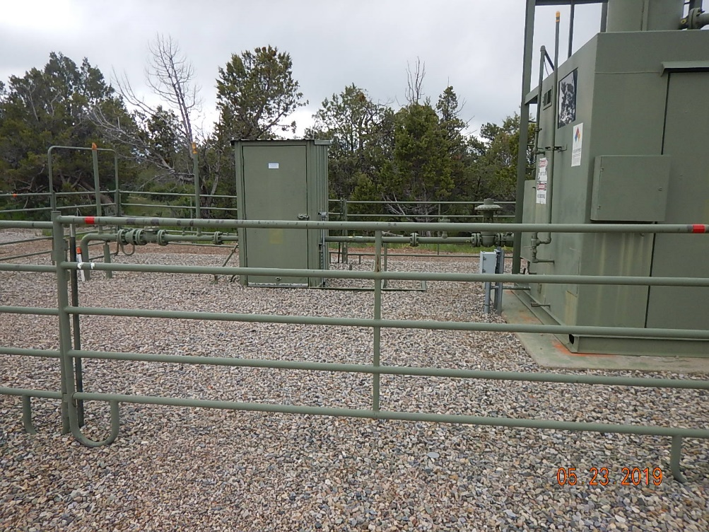
Inspection Photos
Annala Federal A1
API: 05-067-07741
#13 Stormwater BMP’s not functioning or maintained, erosion channel offsite.
#14 Production equipment.

