Slide 1
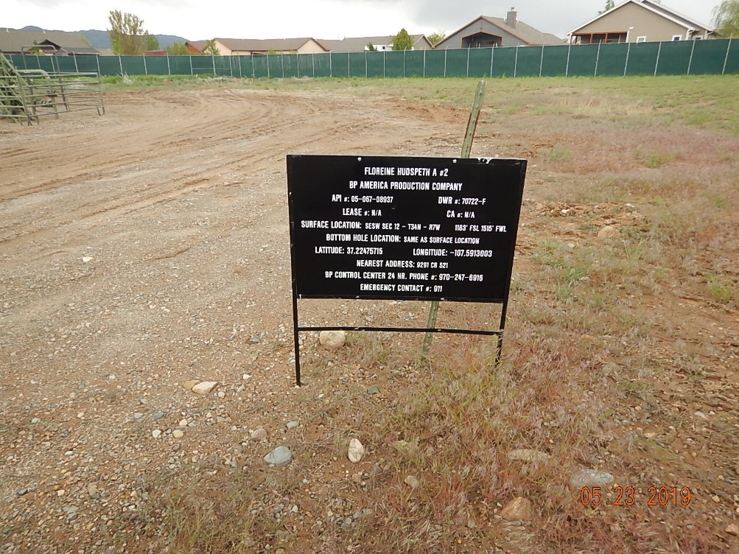
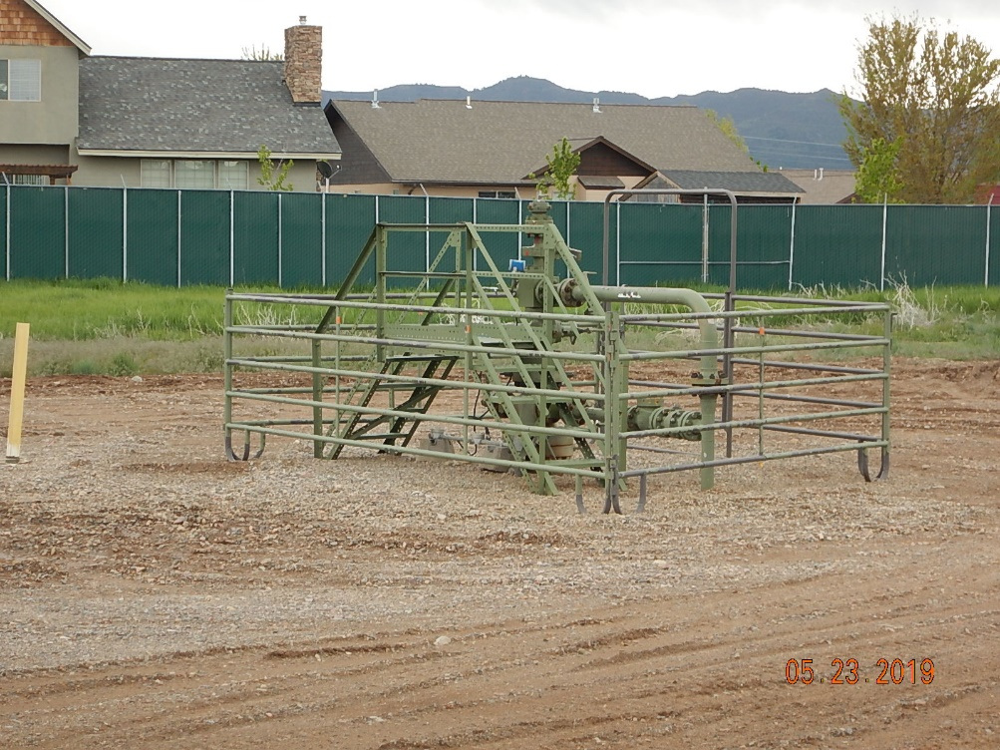
Inspection Photos
Floreine Hudspeth A#2
API: 05-067-08937
#1 Location
#2 Wellhead

Slide 2
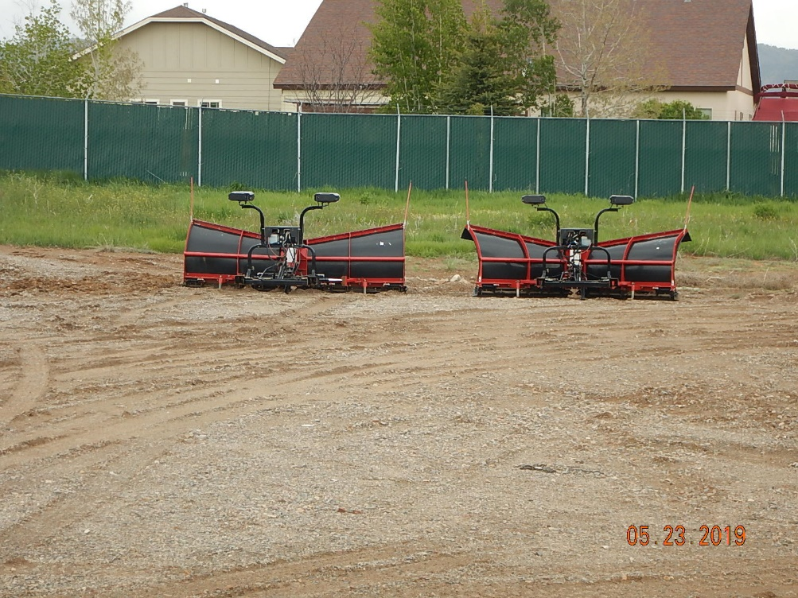
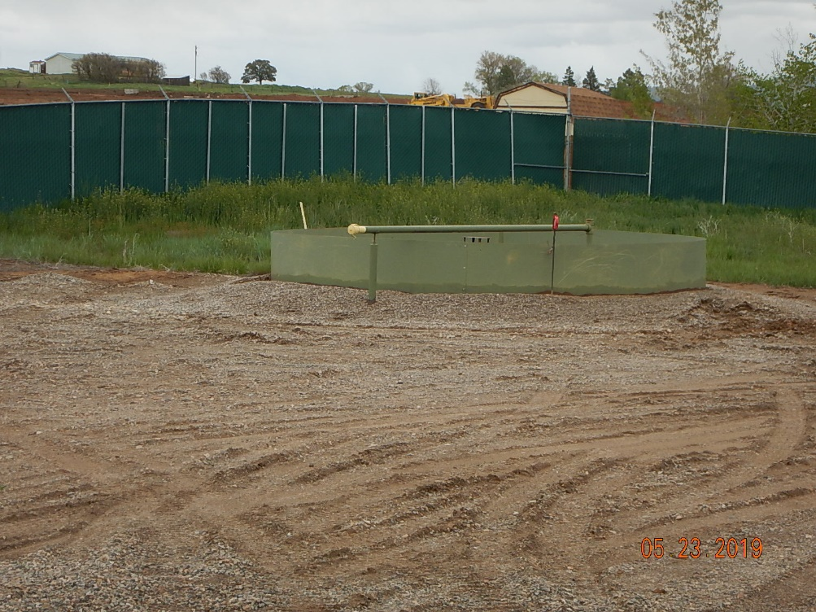
Inspection Photos
Floreine Hudspeth A#2
API: 05-067-08937
#3 Stored equipment on site.
#4 production equipment.

Slide 3
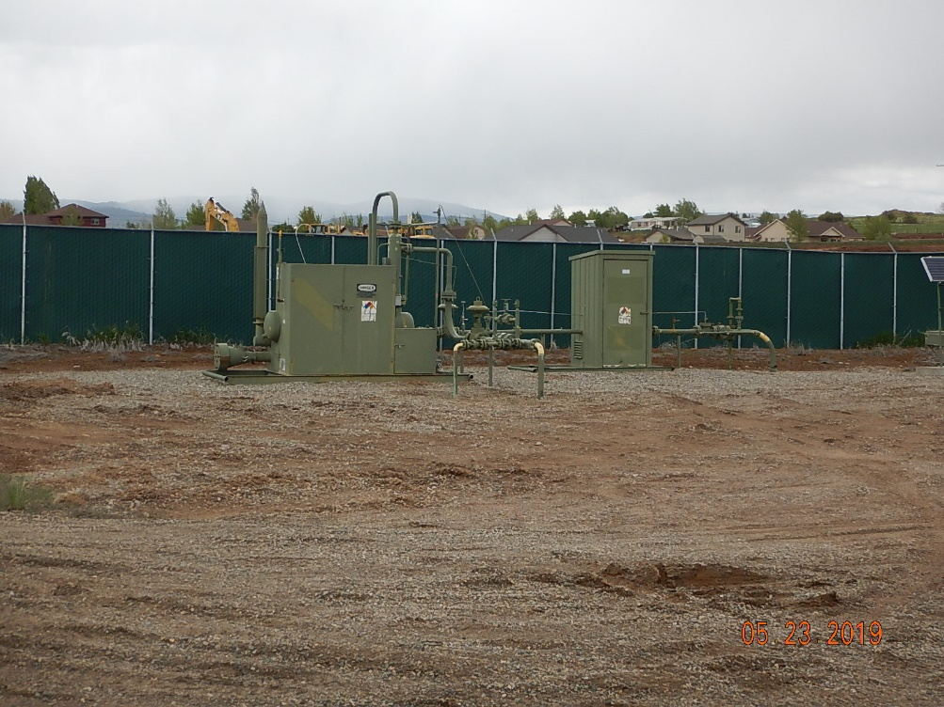
Inspection Photos
Floreine Hudspeth A#2
API: 05-067-08937
#5 Production equipment.

