Slide 1
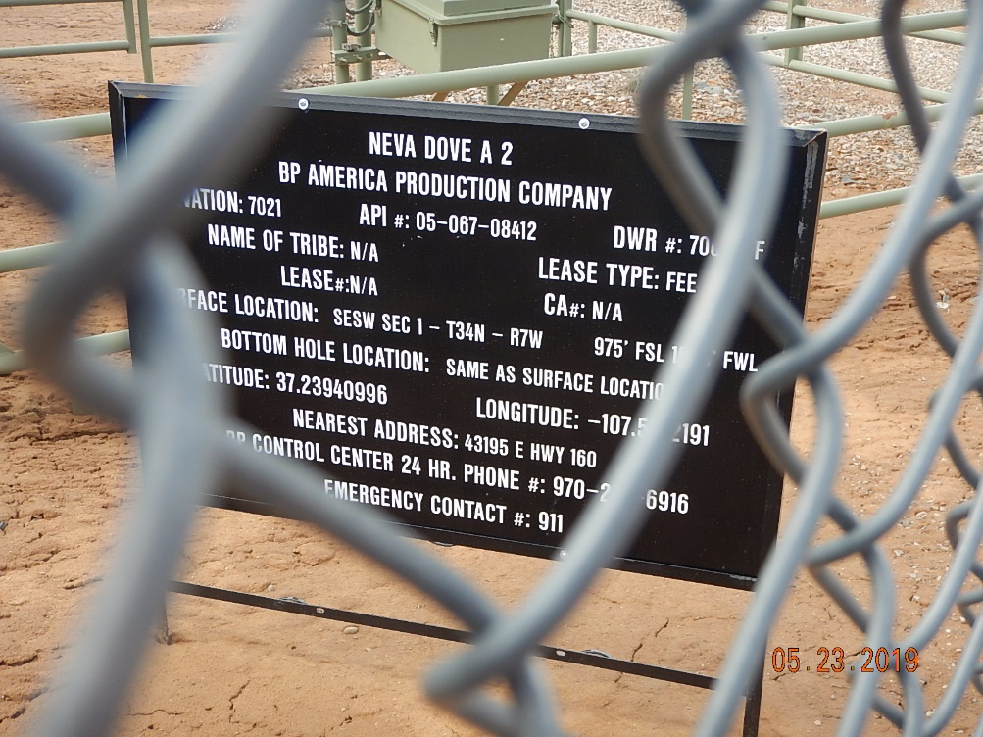
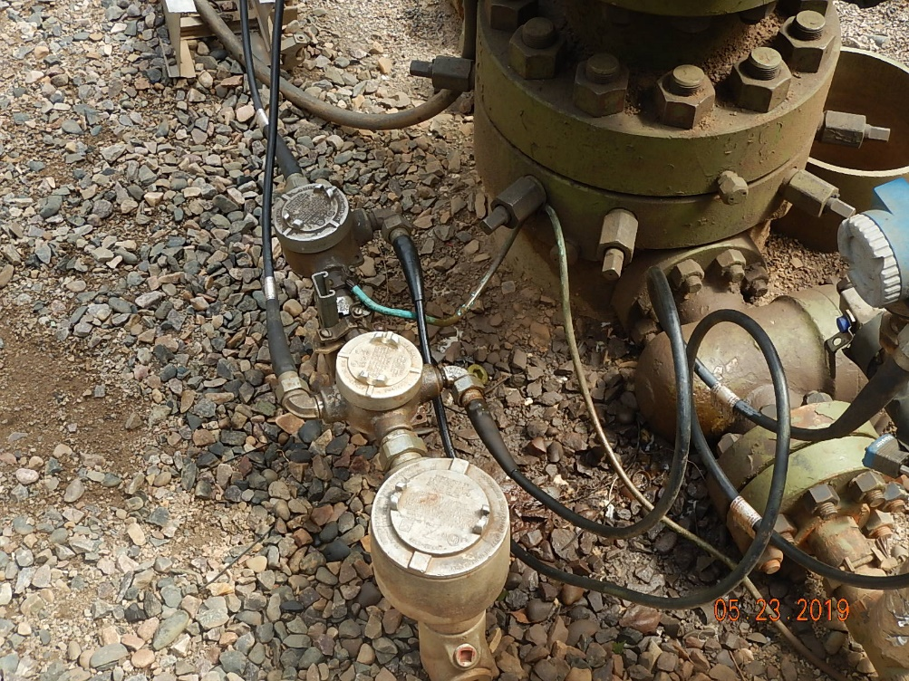
Inspection Photos
Neva Dove A2
API: 05-067-08412
#1 Location
#2 Stained soil/gravel around wellhead.

Slide 2
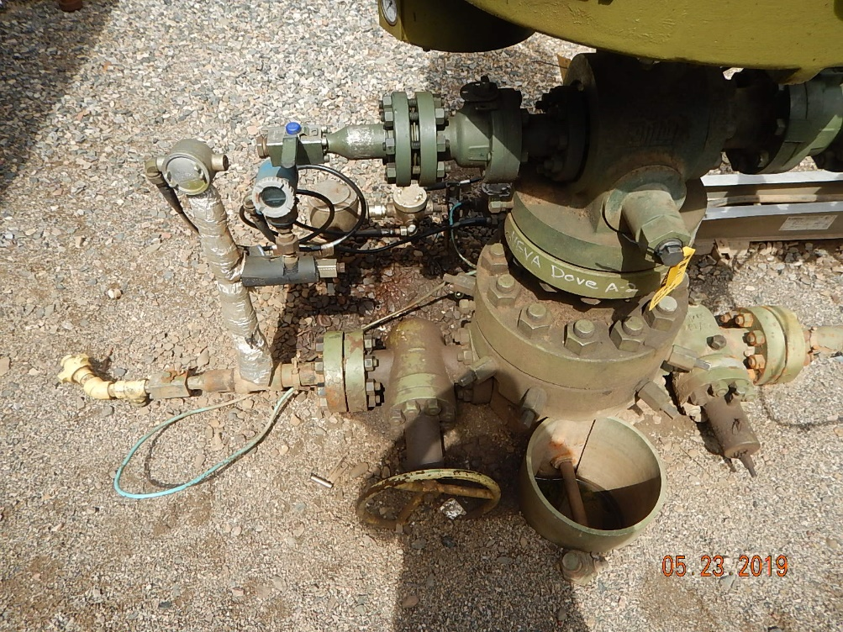
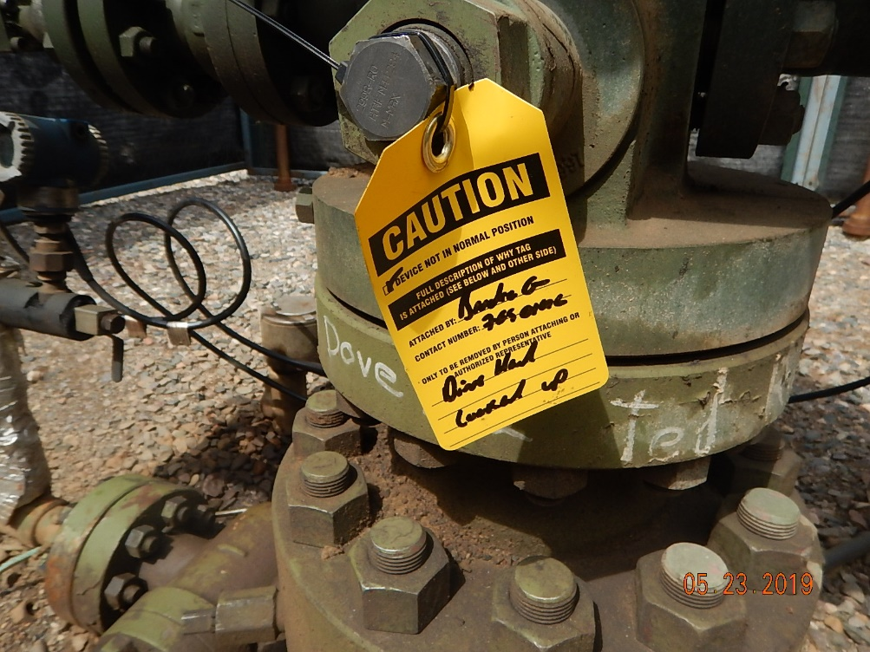
Inspection Photos
Neva Dove A2
API: 05-067-08412
#3 Stained soil/gravel around wellhead.
#4 LOTO, well shut-in for service.

Slide 3
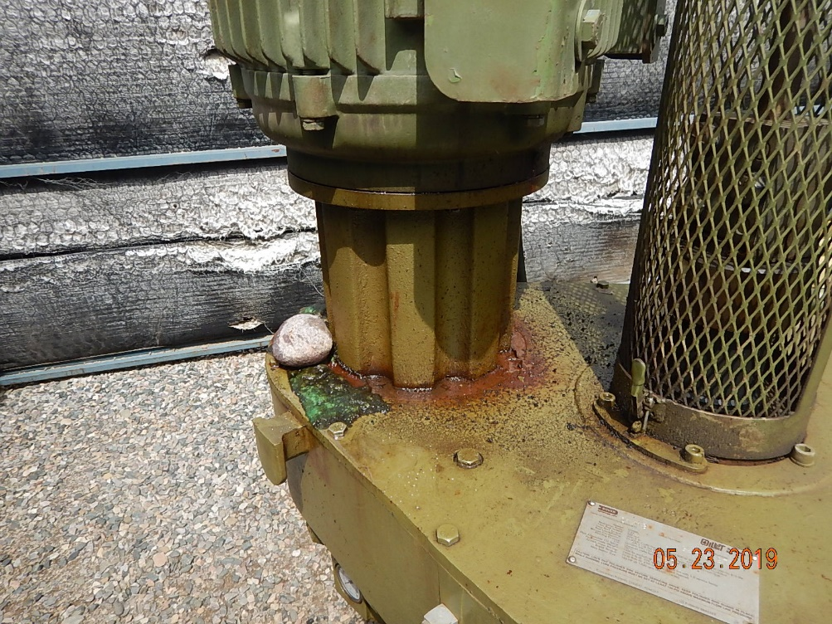
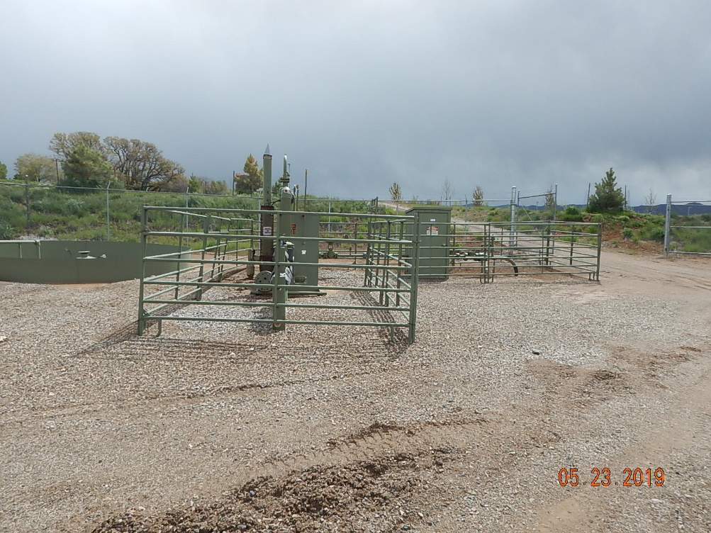
Inspection Photos
Neva Dove A2
API: 05-067-08412
#5 Oil waste around prime mover.
#6 Location equipment.

Slide 4
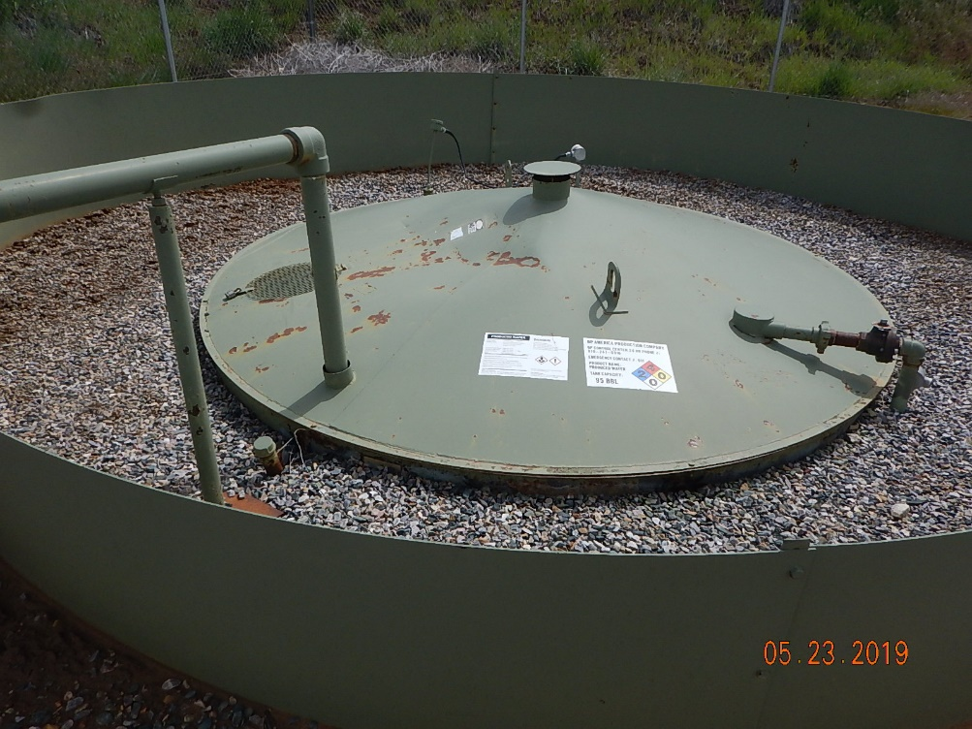
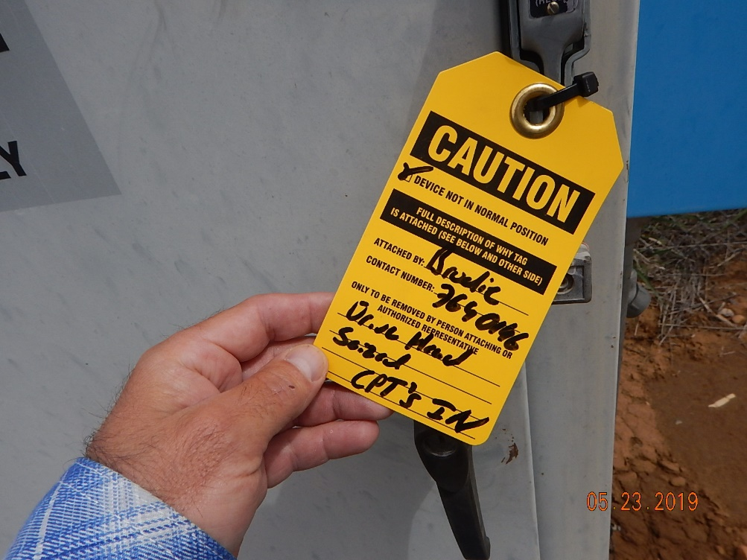
Inspection Photos
Neva Dove A2
API: 05-067-08412
#7 Location equipment.
#8 LOTO shut-in for service.

