Slide 1
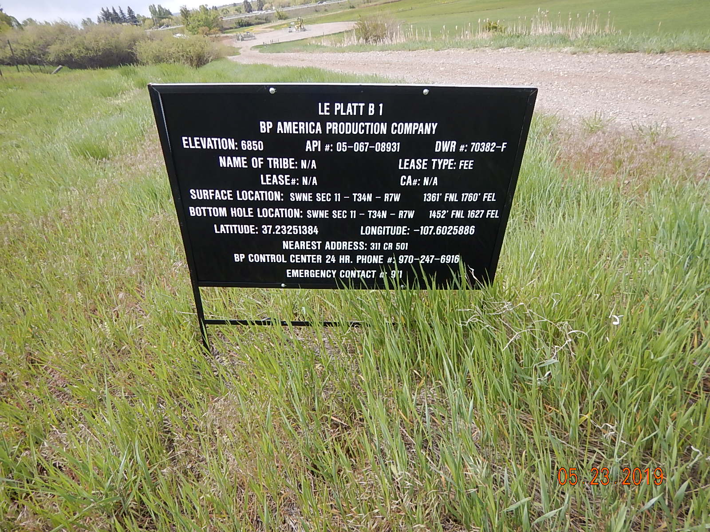
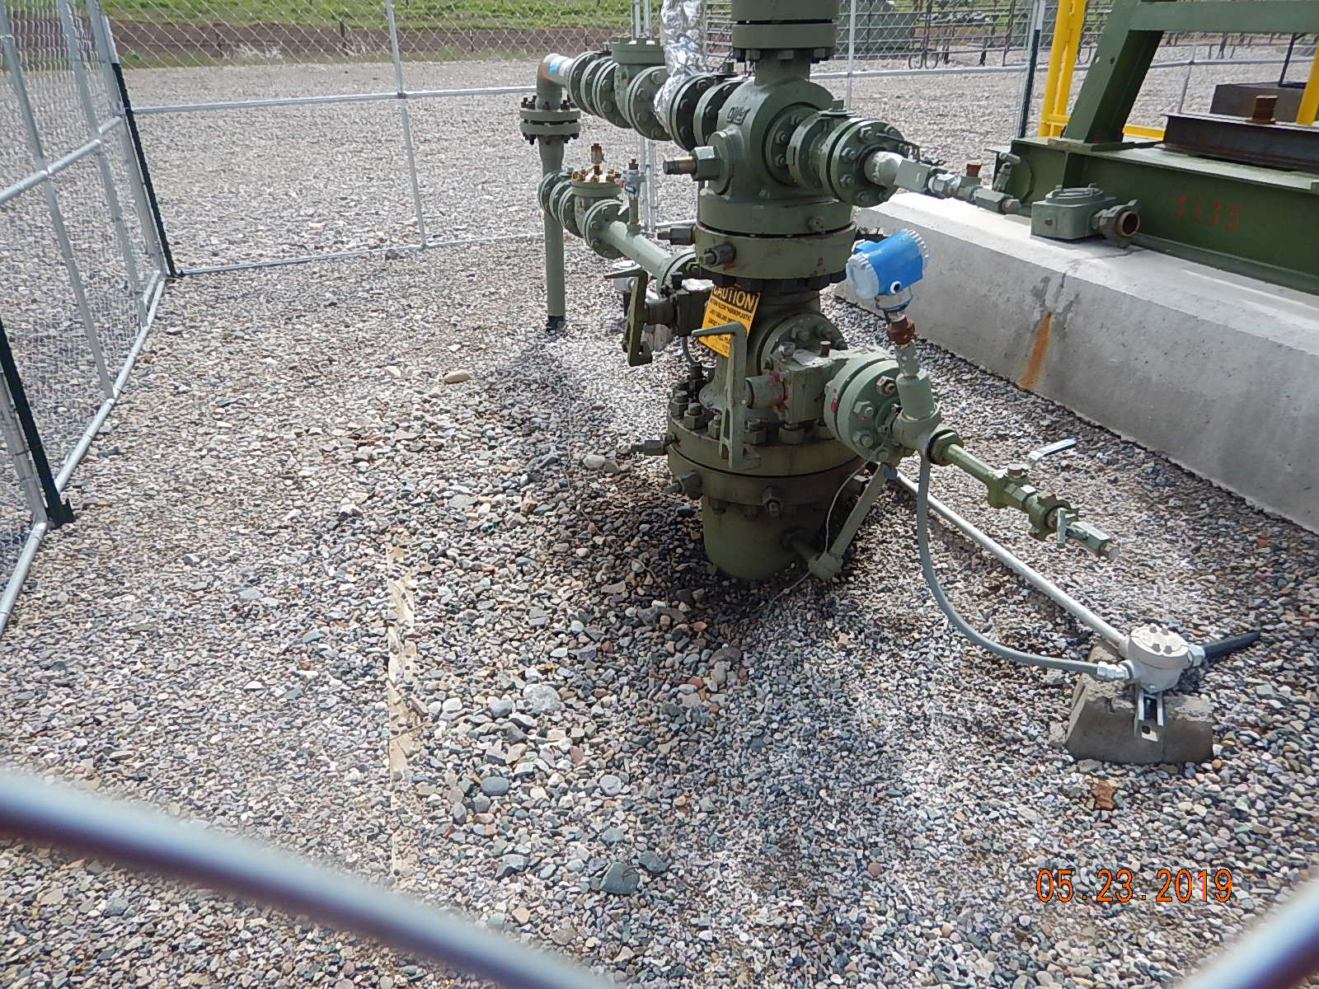
Inspection Photos
Le Platt B1
API: 05-067-08931
#1 location sign.
#2 Stained gravel/soil around wellhead.

Slide 2
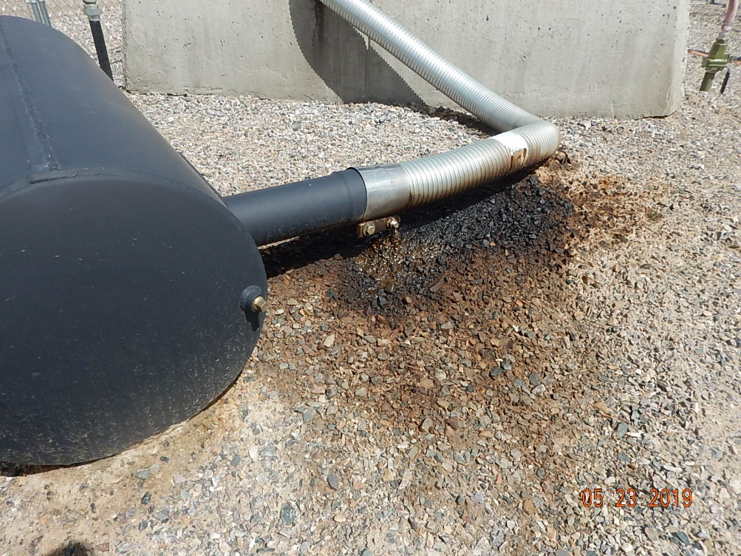
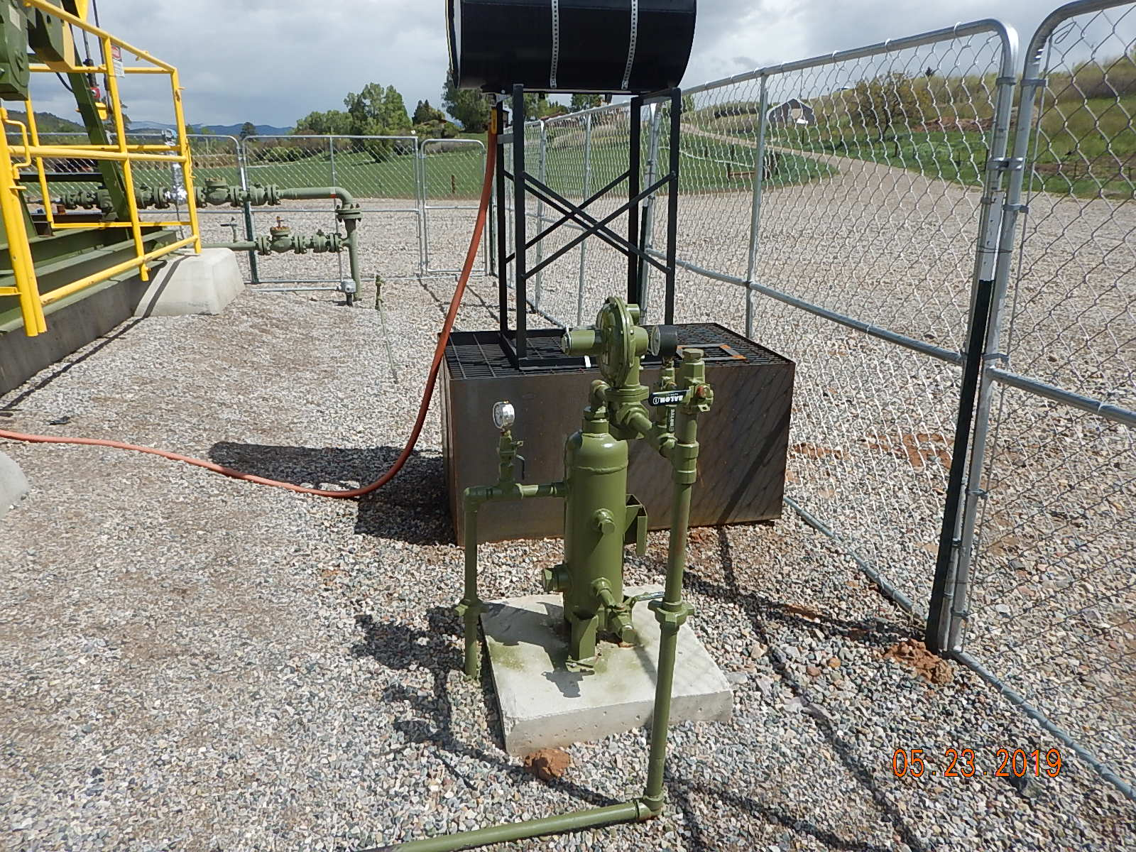
Inspection Photos
Le Platt B1
API: 05-067-08931
#3 Stained soil/gravel around muffler connection.
#4 Spill prevention.

Slide 3
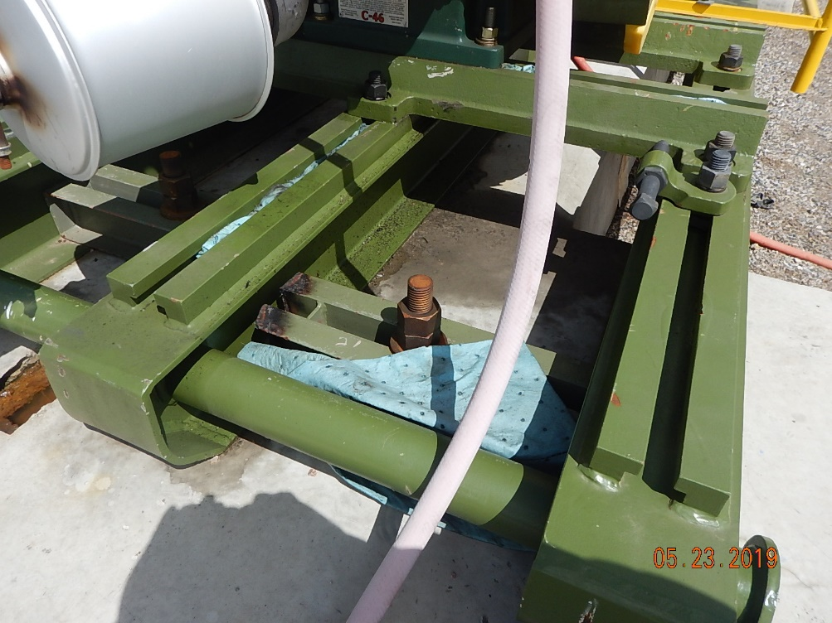
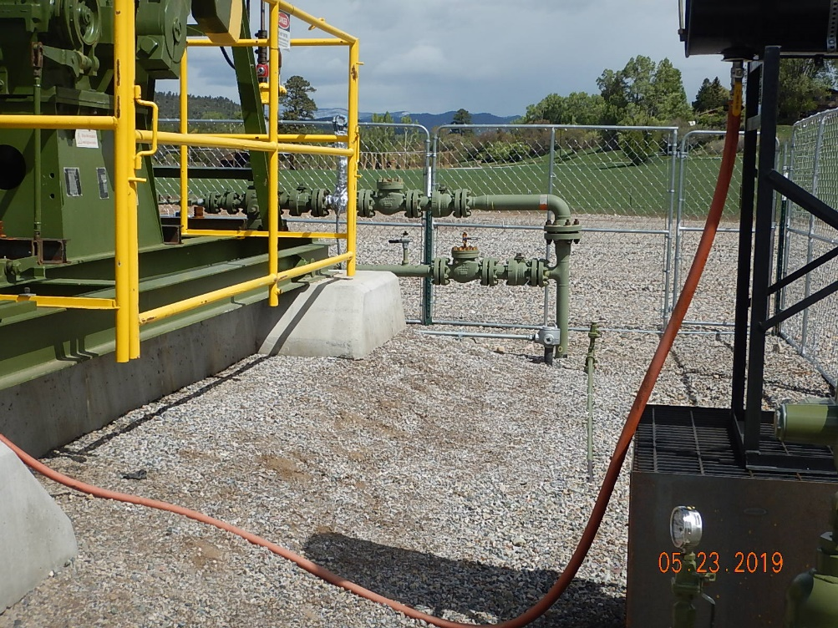
Inspection Photos
Le Platt B1
API: 05-067-08931
#5 Oily rags/pads below equipment.
#6 Flowlines.

Slide 4
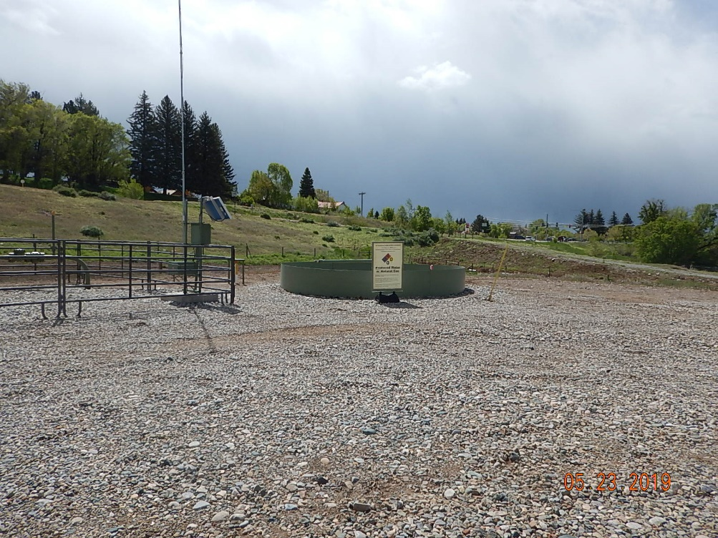
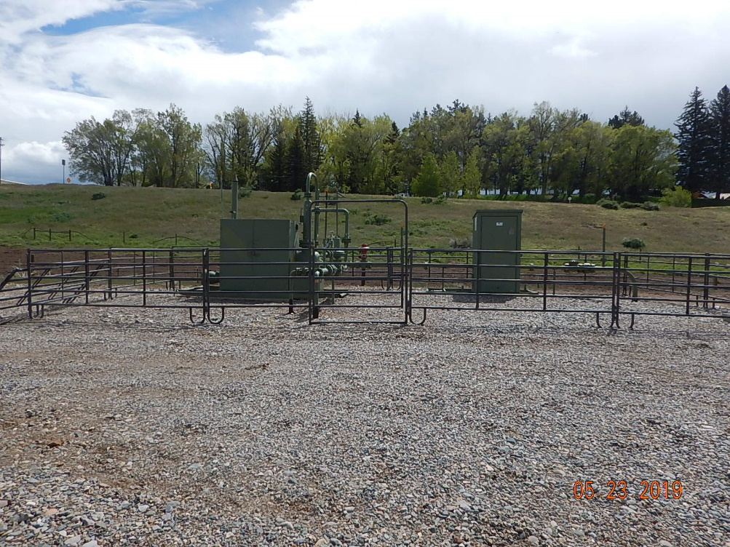
Inspection Photos
Le Platt B1
API: 05-067-08931
#7 Location equipment.
#8 Location equipment.

