Slide 1
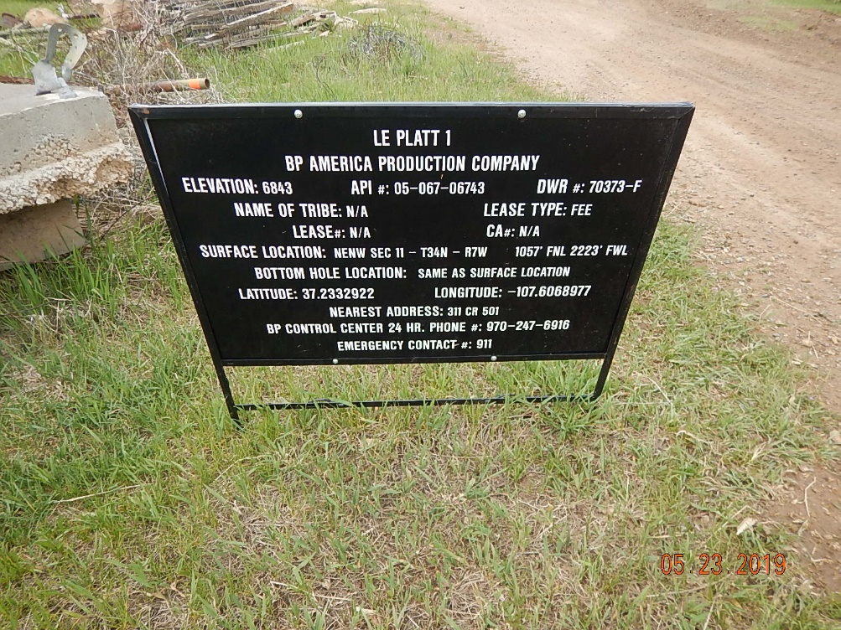
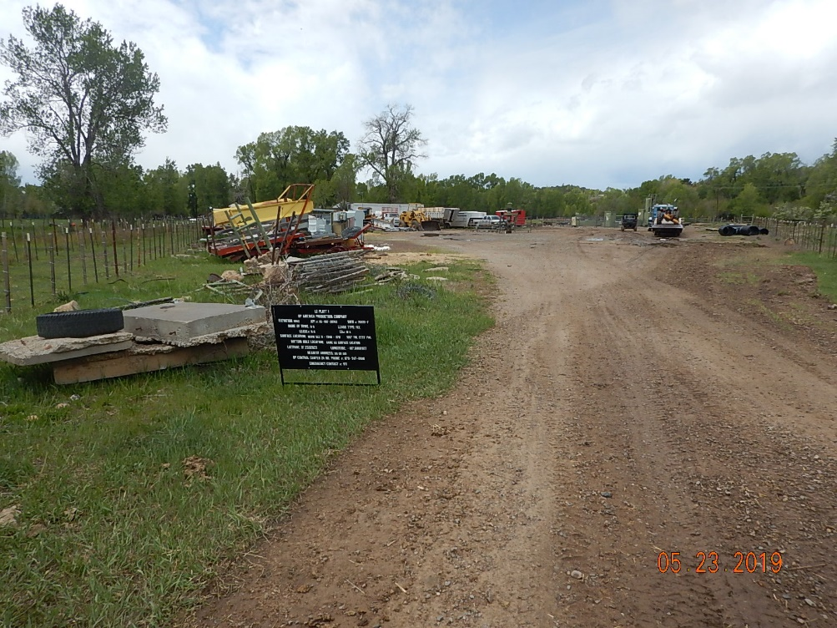
Inspection Photos
Le Platt 1
API: 05-067-06743
#1 Location.
#2 Unused equipment, waste and debris on location.

Slide 2
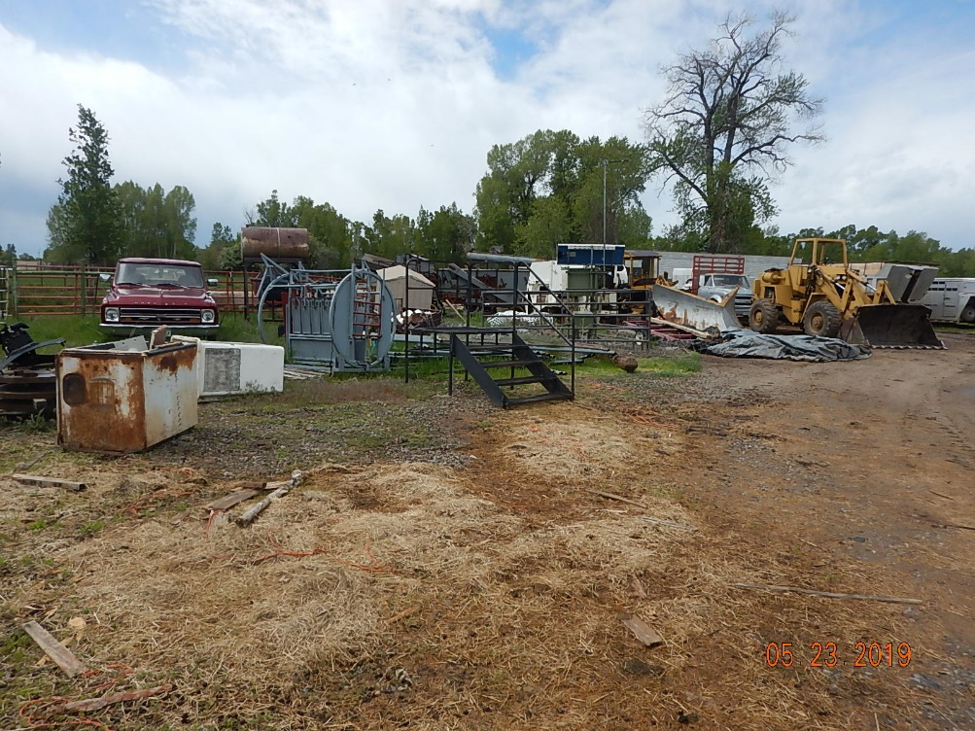
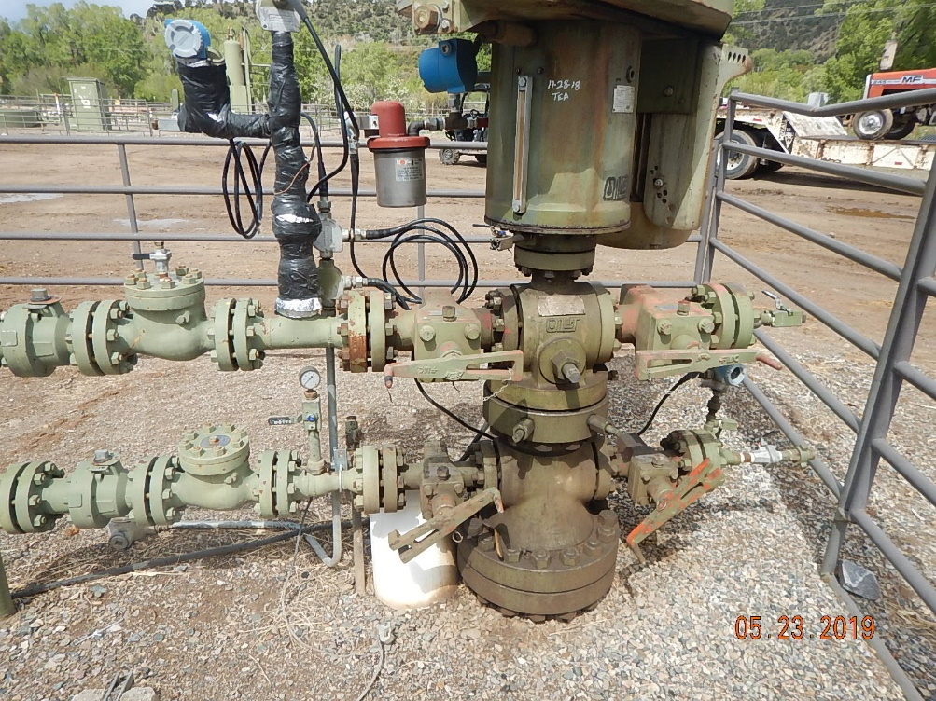
Inspection Photos
Le Platt 1
API: 05-067-06743
#3 Waste, debris and unused equipment on location.
#4 Wellhead.

Slide 3
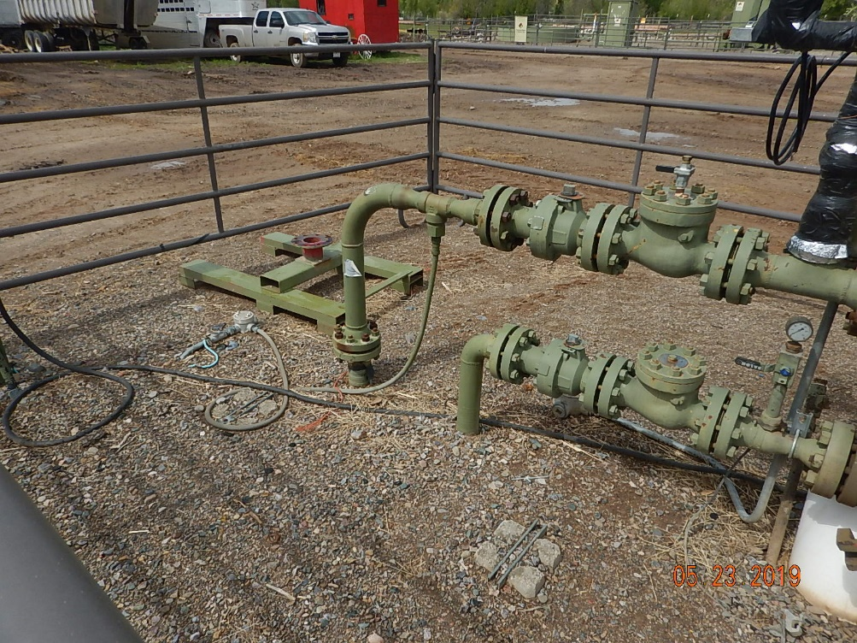
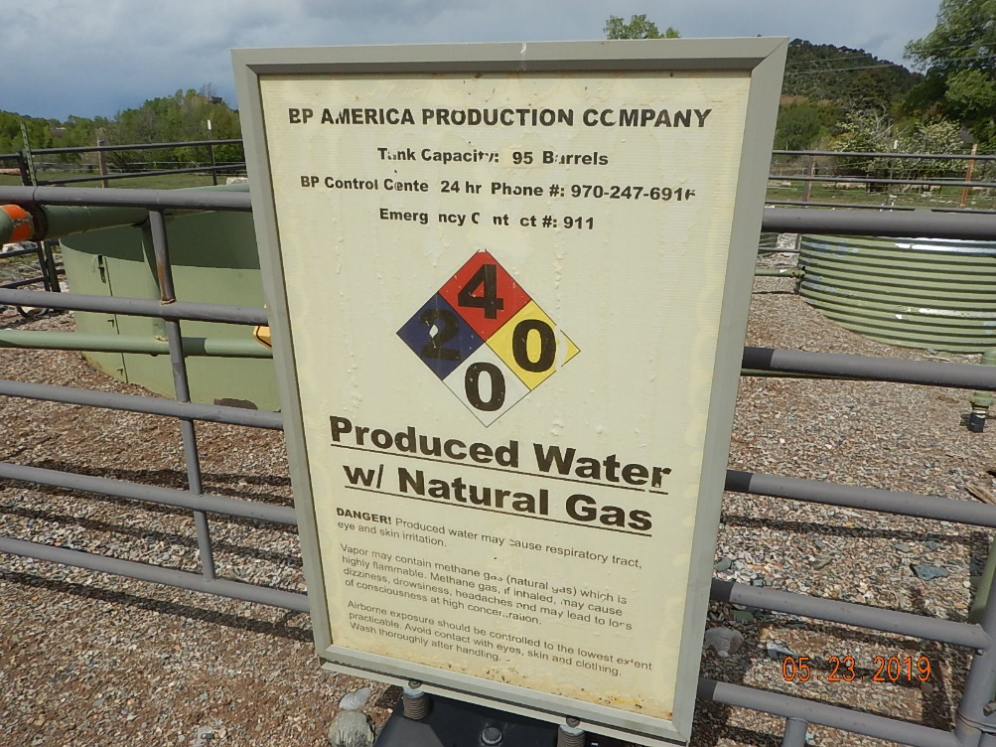
Inspection Photos
Le Platt 1
API: 05-067-06743
#5 Flowlines.
#6 Produced water tank.

Slide 4
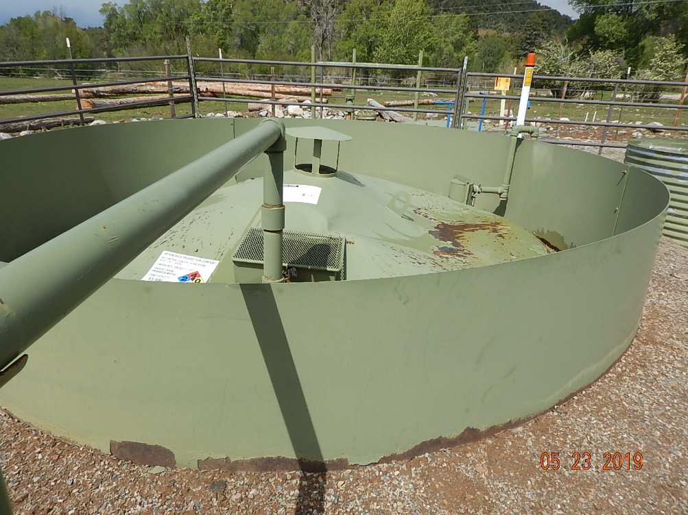
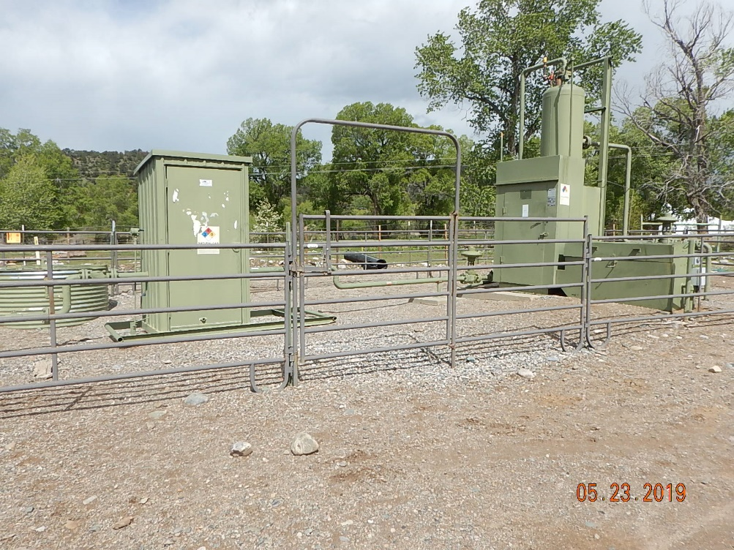
Inspection Photos
Le Platt 1
API: 05-067-06743
#7 Produced water tank.
#8 Production equipment.

Slide 5
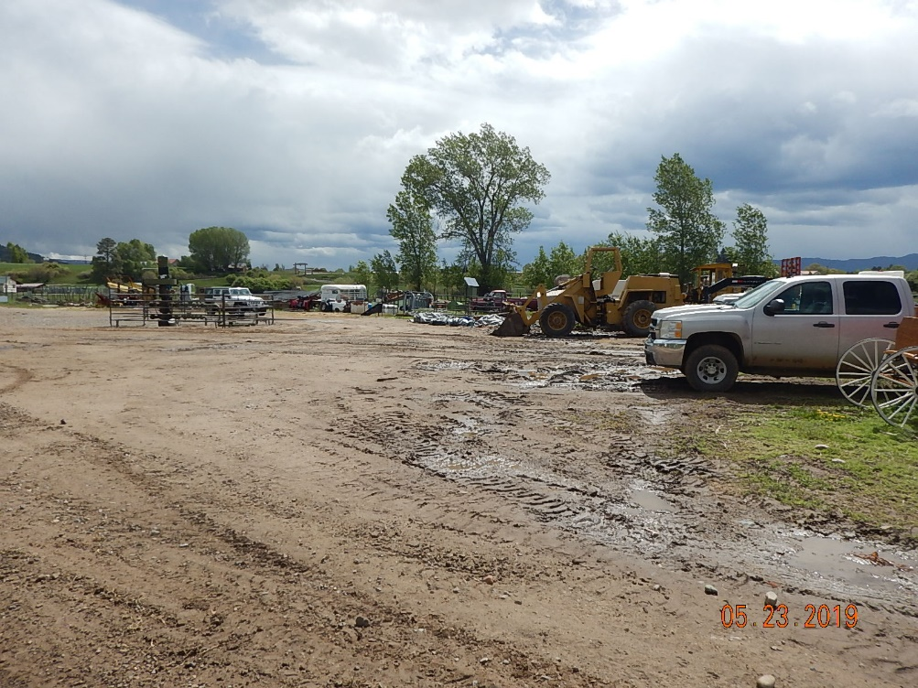
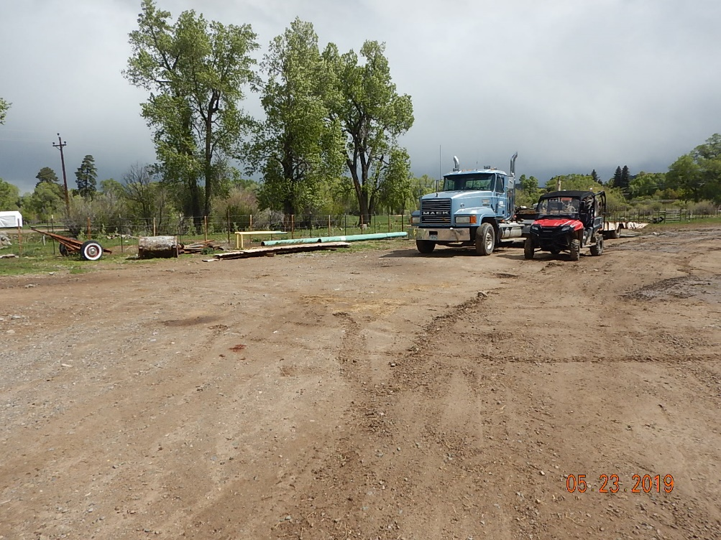
Inspection Photos
Le Platt 1
API: 05-067-06743
#9 Unused equipment on location.
#10 Unused equipment on location.

Slide 6
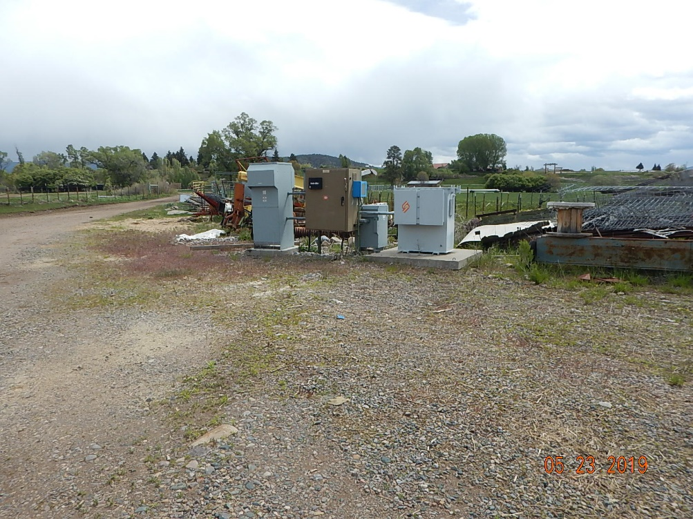
Inspection Photos
Le Platt 1
API: 05-067-06743
#11 Production equipment and waste and debris on location.

