Slide 1
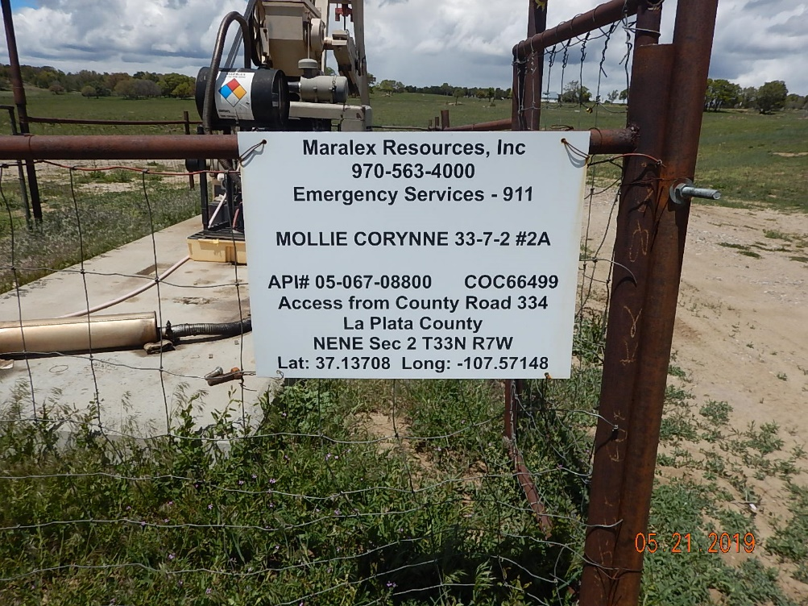
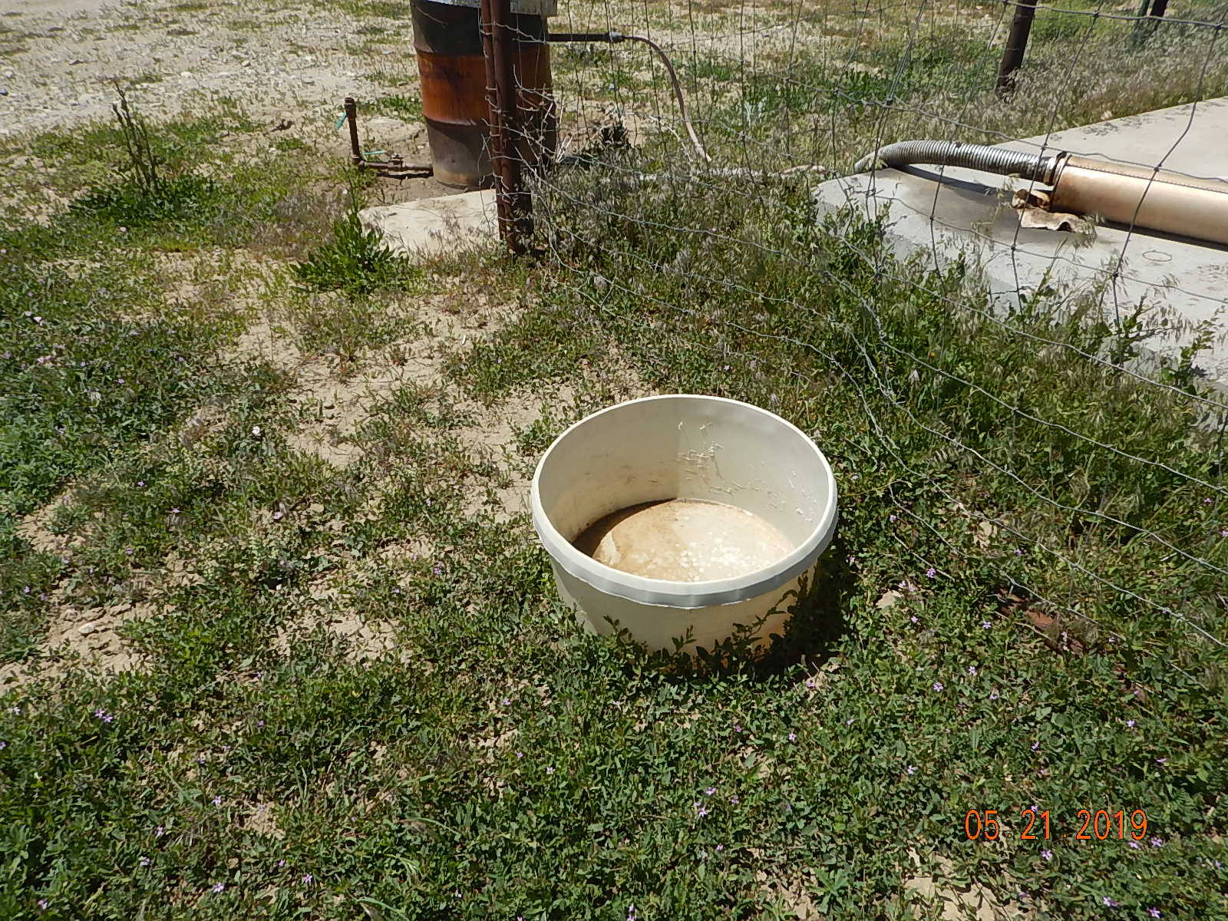
Inspection Photos
MOLLIE CORYNNE 33-7-2 #2A
API: 05-067-08800
#1 Sign posted at location.
#2 Unused equipment bucket. Weeds around equipment.

Slide 2
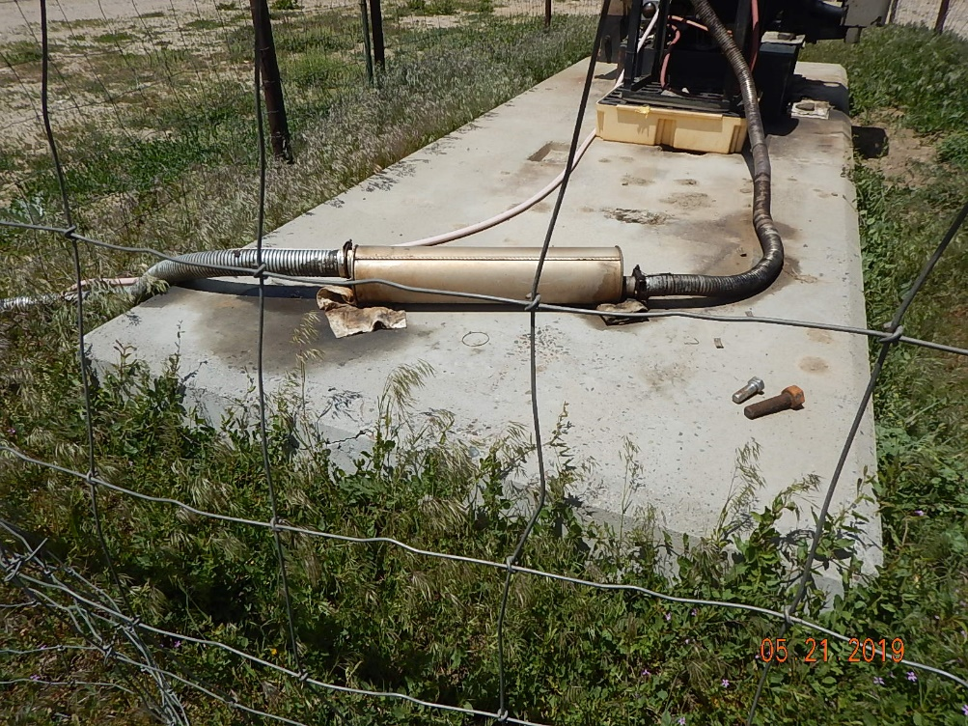
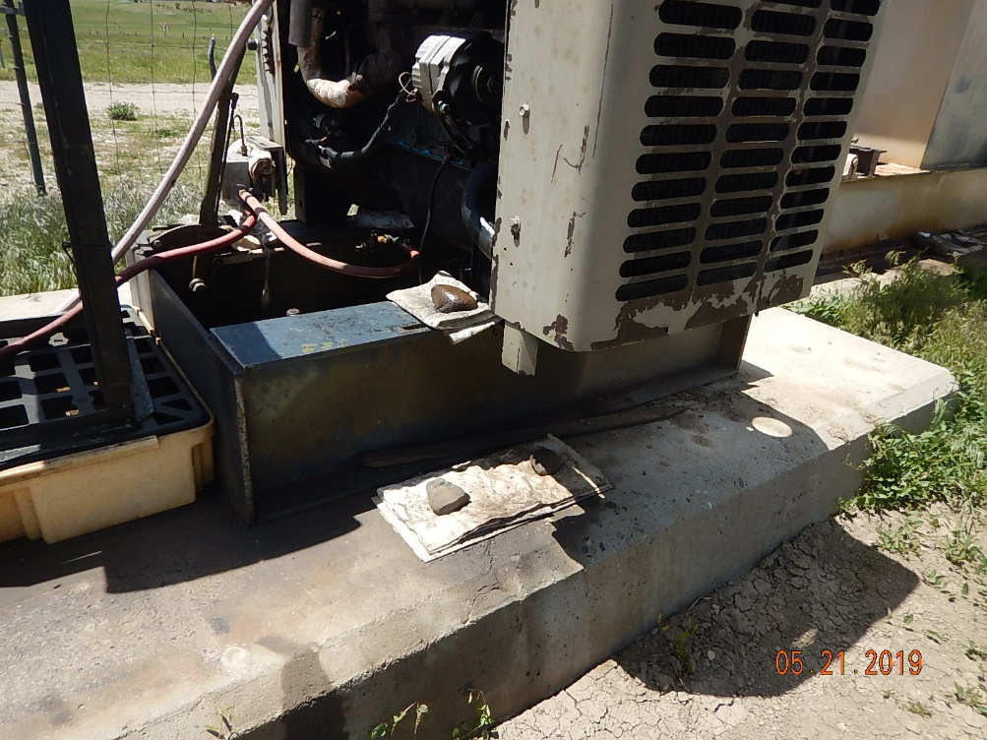
Inspection Photos
MOLLIE CORYNNE 33-7-2 #2A
API: 05-067-08800
#3 Weeds around equipment. Oily pads/rags and staining on concrete. Unused parts on pad.
#4 Oily pads/rags and spotting on concrete.

Slide 3
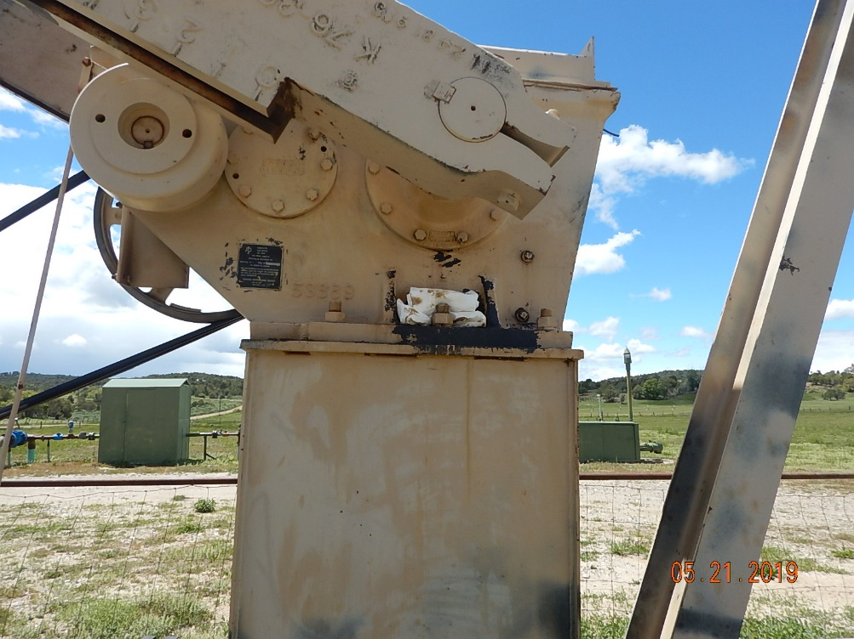
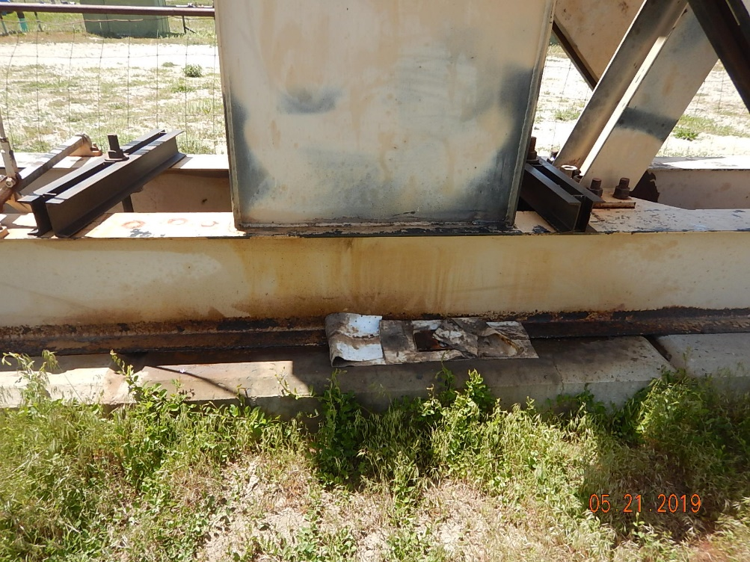
Inspection Photos
MOLLIE CORYNNE 33-7-2 #2A
API: 05-067-08800
#5 Leaking gearbox seal.
#6 Leaking gearbox seal causing oily waste spotting on concrete.

Slide 4
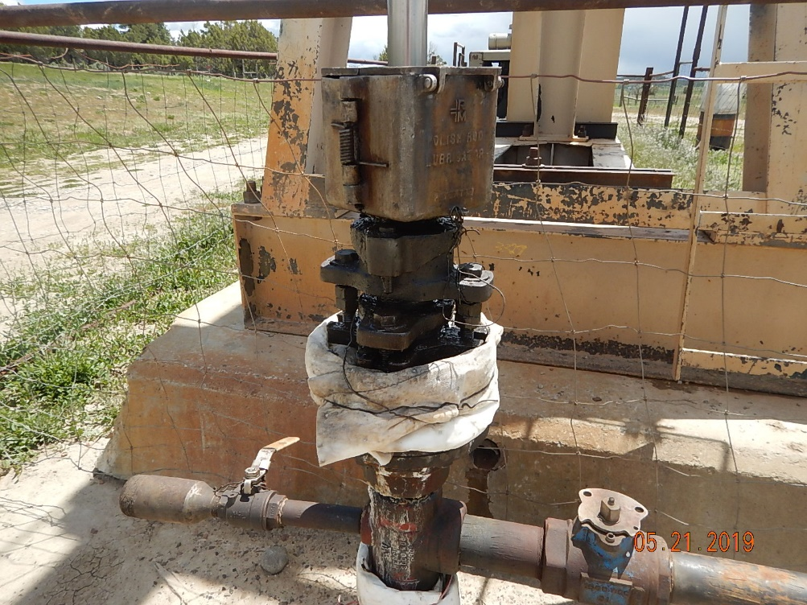
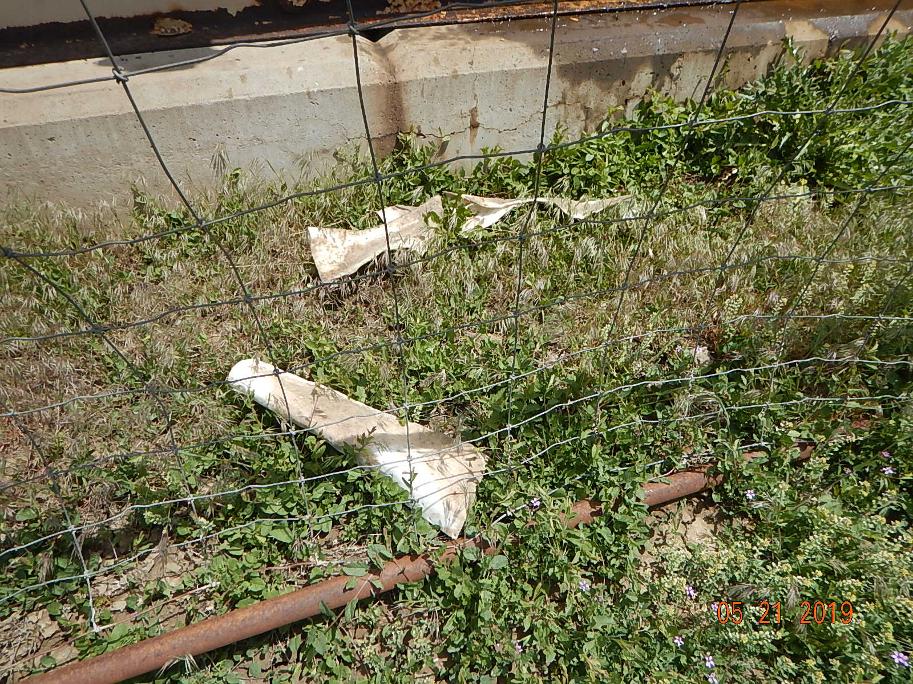
Inspection Photos
MOLLIE CORYNNE 33-7-2 #2A
API: 05-067-08800
#7 Leaking packing gland on wellhead.
#8 Weeds around pumpjack. Oily rags laying on ground. Oil staining on concrete.

Slide 5
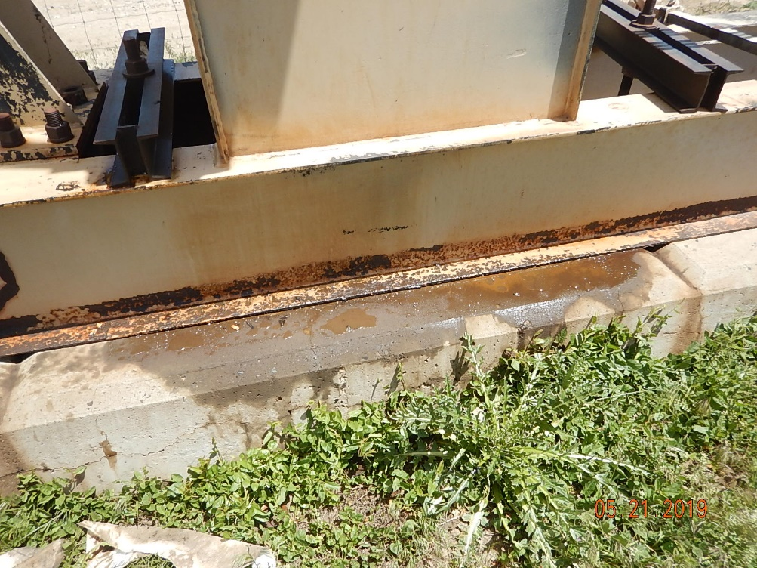
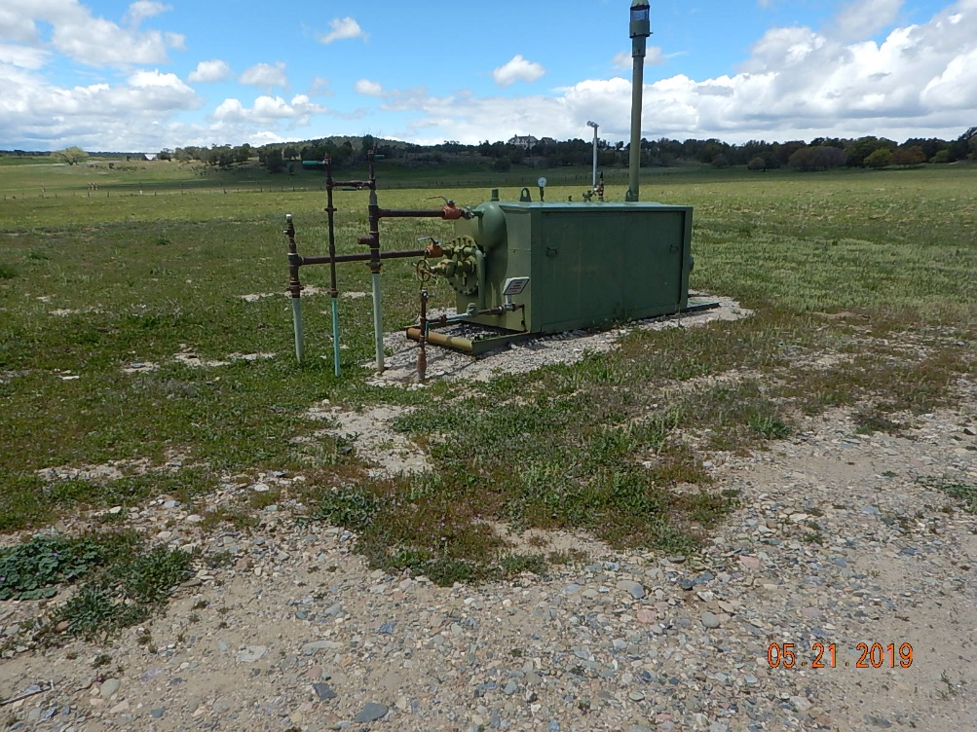
Inspection Photos
MOLLIE CORYNNE 33-7-2 #2A
API: 05-067-08800
#9 Oily waste from gearbox leak on concrete.
#10 Separator on location.

Slide 6
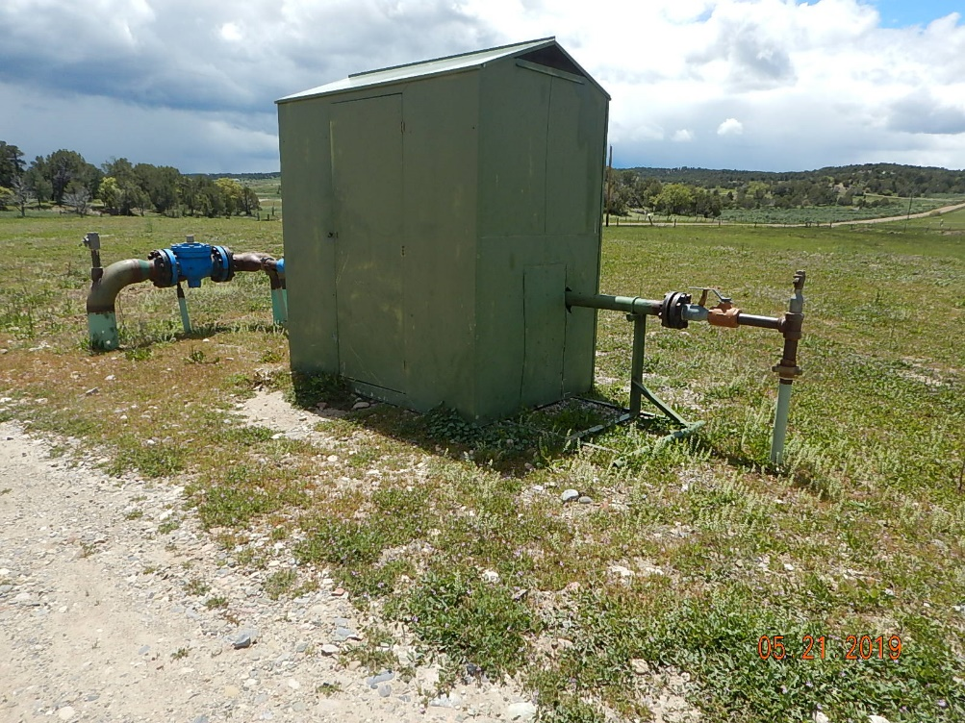
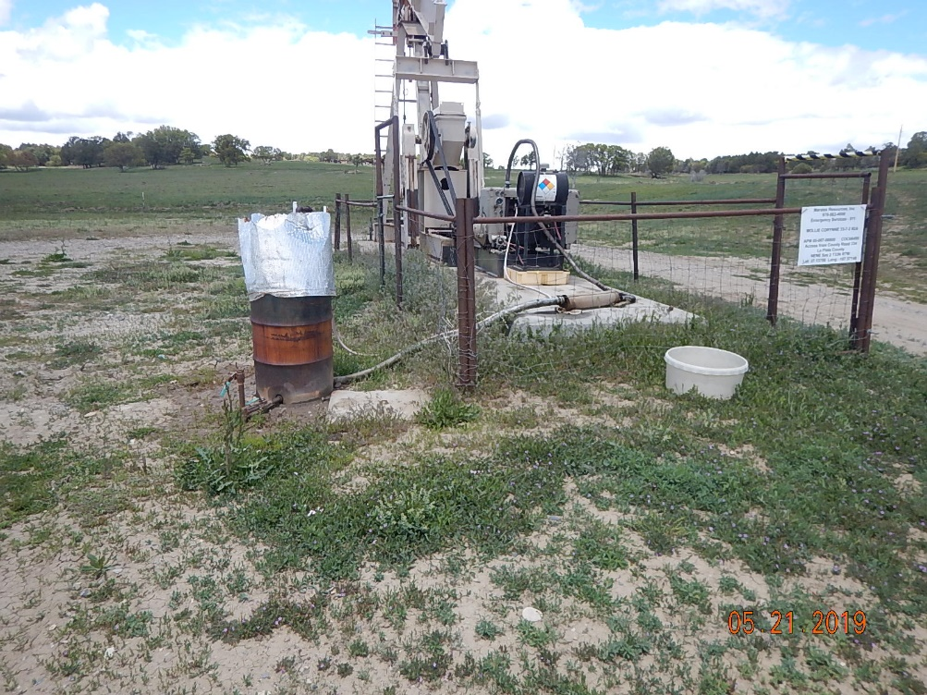
Inspection Photos
MOLLIE CORYNNE 33-7-2 #2A
API: 05-067-08800
#11 Meter house on location.
#12 Pumpjack photo. Drum contains fuel gas knockout pot.

