Slide 1
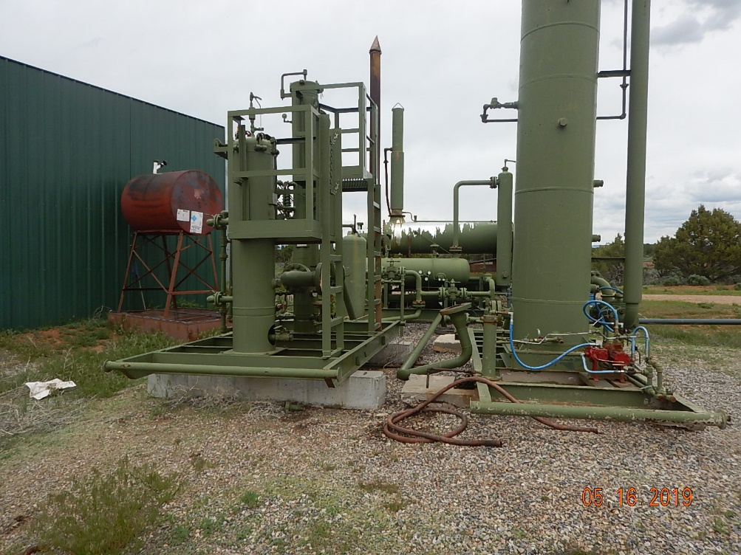
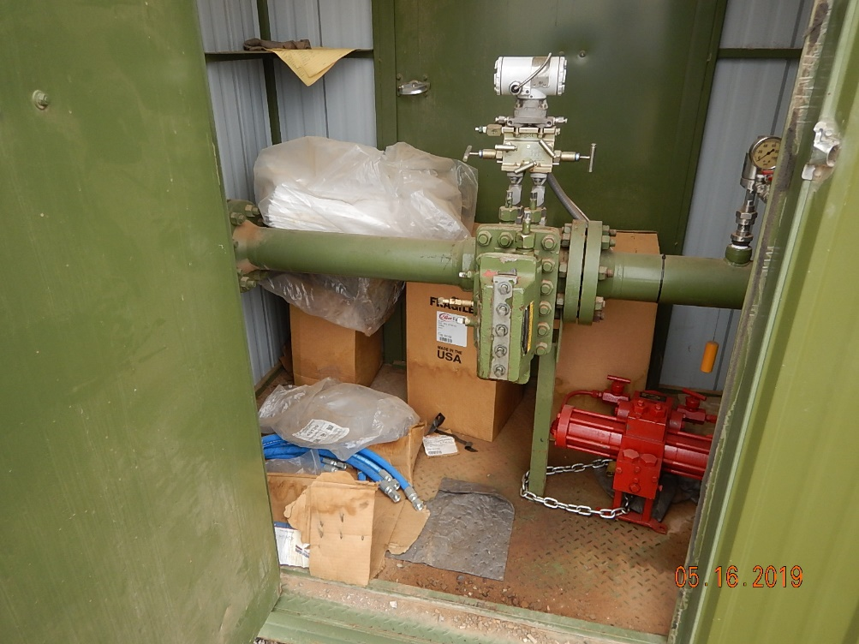
Inspection Photos
SHELLHAMMER COMPRESSOR
Facility ID: 214932
#1 Photo left, used soaker pads are trash; center, used rubber hose is trash. Unused piping and equipment disconnected from the process.
#2 Unused equipment stored in meter house.

Slide 2
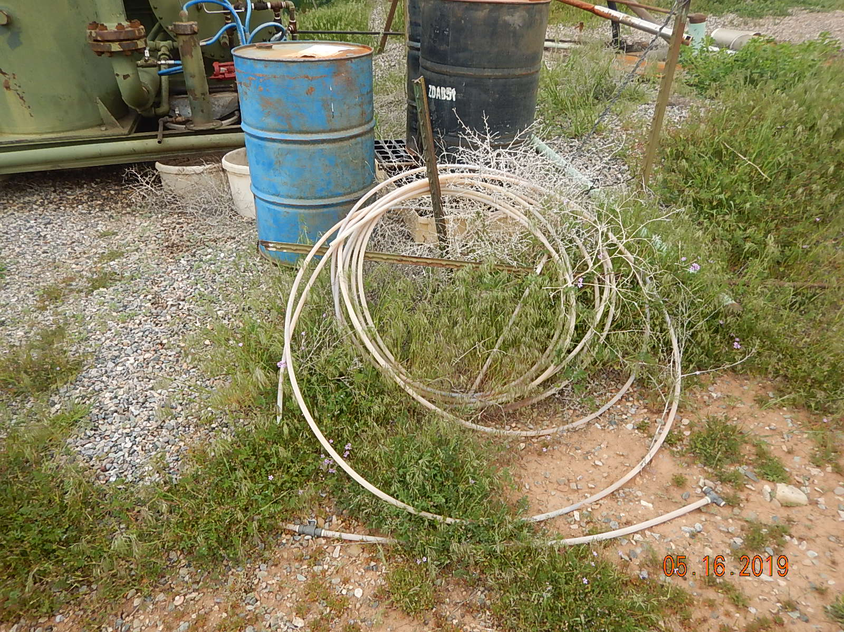
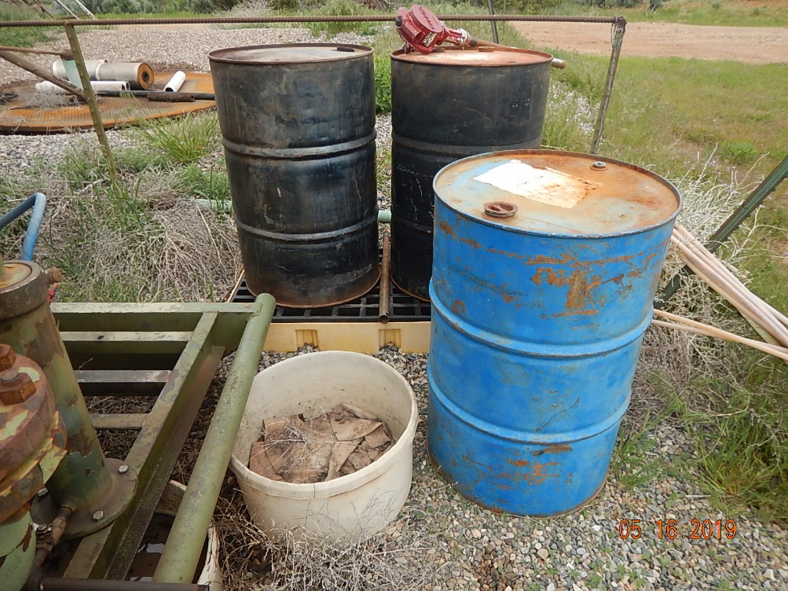
Inspection Photos
SHELLHAMMER COMPRESSOR
Facility ID: 214932
#3 Plastic tubing is trash. Barrels are unidentified with no labeling and not all are sitting on approved spill prevention for safe materials handling. Weeds around equipment.
#4 Unidentified barrels with no labeling. Unused equipment drum pump. Oily rags and waste. Weeds around fired process equipment.

Slide 3
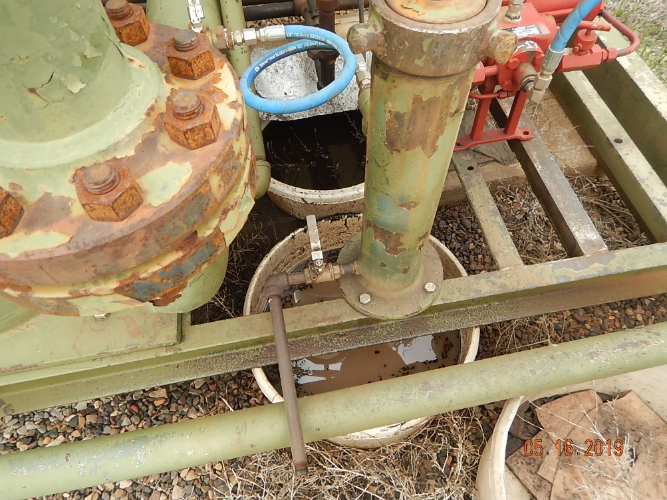
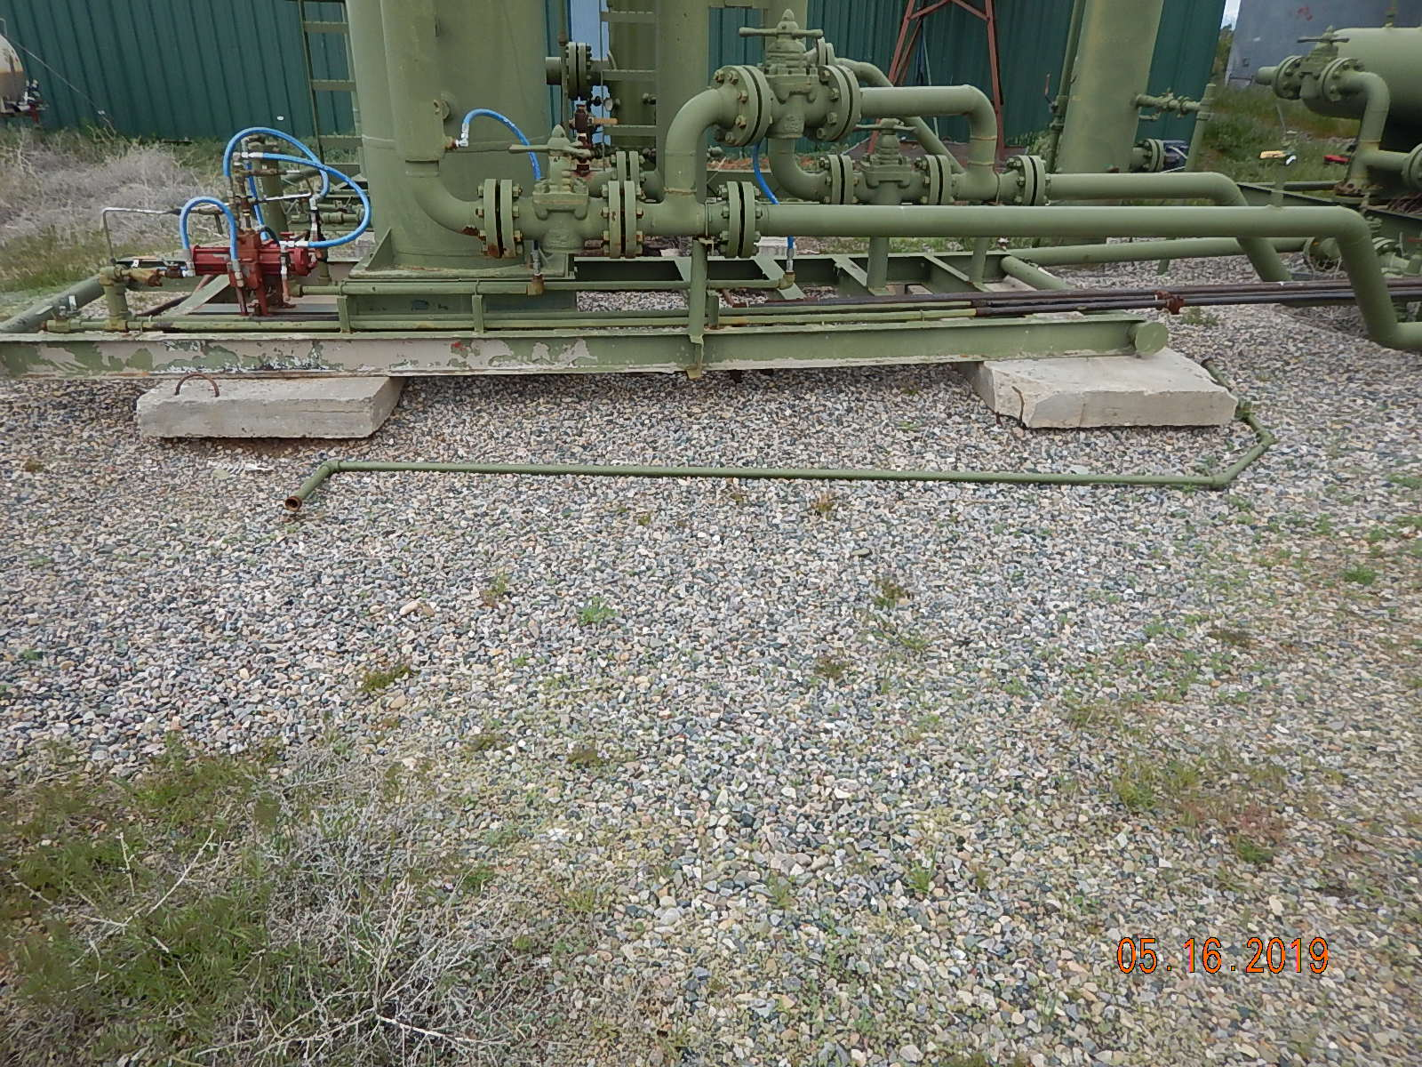
Inspection Photos
SHELLHAMMER COMPRESSOR
Facility ID: 214932
#5 Oily waste/TEG/Glycol/water in buckets below equipment with stained gravel/soil spill around area of use.
#6 Unused equipment disconnected from the process and not in use.

Slide 4
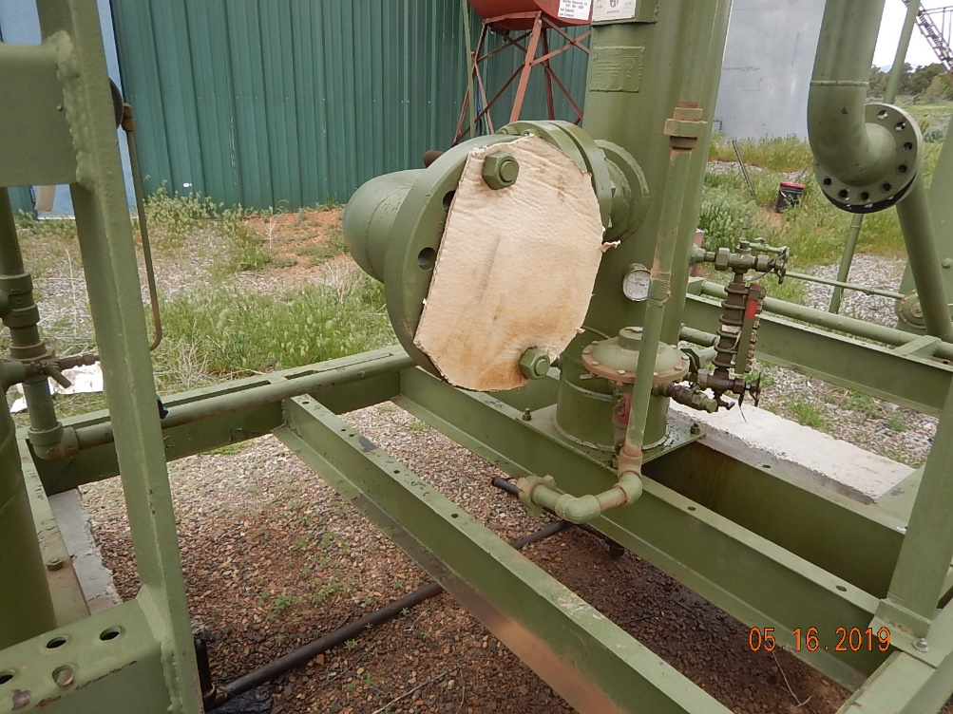
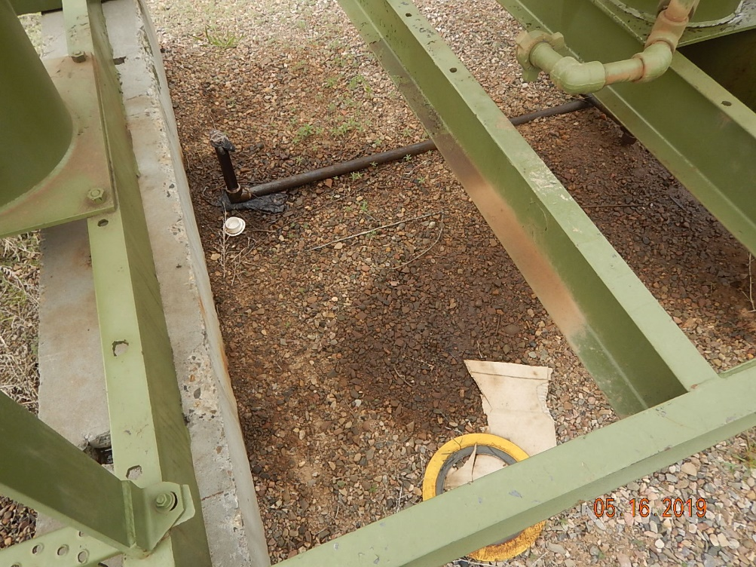
Inspection Photos
SHELLHAMMER COMPRESSOR
Facility ID: 214932
#7 Gravel/soil are oil stained below equipment. Unused equipment disconnected from the process (cardboard on flange and broken flange on right of photo, arrows)
#8 Used CGI gaskets and trash on ground. Gravel/soil are oil stained below equipment. Unsued equipment piping disconnected from the process. Rags stuffed in piping (See Arrow).

Slide 5
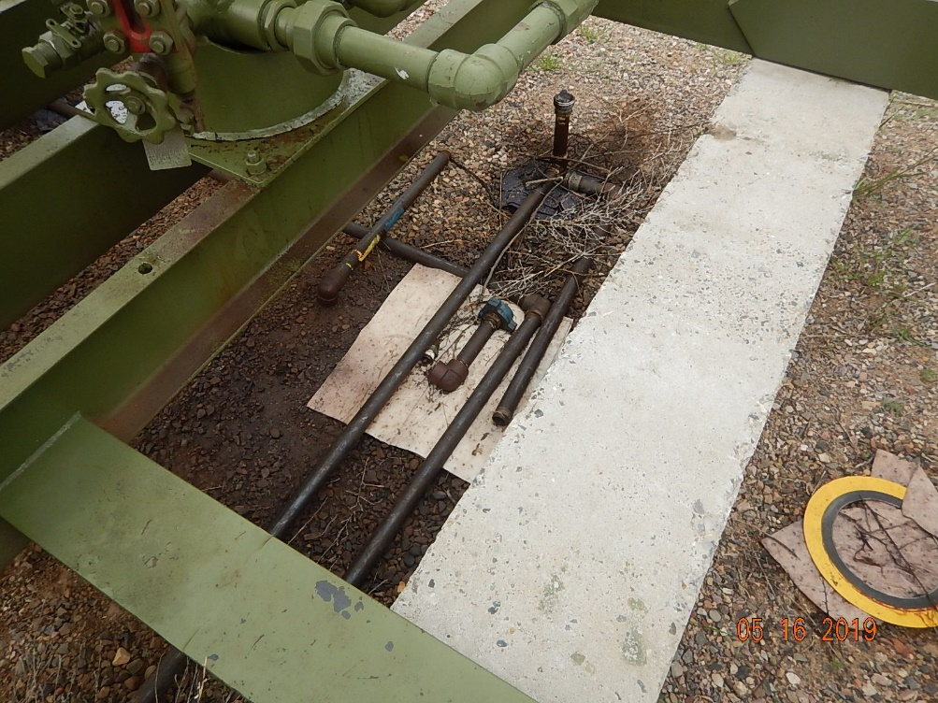
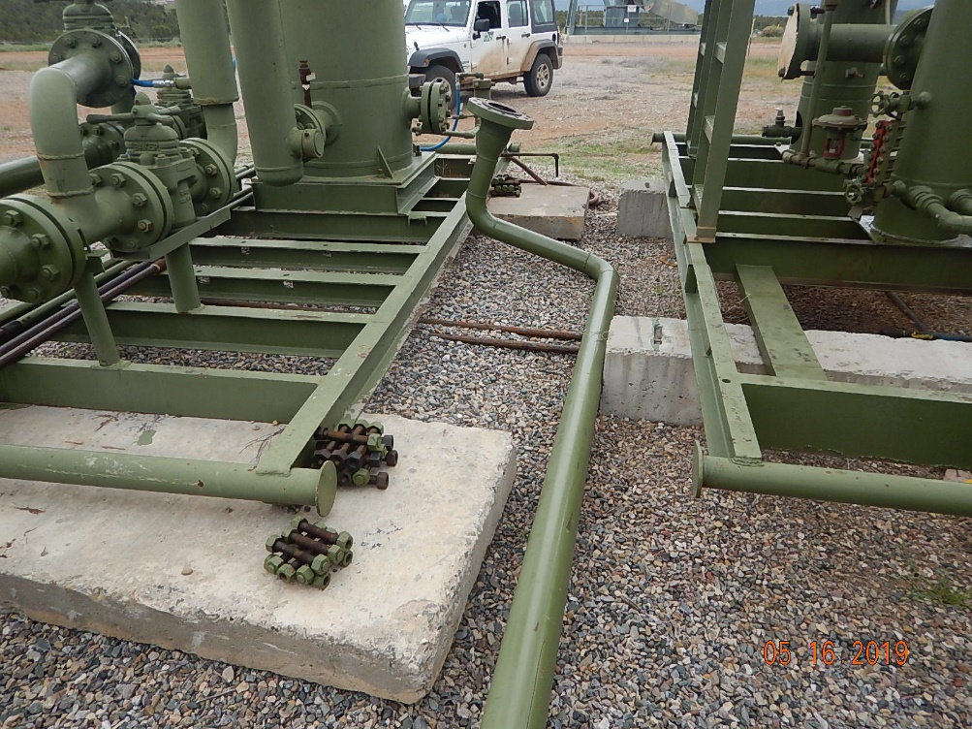
Inspection Photos
SHELLHAMMER COMPRESSOR
Facility ID: 214932
#9 Unused equipment that has been disconnected from the process. Trash on the ground. Gravel/soil are oil stained below equipment. Rags stuffed in piping (see arrow)
#10 Unused flange bolts and piping from equipment.

Slide 6
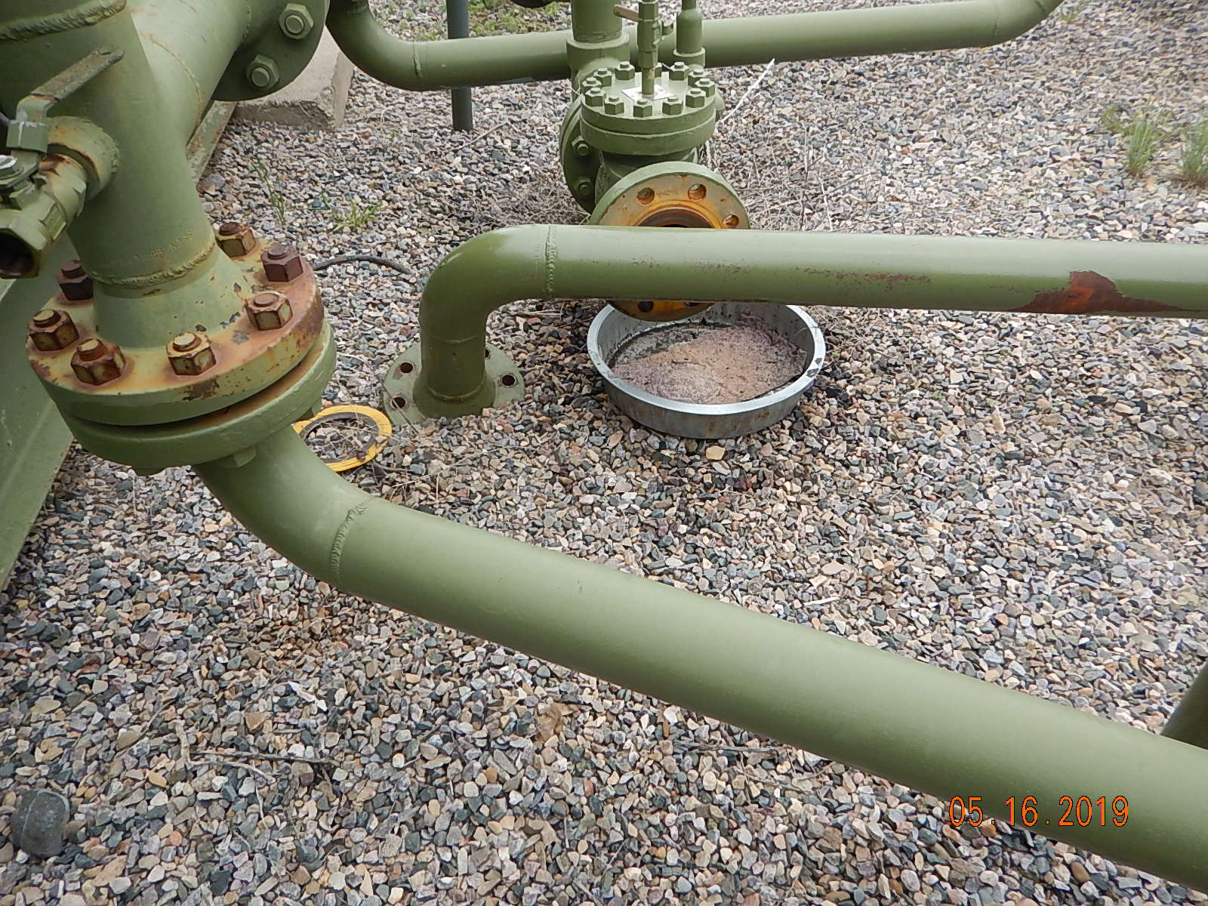
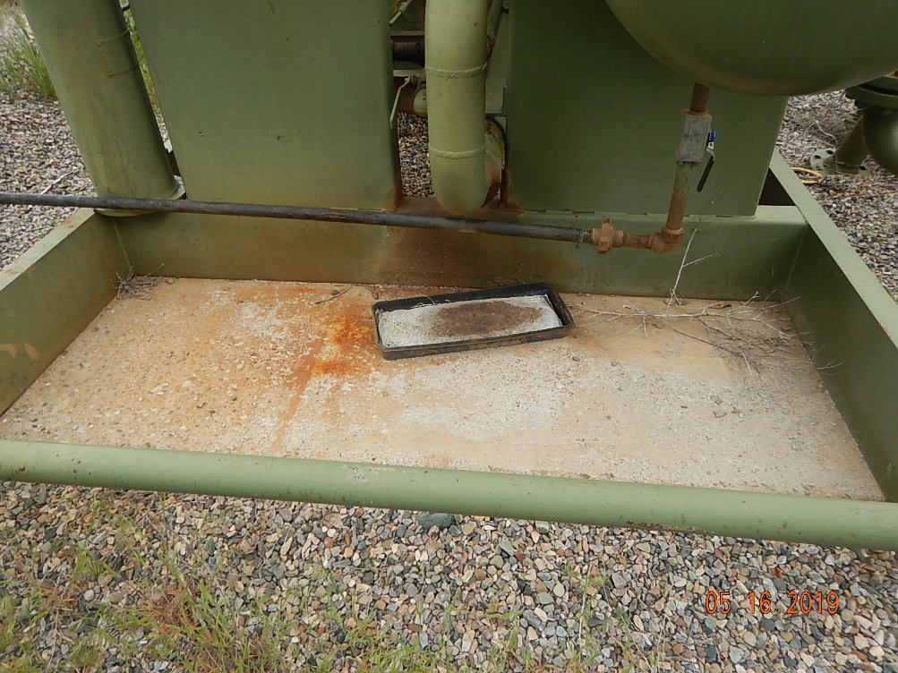
Inspection Photos
SHELLHAMMER COMPRESSOR
Facility ID: 214932
#11 Drip pan containing oily waste and rags. Trash on ground. Unused disconnected equipment.
#12 Used soaker pads.

Slide 7
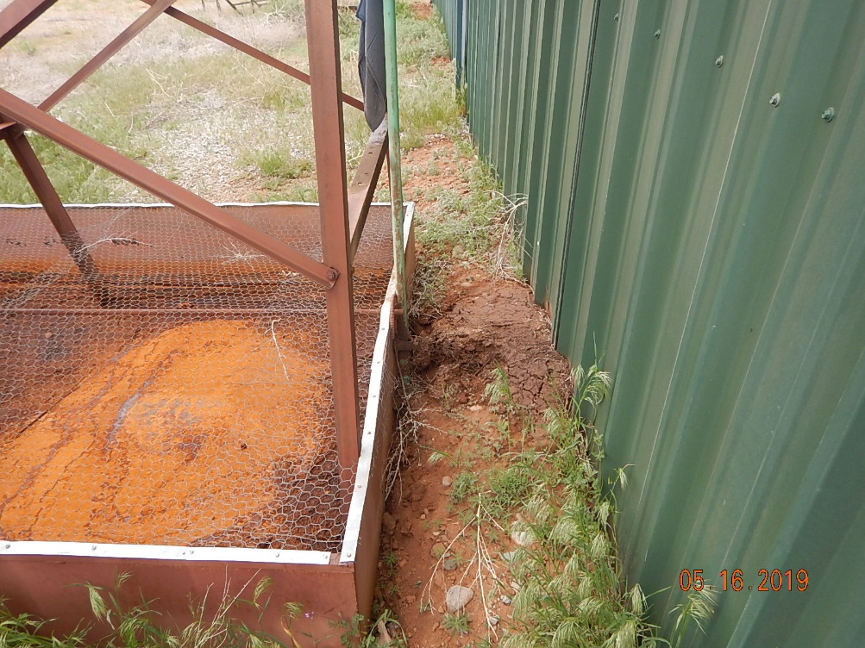
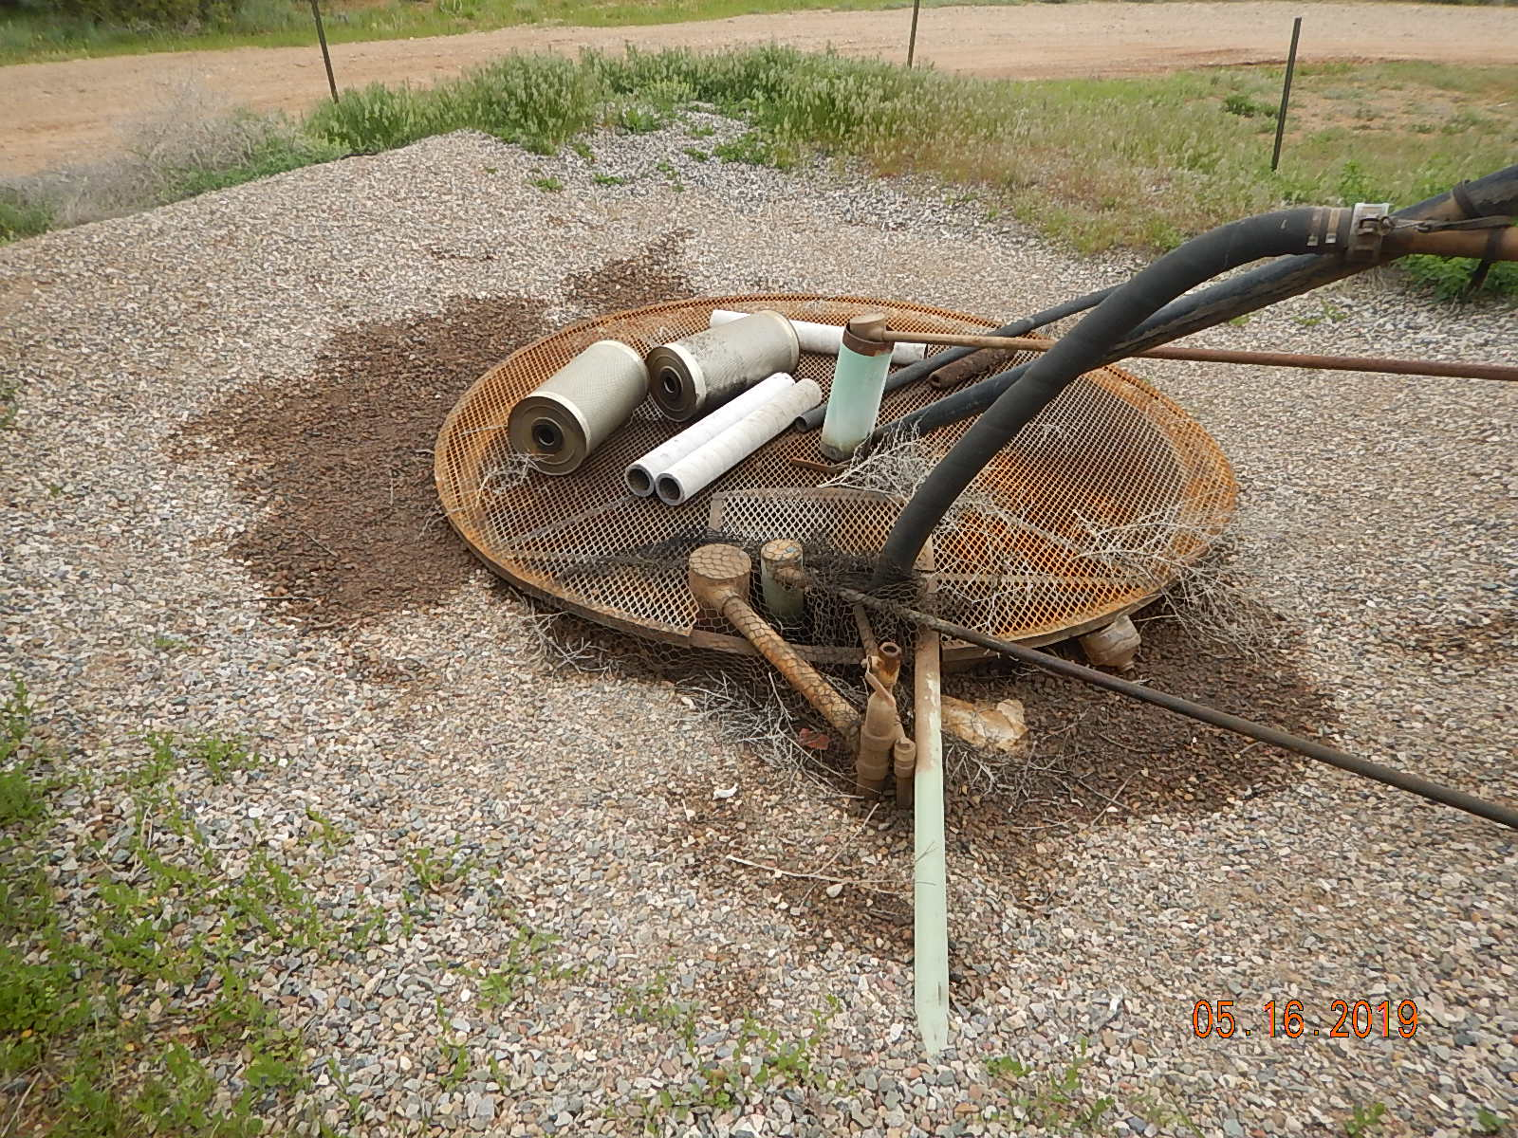
Inspection Photos
SHELLHAMMER COMPRESSOR
Facility ID: 214932
#13 Oily gravel/soil spill below lube oil storage tank.
#14 Used process filters are trash. Oily gravel/soil spill around tank.

Slide 8
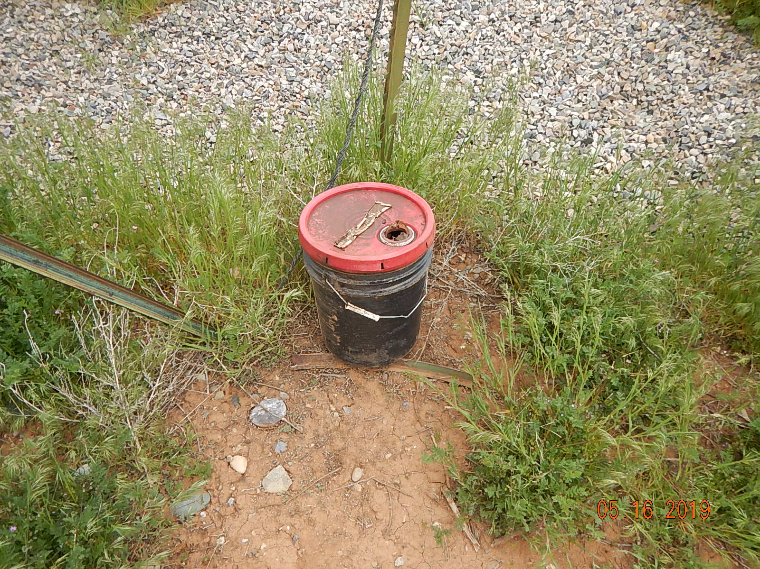
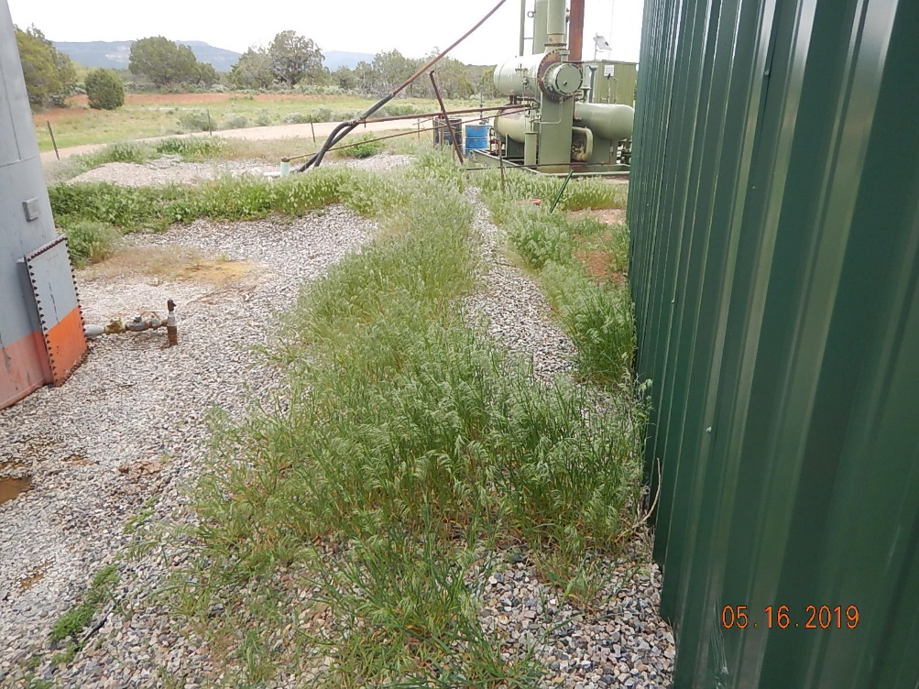
Inspection Photos
SHELLHAMMER COMPRESSOR
Facility ID: 214932
#15 Used bucket on facility. Weeds around equipment.
#16 Weeds around berm of produced water tank battery.

Slide 9
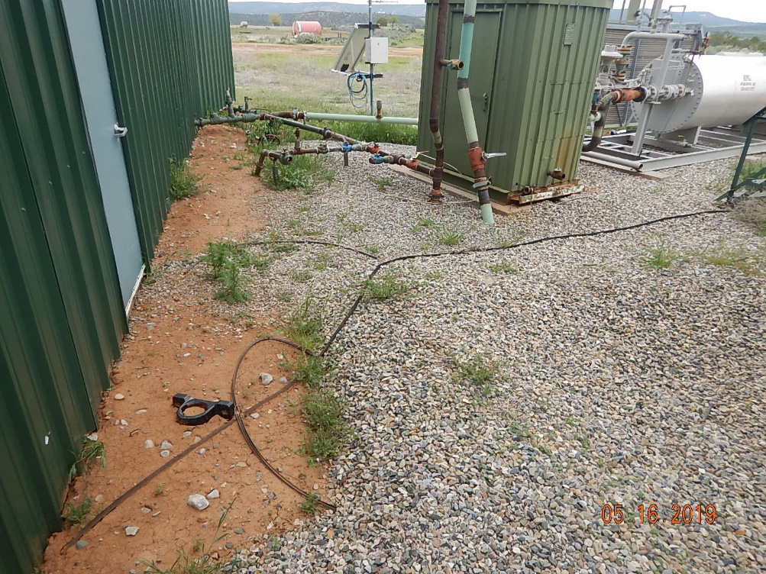
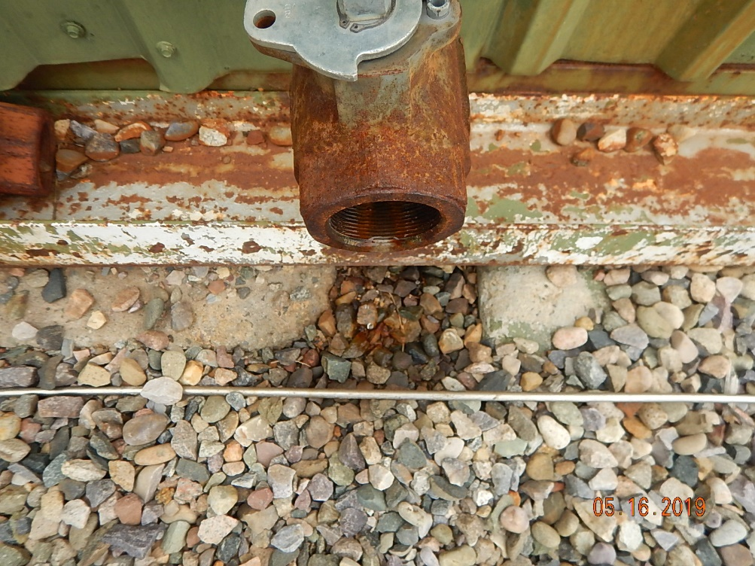
Inspection Photos
SHELLHAMMER COMPRESSOR
Facility ID: 214932
#17 Unused equipment hoses and parts laying on the ground.
#18 Leaking ball valve at separator on north side of sound wall.

Slide 10
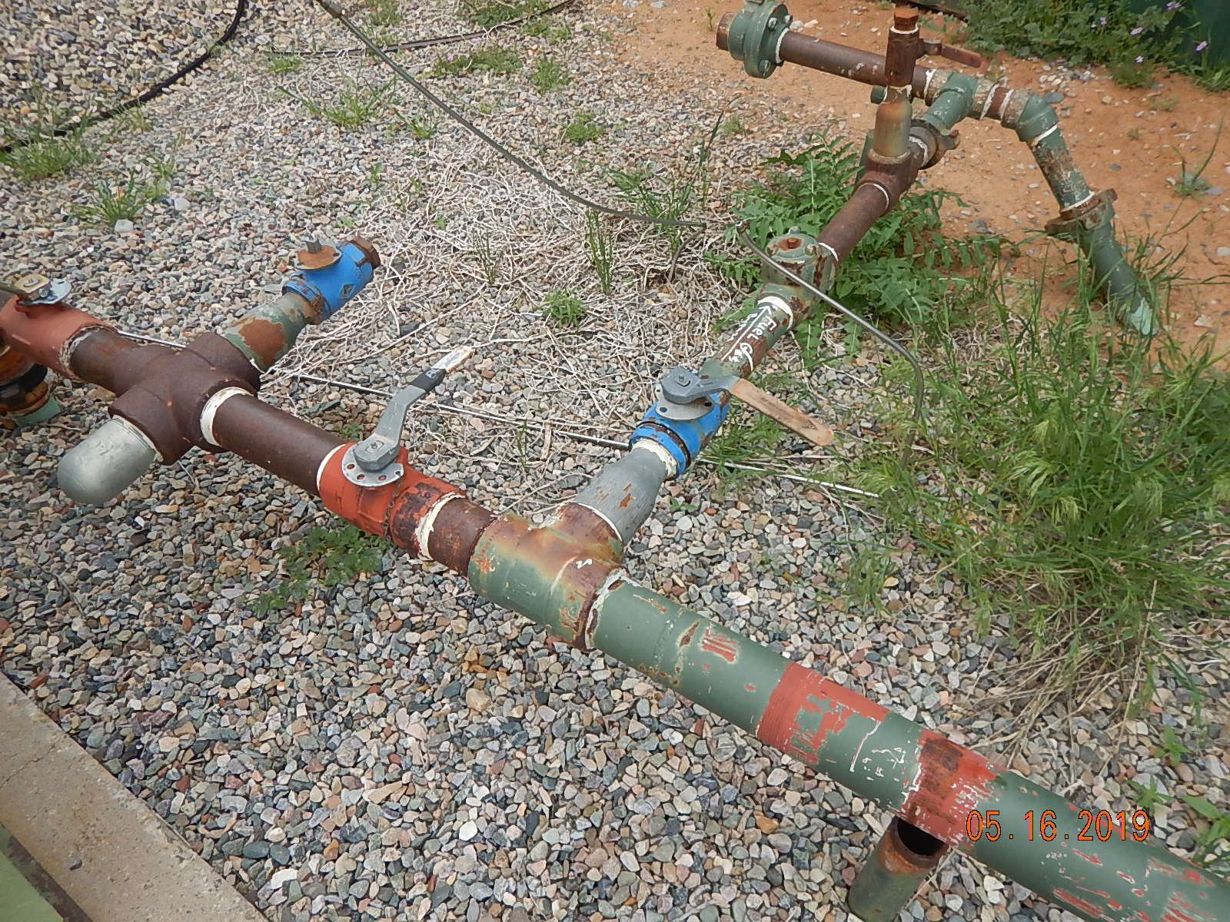
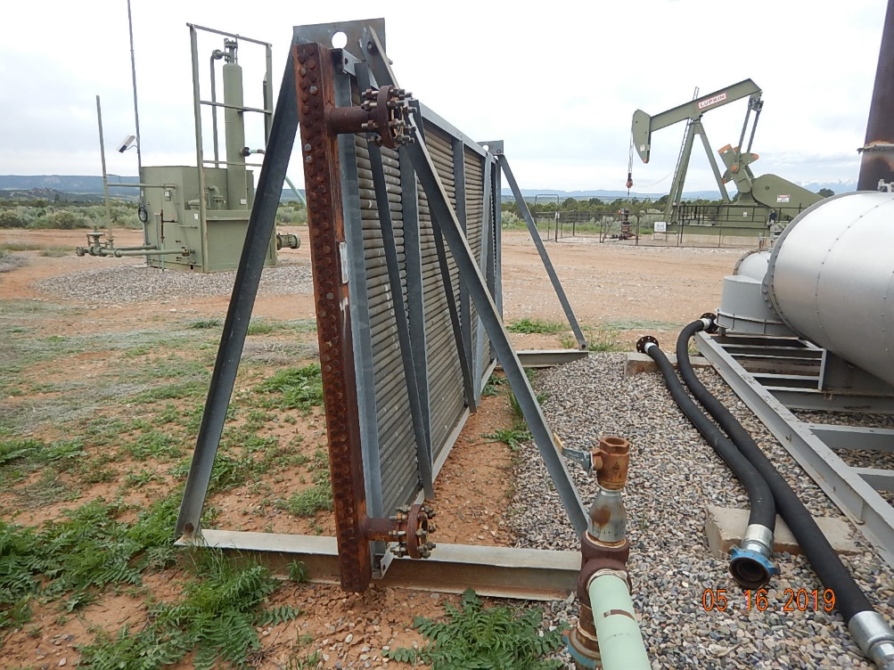
Inspection Photos
SHELLHAMMER COMPRESSOR
Facility ID: 214932
#19 Blue painted valve in center of photo (arrow) is leaking gas with an audible sound, valve body is coming apart at the threads. Flir camera data shows valve leaking.
#20 Unused equipment gas cooler with unused equipment hoses on the ground.

Slide 11
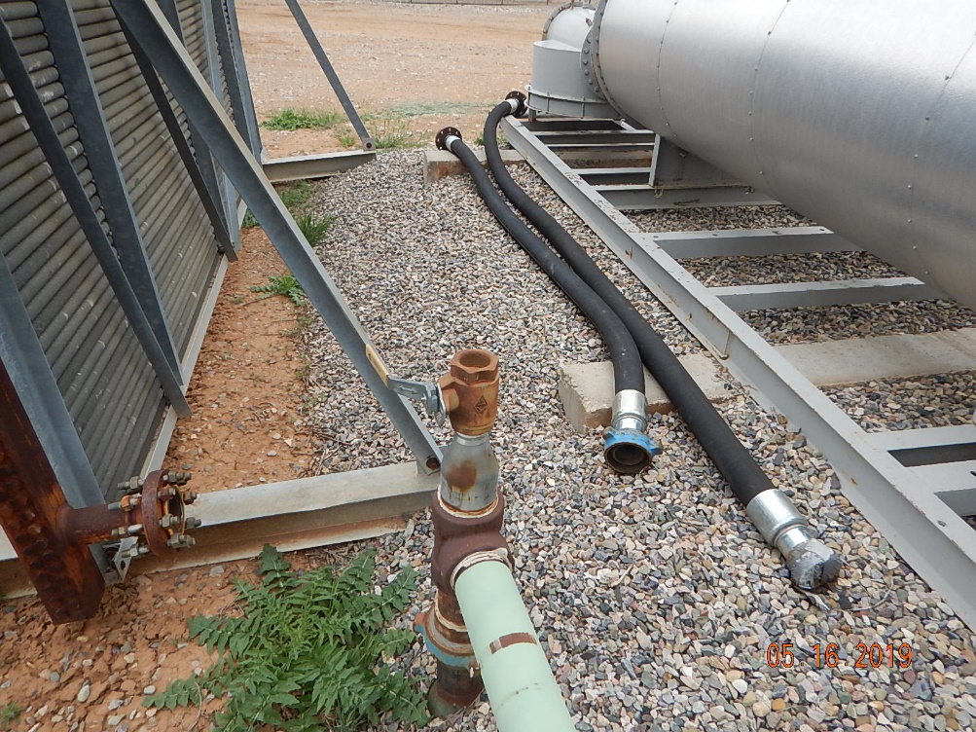
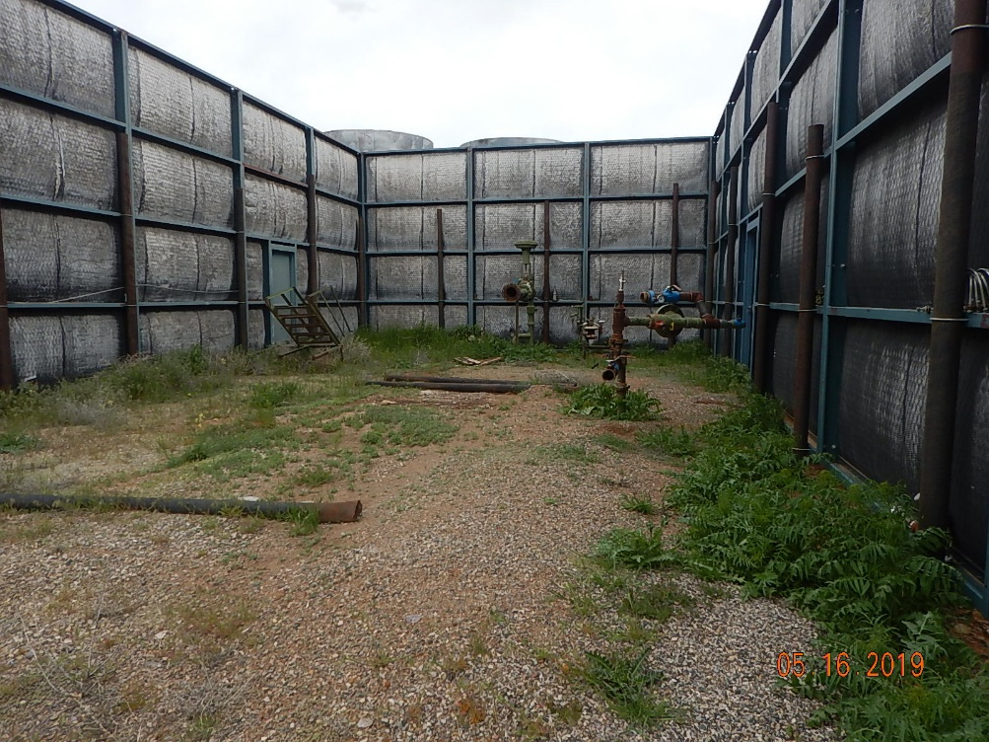
Inspection Photos
SHELLHAMMER COMPRESSOR
Facility ID: 214932
#21 Unused equipment hoses and unused gas cooler disconnected from the process.
#22 Weeds around sound walls. Unused equipment stairs, skids and disconnected piping from compressor.

Slide 12
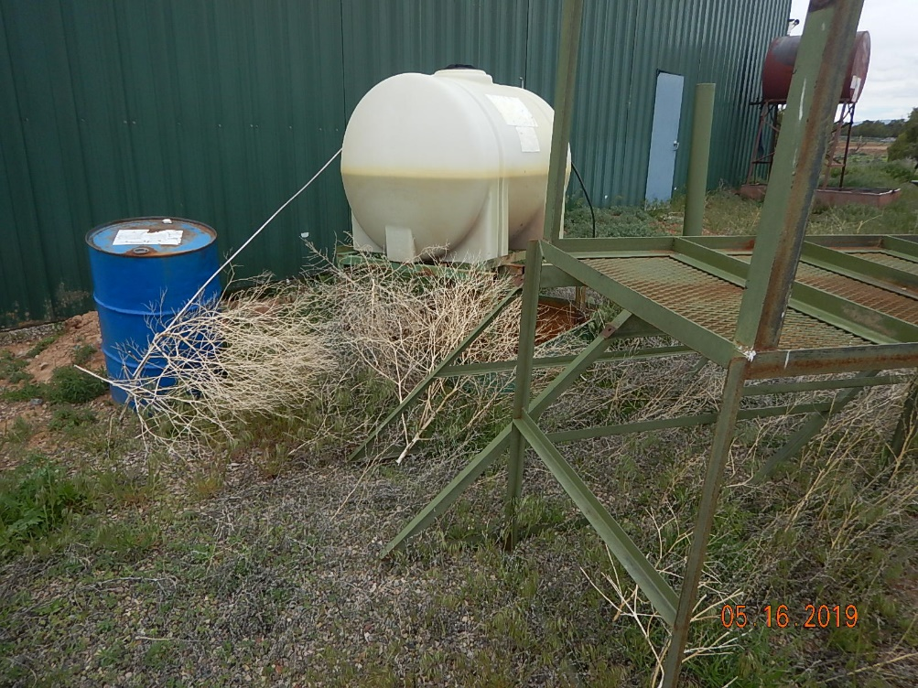
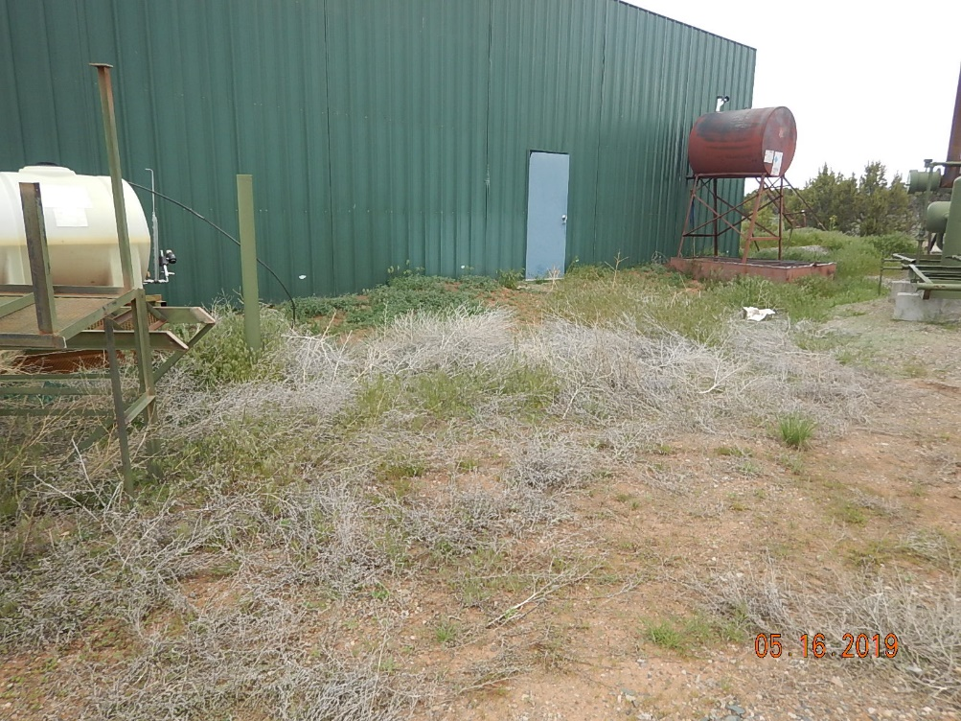
Inspection Photos
SHELLHAMMER COMPRESSOR
Facility ID: 214932
#23 Unlabeled drum with improper storage and no spill prevention. Unlabeled chemical injection tank. Unused equipment catwalk and stairs. Weeds and dead brush around facility.
#24 Weeds and dead brush around facility. Unused lube oil storage tank.

Slide 13
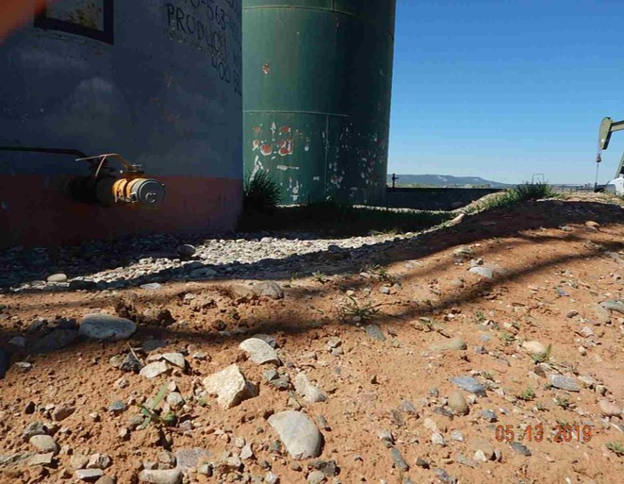
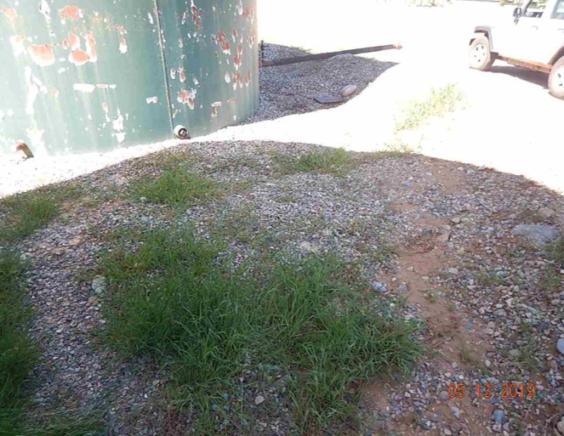
Inspection Photos
SHELLHAMMER COMPRESSOR
Facility ID: 214932
#25 Secondary containment volume inadequate, tanks not painted to match.
#26 Weeds in secondary containment.

