Slide 1
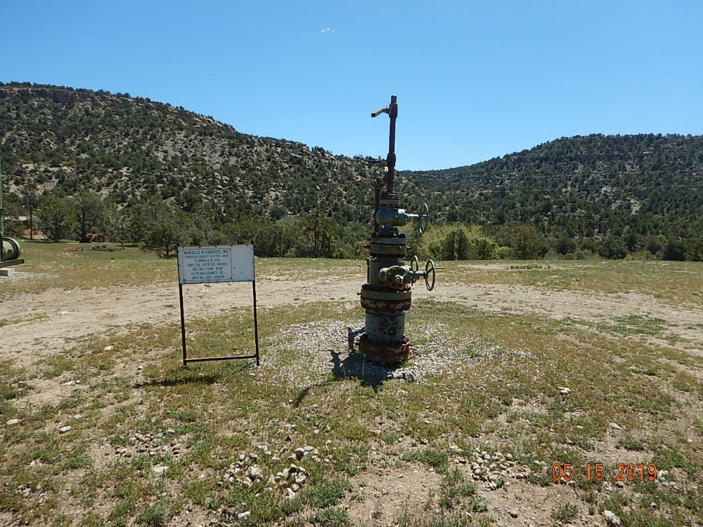
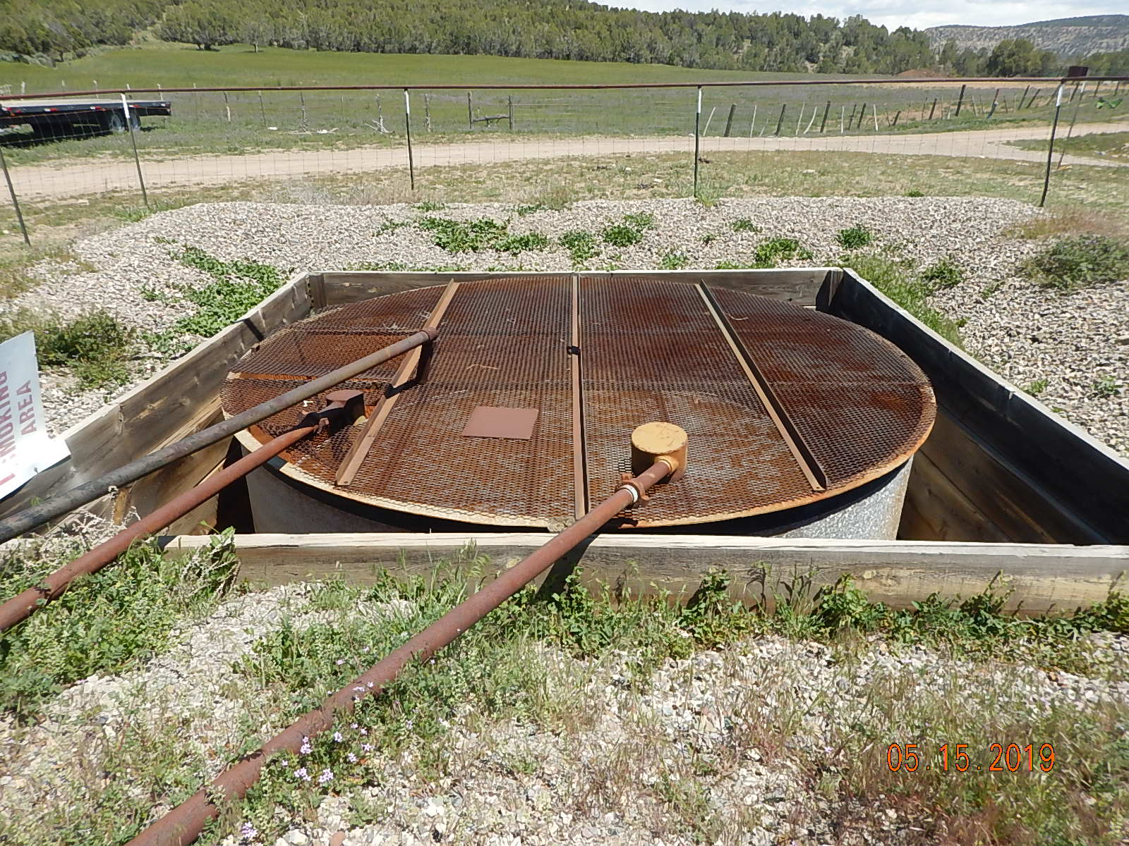
Inspection Photos
FLORIDA G.U. 31
API: 005-067-09350
Weeds around wellhead.
Produced water tank.

Slide 2
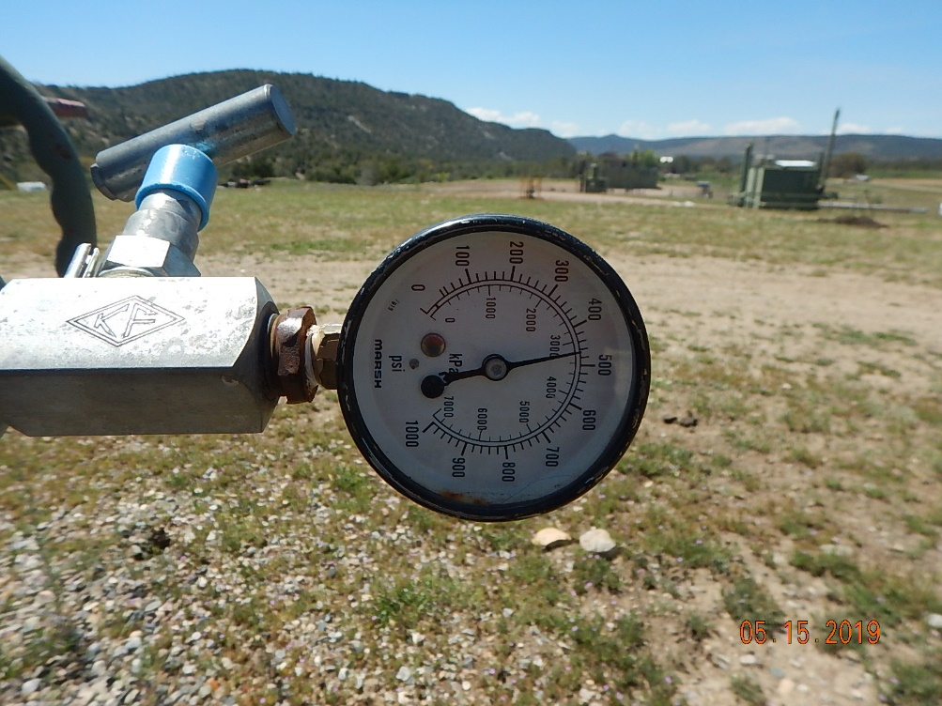
Inspection Photos
FLORIDA G.U. 31
API: 005-067-09350
Wellhead line pressure.

Slide 3
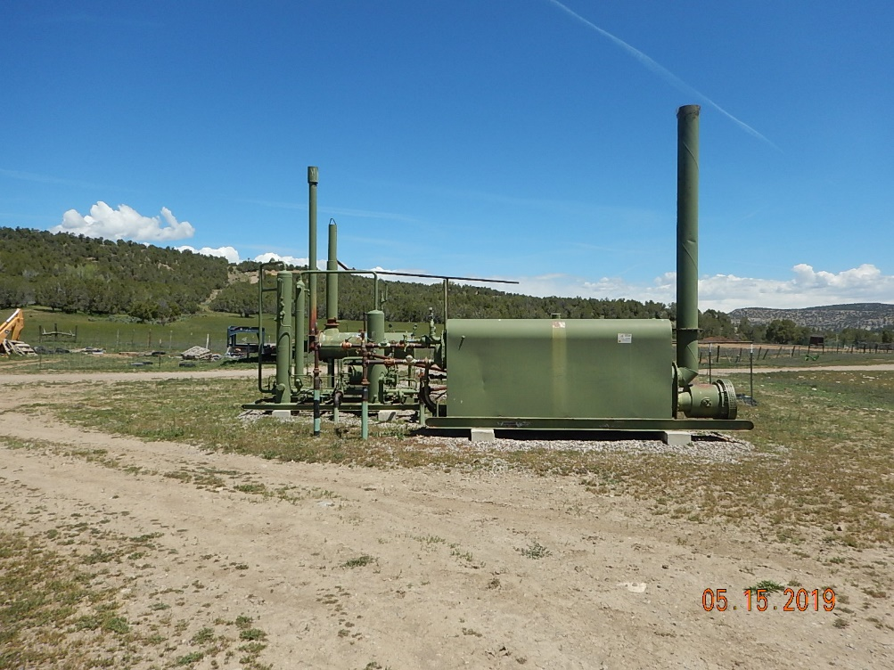
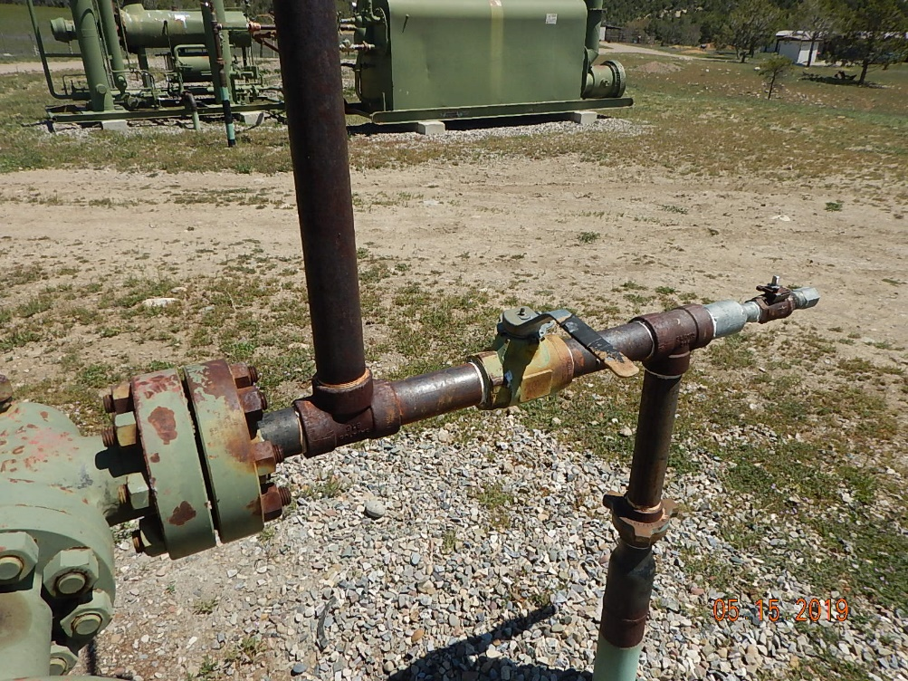
Inspection Photos
FLORIDA G.U. 31
API: 005-067-09350
Weeds around equipment.
Wellhead shut in.

