Slide 1
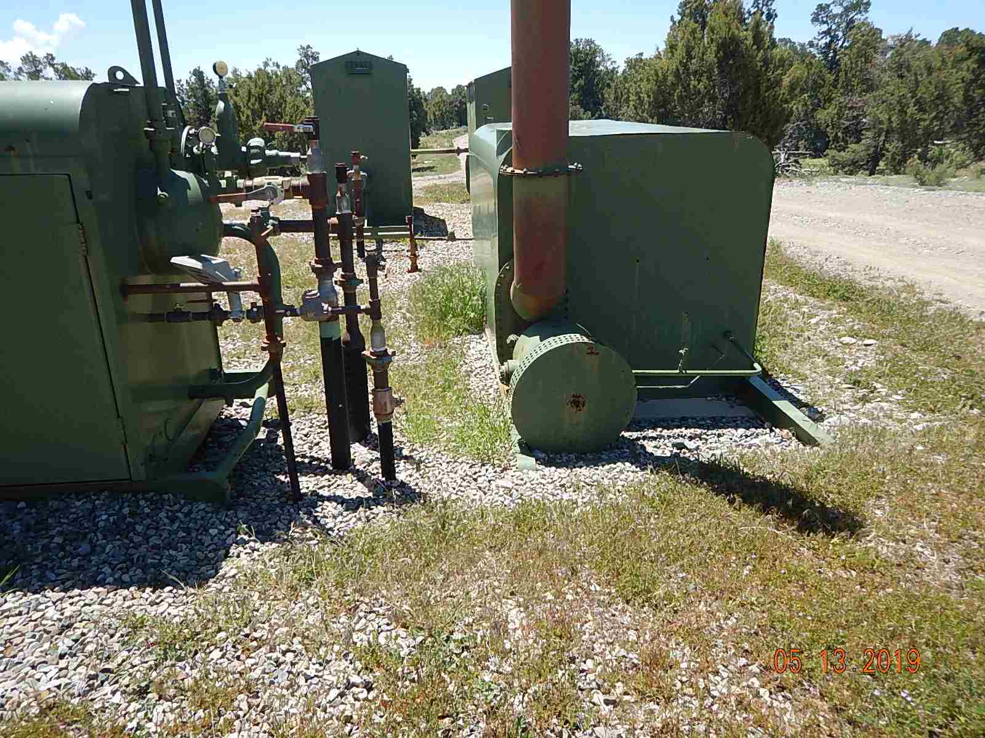
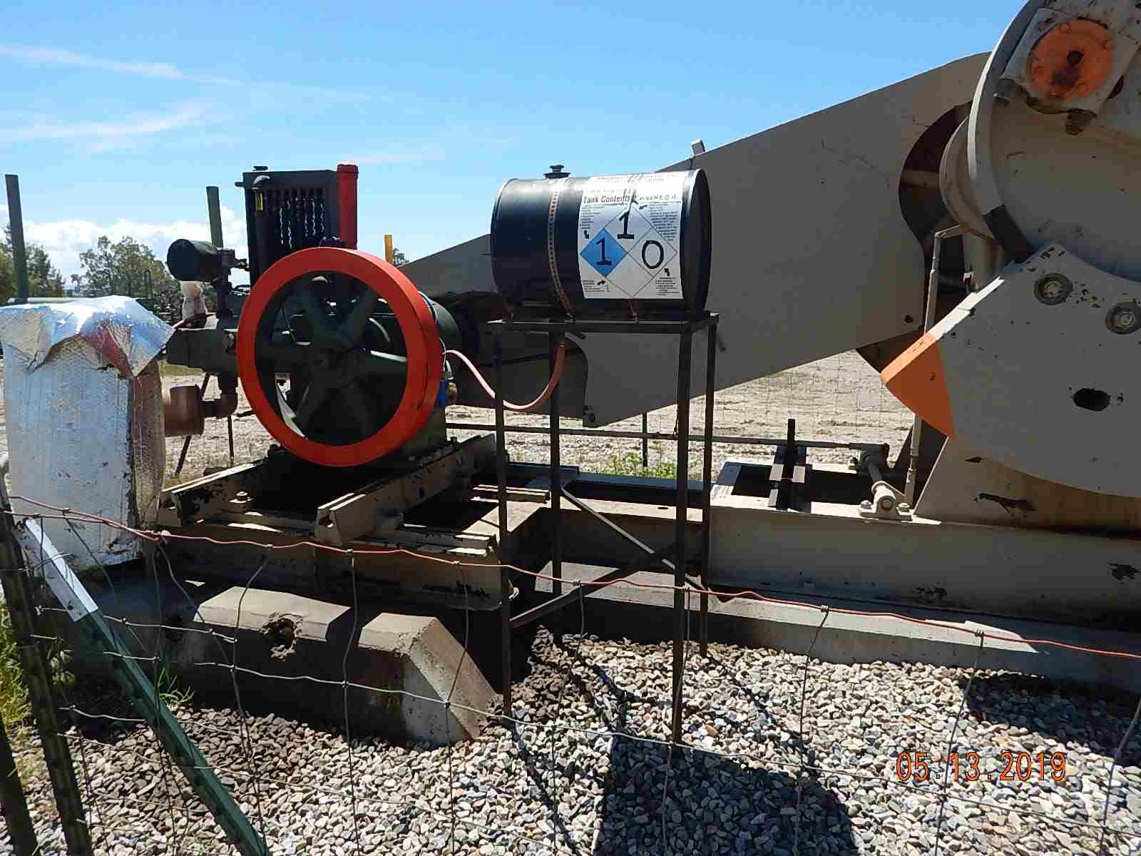
Inspection Photos
MARY CATHERINE 33-7-3 2A
API: 005-067-09049
Weeds around equipment.
No spill prevention on engine oil day tank and oily waste/stained soil and gravel around pumpjack.

Slide 2
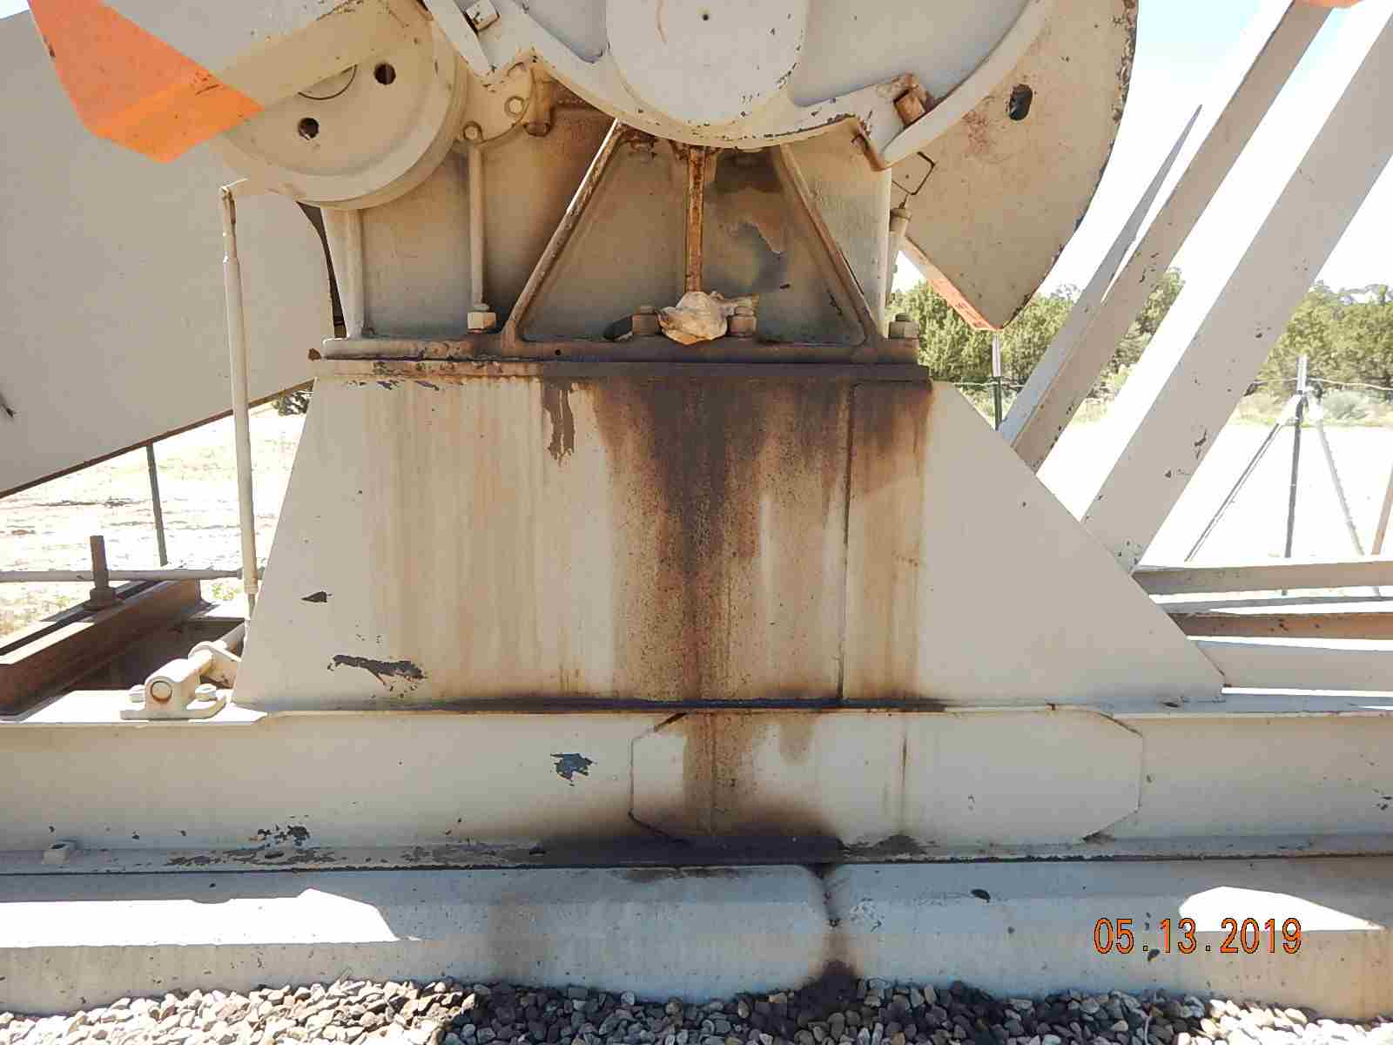
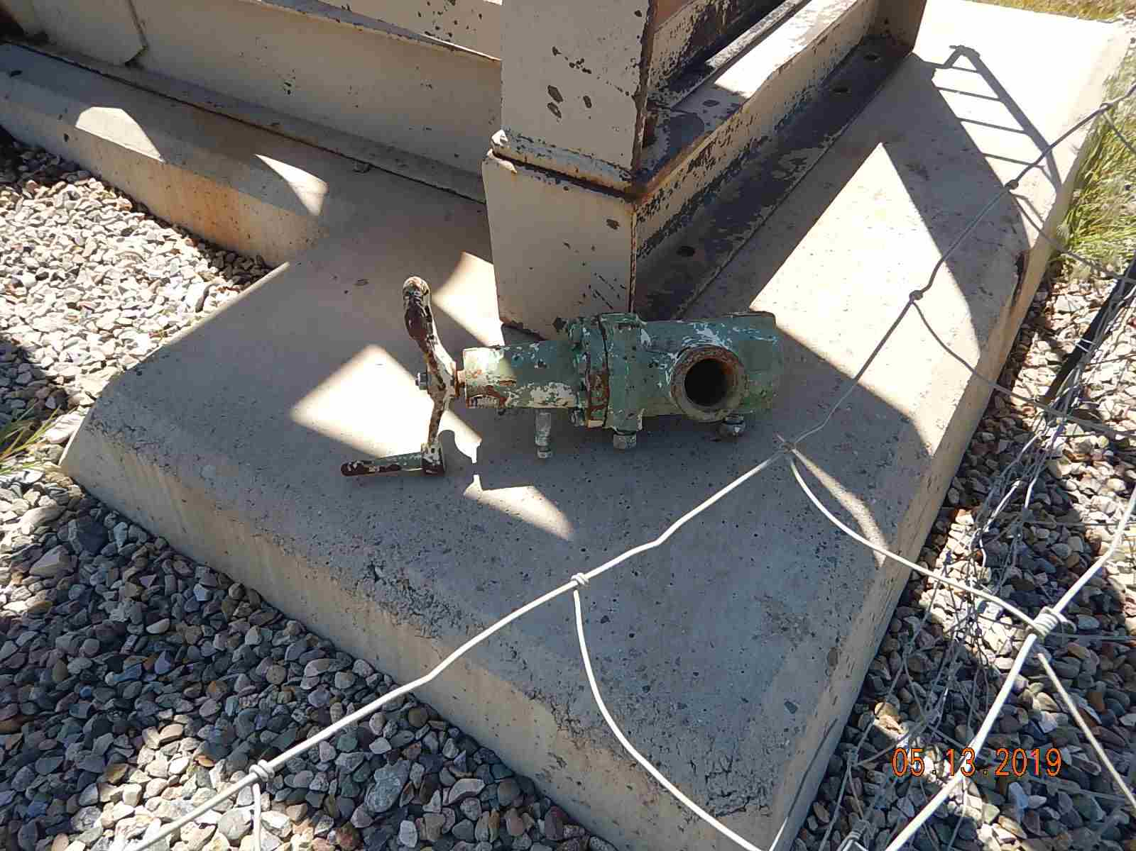
Inspection Photos
MARY CATHERINE 33-7-3 2A
API: 005-067-09049
Pumpjack gearbox leak with stained soil/gravel and oily waste around concrete.
Unused equipment wellhead valve sitting on pumpjack skid.

Slide 3
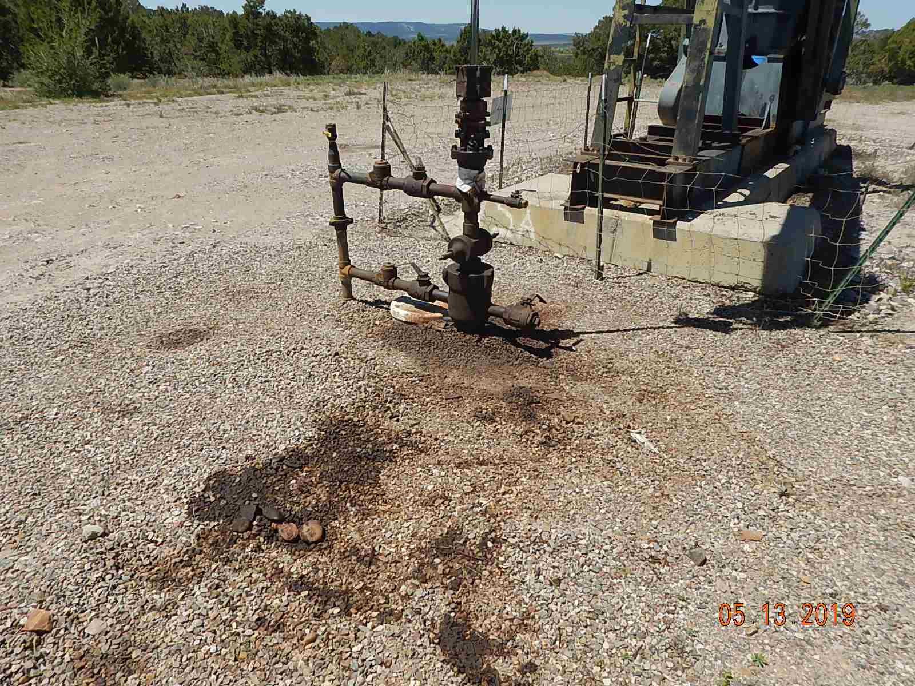
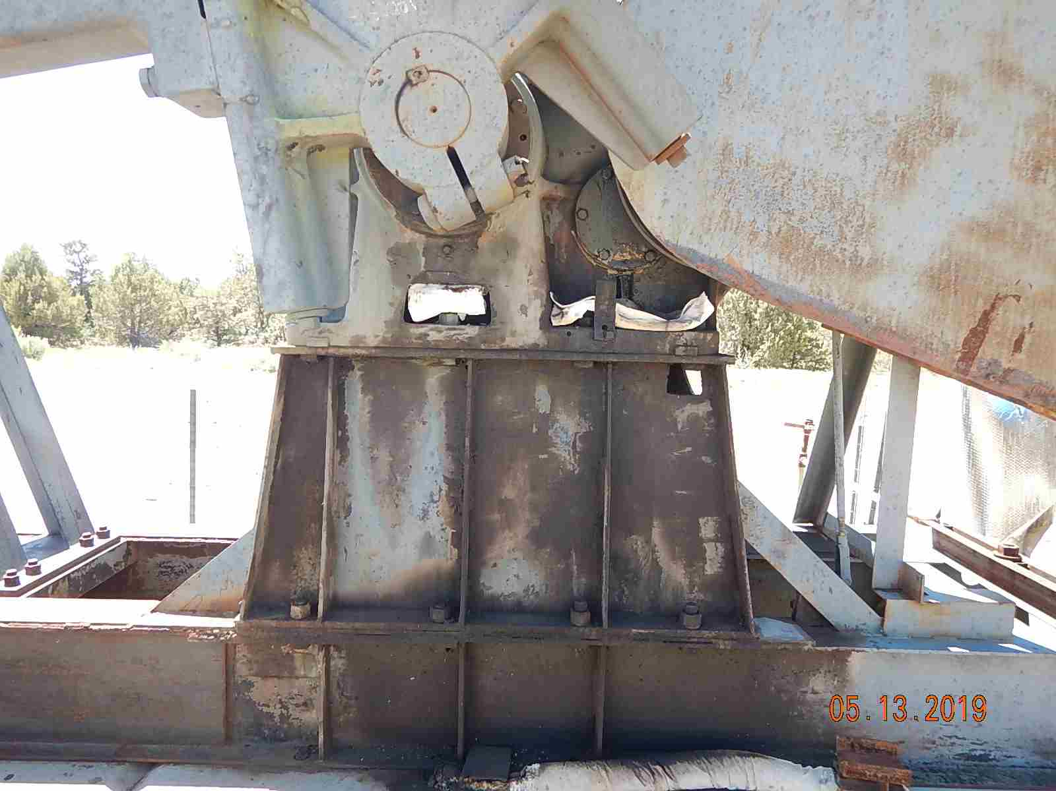
Inspection Photos
MARY CATHERINE 33-7-3 2A
API: 005-067-09049
Stained soil/gravel and oily waste around wellhead.
Pumpjack gearbox leak with stained soil/gravel and oily waste around concrete.

