Slide 1
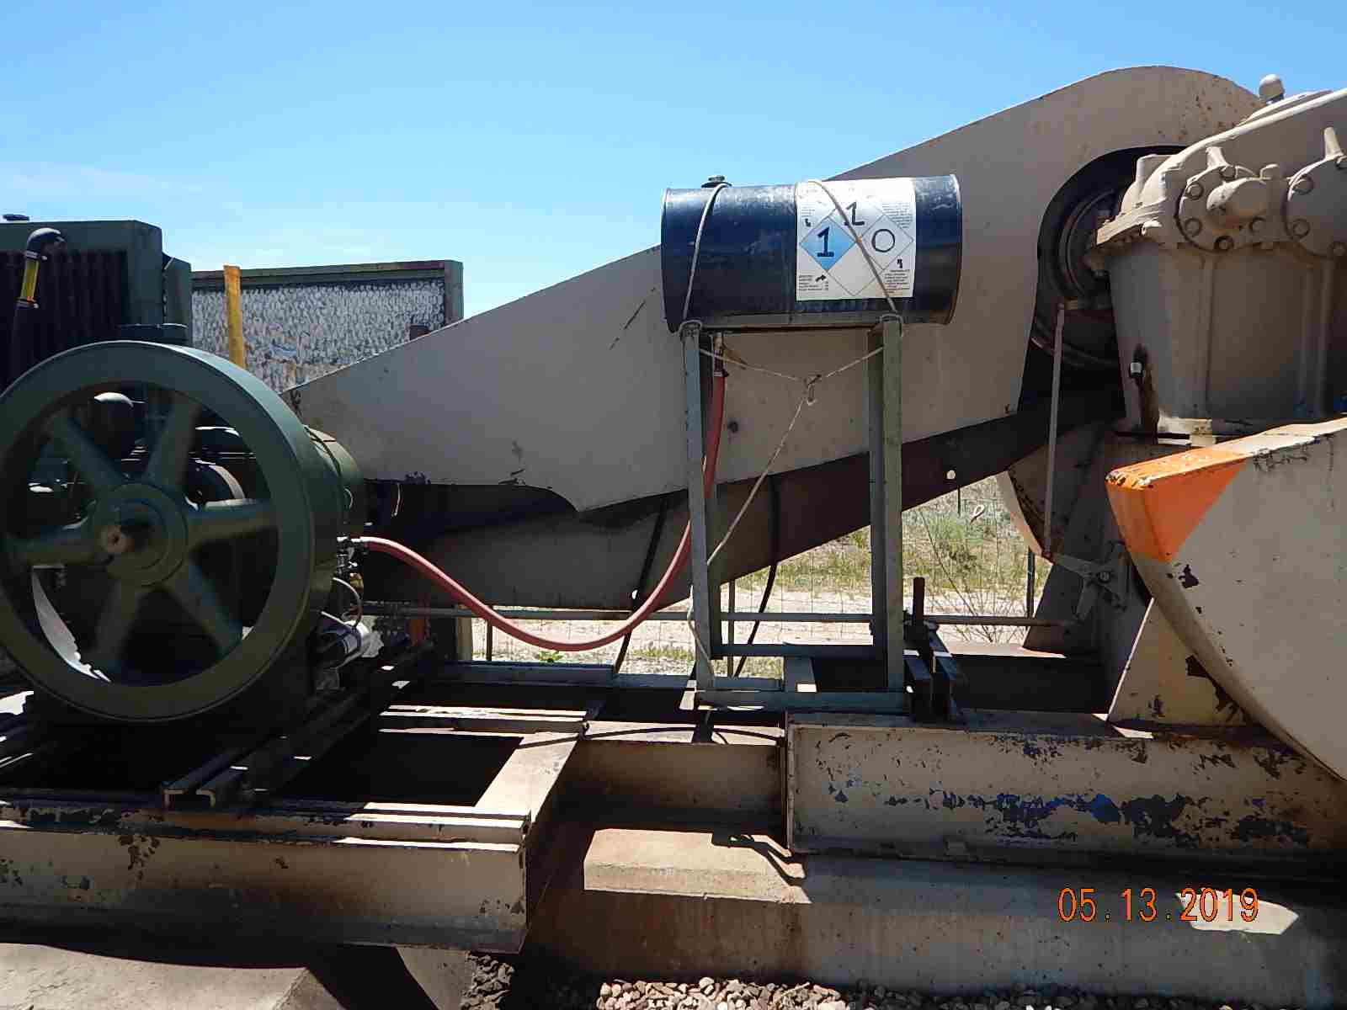
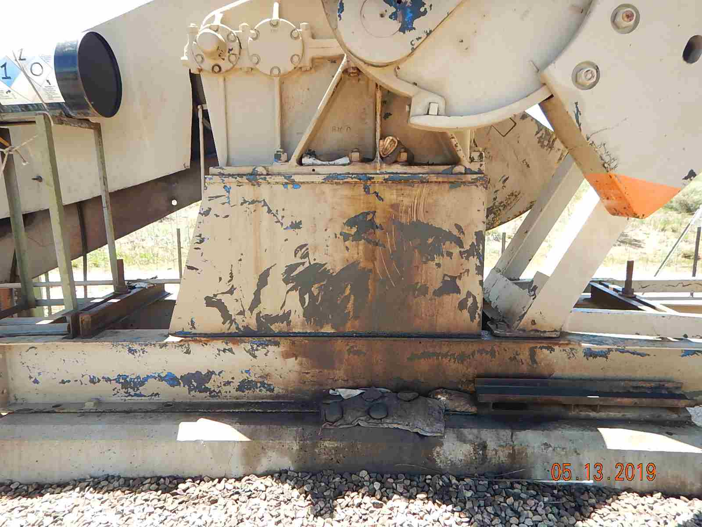
Inspection Photos
MARY CATHERINE 33-7-3 3B
API: 005-067-09475
Engine oil day tank with no spill prevention.
Leaking gearbox oil seal with stained gravel/soil below case.

Slide 2
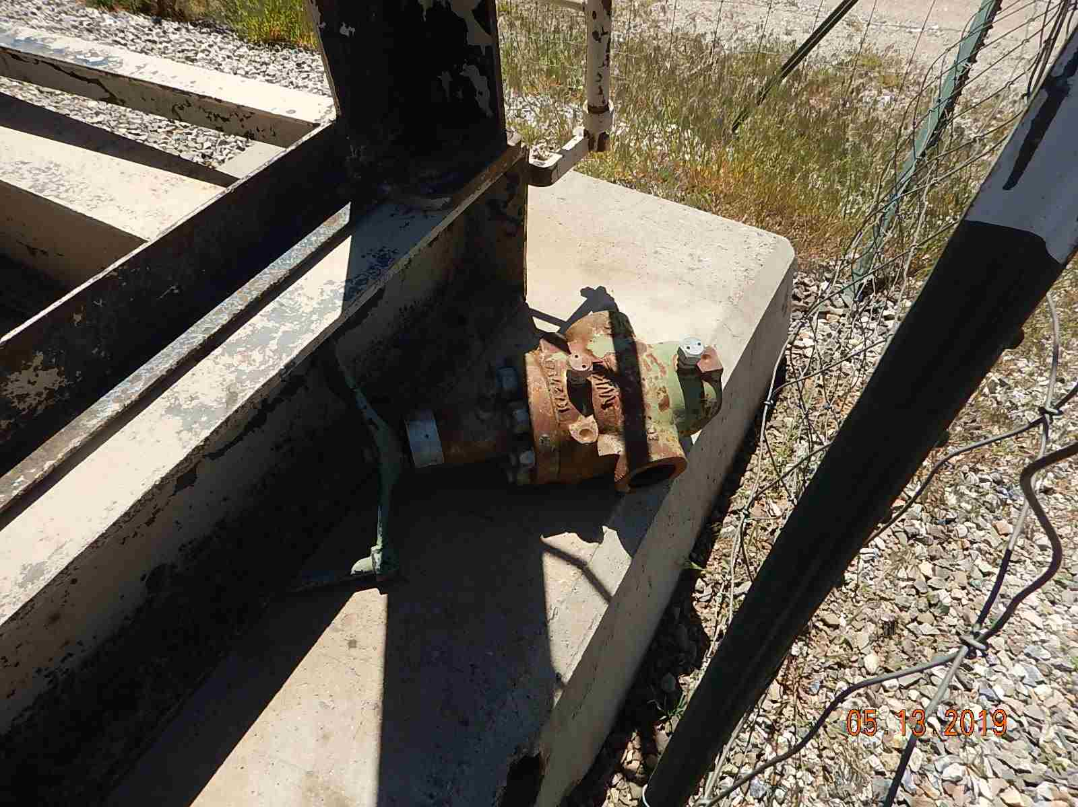
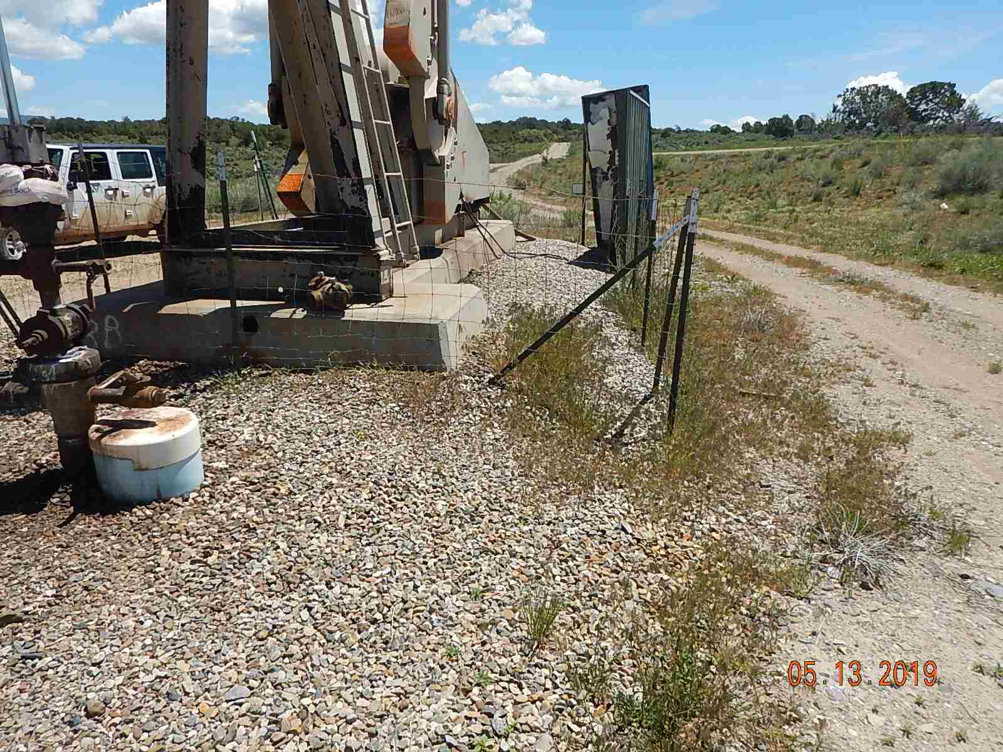
Inspection Photos
MARY CATHERINE 33-7-3 3B
API: 005-067-09475
Unused equipment laying on pumpjack.
Weeds around equipment.

Slide 3
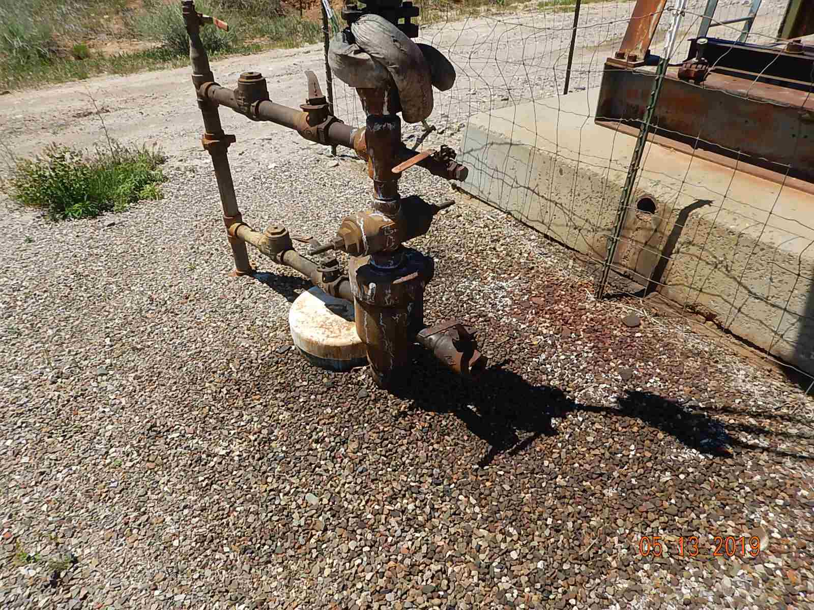
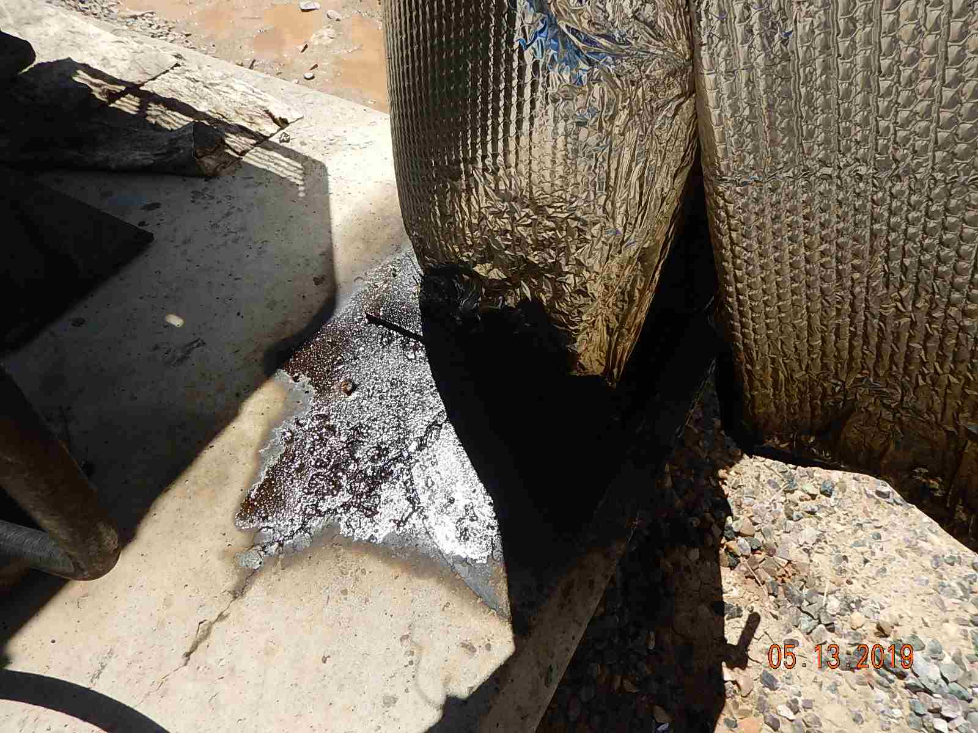
Inspection Photos
MARY CATHERINE 33-7-3 3B
API: 005-067-09475
Spotting, stained soil and oily waste around wellhead.
Engine exhaust oil on fuel gas knockout pot and concrete.

Slide 4
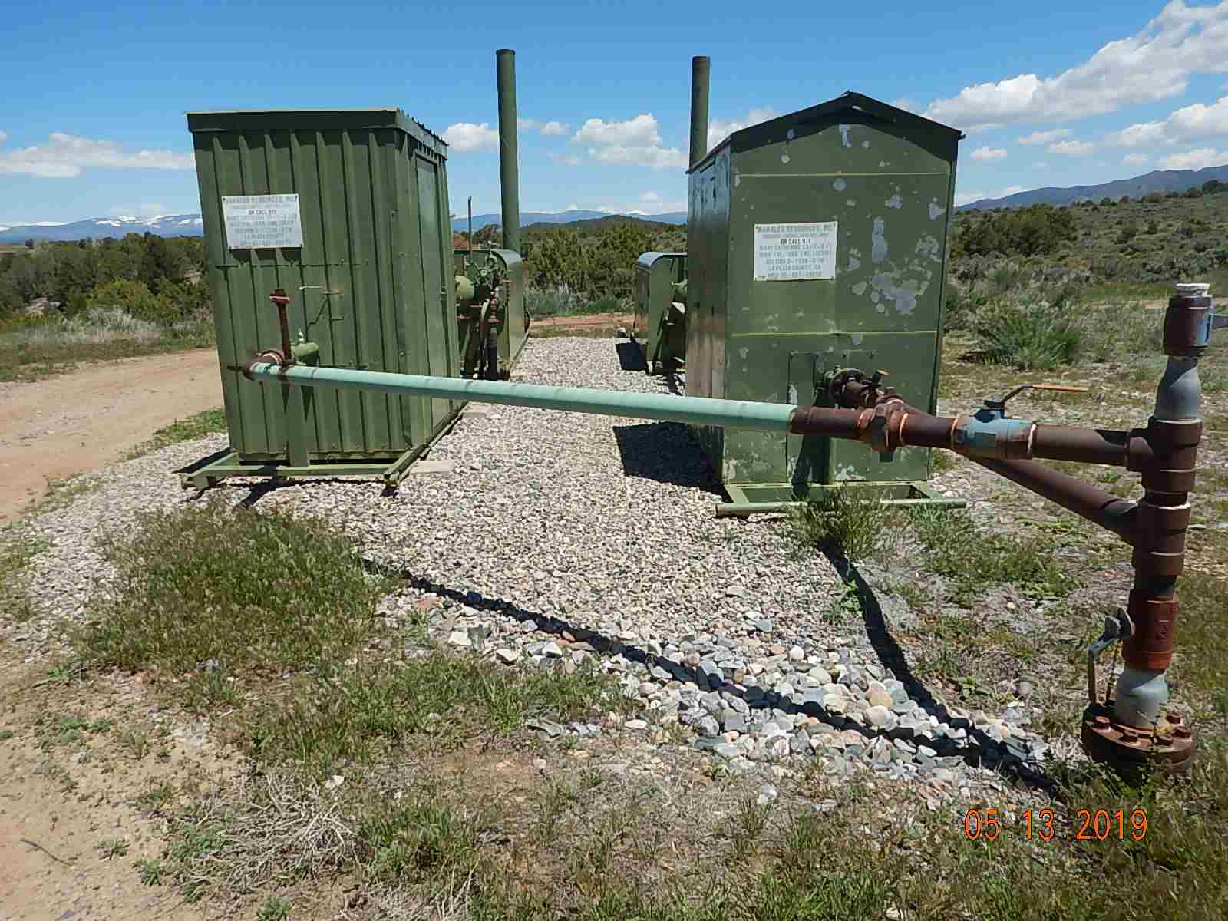
Inspection Photos
MARY CATHERINE 33-7-3 3B
API: 005-067-09475
Weeds around equipment.

